Slide 2

World Book Day
What is World Book Day?
It is always on the first Thursday in March, which is tomorrow.
The first World Book Day was in 1995.
World Book Day is a celebration of:
  authors – people who write books;
  illustrators – artists who draw pictures for books;
  books – funny, scary and true stories, poetry, jokes and
  much more.
Most importantly, it’s a
celebration of readers – that’s you!

Slide 3

Do Other Countries Celebrate
World Book Day?
It’s not just celebrated in Britain - over 100 different countries also celebrate World Book Day.
They include:
Ireland
Spain
Sweden
United States of America

Slide 4
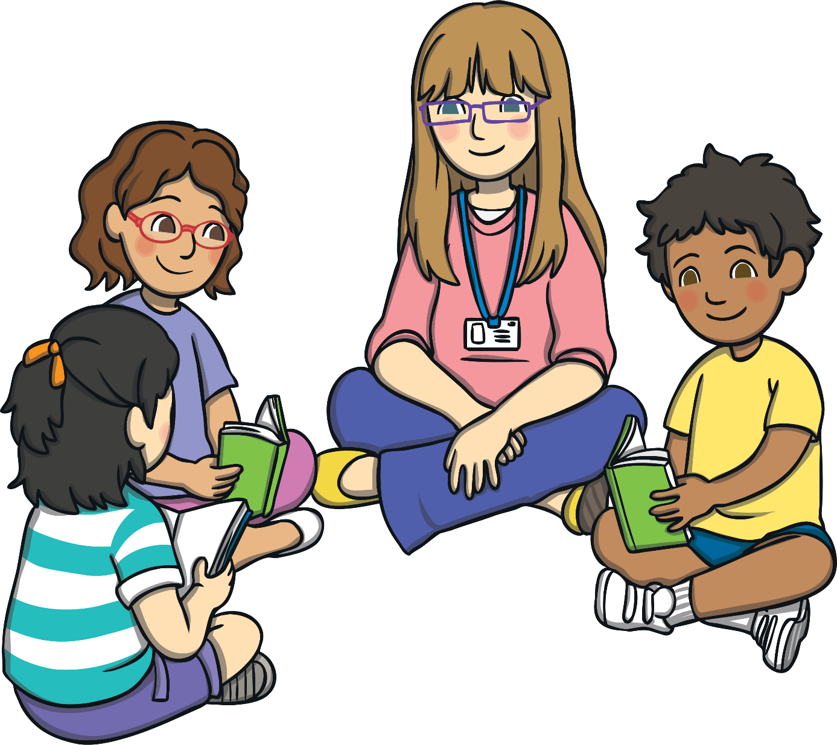
Our favourite books
Today you are going to write a book review about your favourite book.
A book review is where you say why you like your favourite book.
In newspapers and magazines people write book reviews so that they can tell other people if the book is a good book or not. After reading the book review they will then decide if they are going to go and buy the book or borrow the book from the library.

Slide 5
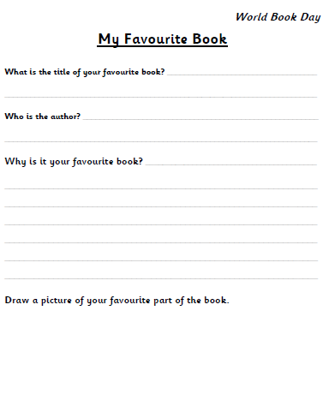
Our favourite books
Today when you write your book review you need to do the following things:
-Write the title of the book.
-Say who is the author.
-Say why it is your favourite book.
-Draw a picture of your favourite part of the book.

Slide 6
Our favourite books
When you are writing your book review to say why your book is your favourite book you need to make sure that you do the following things:
-Write the title and author of the book.
-Write sentences to explain why your book is your favourite, you will need to use the word ‘because’ to explain your reasons.
-Include a capital letter at the start of each sentence.
-Leave a finger space after each word.
-Include a full stop at the end of each sentence.
-Please write neatly.
-Draw a picture to show your favourite part of the book.

