Slide 2
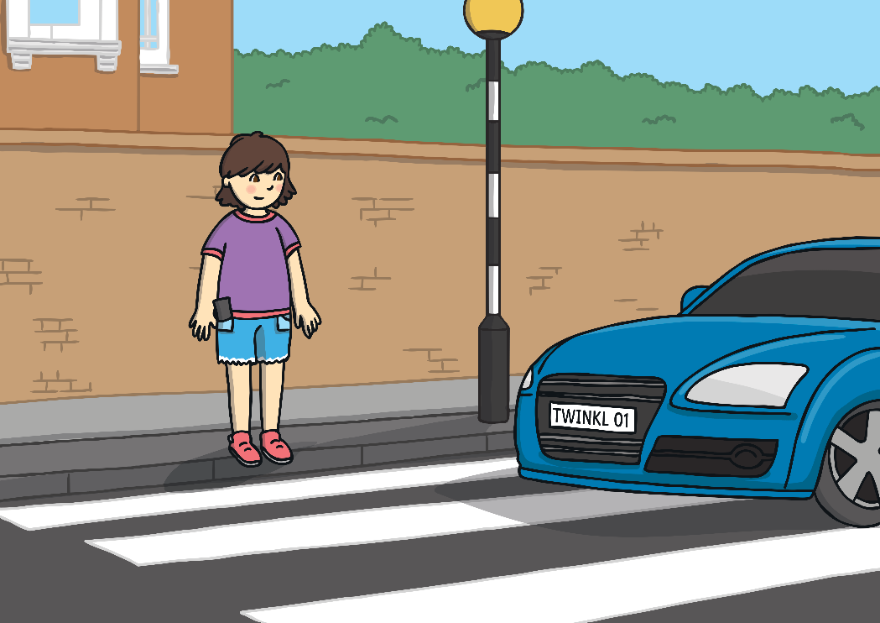
Road Safety
We learnt last week that there are some special rules to follow to help you keep safe around roads. Let’s go through these rules again.
Think about where you should cross.
Make sure you can see both ways along the road.

Slide 3
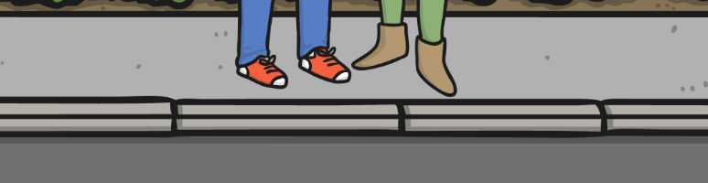
Road Safety
Stop at the side of the road.

Slide 4


Road Safety
Look and listen to see and hear if any vehicles are coming.

Slide 5
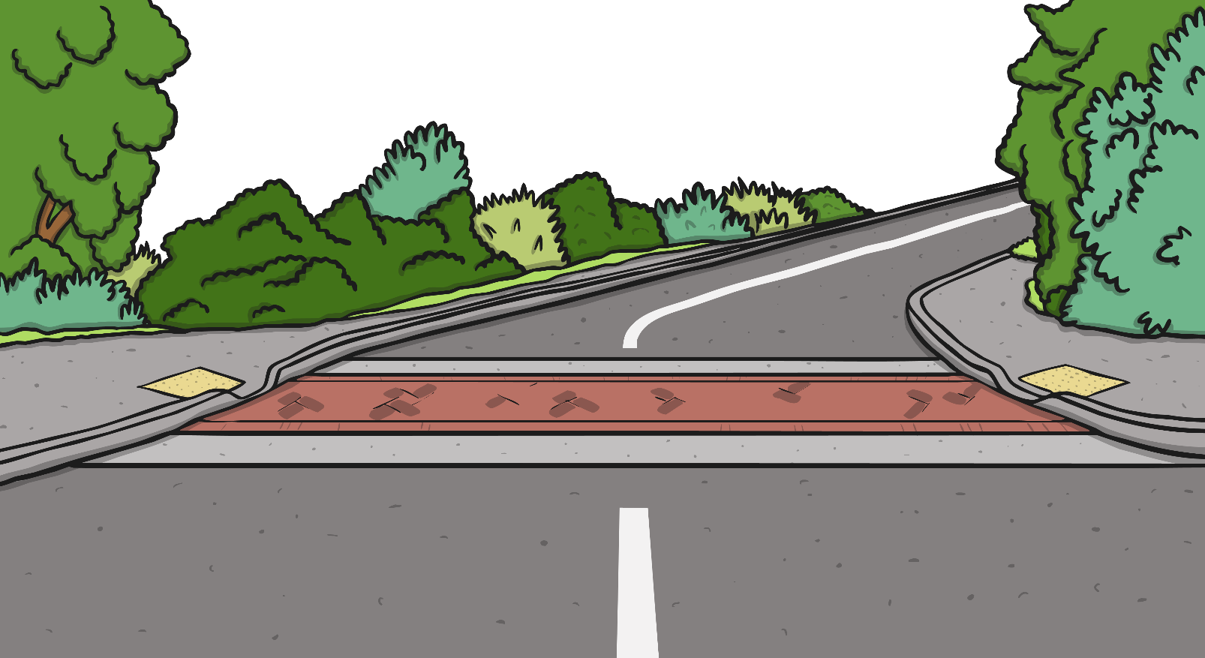


Road Safety
Wait until any vehicles have passed.

Slide 6
Road Safety
Look and listen again to see and hear if any more vehicles are coming.

Slide 7
Road Safety
Cross the road – but keep looking and listening.

Slide 8
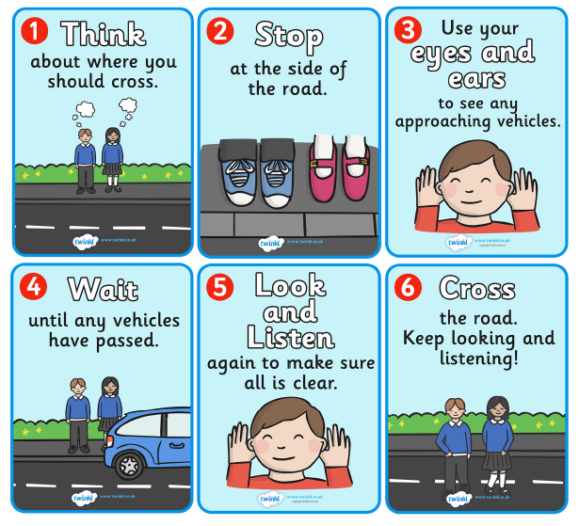
Road Safety
All of those things that you have to do when crossing the road mean that you are following The Green Cross Code.

Slide 9


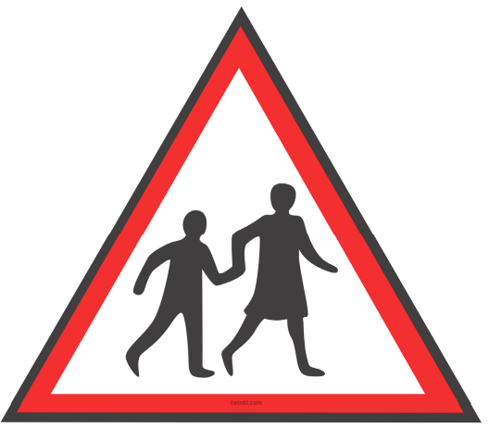
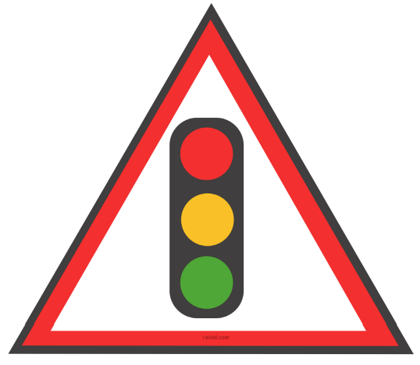
Road Safety
Unfortunately some people do not always follow the Green Cross Code and these people can get hurt.
To remind people to be careful when crossing the roads, we are going to make a road safety sign to remind people to stay safe when crossing the road.
Here are some warning signs for drivers that you might have seen. Some signs have words, numbers or pictures.

Slide 10
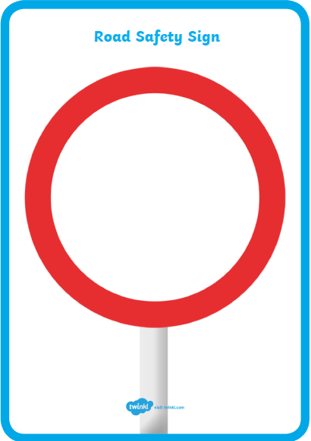
Road Safety – Sign
For your activity today you need to make a road safety sign.
On your sign you could write some words like:
-Stop, Look and Listen
-Don’t play near the road
-Look both ways
and then draw a picture to go with your writing.
When you are designing your sign make sure that it is eye catching and that you make it bright and colourful so that people will look at it.

