Slide 2
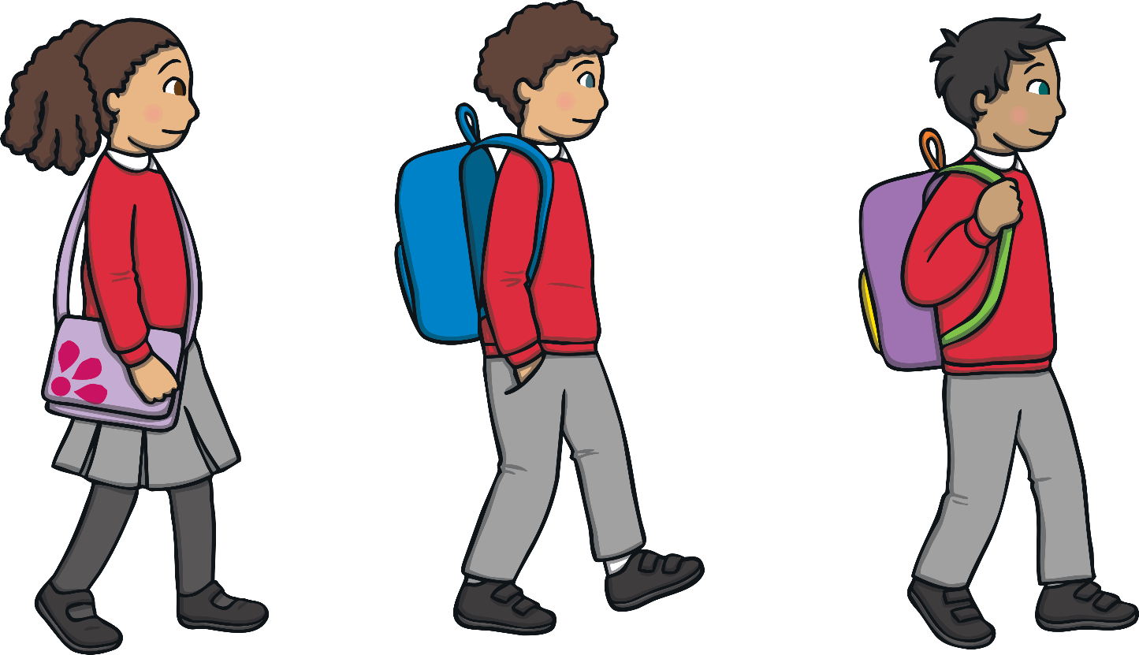
Road Safety
Crossing the road can be very dangerous. Adults can help you, and there are some special rules to follow to make sure you can cross the roads safely.

Slide 3
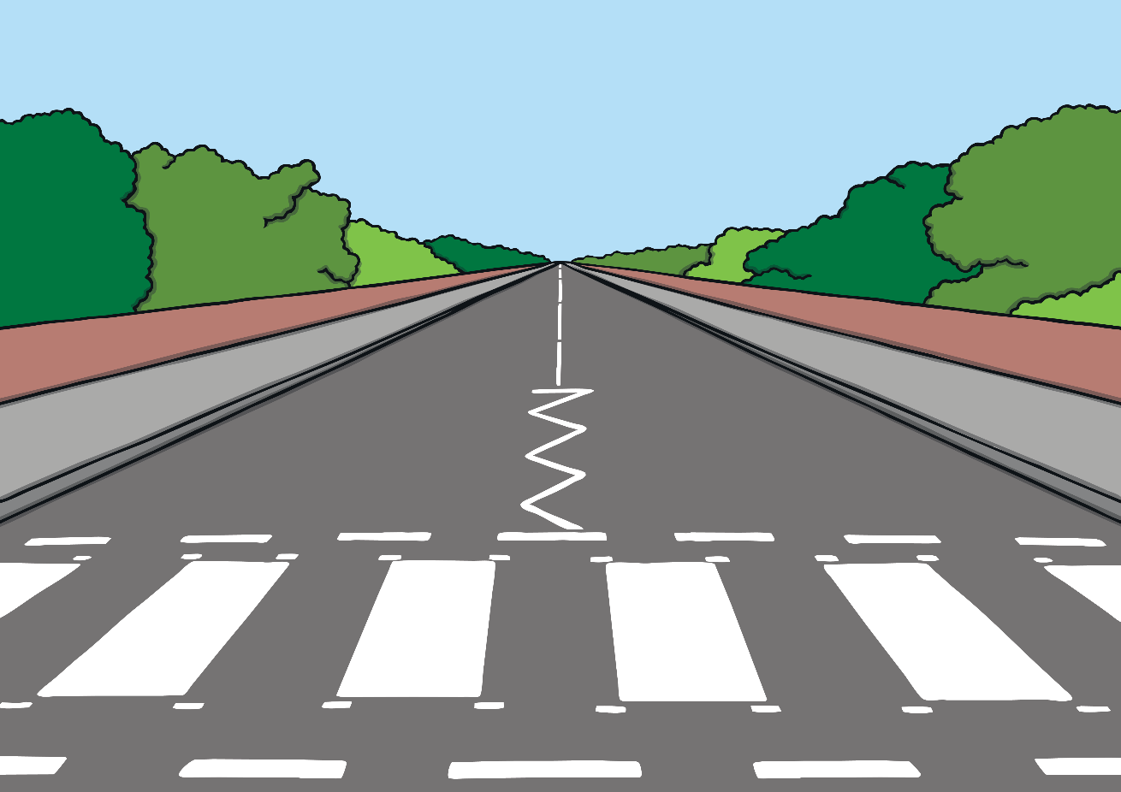
Road Safety
On some roads, there are things to help you cross, like zebra crossings.

Slide 4
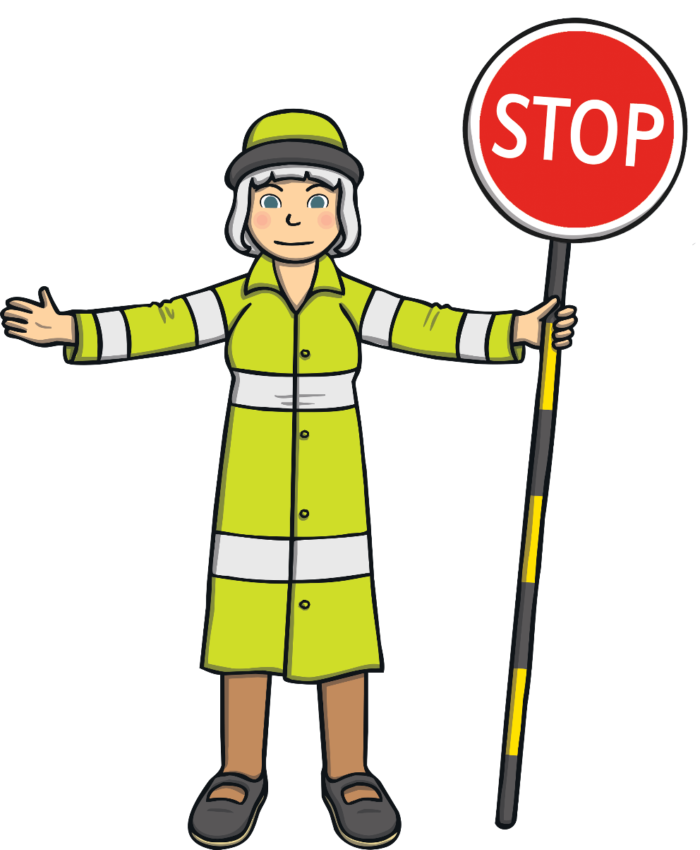
Road Safety
On some roads there are people to help you cross. The lollypop lady or man will hold up a special sign to ask cars to stop so that people can cross the road safely.

Slide 5
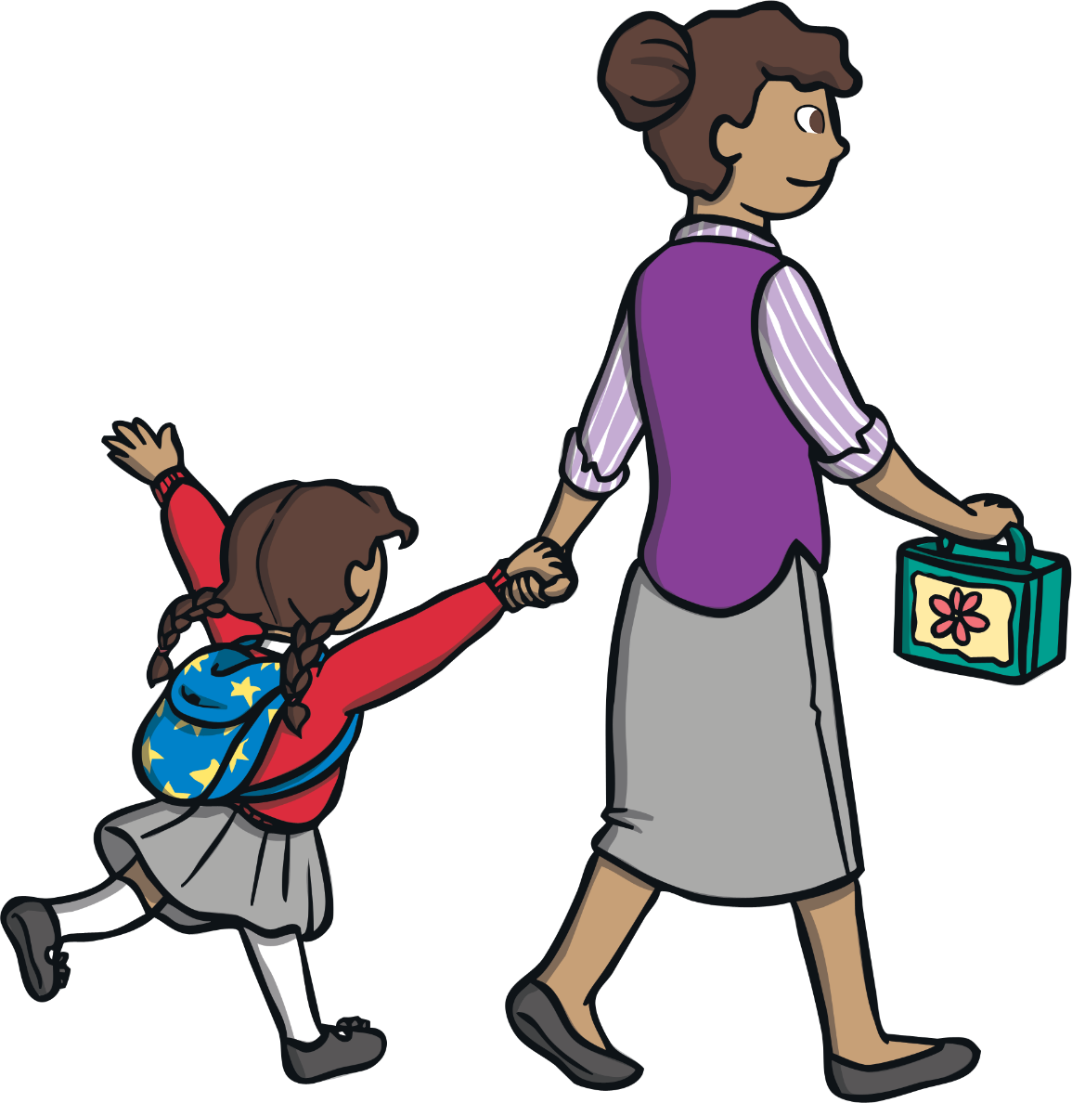
Road Safety
When walking with an adult, hold their hand – especially when you need to cross a road.

Slide 6
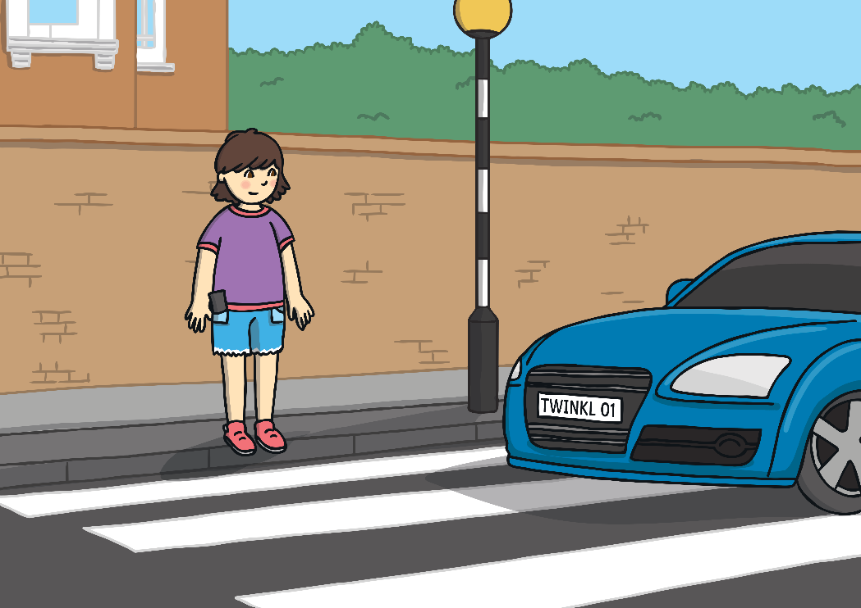
Road Safety
There are some special rules to follow to help you keep safe around roads.
Think about where you should cross.
Make sure you can see both ways along the road.

Slide 7
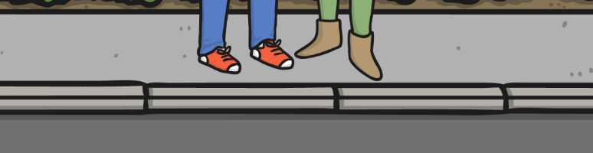
Road Safety
Stop at the side of the road.

Slide 8


Road Safety
Look and listen to see and hear if any vehicles are coming.

Slide 9
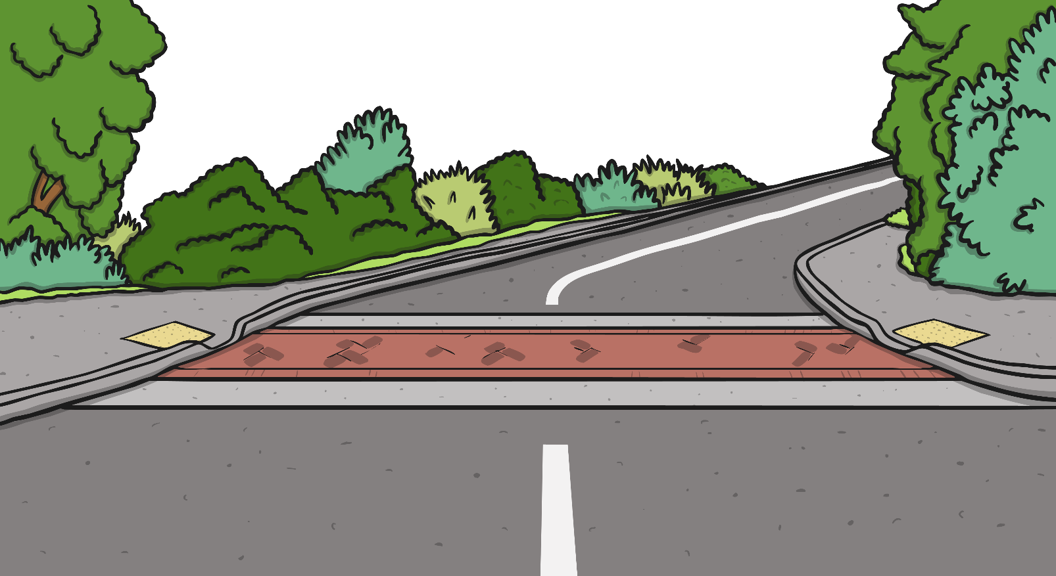


Road Safety
Wait until any vehicles have passed.

Slide 10
Road Safety
Look and listen again to see and hear if any more vehicles are coming.

Slide 11
Road Safety
Cross the road – but keep looking and listening.

Slide 12
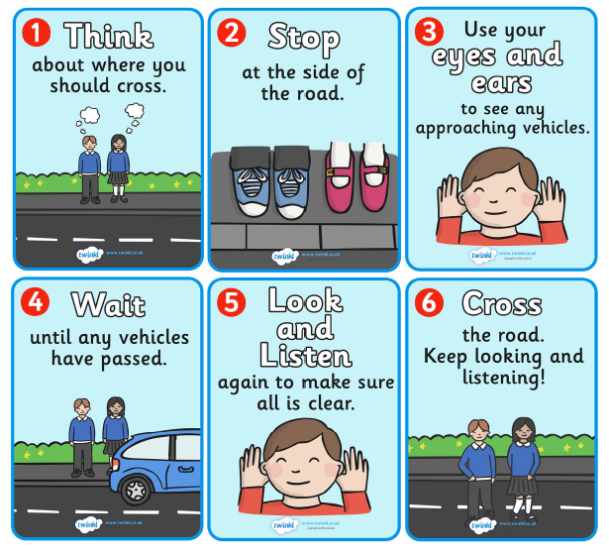
Road Safety
All of those things that you have to do when crossing the road mean that you are following The Green Cross Code. Let’s have a look again at what we have to do when we cross the road.

Slide 13
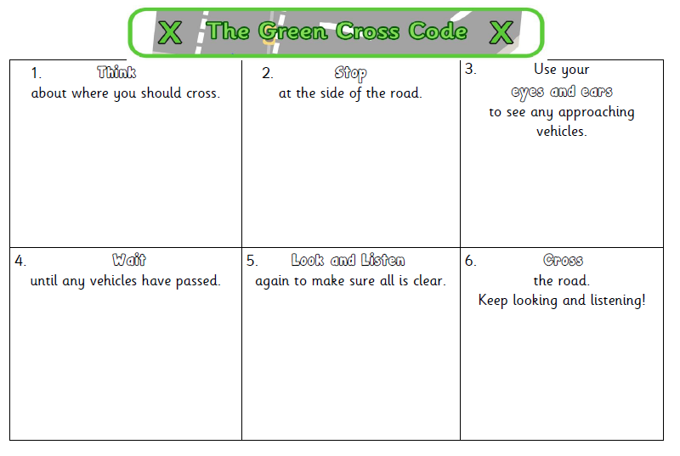
Road Safety – The Green Cross Code
For your activity today you need to make your own version of The Green Cross Code.
On the worksheet the sentences which tell you what to do when crossing the road are there but the pictures have fallen off!
Can you draw the pictures to go with the writing to make a fantastic Green Cross Code poster?
For the people in the pictures why don’t you draw yourself and a friend or your family.
Can you then go with an adult outside and follow the Green Cross Code and practise safely crossing the road?

