Slide 1


St. Valentine’s Day
On the 14th of February each year many people around the world celebrate St. Valentine’s Day.
Today we are going to learn about this special day.

Slide 3
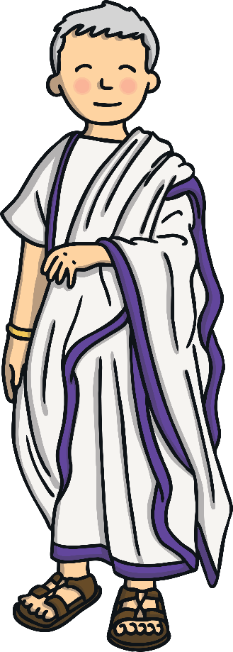
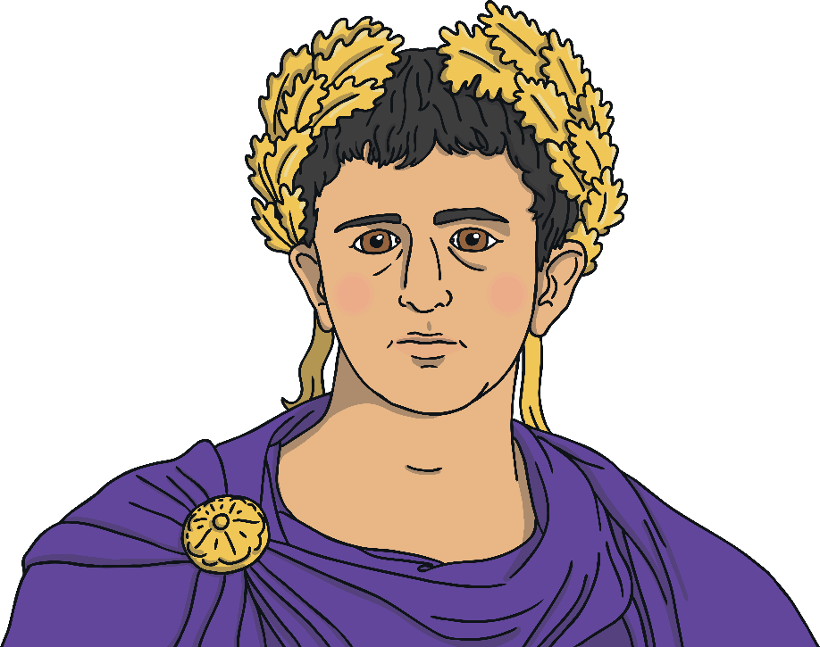
Valentine was a Roman priest who lived during the third century. At the time, Rome was ruled by an emperor called Claudius.
Valentine
Claudius

Slide 4
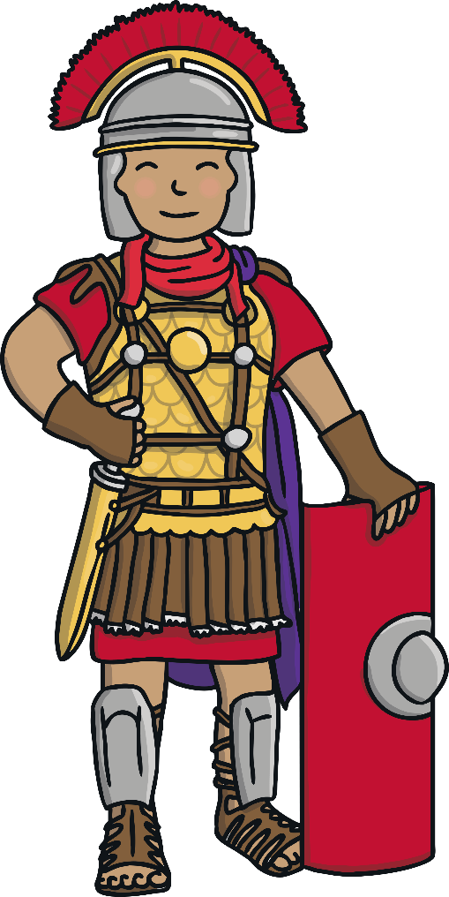
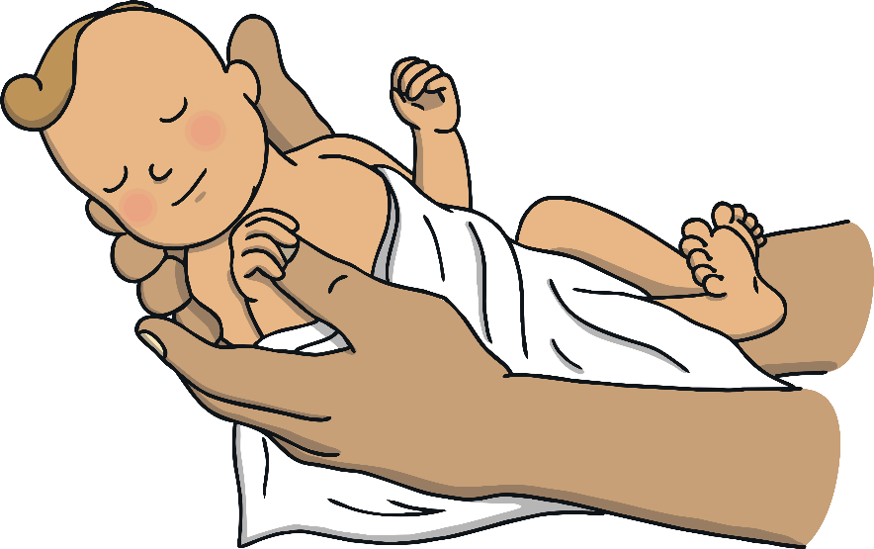
Claudius was angry because there weren’t enough Roman men becoming soldiers as nobody wanted to leave their wives and children to fight for him.

Slide 5

He forbade all men to marry so that they had no families or wives to use as an excuse for not wanting to join the army.
As Valentine was a priest, he helped the men by marrying them to their partners in secret.

Slide 6
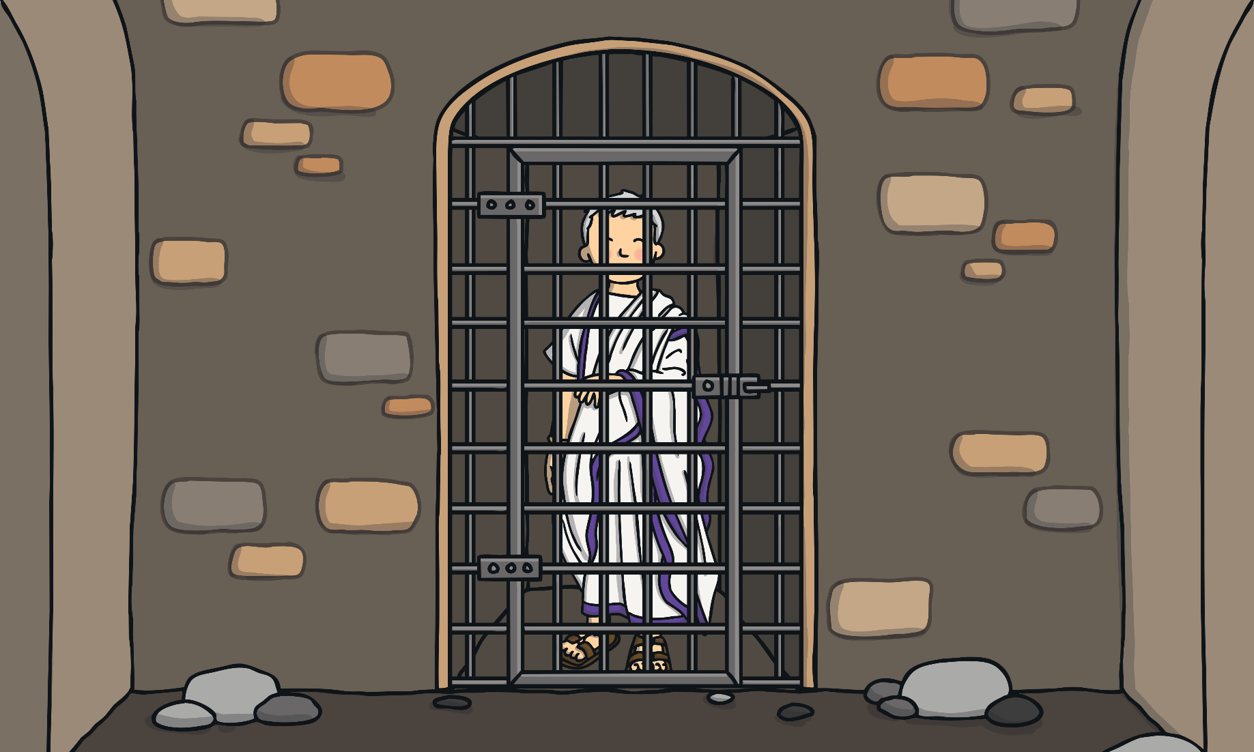
But Claudius soon found out about Valentine and ordered for him to be arrested and imprisoned.

Slide 7
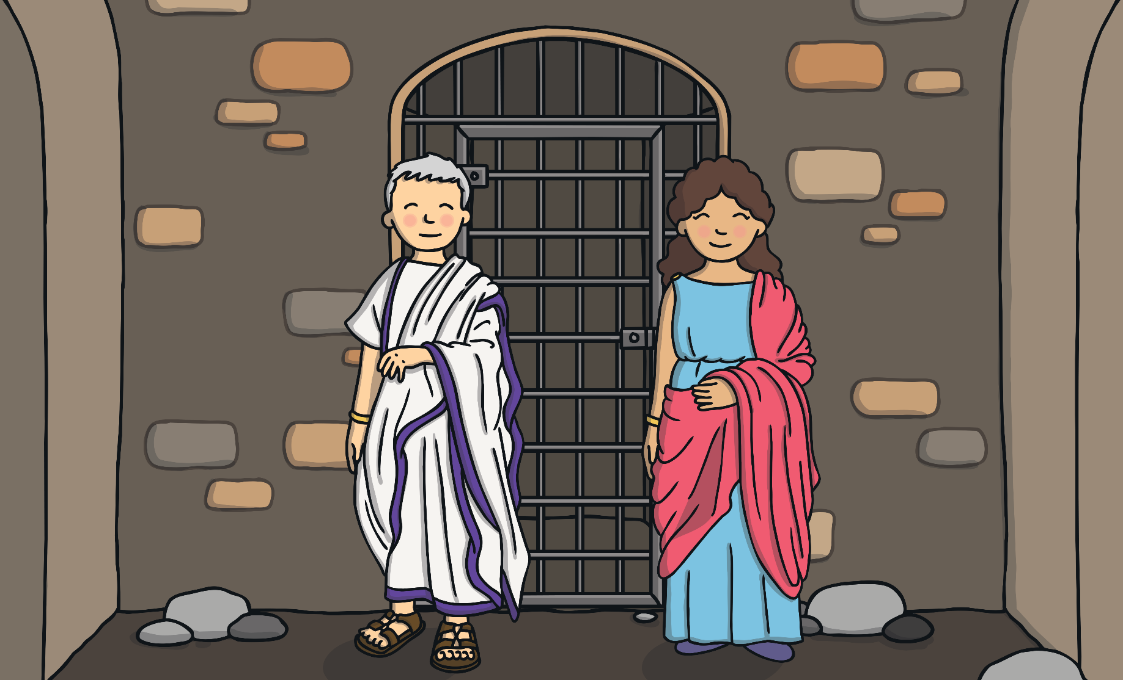
Whilst in jail, Valentine became a teacher to his jailer’s blind daughter, Julia.

Slide 8
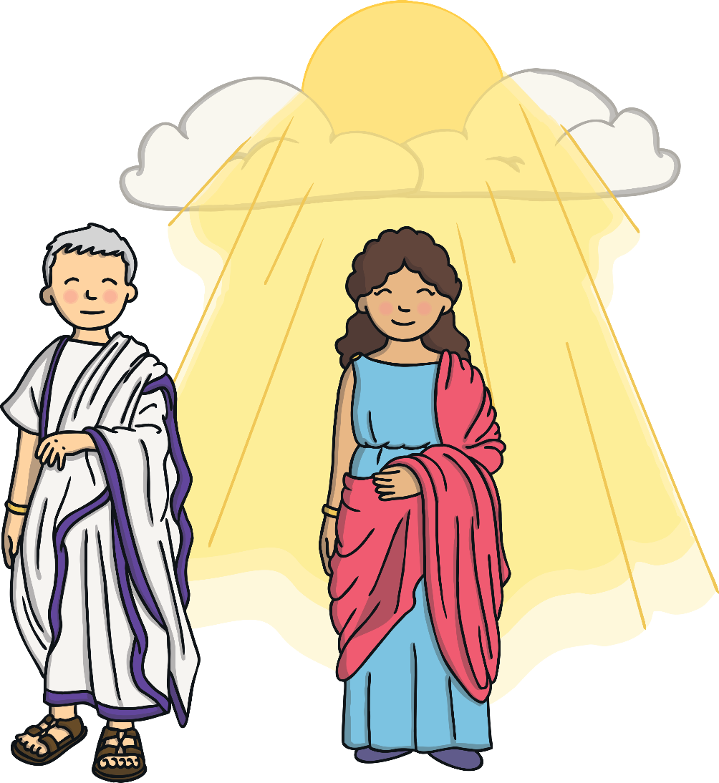
It is said that Valentine and Julia became great friends and that Valentine cured Julia’s blindness with a miracle!

Slide 9

On the day that Valentine died, he wrote Julia a goodbye letter and signed it from ‘your Valentine’.
He died on the 14th February.

Slide 10

Nowadays, we celebrate Valentine’s day by expressing our love for each other with cards, flowers, etc.

Slide 11
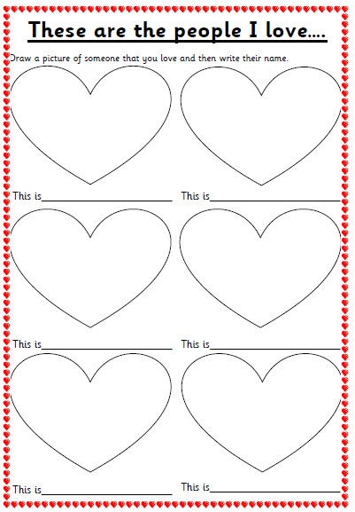


Today we are going to think of the people who we love. On the worksheet you need to draw pictures of the people who you love and write their names.
After you have done your pictures of who you love, can you make a card or cards to give to the people who you love?
On our class page on the website there are several card designs that you can choose from to print off or you can make your own.

