Slide 1
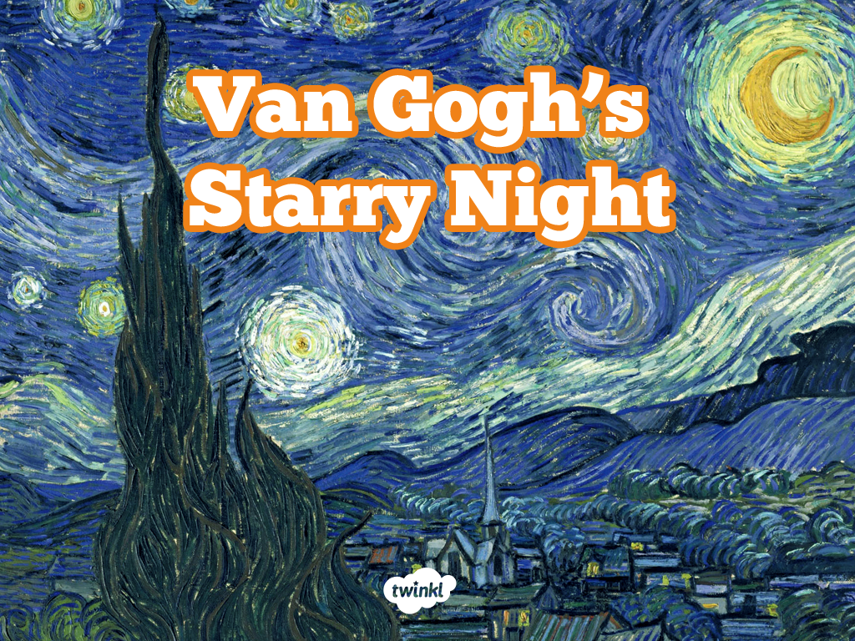
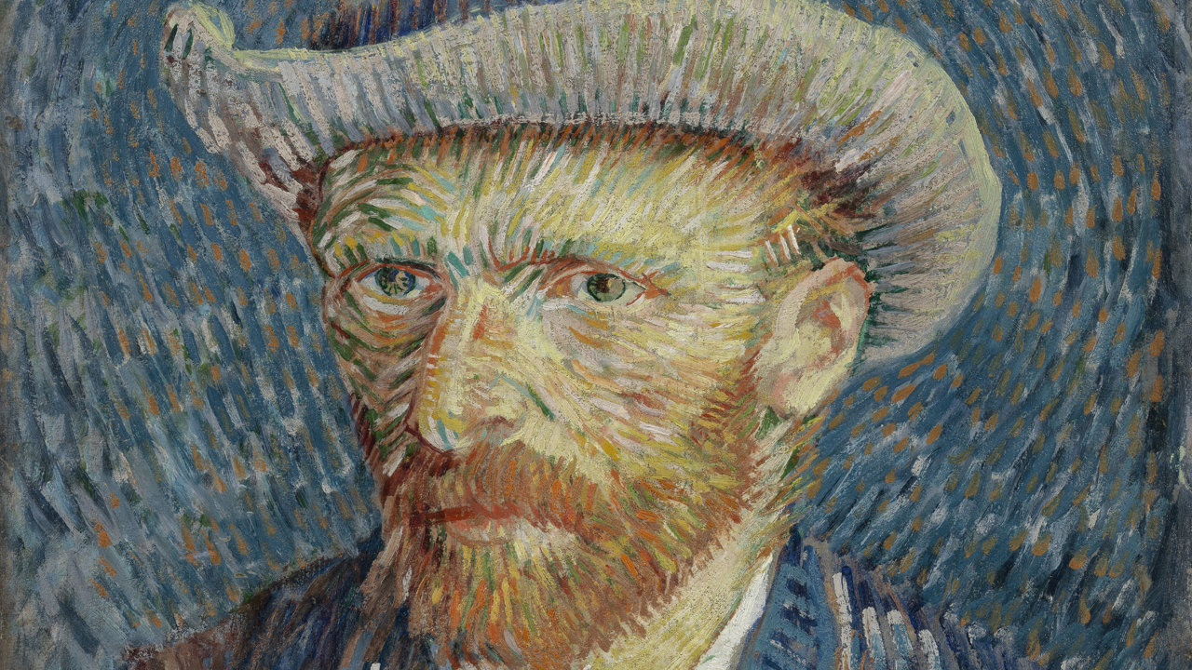
Vincent Van Gogh

Slide 2
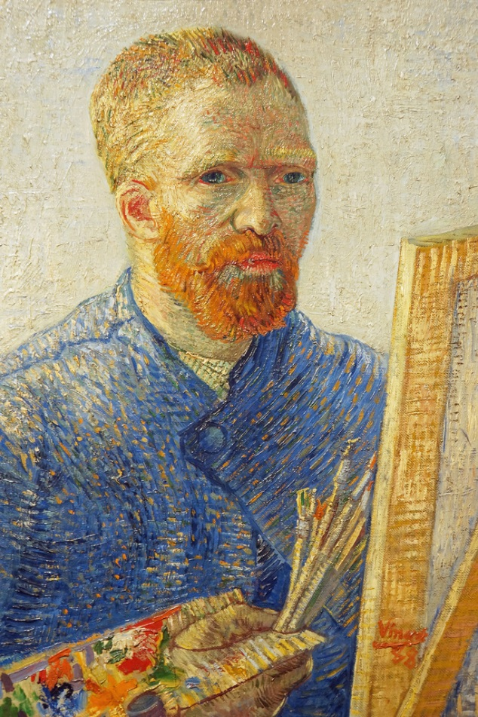
Vincent van Gogh
Vincent van Gogh was a Dutch artist and he was born in the Netherlands in 1853.
He had two brothers and three sisters.
He painted portraits, and landscapes.
He used watercolours and oil paints.
He is famous for using bright colours and bold brushstrokes in his work.
Attribution - Photo courtesy of Dennis Jarvis (@flickr.com) - granted under creative commons licence - attribution

Slide 3
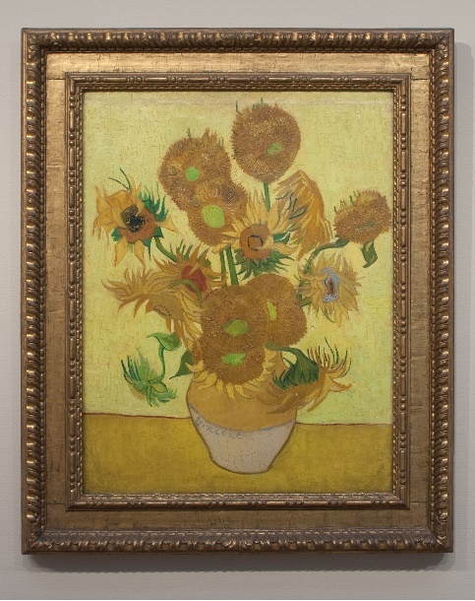
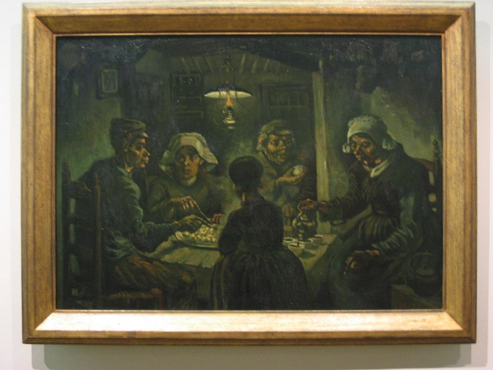
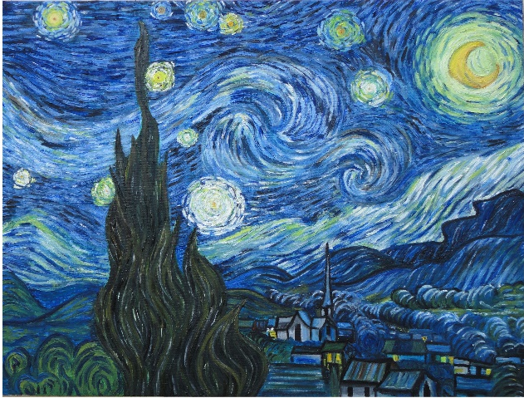
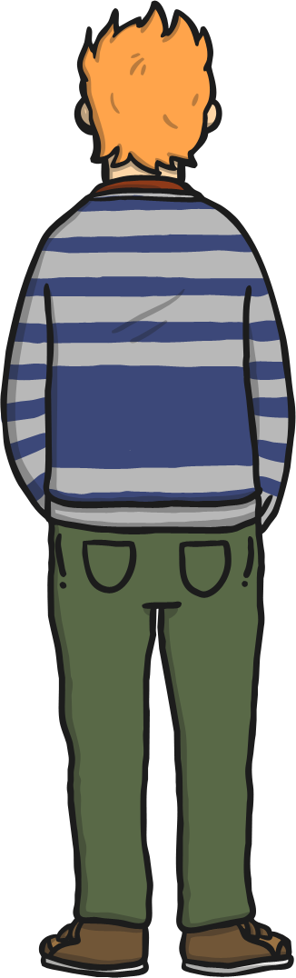
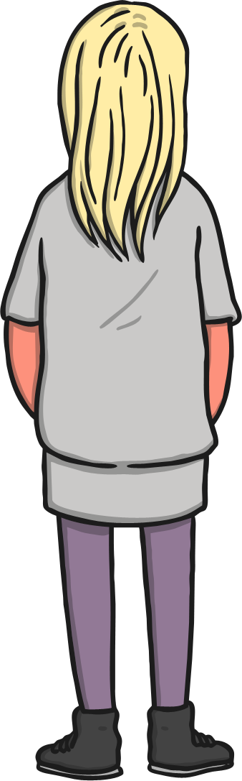
Famous Paintings by Van Gogh
Here is a gallery of Van Gogh’s most famous works.
The Potato Eaters
1885
Starry Night
1889
Sunflowers
1888
The Potato Eaters Photo courtesy of Minke Wagenaar (@flickr.com) - granted under creative commons licence – attribution
Sunflowers Photo courtesy of Pachango (@flickr.com) - granted under creative commons licence – attribution
Starry Night Photo courtesy of Saad Faruque (@flickr.com) - granted under creative commons licence – attribution

Slide 4

The Potato Eaters, 1885
This painting shows five people sitting around a table eating potatoes.
Van Gogh had not been painting for very long when he made this picture.
He painted this picture in oil paints.
He wanted to show real life in his picture.
He used quite dark colours in this artwork.

Slide 5

Sunflowers, 1888
Van Gogh painted this for his friend, the artist Paul Gauguin.
He chose the colour yellow to represent happiness.
He made lots of paintings of sunflowers.
This is one of Van Gogh’s most popular and famous paintings.

Slide 6

Starry Night, 1889
This is one of Van Gogh’s most famous paintings.
Van Gogh was very interested in the night-time.
He used his paint to create a swirling effect.
He used light yellow paint to make it look as though the moon and stars are glowing.

Slide 7
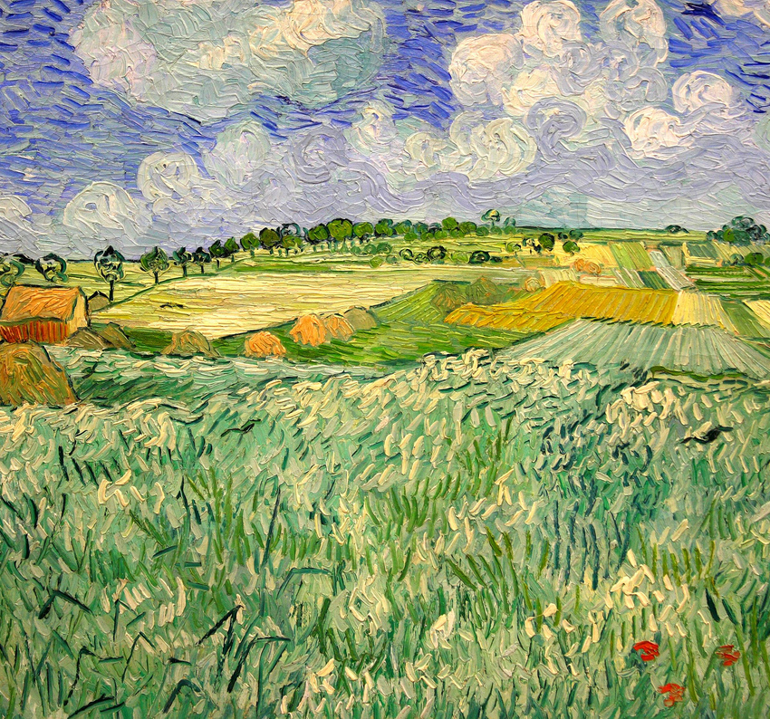
Plain Near Auvers 1890
Landscapes
This is another famous painting by Van Gogh.
Look at the brushstrokes that van Gogh used.
They are all little lines or swirls.
Attribution - Photo courtesy of Frank Kovalchek (@flickr.com) - granted under creative commons licence - attribution

Slide 8
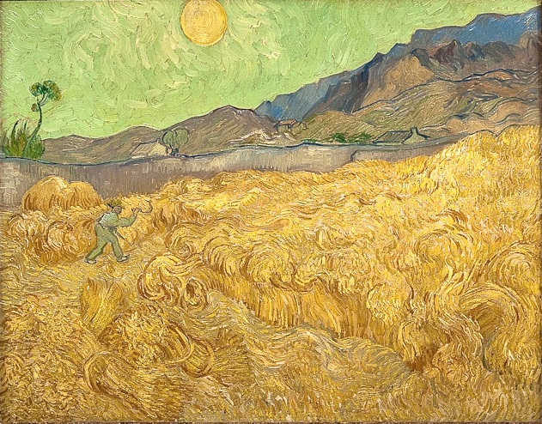
Wheatfield with a Reaper 1889
Landscapes
Look at this picture and you can see the little lines and swirls again.
When Van Gogh painted in the daytime. He used bright colours.
Attribution - Photo courtesy of Michele Ahin (@flickr.com) - granted under creative commons licence - attribution

Slide 9
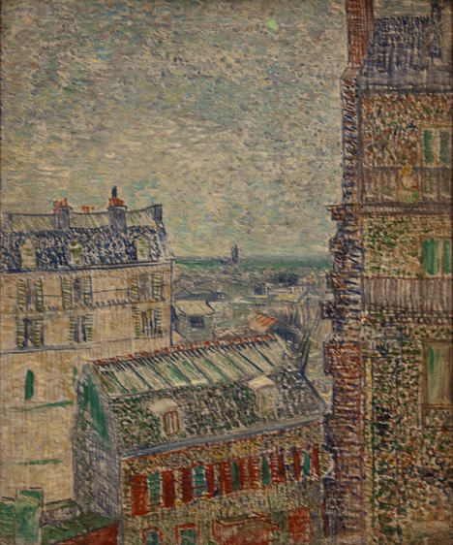
View of Paris from Theo's Apartment in the Rue Lepic 1887
Cityscapes
He didn’t just paint pictures of landscapes he also painted pictures of towns and cities too.
His favourite colour was yellow but when he was painting a town or city he had to use different colours that were a little darker.
He did include some brighter colours, such as green and purple though.
Attribution - Photo courtesy of Michele Ahin (@flickr.com) - granted under creative commons licence - attribution

Slide 10
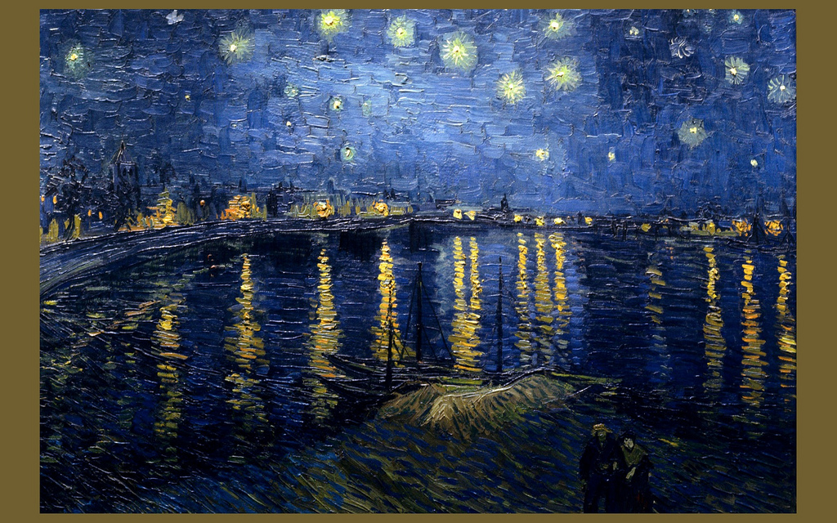
Starry Night Over the Rhone 1888
Van Gogh’s Night-time Cityscapes
Attribution - Photo courtesy of Jim Trodel (@flickr.com) - granted under creative commons licence - attribution

Slide 11

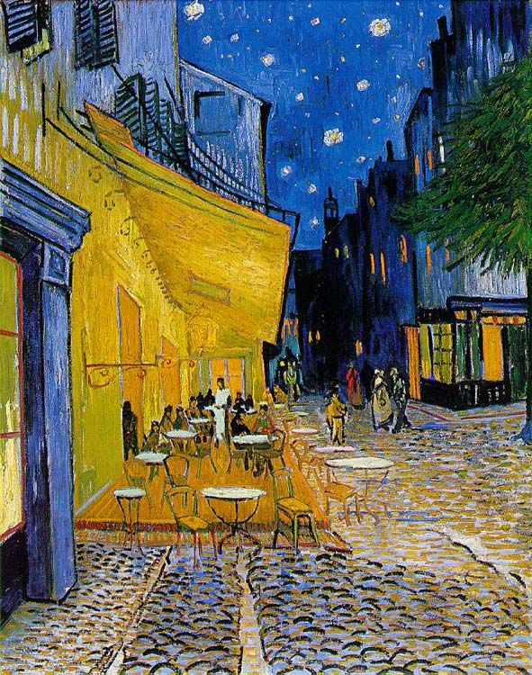
Café Terrace at Night, 1888
Van Gogh painted this city scene at night.
Can you see that Van Gogh started to get his favourite colour yellow into his night-time paintings.
Attribution - Photo courtesy of Victoria (@flickr.com) - granted under creative commons licence - attribution

Slide 12
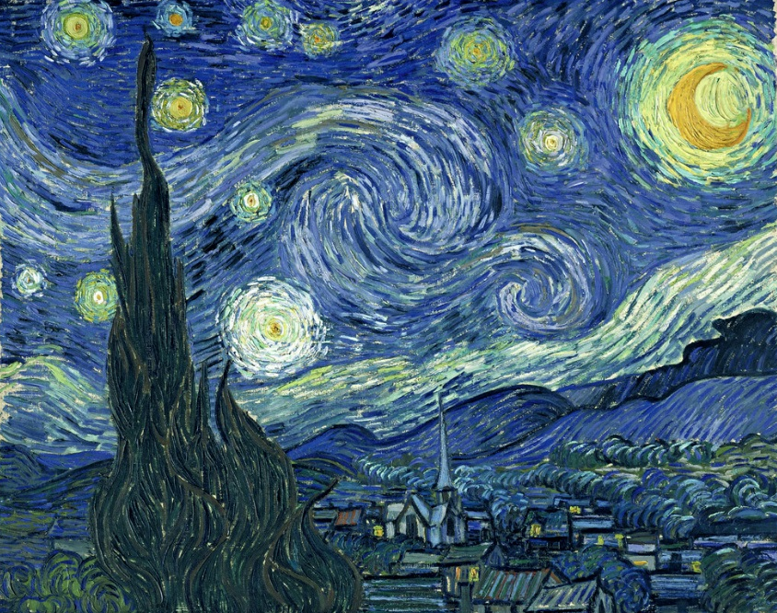
Starry Night 1889
Van Gogh’s Night-time Cityscapes
This is one of van Gogh’s most famous paintings.
Van Gogh created a swirling effect with his paint.
He used thick brushstrokes and curved lines.
He used light yellow paint to make it look like the moon and stars are glowing.
Attribution - Photo courtesy of Christopher Penn (@flickr.com) - granted under creative commons licence - attribution

Slide 13
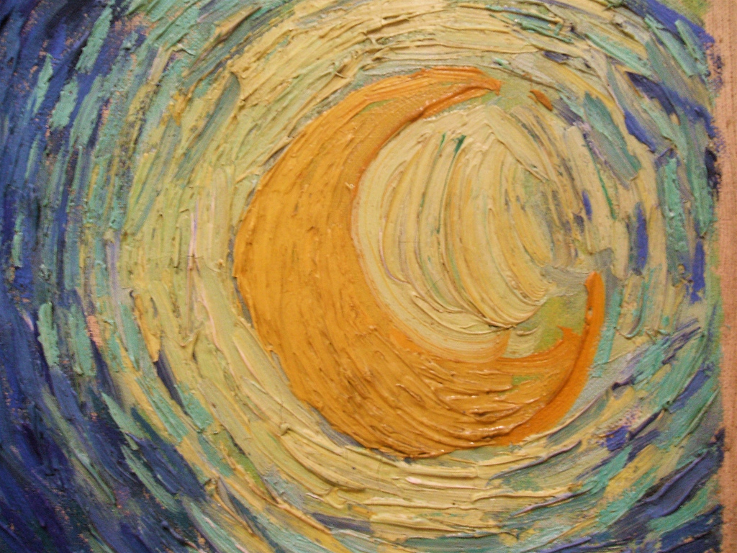
Starry Night Detail
Van Gogh’s Night-time Cityscapes
In this picture, you can see the marks that van Gogh made, and how thick the paint was. You can clearly see where and how he has used his paintbrush.
He used round marks to follow the shape of the Moon.
Attribution - Photo courtesy of Maureen Didde (@flickr.com) - granted under creative commons licence - attribution

Slide 14
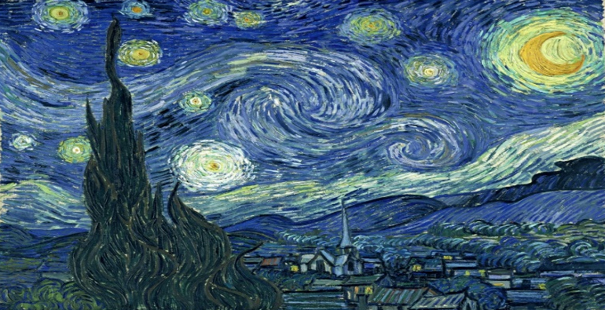
Your Van Gogh
Painting
For your art activity today you will need a piece of paper and some paints or colours (felt tips, crayons or pencil crayons).
You are going to create your own version of Van Gogh’s famous painting ‘Starry Night’. A picture of this painting has been uploaded to the website for you to look at to create your own version.
First get your piece of paper and your paints or felt tips/crayons. You then need to use yellow paint or felt tips to paint or draw your stars and moon with little lines and swirls. When you have painted or drawn your stars and moon you then need to get some different blues or purples and begin to make little lines and swirls to colour in the night sky.

Slide 15
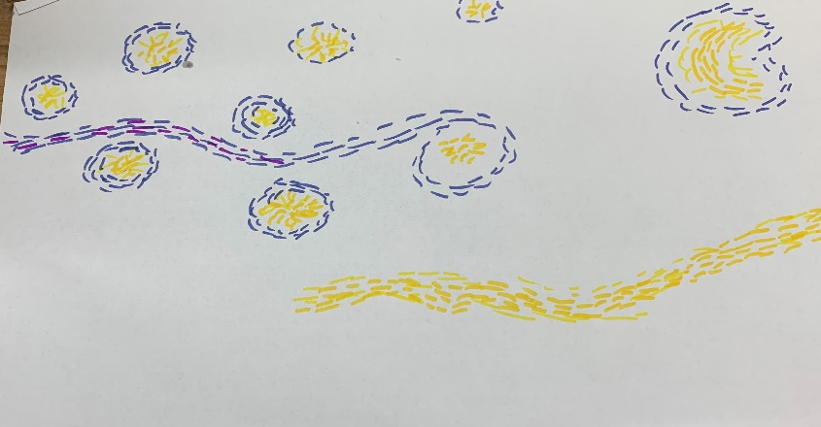
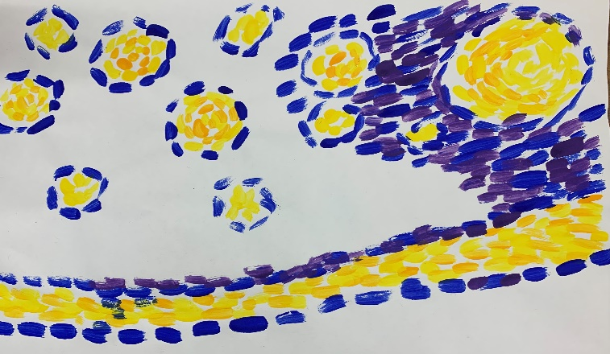
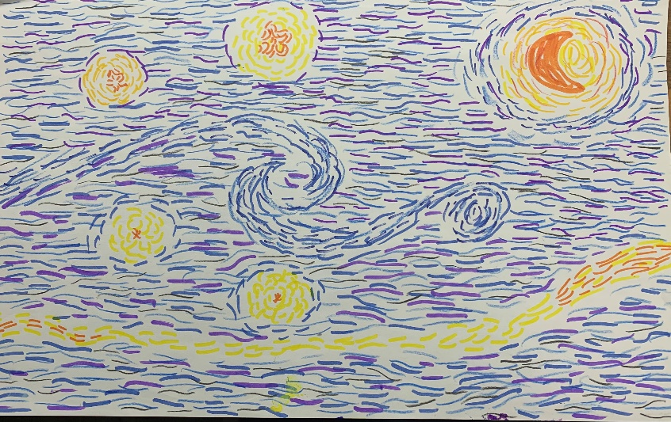
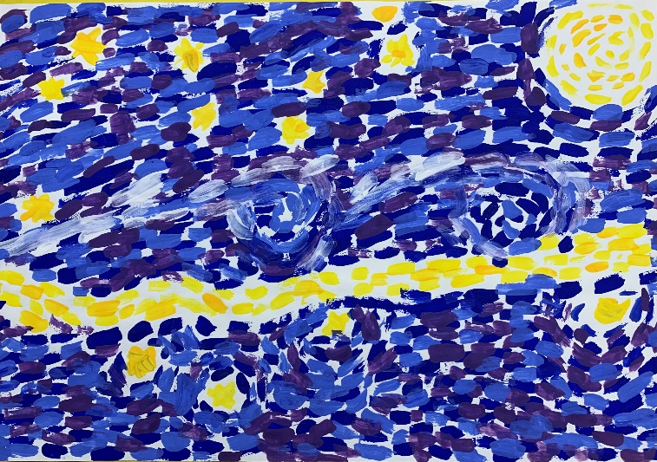
If you are using felt tips or crayons, draw your stars and moon first and then go round them with the night sky.
If you are using paints, paint your stars and moon first and then go round them with the night sky.

Slide 16
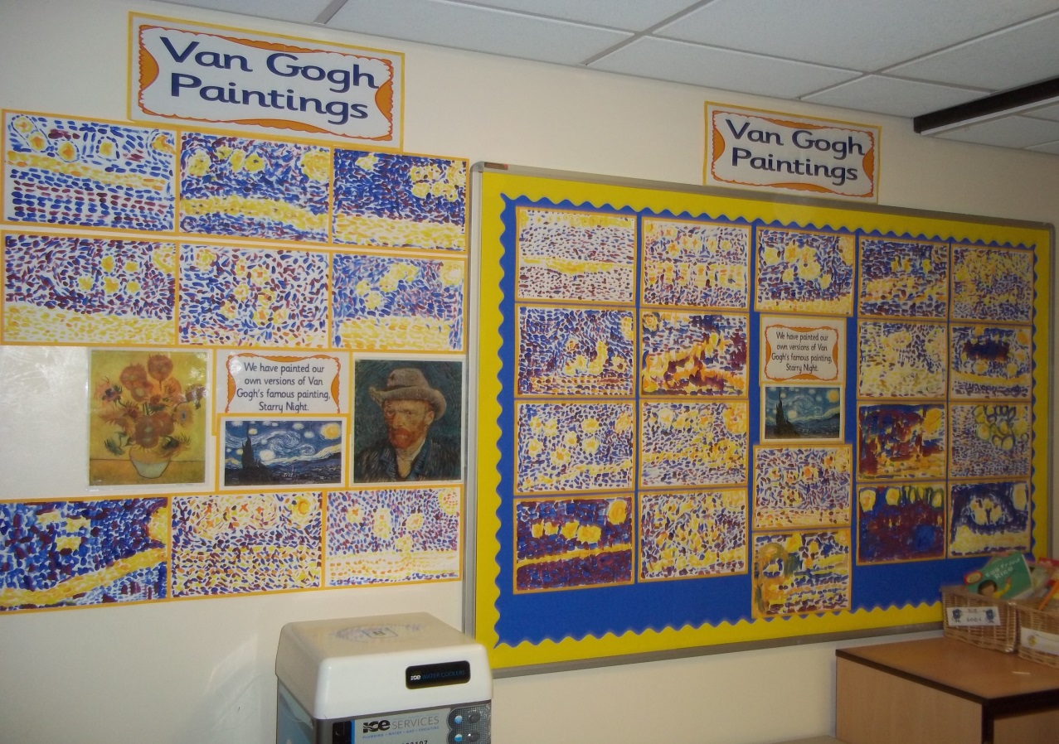
Below is a photograph of the Van Gogh, Starry Night paintings from last year’s class for you to look at

