Slide 1
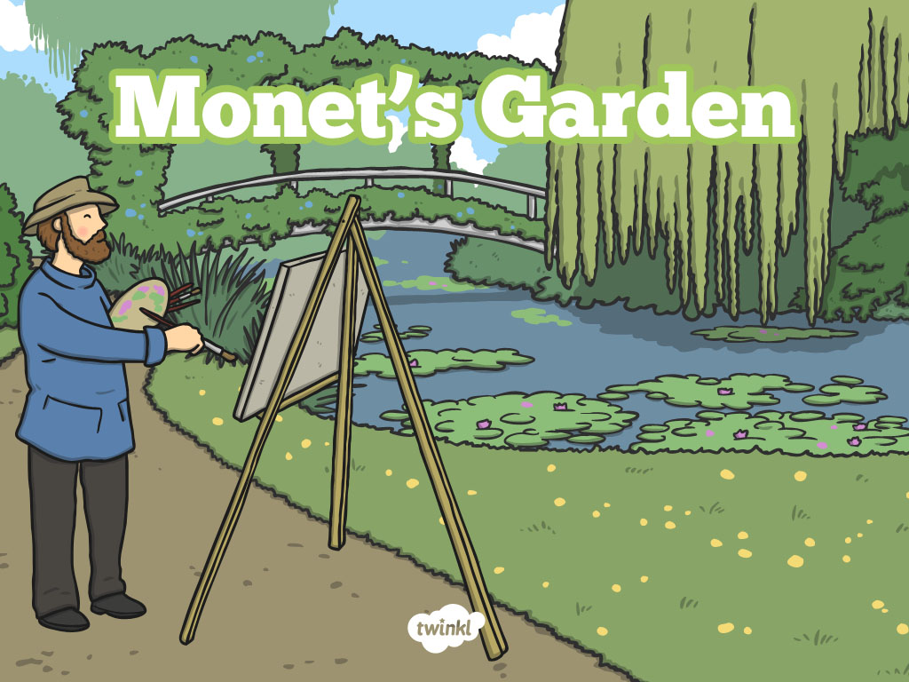
Claude Monet

Slide 2
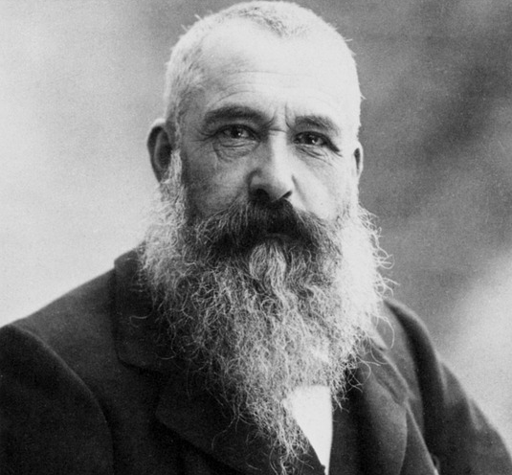
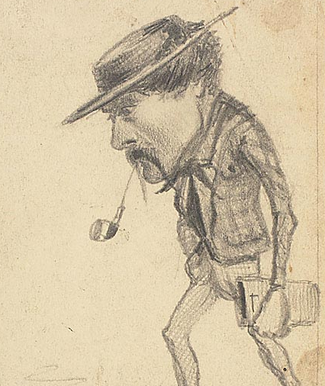
Claude Monet
Oscar- Claude Monet was a French painter who was born in 1840. He was known as Claude Monet even though his mum and dad called him Oscar.
When he was at school he used to draw caricatures of local people and then did this as he grew up to earn some money. A caricature is a cartoon picture of someone. This is one of his caricatures.
He later began to really enjoy painting in the outdoors, and he loved painting in the French countryside. He often painted the same scene many times in different times and seasons.

Slide 3
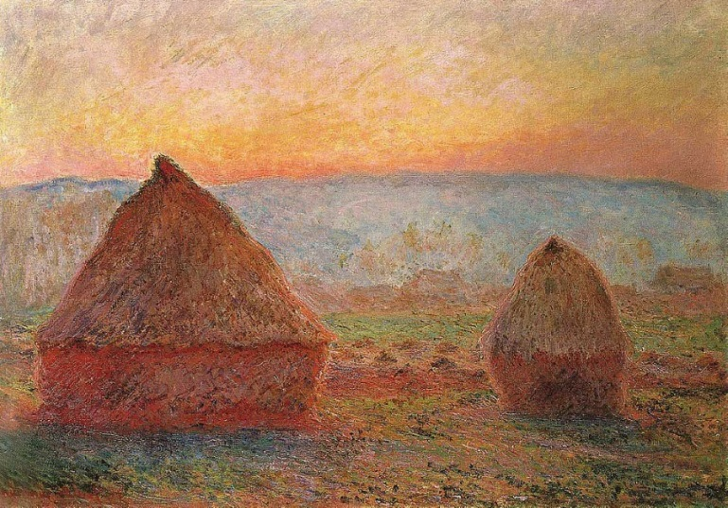
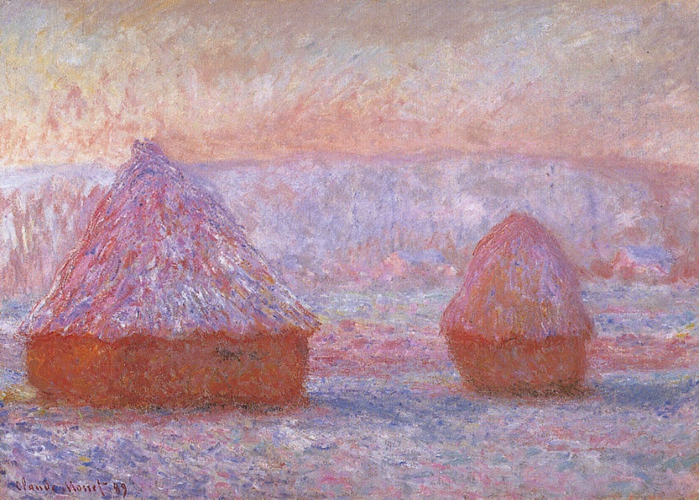
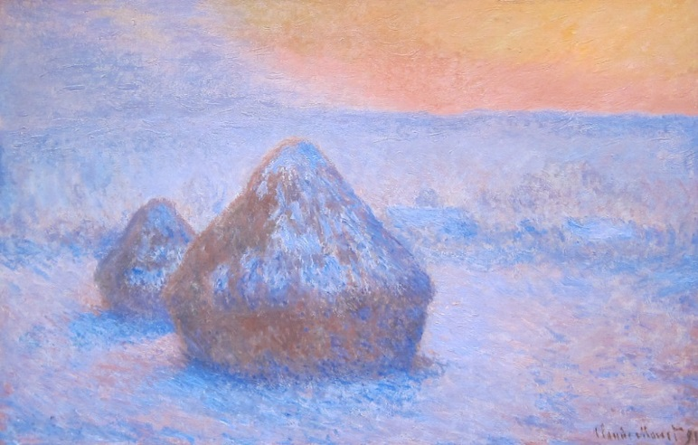
Monet created these 3 very similar paintings of haystacks.
He often painted the same thing at different times of the day and in different seasons.

Slide 4
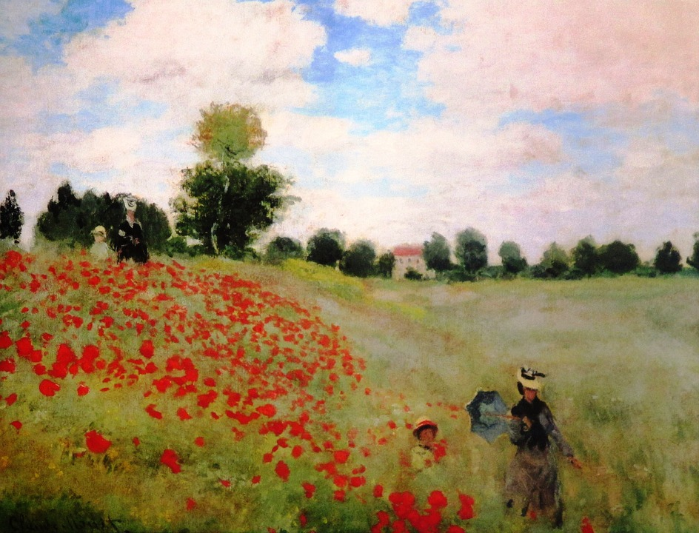
Monet married a lady called Camille and they had children. Monet often painted pictures of Camille and his children. Here is a famous painting called ‘A field with poppies’ which shows his wife Camille and his son Jean.
.

Slide 5
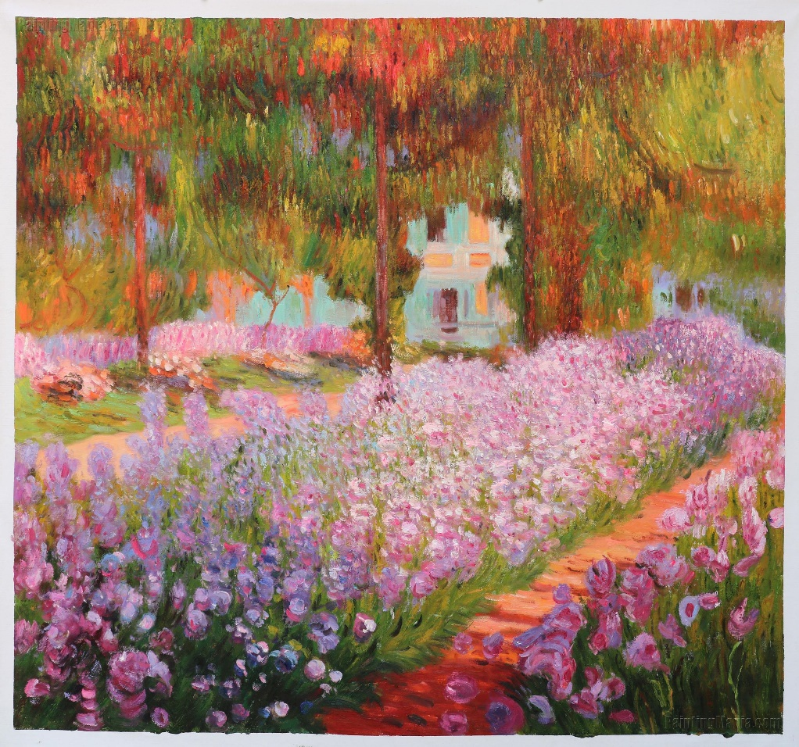
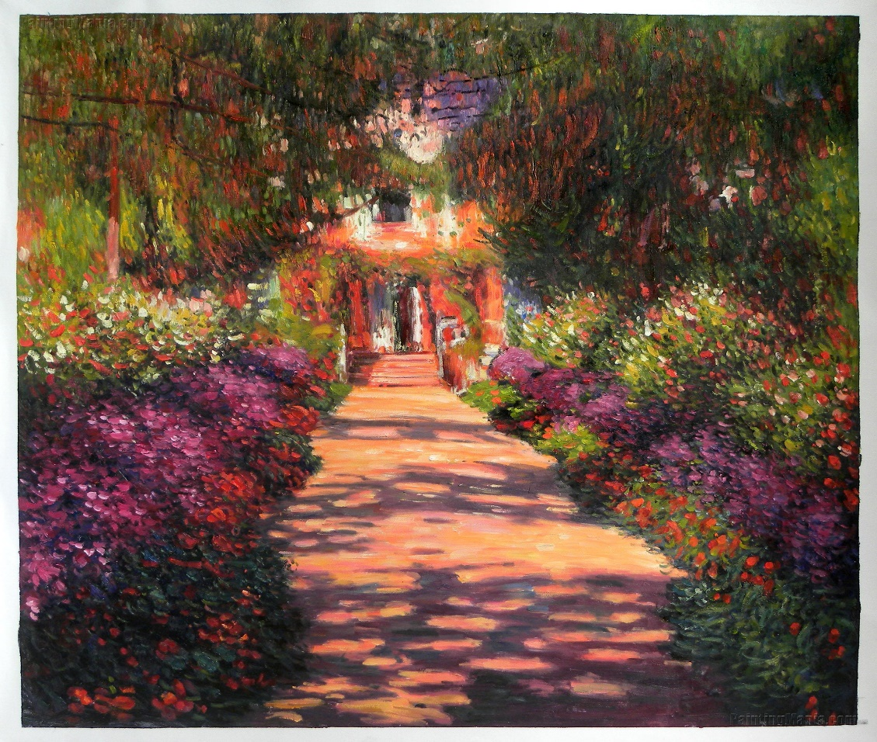
As Monet made more and more money from selling his paintings he then bought a house with large gardens and this is where he painted most of his paintings. This house was also where he painted his most famous paintings of the waterlily pond.

Slide 6
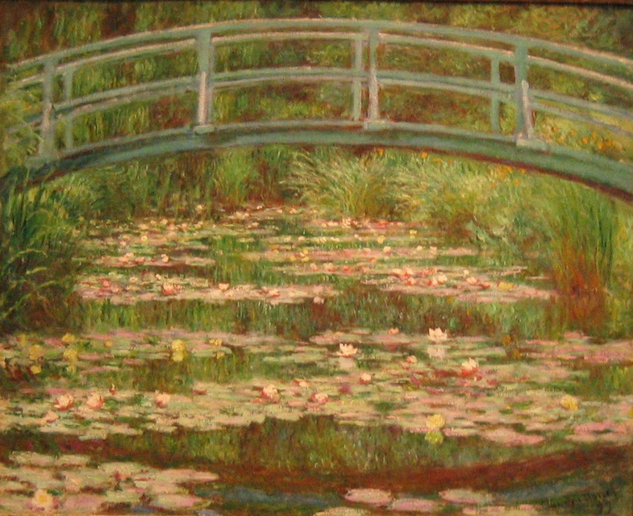
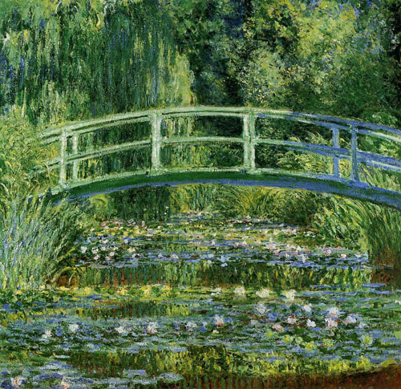
Giverny
The house that he bought was in a place called Giverny and he created beautiful gardens, starting with lily ponds.
He also enjoyed painting his large garden in different seasons.
This is a picture of his famous waterlily pond with a Japanese bridge over it.

Slide 7
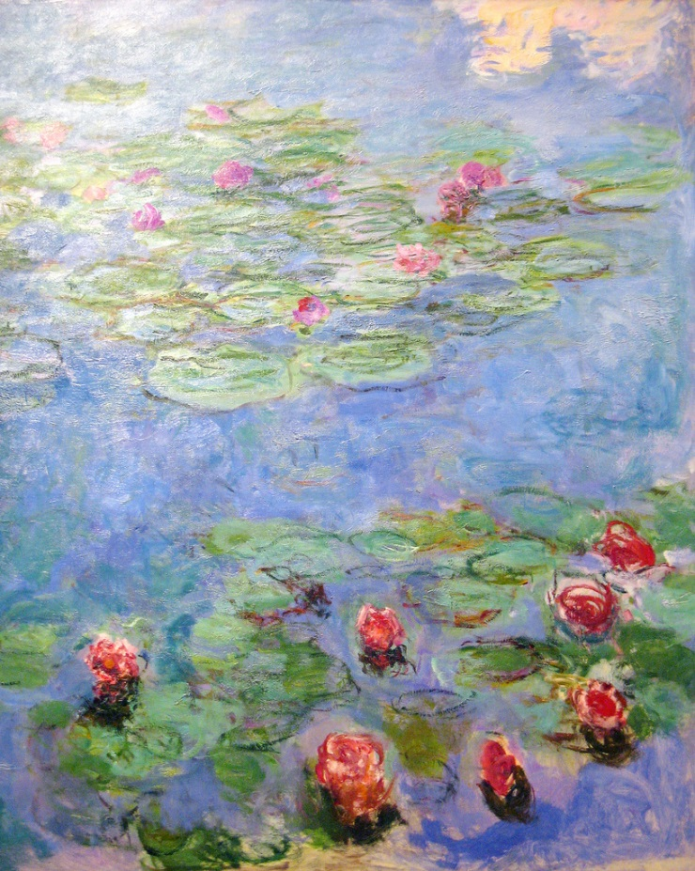
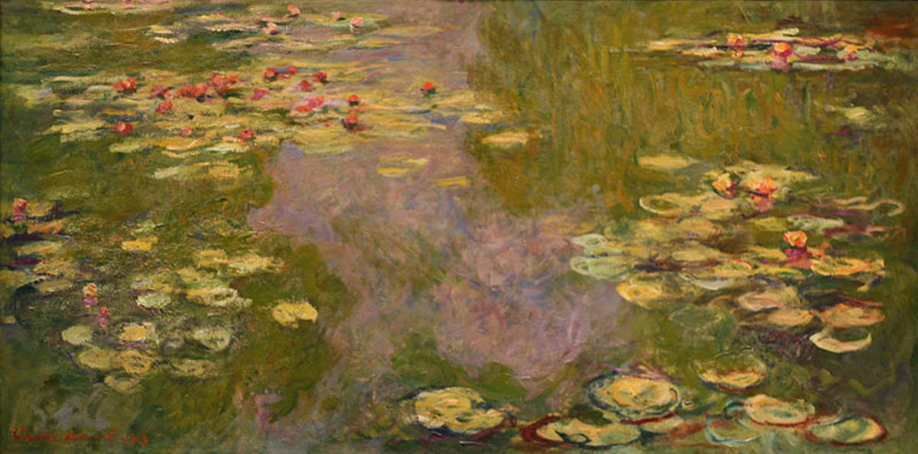
Giverny
Lily Ponds
In 1899, he began painting water lilies and continued to do so for 20 years.
His paintings of water lilies are his most well-known artworks.

Slide 8
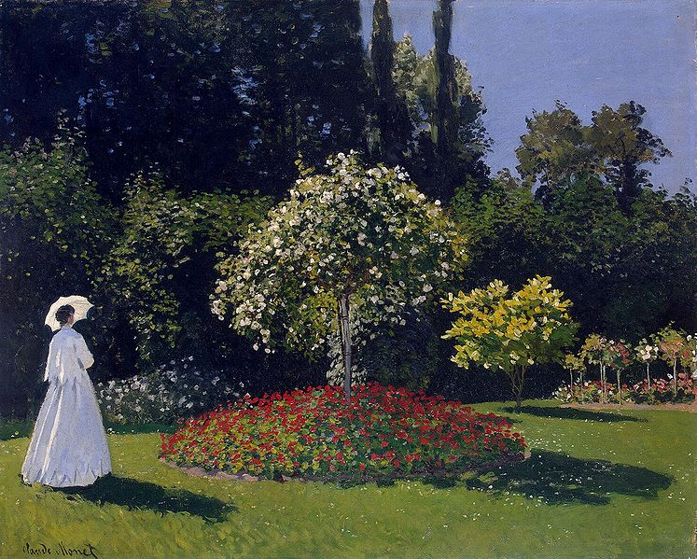
Here are some more on Monet’s famous paintings.
Attribution - Photo courtesy of Joaquín Martínez (@flickr.com) - granted under creative commons licence - attribution

Slide 9
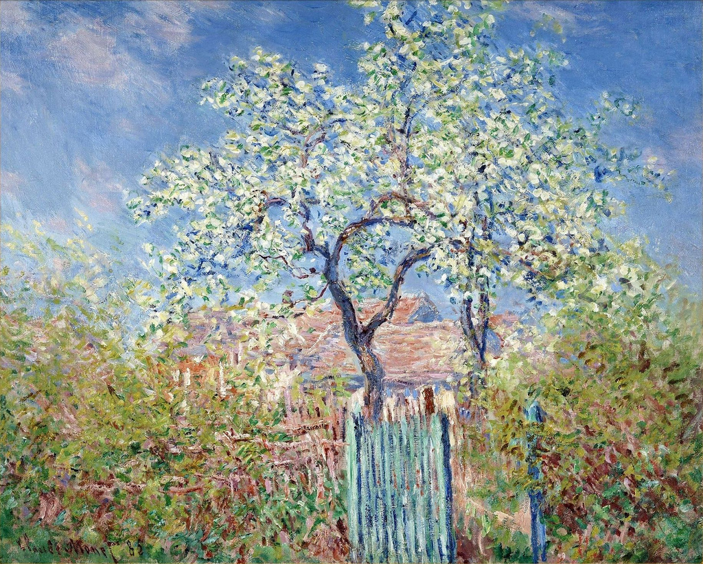
Flowering Pear Tree 1885

Slide 10
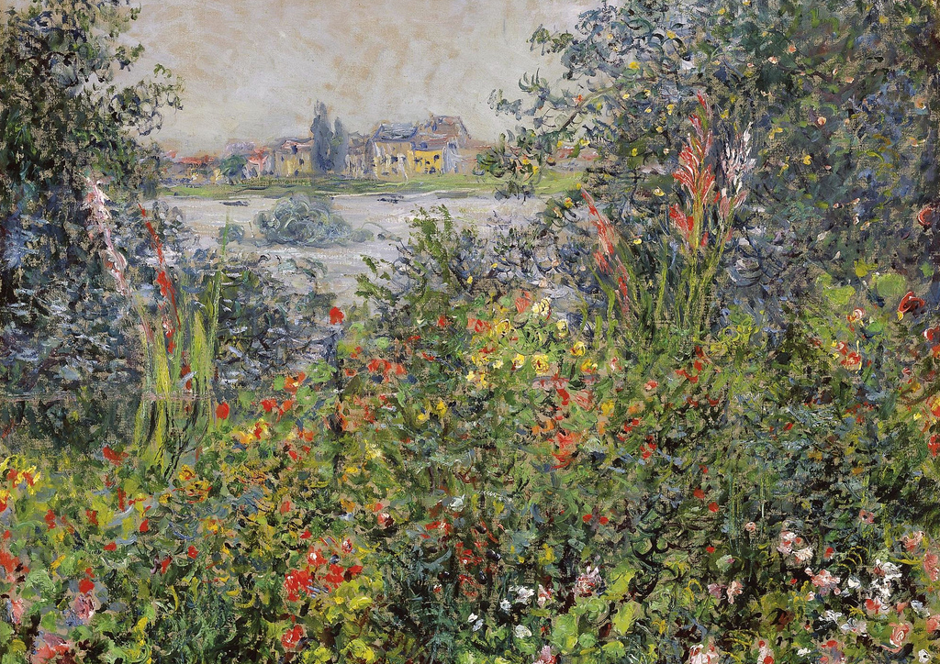

Slide 11
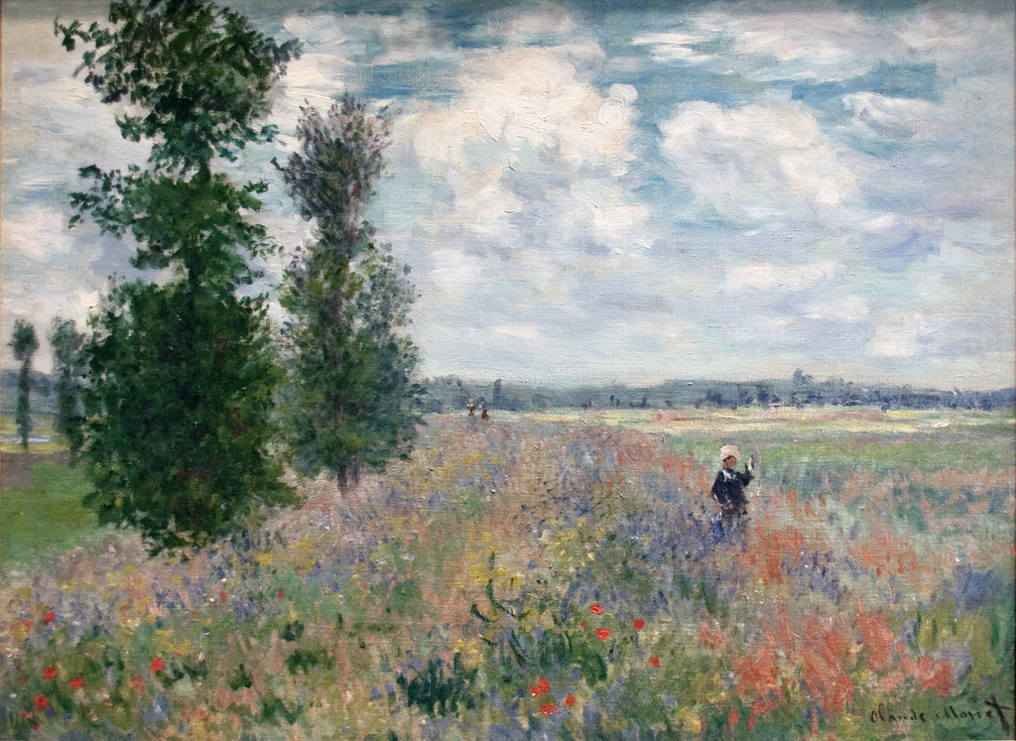

Slide 12
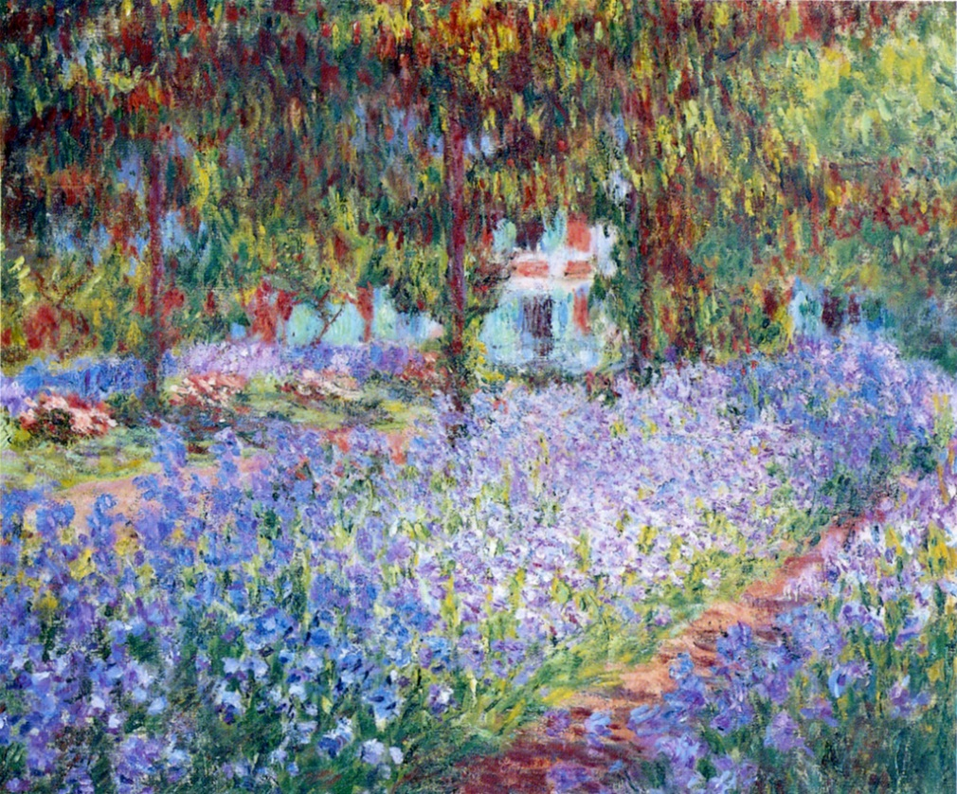

Slide 13
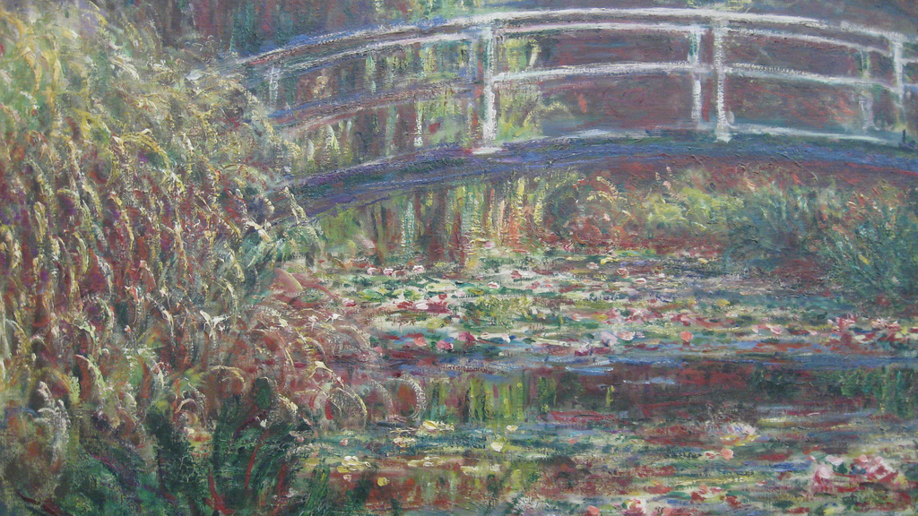

Slide 14
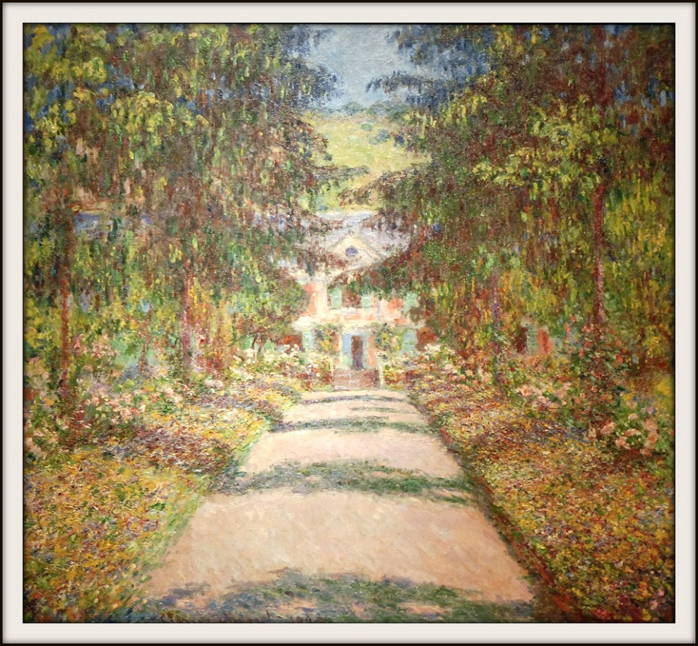

Slide 15
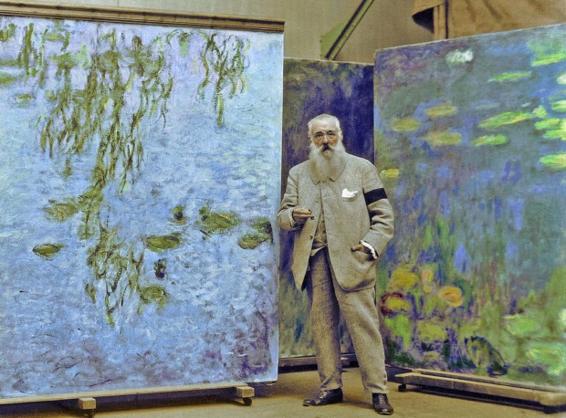
A lot of Monet’s paintings were huge!
He painted them in a large barn at his house.

Slide 16
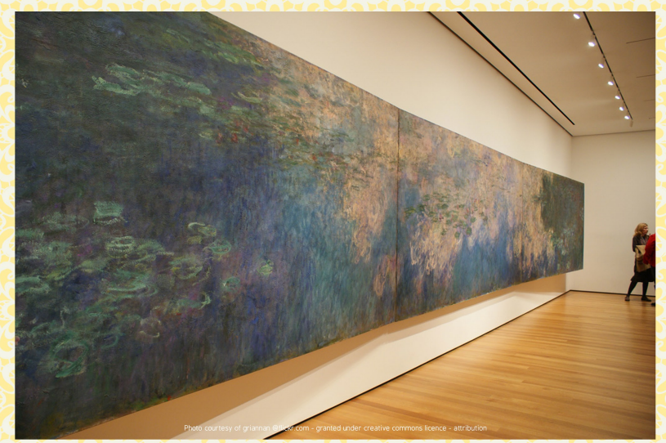

Slide 17
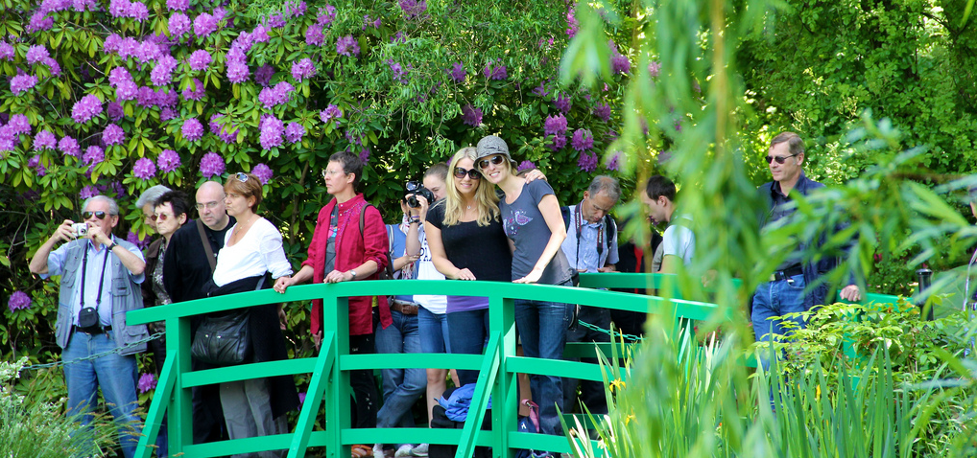
Giverny
Visiting Monet’s Garden
Monet’s garden is now open to the public and visitors come from all over the world to enjoy it.
Attribution - Photo courtesy of MJM Photographie (@flickr.com) - granted under creative commons licence - attribution

Slide 18
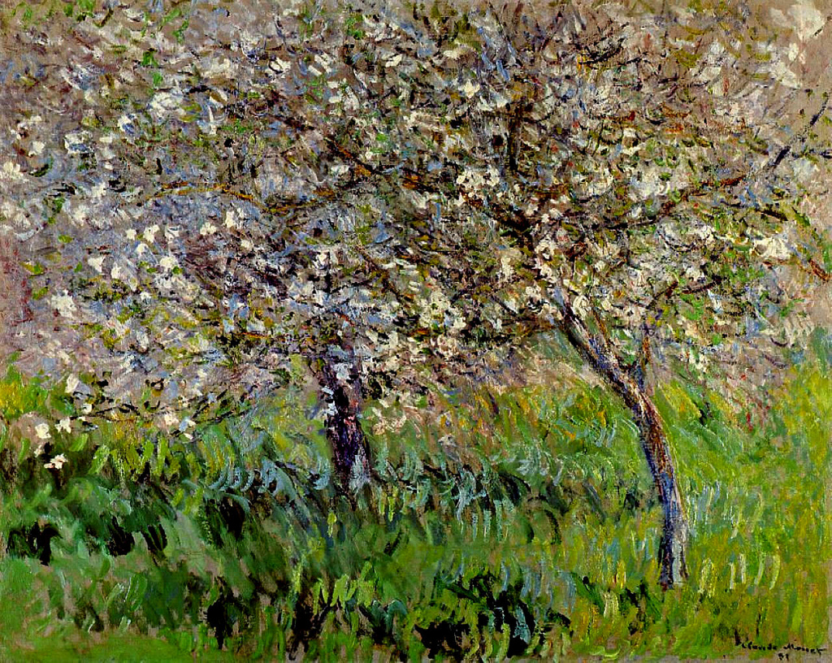
Close-up
Monet painted with bold brushstrokes.
Up close, Monet paintings can look messy, and it can be hard to tell what it is.
What do you think this could be a painting of?

Slide 19
Apple Trees in Bloom at Giverny 1900-01
Close-up
Attribution - Photo courtesy of CarlosR38 (@flickr.com) - granted under creative commons licence - attribution

Slide 20
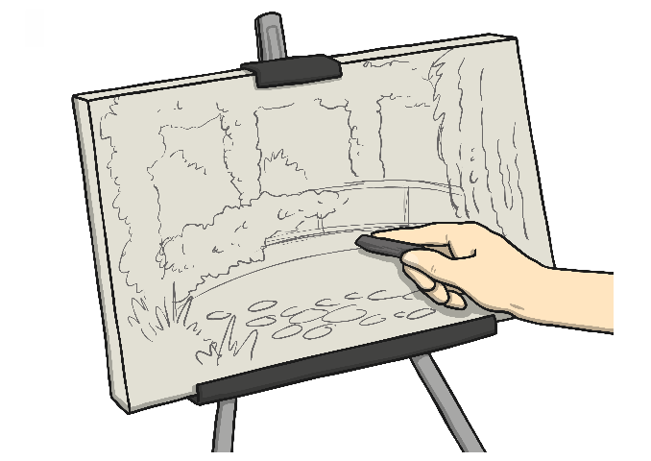
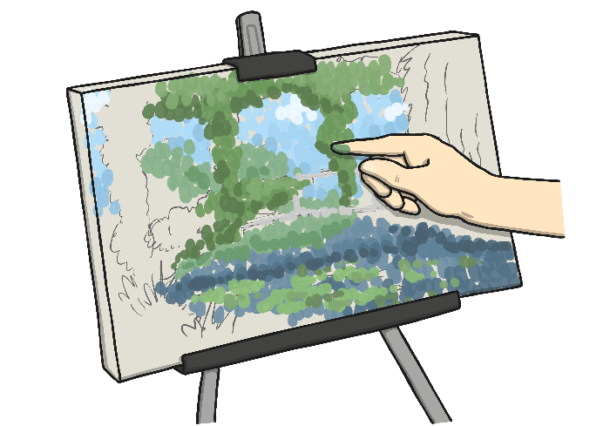
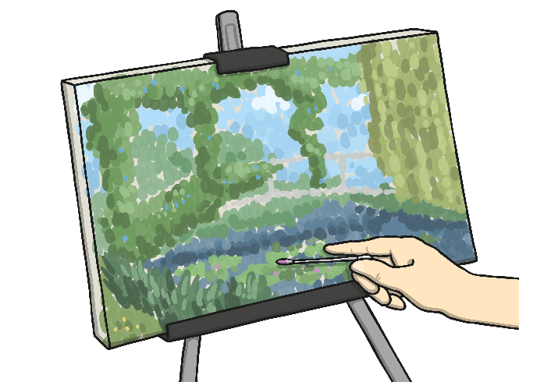
For your art activity today you will need a piece of paper and some paints or colours (felt tips, crayons or pencil crayons).
You are going to create your own picture in the style of Monet of a part of your garden that you love or you can choose your favourite Monet painting and do your own version.
First get your piece of paper and a pencil and lightly draw the outlines of what you want to draw today. When you have done this use your colours to colour in your picture. If you are using paints, Monet made blob like brush strokes which looked a bit messy close up but when you look at the picture when it is finished it looks wonderful.

