Slide 2
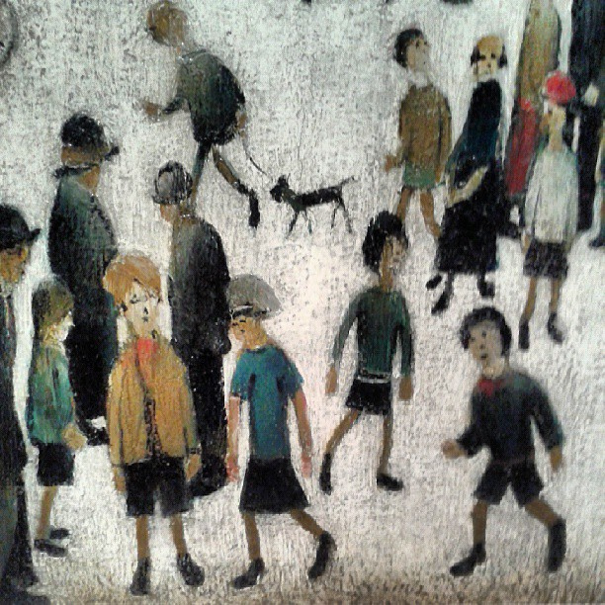
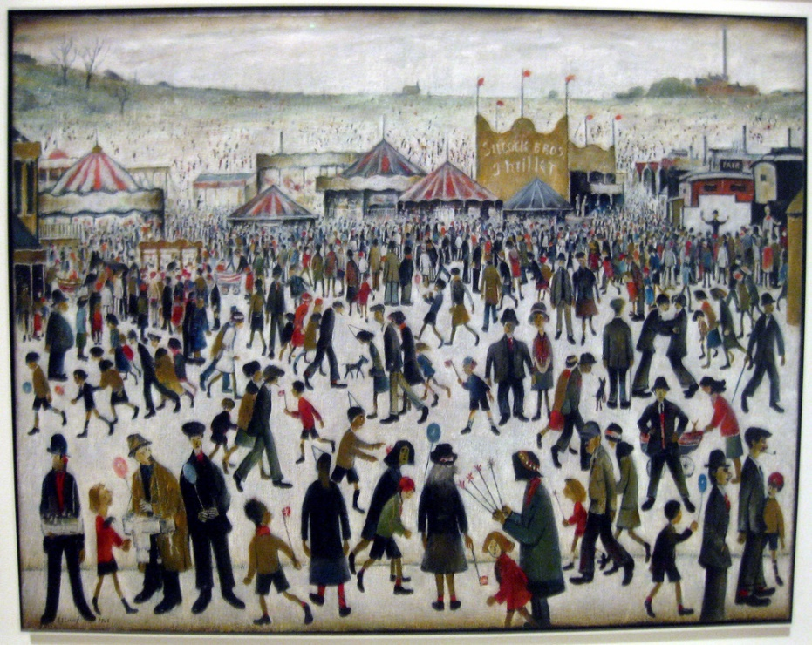
Who is L.S. Lowry?
L.S. Lowry is one of Britain’s most famous artists from the 19th Century.
L.S. Lowry is particularly well known for painting industrial scenes and matchstick characters.
Photos courtesy of Rich_Lem and Diego Sideburns (@flickr.com) - granted under creative commons licence - attribution

Slide 3
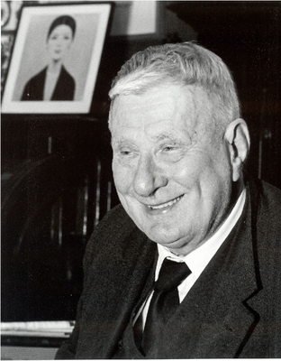
About L.S. Lowry
His full name is Laurence Stephen Lowry.
He was born in Stretford, Manchester, on 1st November 1887.
Even though he was an artist, he had a ‘normal’ everyday job as well. His main job was being a rent collector in Manchester. He worked all his life until he retired when he was 65.
He liked being alone and kept himself to himself, he never got married or had children.
He died on 23rd February 1976, in Glossop, Derbyshire.
Photos courtesy of Karen V Bryan and oknovokght (@flickr.com) - granted under creative commons licence - attribution

Slide 4
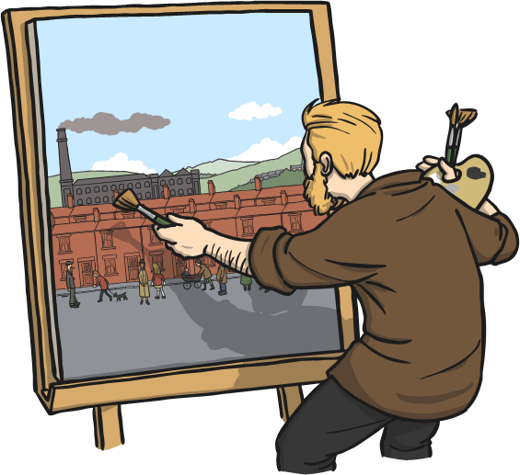
Life as an Artist
One day Laurence Stephen Lowry had been going about his job collecting rent and had missed a train, he found himself mesmerised by the streets and buildings surrounding him in the part of Manchester he was in and felt like he had to draw them. This is how he began life as an artist.
He is best known for his pictures of industrial scenes of towns in the north of England, including his home town of Manchester.
His pictures would include buildings like factories and cotton mills, with lots of workers and passers-by.
The people in his pictures were not very
detailed, in fact they are often called
‘matchstick men.’
In 1978 a song called ‘Matchstick Men and
Matchstick Cats and Dogs’ was written as a
tribute to Lowry. It made it to Number 1
in the charts.

Slide 5
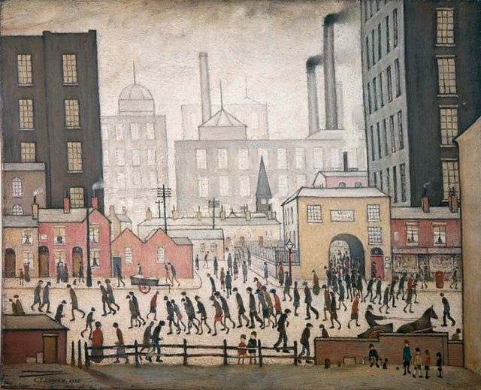
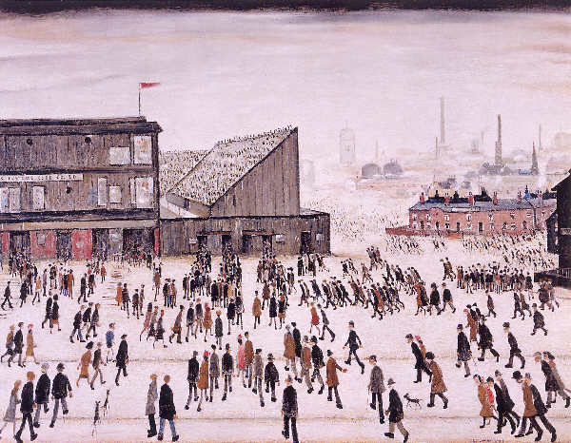
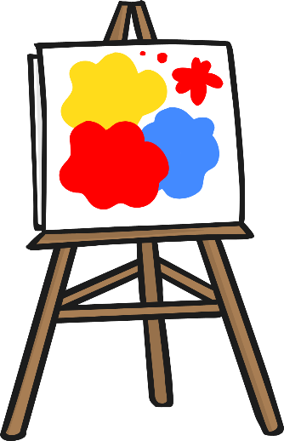

Famous Paintings
Here are some pictures of L.S. Lowry’s famous paintings.
Photos courtesy of Northshore School of Art and mrrobertwade (@flickr.com) - granted under creative commons licence - attribution

Slide 6
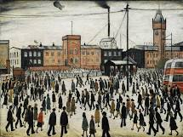
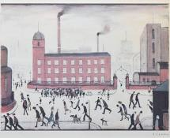
Famous Paintings
Here are some pictures of L.S. Lowry’s famous paintings.
Photos courtesy of Northshore School of Art and mrrobertwade (@flickr.com) - granted under creative commons licence - attribution

Slide 7
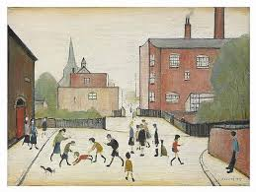
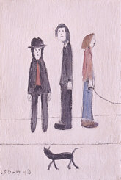
Famous Paintings
Here are some pictures of L.S. Lowry’s famous paintings.
Photos courtesy of Northshore School of Art and mrrobertwade (@flickr.com) - granted under creative commons licence - attribution

Slide 8
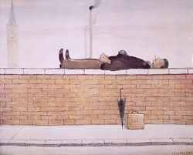
Famous Painting
Here are some pictures of L.S. Lowry’s famous paintings.
Photos courtesy of Northshore School of Art and mrrobertwade (@flickr.com) - granted under creative commons licence - attribution

Slide 9
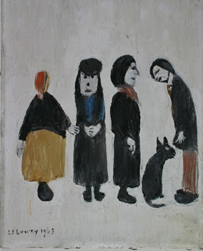
Famous Painting
Here are some pictures of L.S. Lowry’s famous paintings.
Photos courtesy of Northshore School of Art and mrrobertwade (@flickr.com) - granted under creative commons licence - attribution

Slide 10
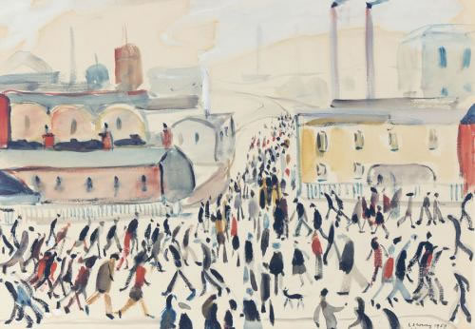
Famous Painting
Here are some pictures of L.S. Lowry’s famous paintings.
Photos courtesy of Northshore School of Art and mrrobertwade (@flickr.com) - granted under creative commons licence - attribution

Slide 11
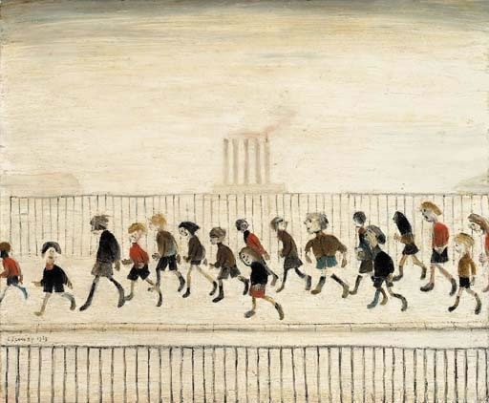
Famous Painting
Here are some pictures of L.S. Lowry’s famous paintings.
Photos courtesy of Northshore School of Art and mrrobertwade (@flickr.com) - granted under creative commons licence - attribution

Slide 12
For your art activity today you will need a piece of paper, a black pencil or felt tip and some colours.
We are going to make our own picture in the style of Lowry or you can choose your favourite Lowry painting and do your own version.
First get your piece of paper and a black pen or pencil and draw some people in the style of Lowry. Look at the legs and arms of the people that Lowry drew and draw your own people. His people were known as ‘matchstick men’ which means that they had thin legs and bodies as thin as a matchstick.
After you have drawn your people you need to then think of which buildings you would like in the background of your picture. When you have decided what you want in the background you need to draw your buildings.

Slide 13
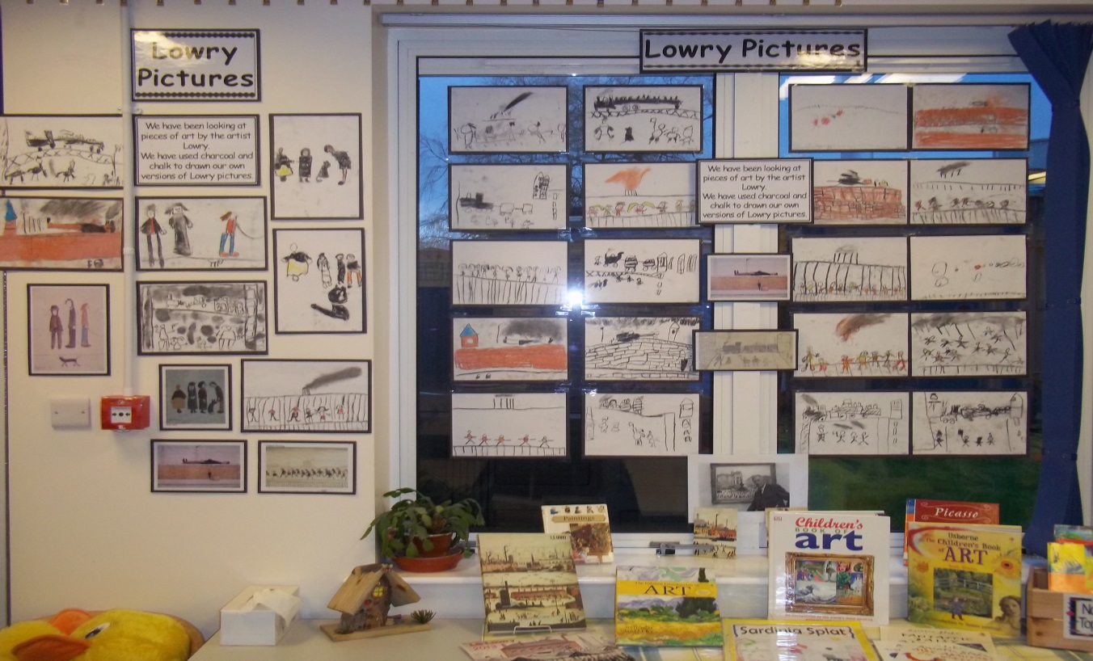
It is up to you if you want to use colour in your picture because Lowry sometimes did his pictures in black and white too.
Below are some photographs of the Lowry pictures from last years class for you to look at.
Photos courtesy of Northshore School of Art and mrrobertwade (@flickr.com) - granted under creative commons licence - attribution

