Slide 2
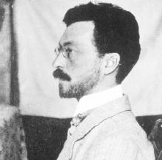
Wassily Kandinsky (1866 - 1944)
Wassily Kandinsky was
a Russian painter.
Many people think he was
the first abstract artist.
Abstract art is a combination of colors, lines, and shapes that are not meant to be realistic.
Photo courtesy of Playing Futures: Applied Nomadology (@flickr.com) - granted under creative commons licence – attribution

Slide 3
All About Wassily Kandinsky
Wassily Kandinsky was born in Russia in 1866. When he grew up, he worked as a university teacher, but it didn’t make him happy.
When he was 30, he left his job and went to art school. He found art school easy and excelled at his studies.
Kandinsky thought a lot about colors and how they make people feel. He believed that colors had a soul.
Wassily Kandinsky

Slide 4
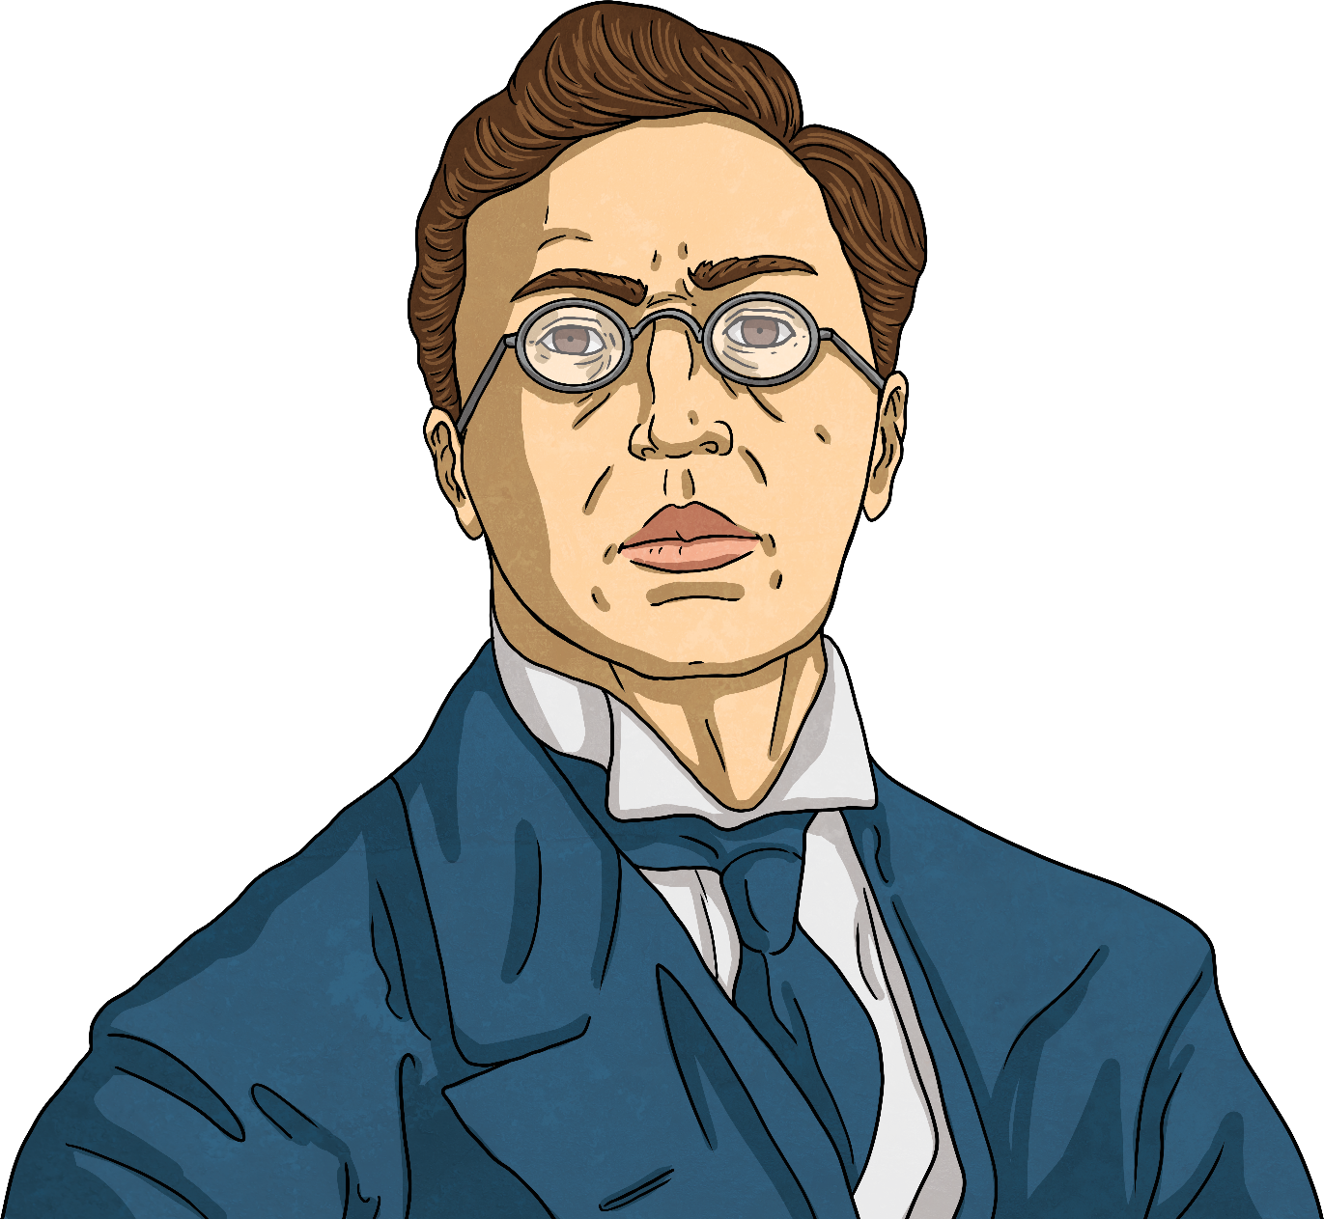
All About Wassily Kandinsky
Kandinsky was the first painter to stop painting pictures of real things and instead paint just using colors and shapes. He believed that this let him paint honestly about his feelings.
Often Kandinsky would listen to music while he painted and try to paint what he heard.
Other painters that came after him learned a lot from Kandinsky’s ideas.

Slide 5
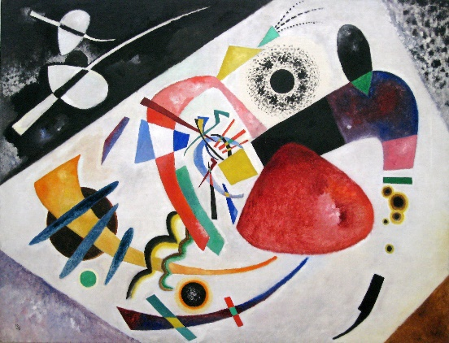
Here are some of his paintings.
Red Spot II (1921)
by Wassily Kandinsky
Photo courtesy of Sharon Mollerus (@flickr.com) - granted under creative commons licence – attribution

Slide 6
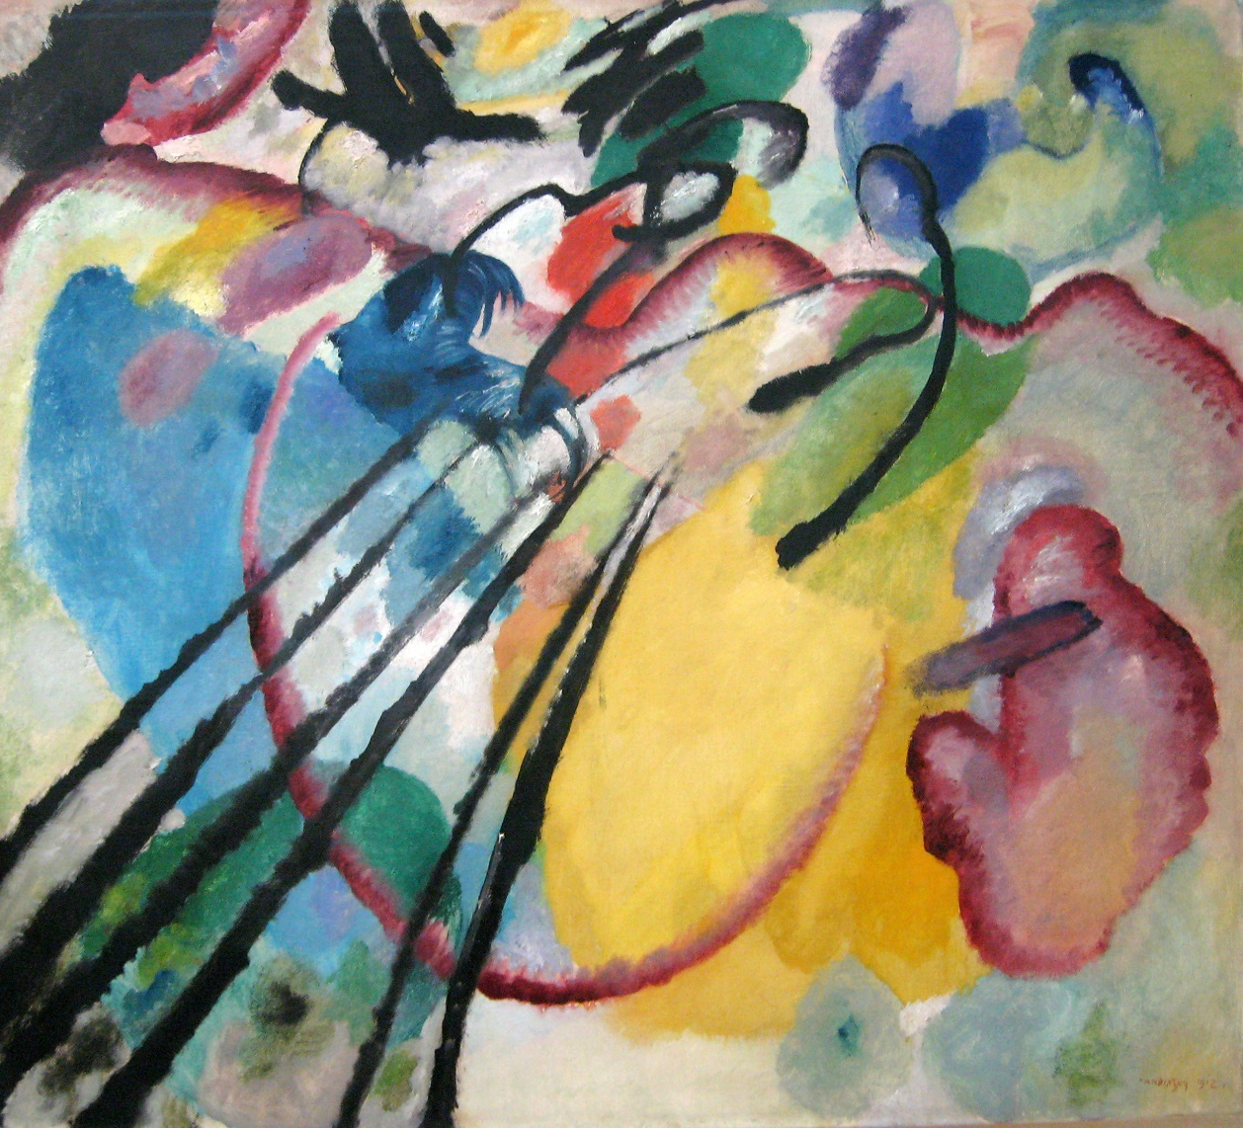
Improvisation 26 (Rowing) (1912)
by Wassily Kandinsky
Photo courtesy of Sharon Mollerus (@flickr.com) - granted under creative commons licence – attribution

Slide 7
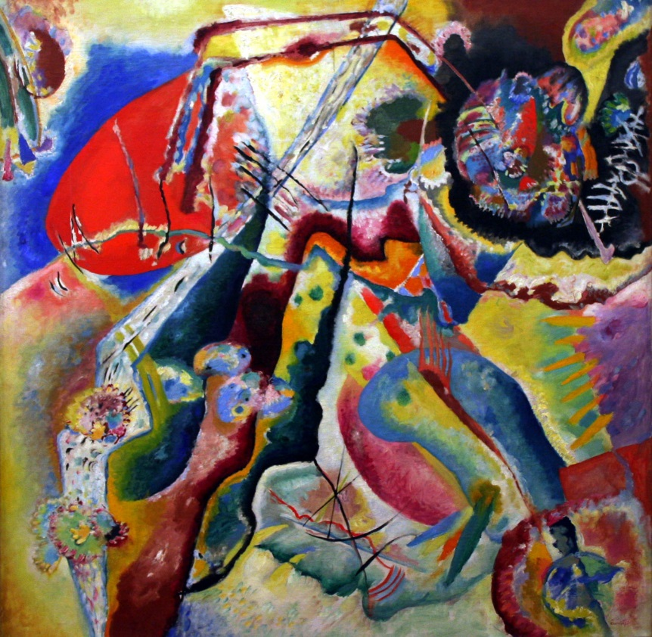
Abstract Painting
by Wassily Kandinsky
Photo courtesy of Playing Futures: Applied Nomadology (@flickr.com) - granted under creative commons licence – attribution

Slide 8
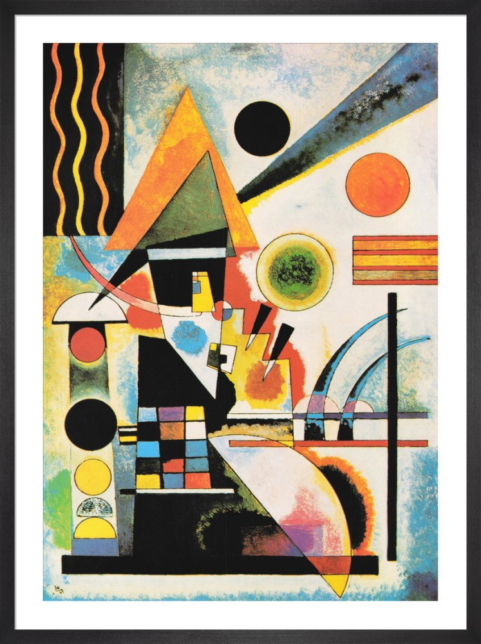
Swinging 1925
by Wassily Kandinsky
Photo courtesy of Playing Futures: Applied Nomadology (@flickr.com) - granted under creative commons licence – attribution

Slide 9
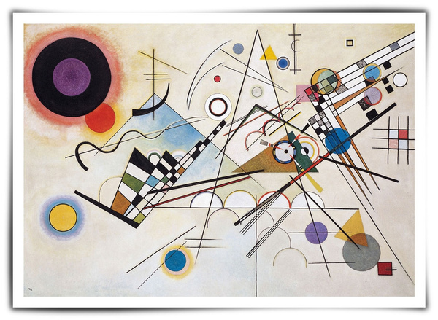
by Wassily Kandinsky
Photo courtesy of Playing Futures: Applied Nomadology (@flickr.com) - granted under creative commons licence – attribution

Slide 10
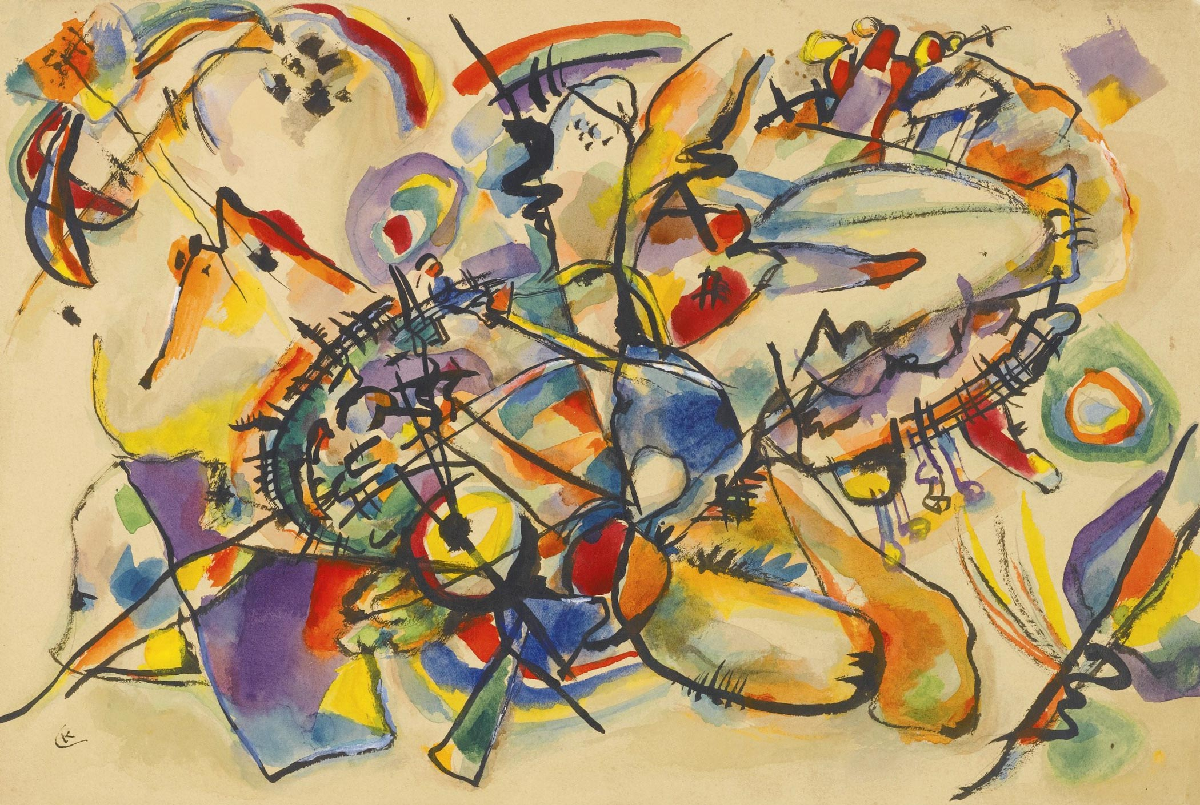
by Wassily Kandinsky
Photo courtesy of Playing Futures: Applied Nomadology (@flickr.com) - granted under creative commons licence – attribution

Slide 11
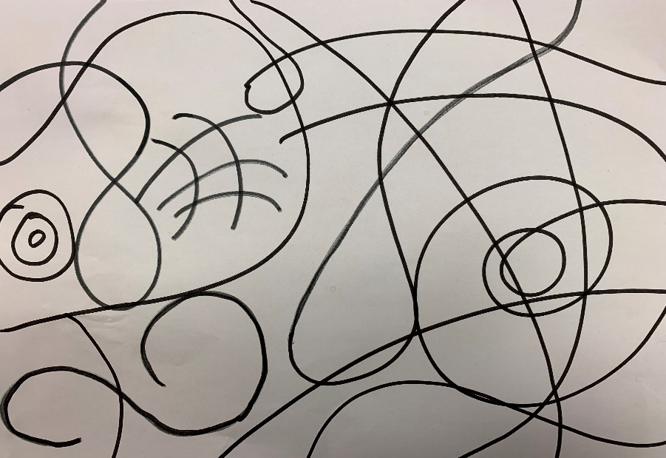
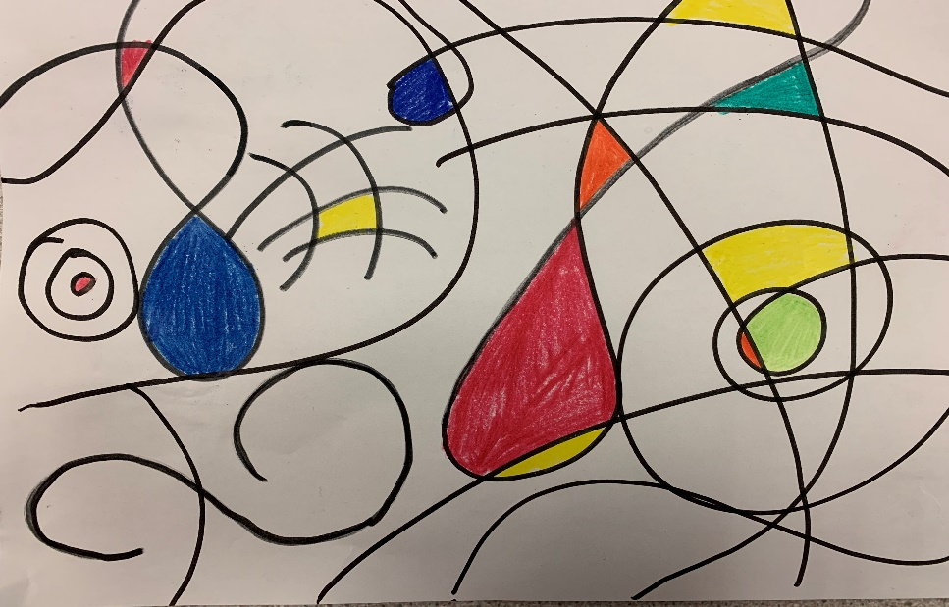
For your art activity today you will need a piece of paper, a black pencil or felt tip and some colours.
We are going to make our own picture in the style of Kandinsky.
First get your piece of paper and a black pen or pencil and draw some squiggly lines and shapes like in example 1 below.
Then get your colours and colour in different parts of the picture – like in example 2 below. You can colour all of the different parts or just some of the parts.
Example 1 Example 2

Slide 12
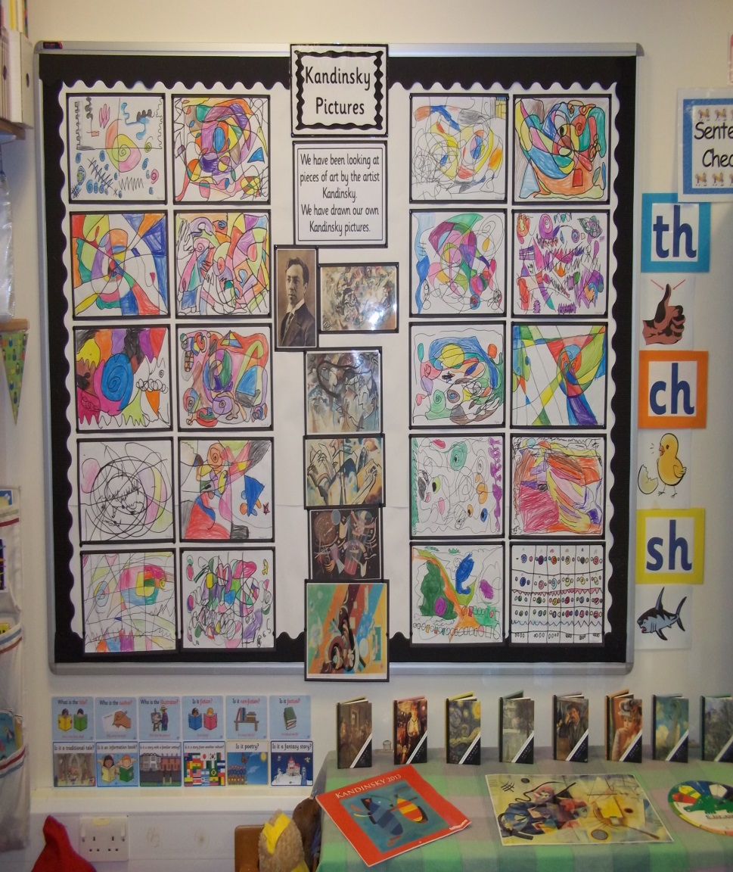
You do not have to colour all of the parts but you can if you want to.
You are creating your own piece of art. You are not copying a Kandinksy picture but you are making your very own that is in the style of Kandinsky.
You can use any colours for your Kandinsky picture they don’t have to be only primary colours.
Below are some photographs of the Kandinsky pictures from last years class for you to look at.

