Slide 1
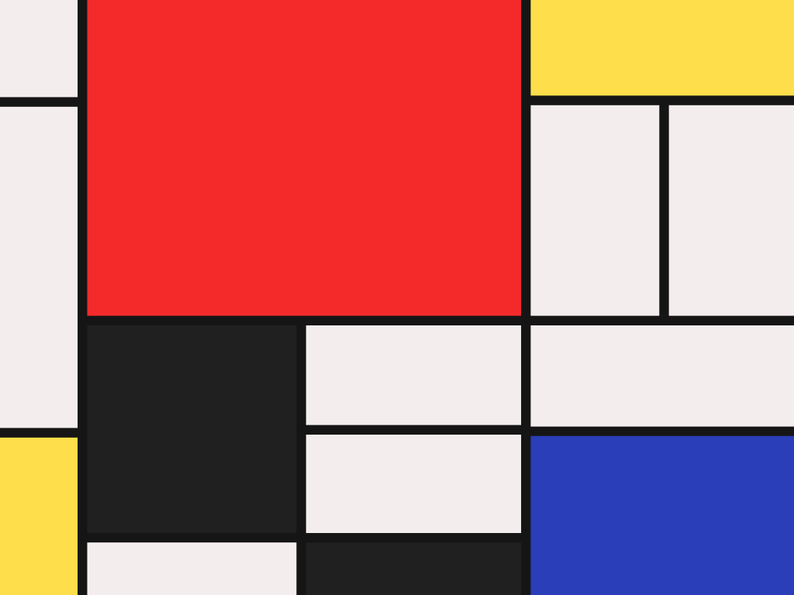
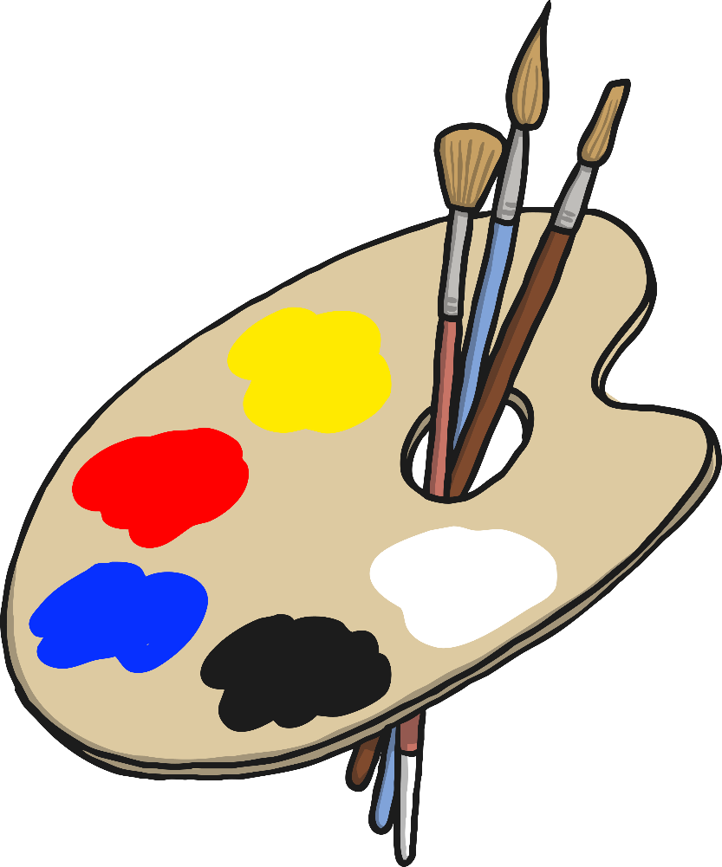

Piet Mondrian

Slide 2
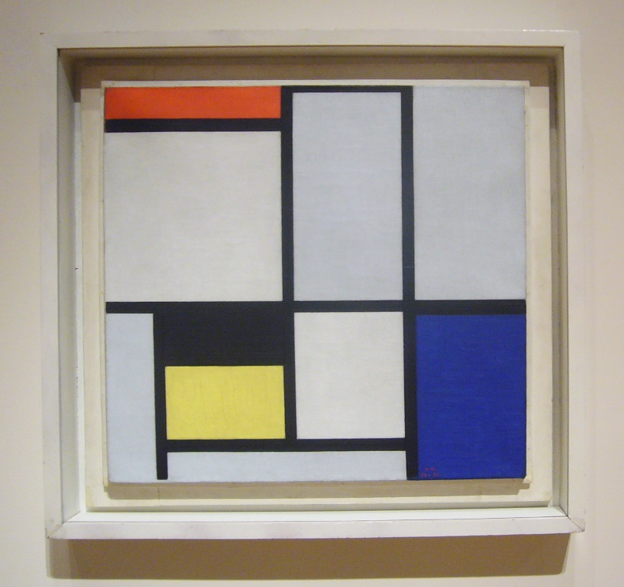
Piet Mondrian
Piet Mondrian was an artist who liked to use primary colours.
Composition No. III
by Piet Mondrian
Photo courtesy of Kent Wang (@flickr.com) - granted under creative commons licence – attribution

Slide 3
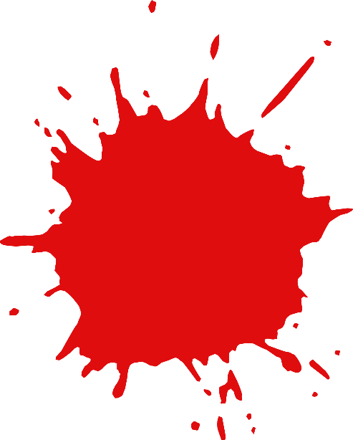
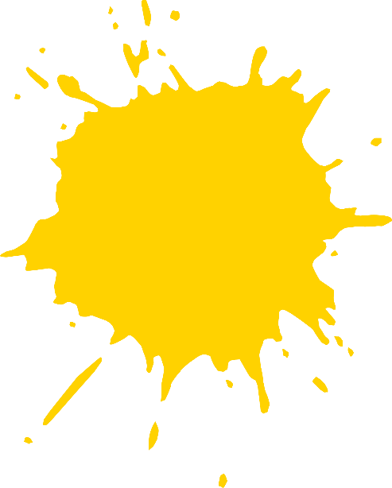

Red, yellow and blue are the primary colours.
Primary colours can’t be made by mixing any other colour.

Slide 4

Primary Colours

Slide 5
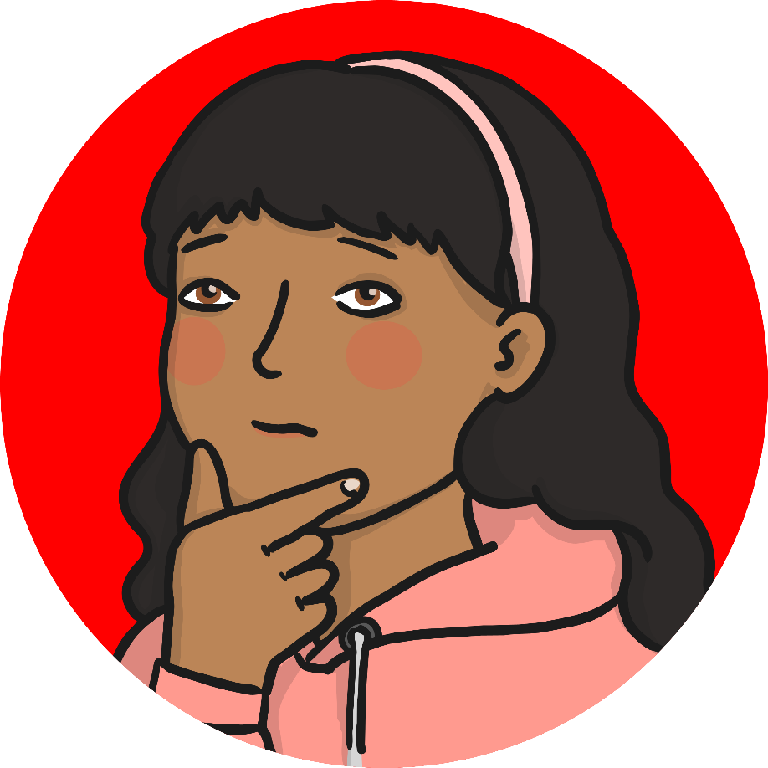
Red
Red is a primary colour. Can you think of things that are red?

Slide 6

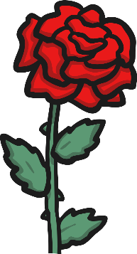
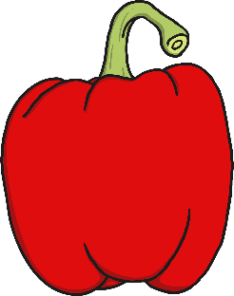
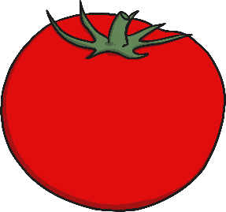
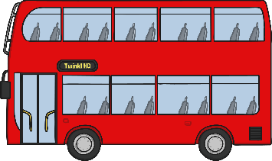

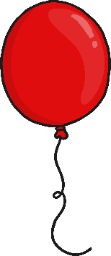
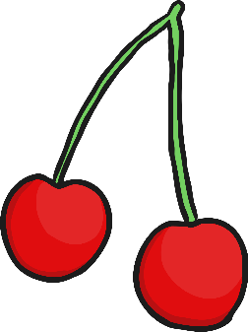

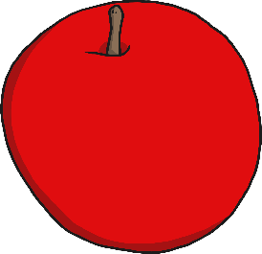
Red

Slide 7
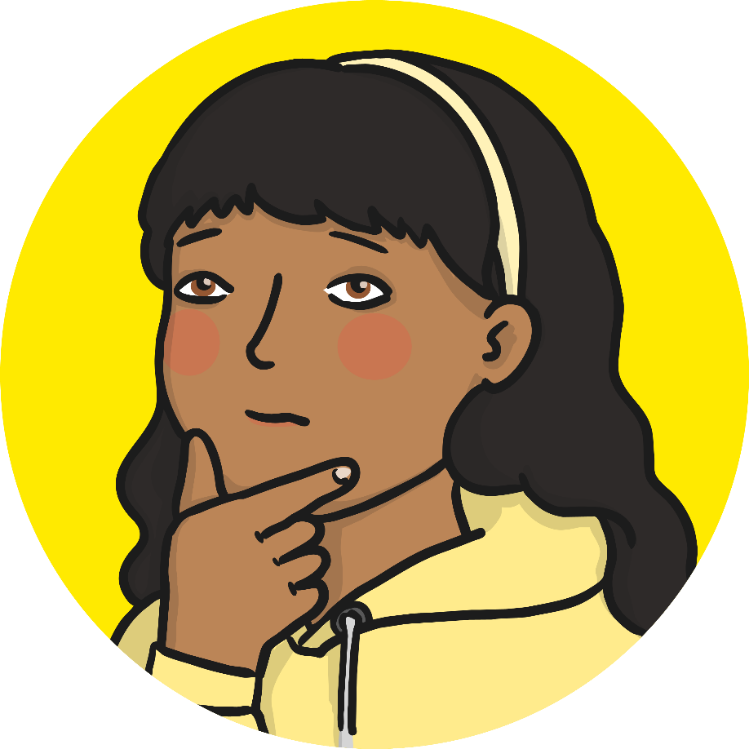
Yellow
Yellow is a primary colour. Can you think of things that are yellow?

Slide 8
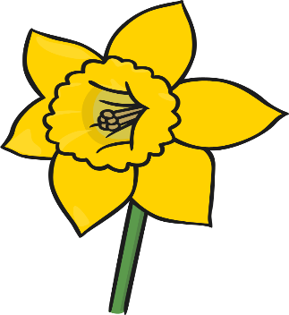

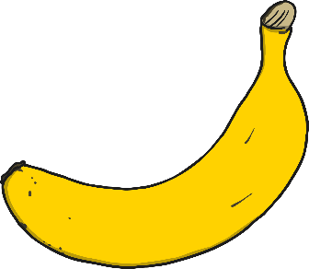




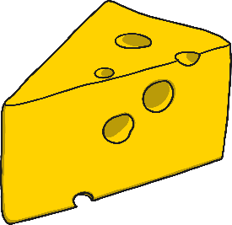


Yellow

Slide 9

Blue
Blue is a primary colour. Can you think of things that are blue?

Slide 10
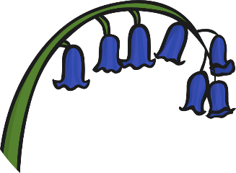




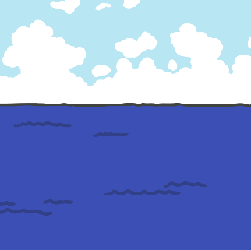
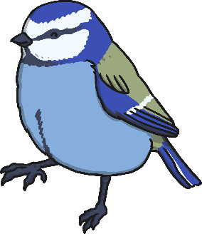
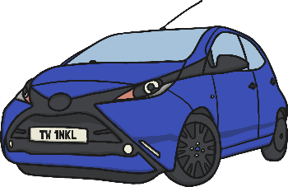
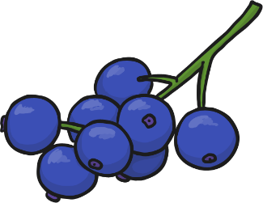

Blue

Slide 11









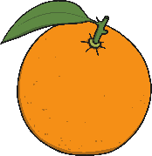
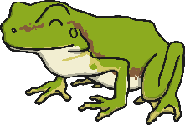
Can you sort the objects?
Click here to reveal the answers!
Primary
Not primary

Slide 12
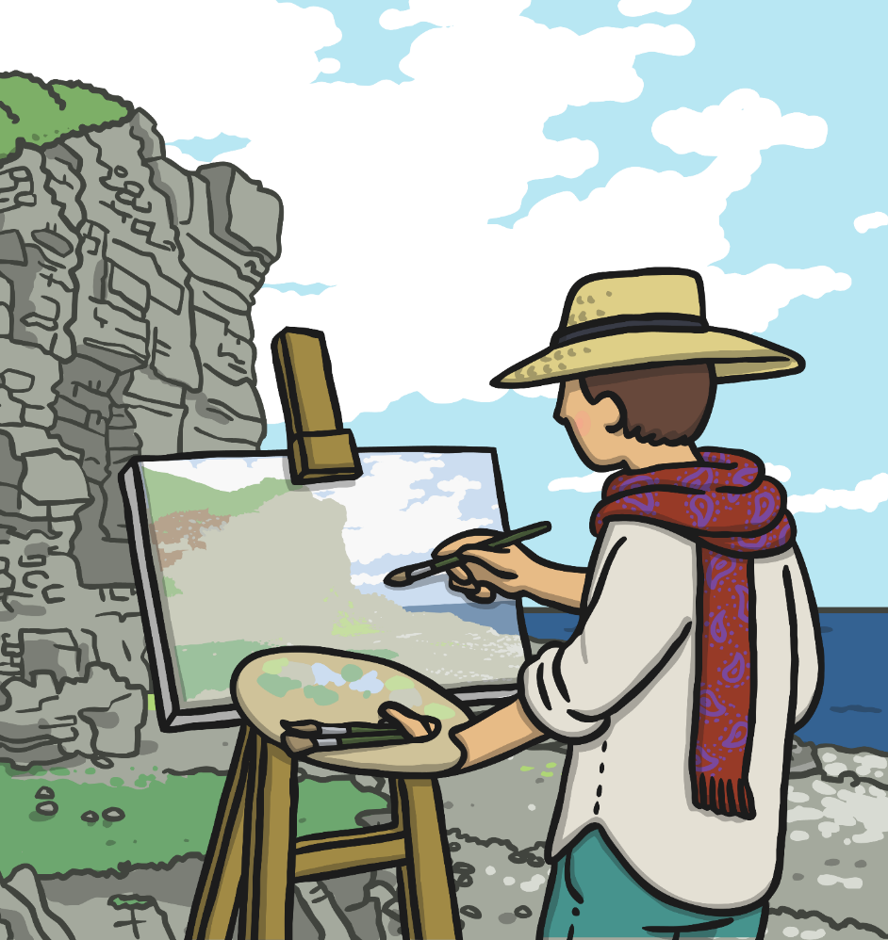
All About Piet Mondrian
(1872 - 1944)
Dutch
Piet Mondrian was born in the Netherlands in 1872. His father and uncle were both artists so he was introduced to art at a very young age.
Mondrian’s first job was as a teacher but he enjoyed painting at the same time.
His first paintings were called ‘landscapes’, which means that he painted things he could see in the countryside around where he lived.

Slide 13
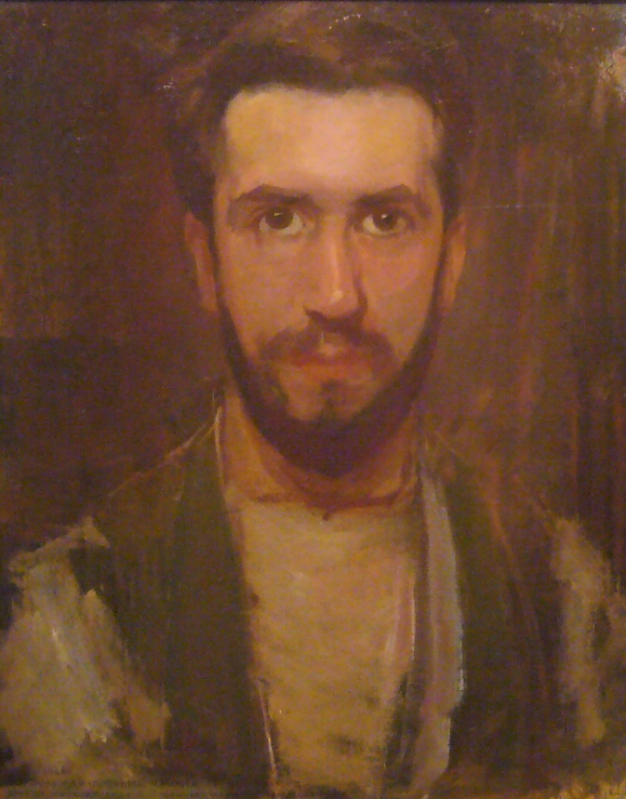
All About Piet Mondrian
(1872 - 1944)
Dutch
Over time Mondrian became interested in abstract art. Abstract art doesn’t show pictures of things but uses colours, lines and shapes to express how the artist is feeling.
Mondrian liked to paint using the primary colours with black lines and white spaces.
Self Portrait (c1900)
by Piet Mondrian
Photo courtesy of Kent Wang (@flickr.com) - granted under creative commons licence – attribution

Slide 14
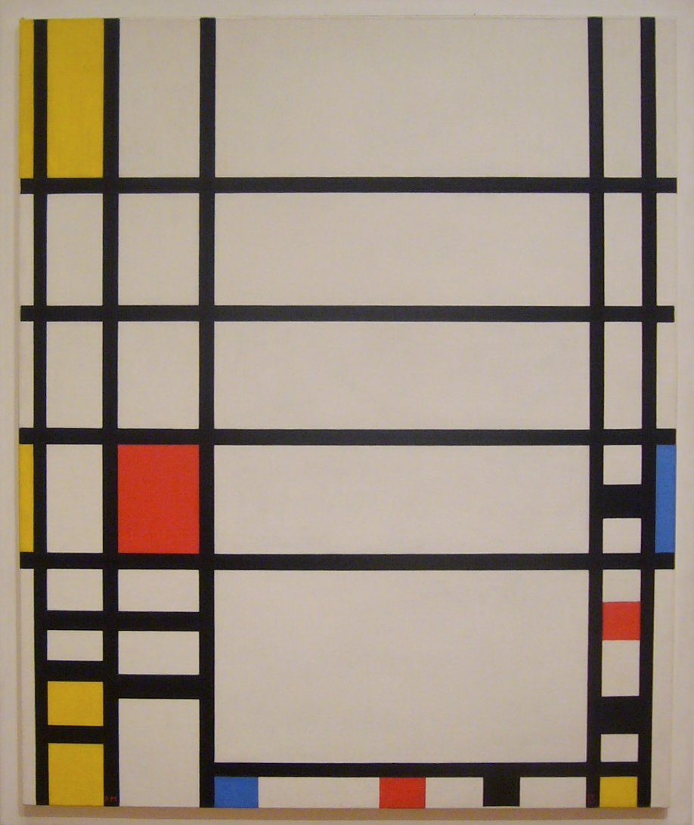
Trafalgar Square (1939 – 1943)
by Piet Mondrian
Photo courtesy of Kent Wang (@flickr.com) - granted under creative commons licence – attribution

Slide 15
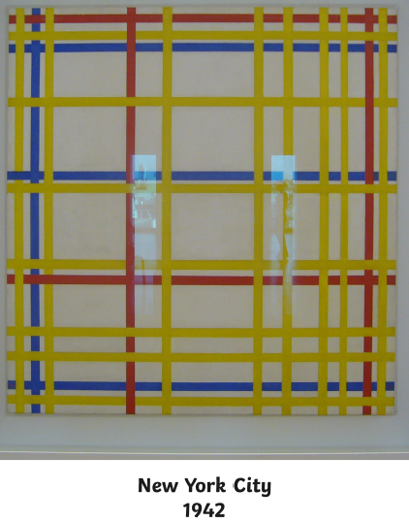

Slide 16
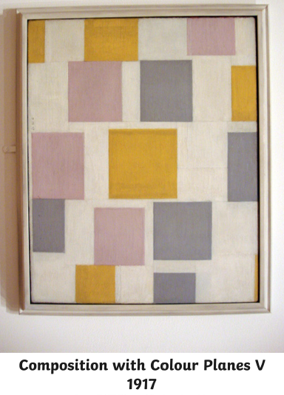

Slide 17
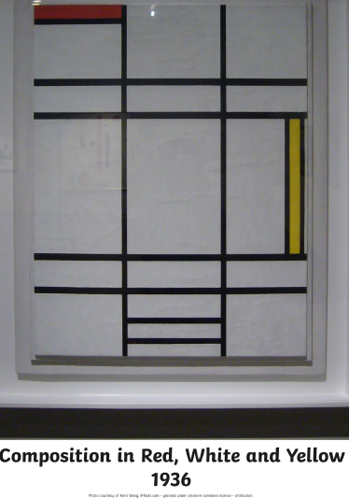

Slide 18
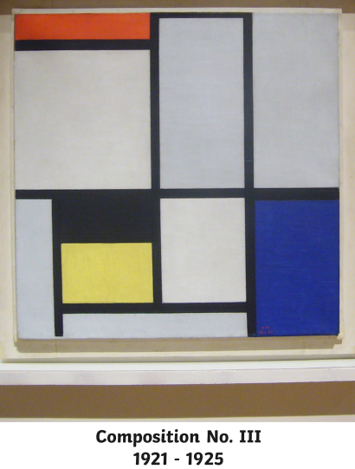

Slide 19
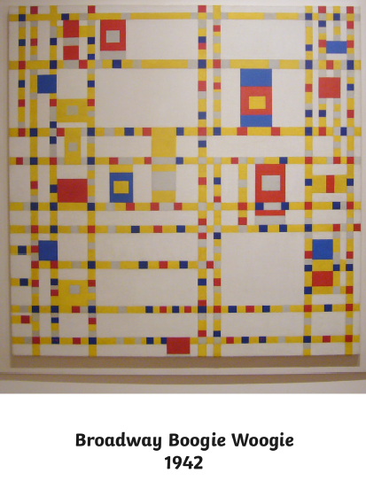

Slide 20
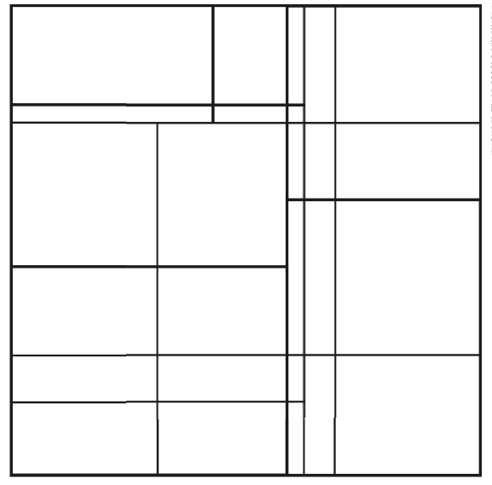
For your art activity today you will need a piece of paper, a black pencil or felt tip and some colours.
We are going to make our own picture in the style of Mondrian.
First get your piece of paper, ruler and black pen or pencil and draw some straight lines like in the example below.
Be careful using your ruler. You must keep one hand on the ruler whilst you draw the line using your other hand.

Slide 21
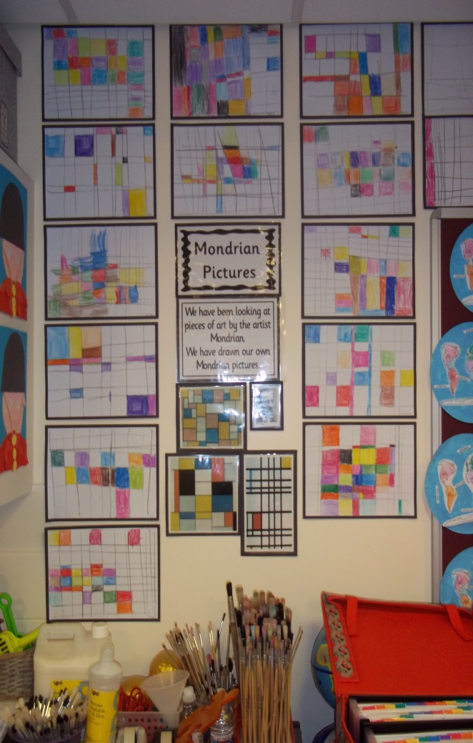
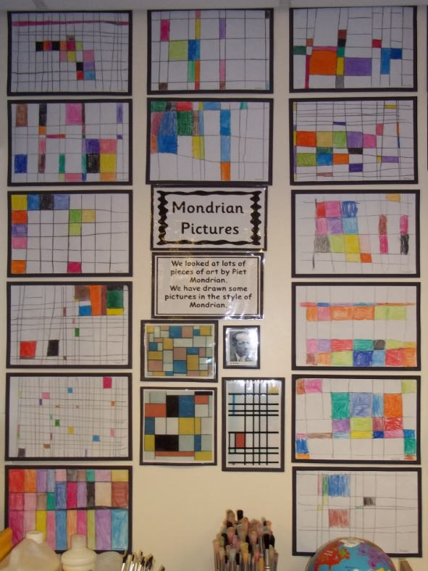
After you have drawn your black lines you need to colour in the boxes just like Mondrian did.
You do not have to colour all of the boxes but you can if you want to.
You are creating your own piece of art. You are not copying a Mondrian picture but you are making your very own that is in the style of Mondrian.
Mondrian only used primary colours but you can use any colour that you want.
Below is a photograph of the Mondrian pictures from last year for you to look at.

