Slide 1
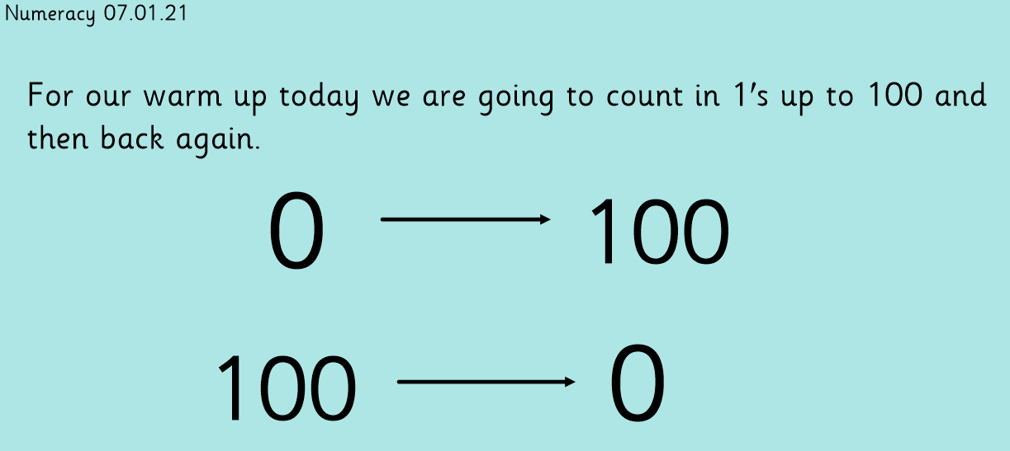

Slide 3
Aim
To understand what an odd number is.
To understand what an even number is.

Slide 4

What Is An Even Number?
Even numbers are numbers which can be laid out in pairs.
You can count up in 2s and the numbers will always be even, because you are always adding another pair.
4
2
0
6
8

Slide 5
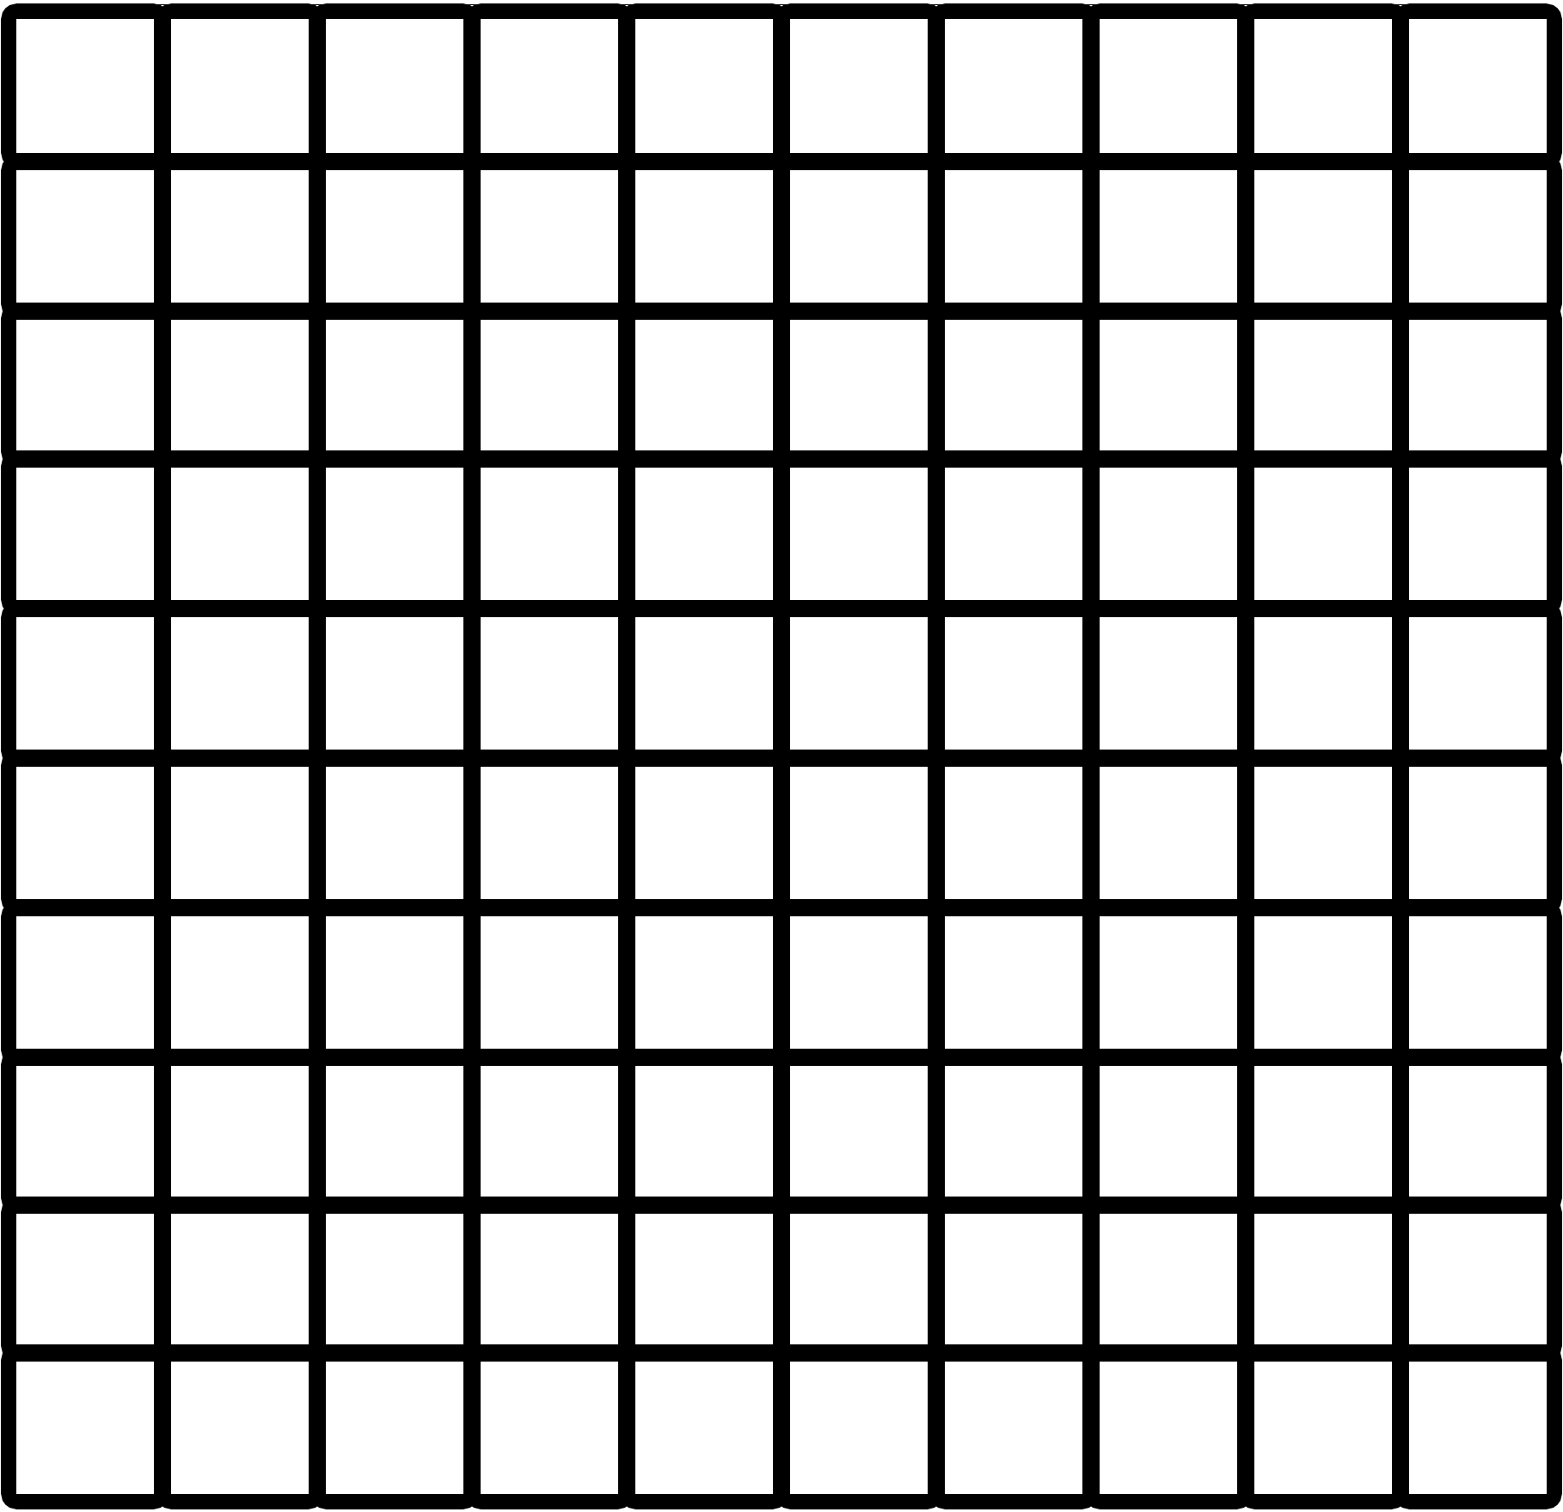
What Is An Even Number?
1
2
3
4
5
6
7
8
9
10
11
12
13
14
15
16
17
18
19
20
21
22
23
24
25
26
27
28
29
30
31
32
33
34
35
36
37
38
39
40
41
42
43
44
45
46
47
48
49
50
51
52
53
54
55
56
57
58
59
60
61
62
63
64
65
66
67
68
69
70
71
72
73
74
75
76
77
78
79
80
81
82
83
84
85
86
87
88
89
90
91
92
93
94
95
96
97
98
99
100

Slide 6
What Is An Even Number?
Even numbers can be small or they can be very big.
If a number ends in a 0, 2, 4, 6 or 8, it is an even number.
14
20
36
100
252
112
18

Slide 7





What Is An Odd Number?
Odd numbers are different.
They are never in the 2 times table.
(They might be in other times tables, however!)
1
3
5
7
9
Click for interesting fact!
There is always an odd one out.

Slide 8
What Is An Odd Number?
1
2
3
4
5
6
7
8
9
10
11
12
13
14
15
16
17
18
19
20
21
22
23
24
25
26
27
28
29
30
31
32
33
34
35
36
37
38
39
40
41
42
43
44
45
46
47
48
49
50
51
52
53
54
55
56
57
58
59
60
61
62
63
64
65
66
67
68
69
70
71
72
73
74
75
76
77
78
79
80
81
82
83
84
85
86
87
88
89
90
91
92
93
94
95
96
97
98
99
100

Slide 9
What Is An Odd Number?
Like even numbers, odd numbers can be small or they can be very big.
If a number ends in a 1, 3, 5, 7 or 9, it is an odd number.
11
23
39
99
109
117
225

Slide 10

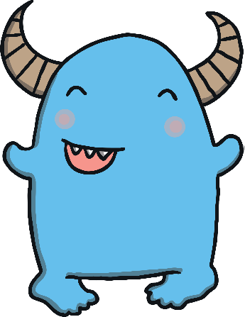
Number Cruncher Poems
1 3 5 7 9
I’m a number cruncher and my name is Todd,
I like numbers that are odd,
All these numbers taste just fine,
If they end in 1, 3, 5, 7, or 9!
0 2 4 6 8
I’m a number cruncher and my name is Steven,
I like numbers that are even,
All these numbers taste just great,
If they end in 0, 2, 4, 6, or 8!

Slide 11


Can You Sort These Numbers?
When your teacher says a number, put it in either the odd or even column. Click on the numbers to reveal the answers!
7
1
15
3
4
20
6
13
11
9
5
16
19
10
12
18
2
17
8
14
Odd
Even

Slide 12
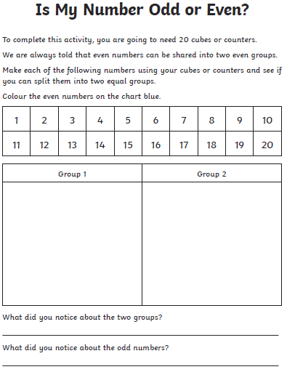
For your activity today you need to complete the worksheet titled ‘Is my number odd or even?’
There are three different worksheets here to use. The first one uses numbers up to 20, the second worksheet uses numbers to 50 and the third worksheet uses numbers to 100.
Please choose the sheet that you wish to complete. I would expect you all to be able to do the first sheet easily.

