Slide 1


Slide 2


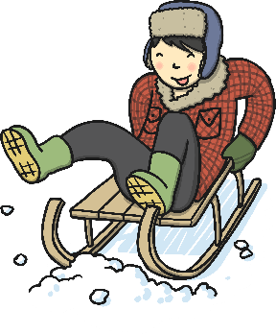

Winter Weather
What do you already know about winter? Tell your partner.

Slide 3
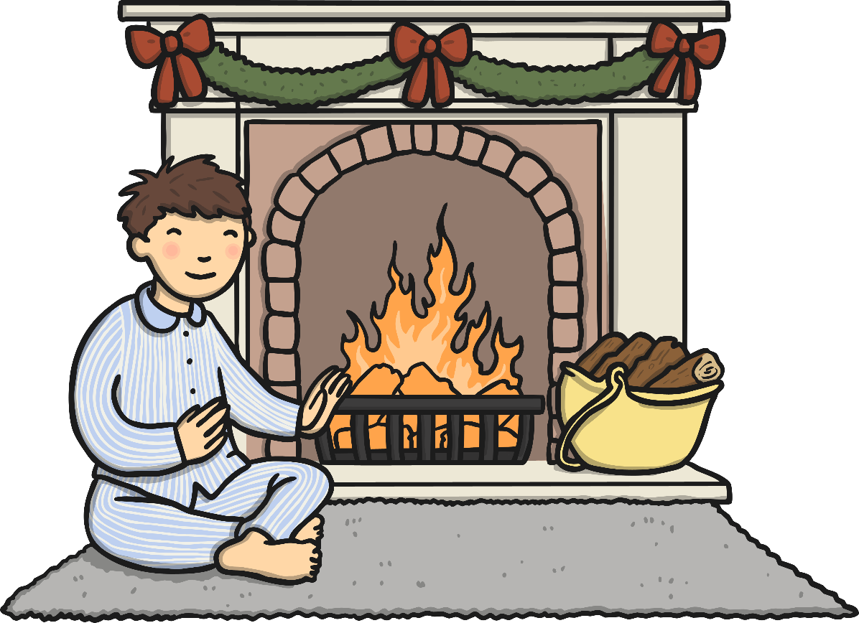
How People Adapt
Think about what you and your family do during the winter. Use these questions to help you.
What do you wear in winter?
How do you keep warm indoors and outdoors?
What do like to eat in the winter?
What do you do after school?

Slide 4
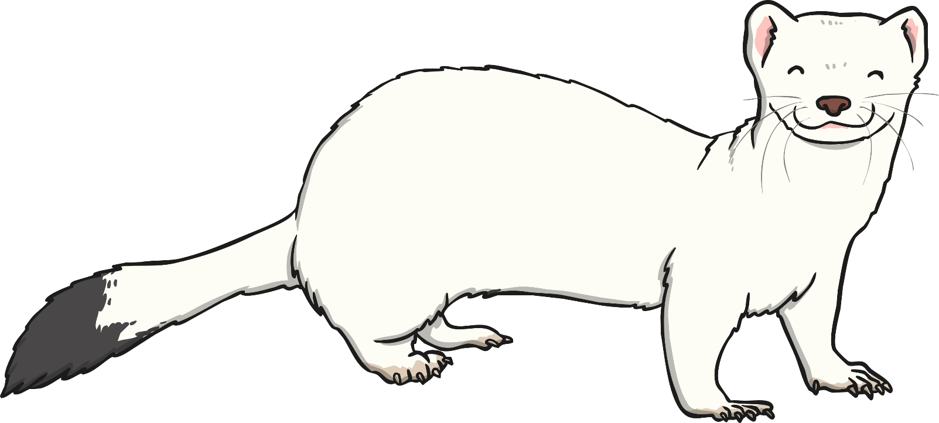
How Animals Adapt
Think about what animals might have to do during the winter. Use these questions to help you.
Where do they go?
How do they keep warm?
How do they find food?

Slide 5
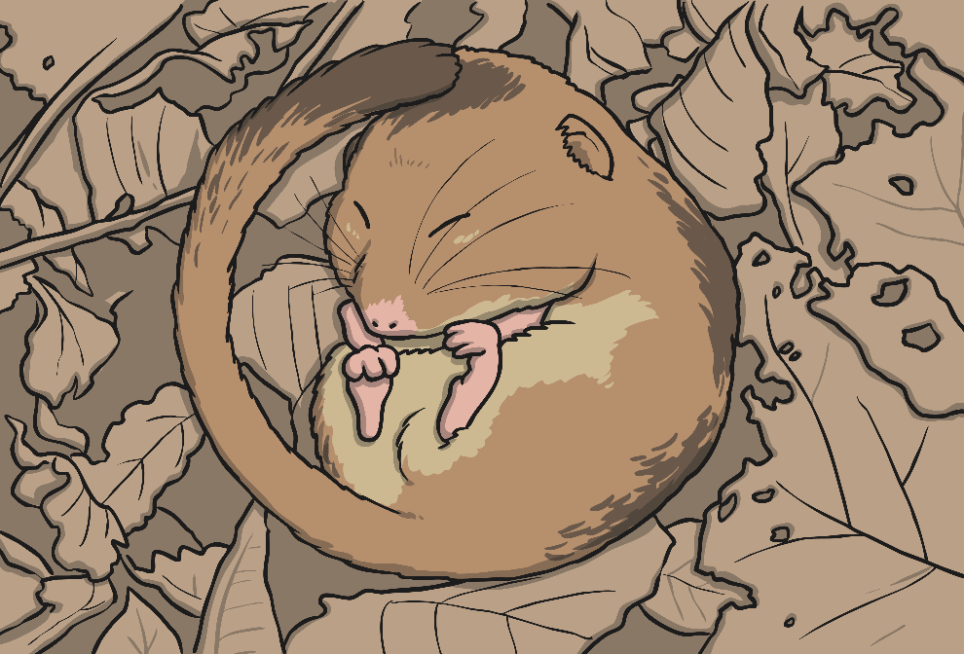
How Animals Survive Winter
Animals cope with winter weather by doing one of the following things…
Hibernate: Some animals hibernate for some, or all, of the winter because the weather is cold and it is hard to find food. They find a safe place and fall into a very deep sleep. They don’t need to eat because during the autumn they eat extra food to help feed them in winter.

Slide 6
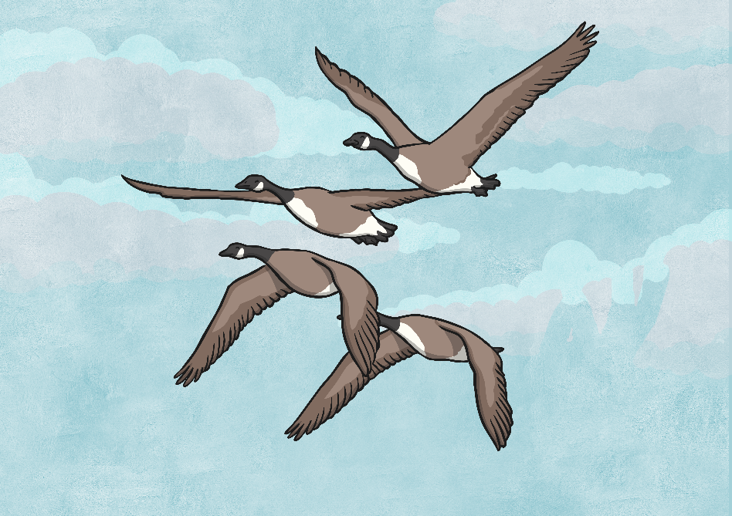
How Animals Survive Winter
Animals cope with winter weather by doing one of the following things…
Migrate– Some animals migrate, which means they travel to another place where the weather is warmer and it’s easier to find food.

Slide 7
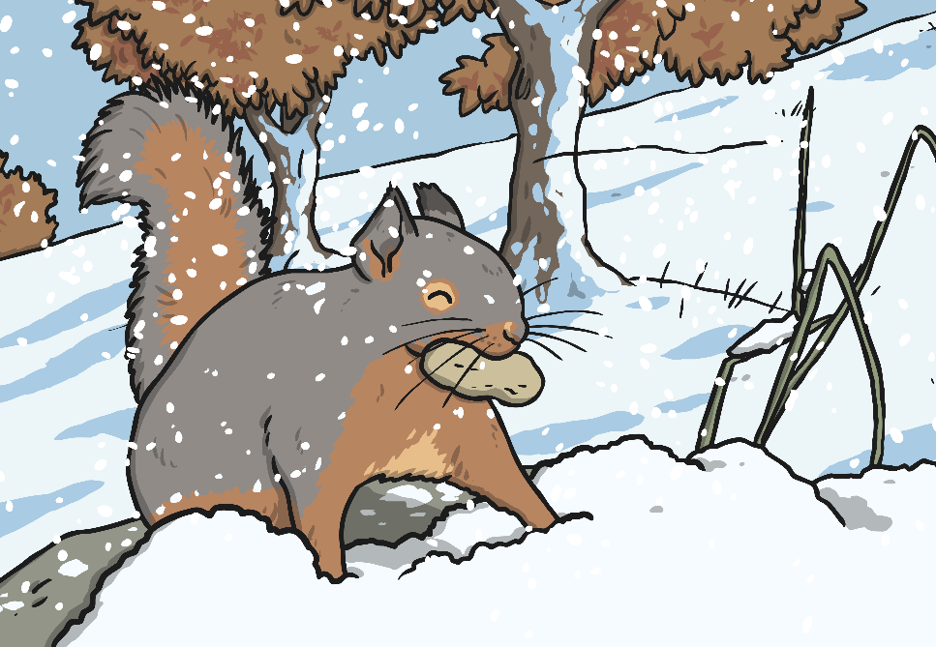
How Animals Survive Winter
Animals cope with winter weather by doing one of the following things…
Adapt – Some animals adapt, which means they change their behaviour or bodies. Some animals grow thicker fur to keep warm, some eat food which they have collected in the autumn and saved for winter, and other animals eat different kinds of food as the seasons change.

Slide 8
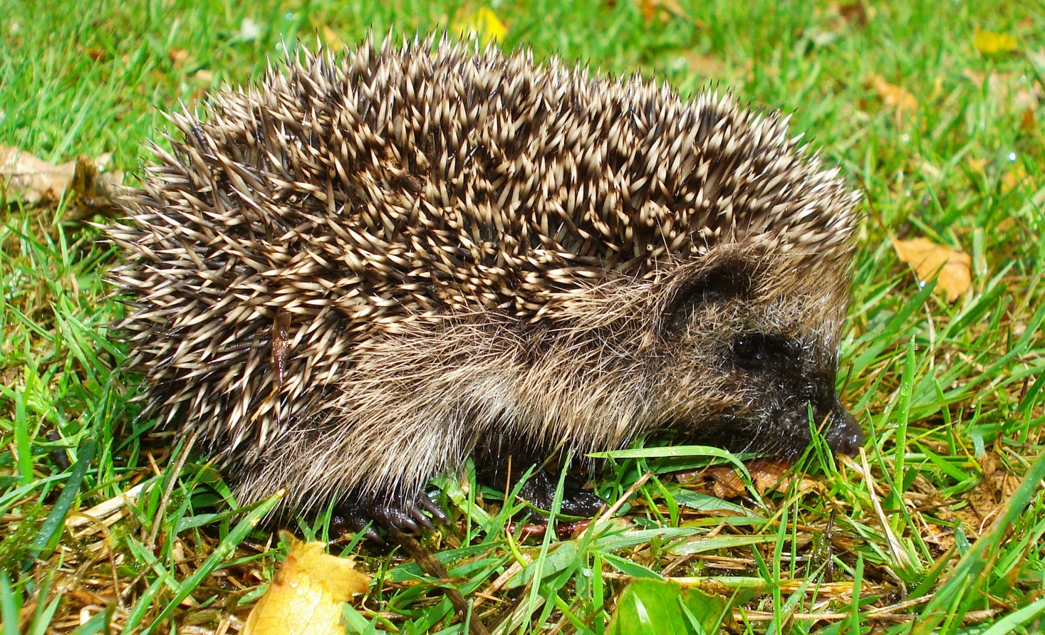
How Animals Survive Winter
Hedgehogs hibernate.
Photo courtesy of Mick E. Talbot (@flickr.com) - granted under creative commons licence - attribution

Slide 9
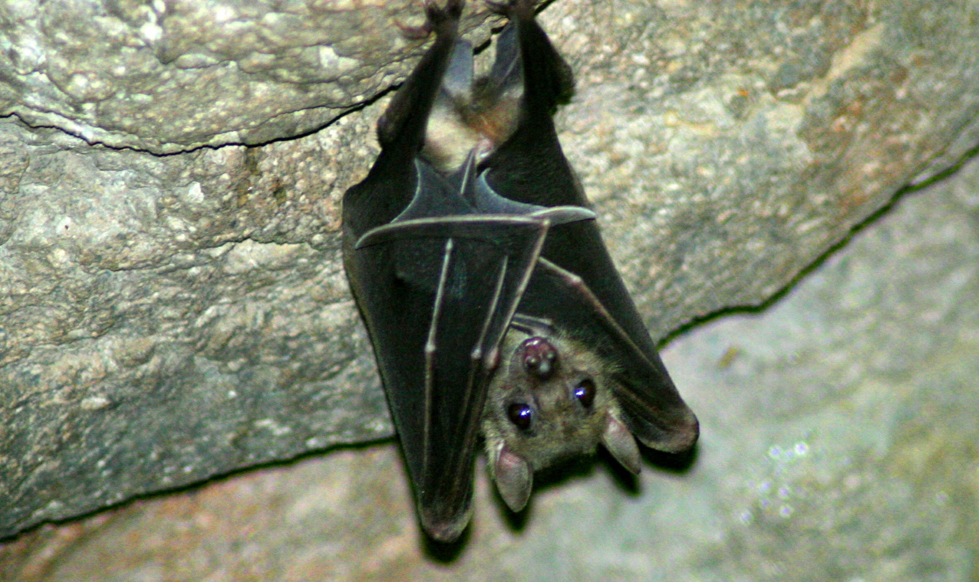
How Animals Survive Winter
Bats hibernate.
Photo courtesy of chimothy27 (@flickr.com) - granted under creative commons licence - attribution

Slide 10
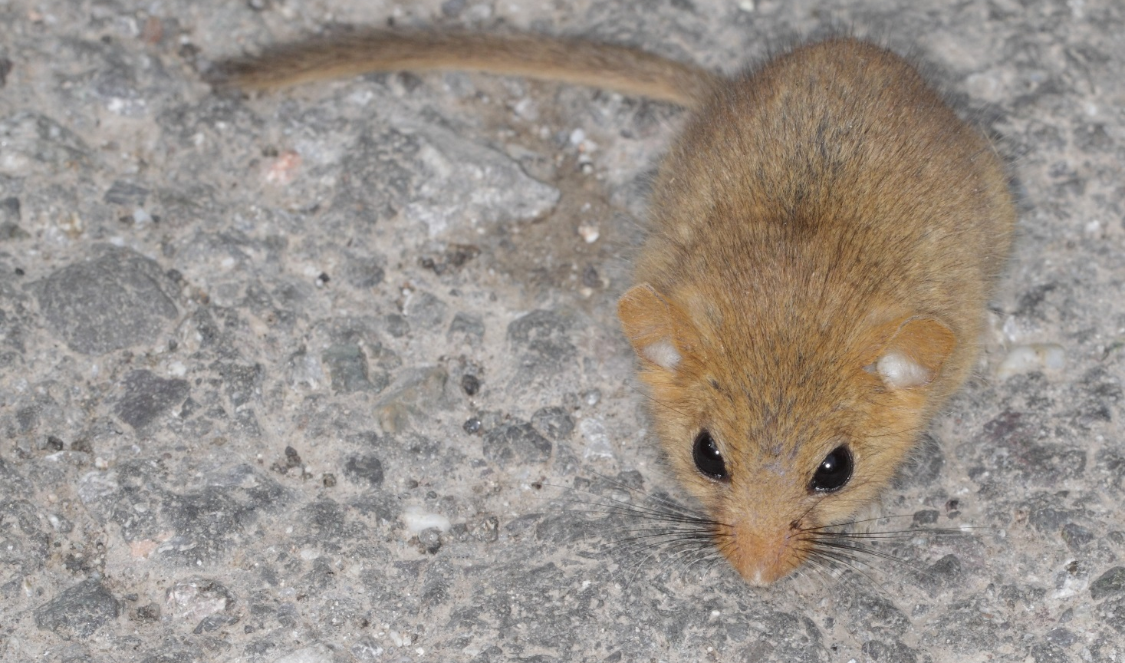
How Animals Survive Winter
Dormice hibernate.
Photo courtesy of gbohne (@flickr.com) - granted under creative commons licence - attribution

Slide 11
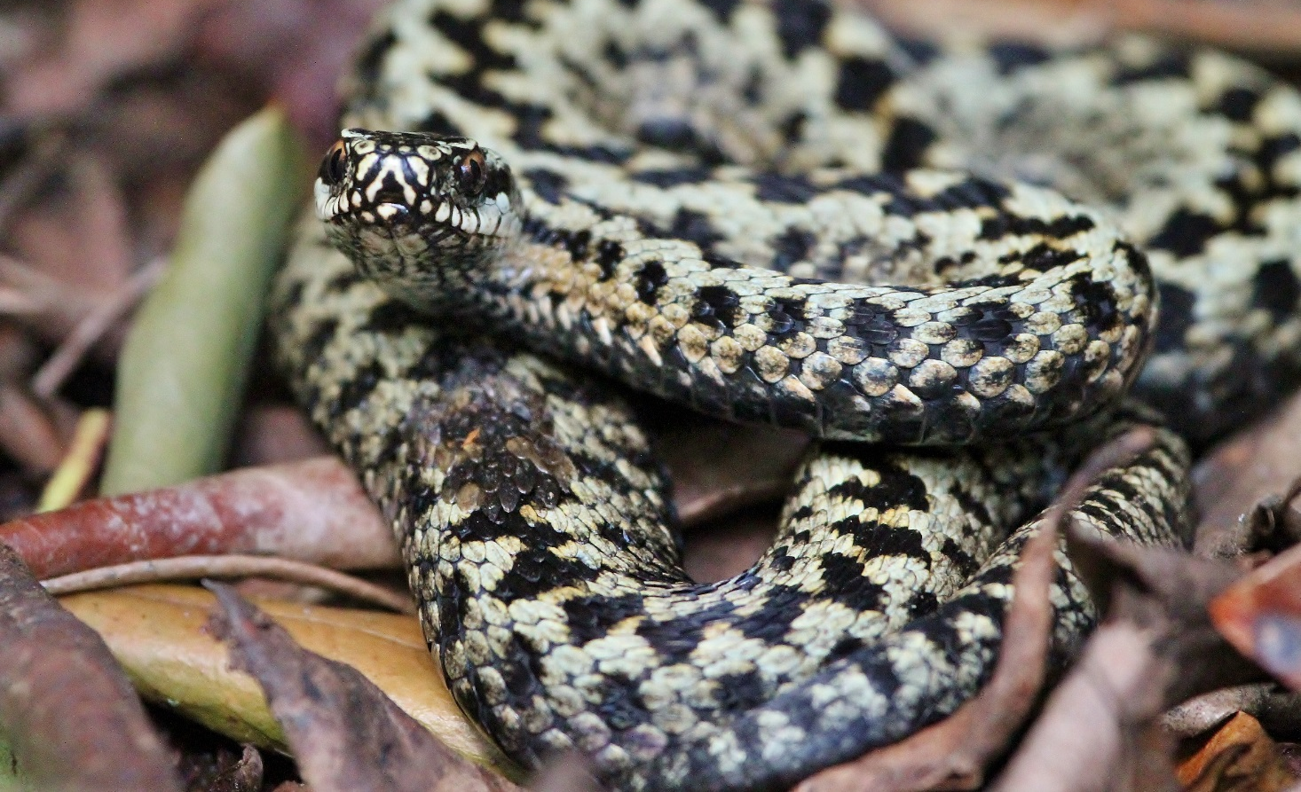
How Animals Survive Winter
Adders hibernate.
Photo courtesy of Jo Reeve (@flickr.com) - granted under creative commons licence - attribution

Slide 12
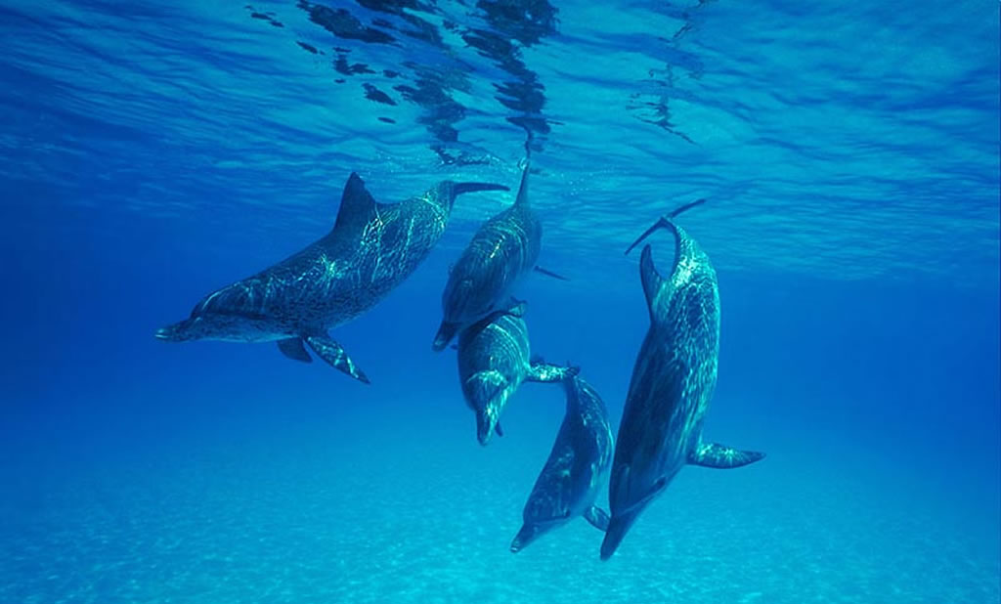
How Animals Survive Winter
Most dolphins migrate.
Photo courtesy of J. D. Ebberly (@flickr.com) - granted under creative commons licence - attribution

Slide 13
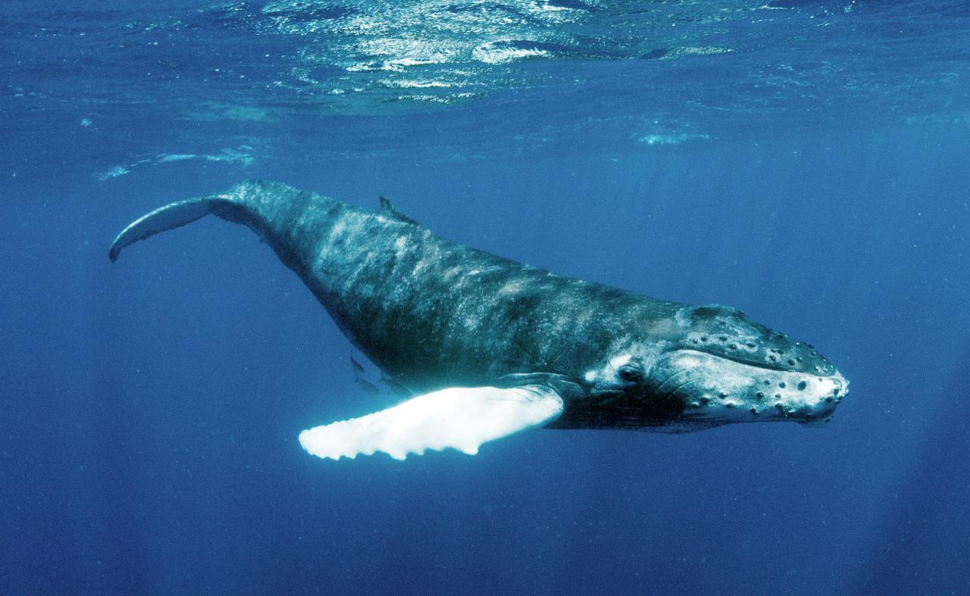
How Animals Survive Winter
Most whales migrate.
Photo courtesy of Christopher.Michel (@flickr.com) - granted under creative commons licence - attribution

Slide 14
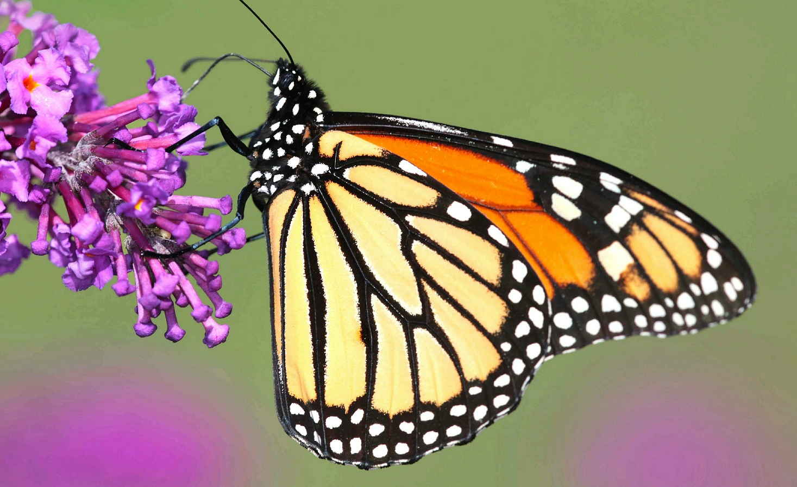
How Animals Survive Winter
Some butterflies, like the monarch butterfly, migrate.
Photo courtesy of DrPhotoMoto (@flickr.com) - granted under creative commons licence - attribution

Slide 15
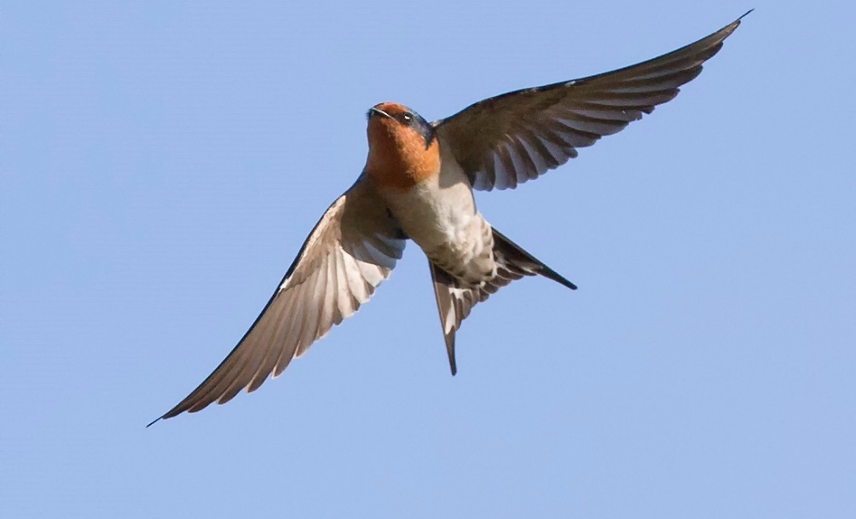
How Animals Survive Winter
Lots of birds, like the swallow, migrate to warmer countries in winter.
Photo courtesy of Jim Bendon (@flickr.com) - granted under creative commons licence - attribution

Slide 16
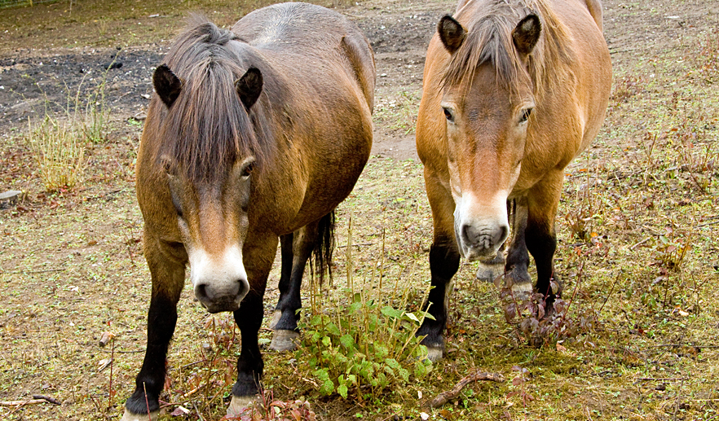
How Animals Survive Winter
Some animals, like Exmoor ponies, adapt to winter conditions by growing an extra layer to their brown coats.
Photo courtesy of Jack Picknell (@flickr.com) - granted under creative commons licence - attribution

Slide 17
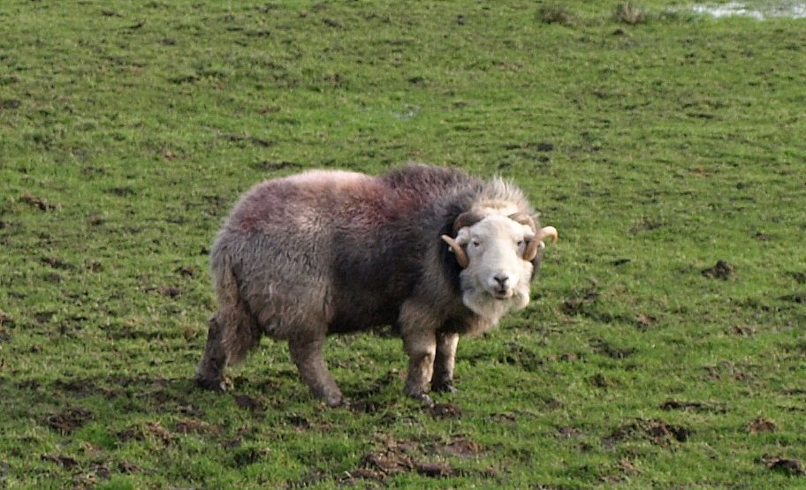
How Animals Survive Winter
Herdwick sheep can survive harsh winters because they have blizzard-proof fleeces.
Photo courtesy of sheepishly (@flickr.com) - granted under creative commons licence - attribution

Slide 18
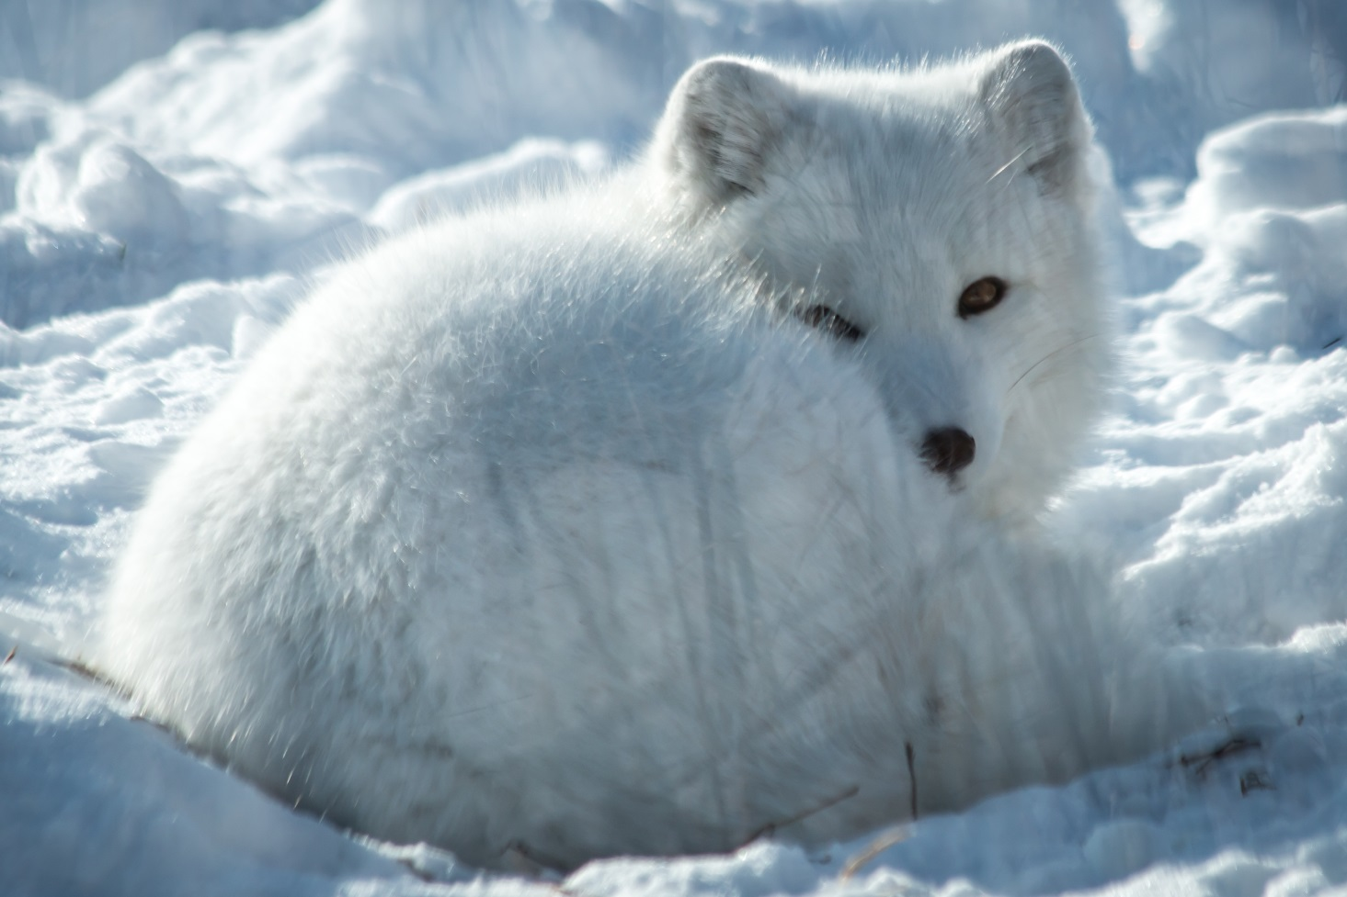
How Animals Survive Winter
Some animals, like the Arctic fox, adapt by changing the colour of their fur coats to match their surroundings in winter conditions.
Photo courtesy of AllieKF (@flickr.com) - granted under creative commons licence - attribution

Slide 19
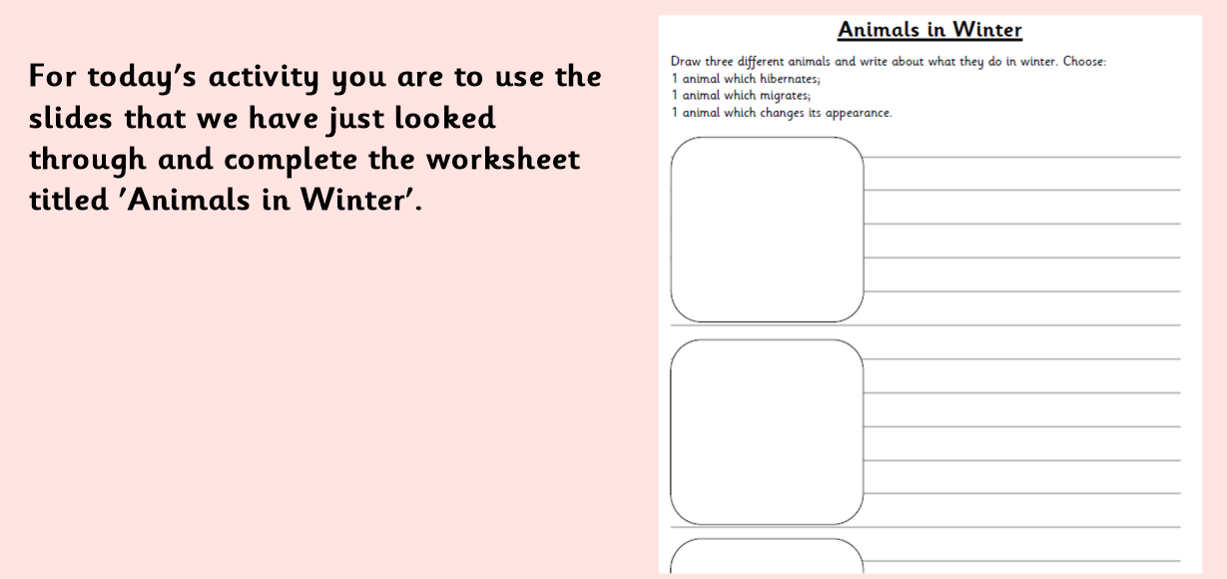

Slide 20

Animals in Winter Quiz
1. If an animal migrates, what does it do?
A. Goes to sleep for the winter.
B. Keeps very still for a long time.
C. Travels to a warmer place.
C. Travels to a warmer place.
D. Goes for a ride in a car.
Click again to reveal answer

Slide 21
Animals in Winter Quiz
2. Which 3 animals hibernate in winter?
A. Dormice, bats and hedgehogs.
A. Dormice, bats and hedgehogs.
B. Dormice, cats and hedgehogs.
C. Dormice, rats and hedgehogs.
D. Dormice, hats and hedgehogs.
Click again to reveal answer

Slide 22
Animals in Winter Quiz
3. Why do some animals hibernate in winter?
A. Because the are lazy.
B. Because they get very tired.
C. Because they get bored.
D. Because it gets colder and its difficult for them to find food.
D. Because it gets colder and it’s difficult for them to find food.
Click again to reveal answer

