Slide 1


The VIRTUAL classroom!

Slide 2
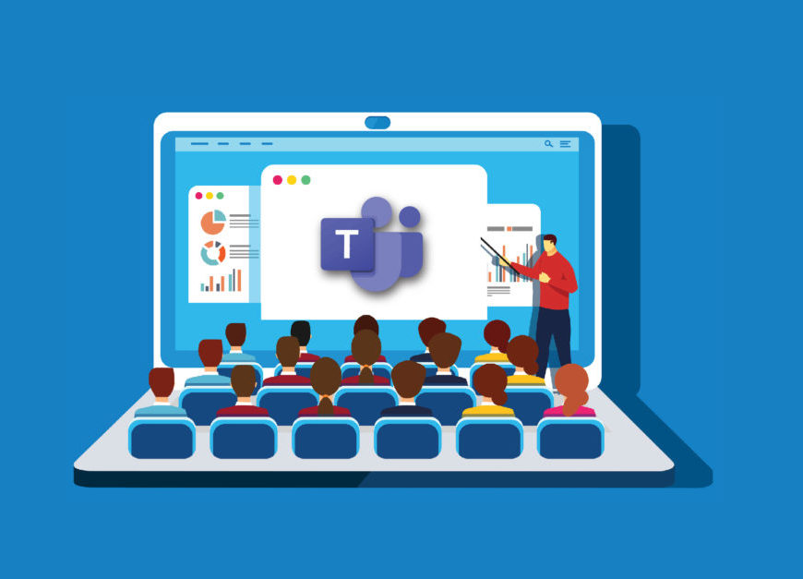
Microsoft Teams is a virtual classroom.
We want children to think of a meeting, like being in a classroom.

Slide 3
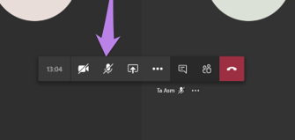
When you are in the virtual classroom, your microphone should be on mute. That way, everyone can focus on the teacher and the learning!

Slide 4
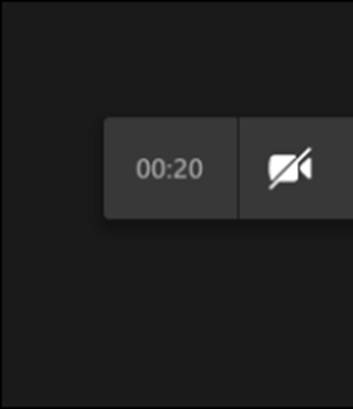
When you join you can have your camera on to say hello – but we will then ask you to turn your camera off so we can focus on learning.

Slide 5



How would you ask a question in class?
You would raise your hand!

Slide 6
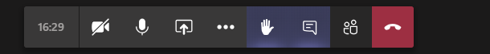
This is the way to raise your hand in our virtual classroom. Click it once to raise your hand and click on it again to put your hand down when the teacher has answered your question.

Slide 7
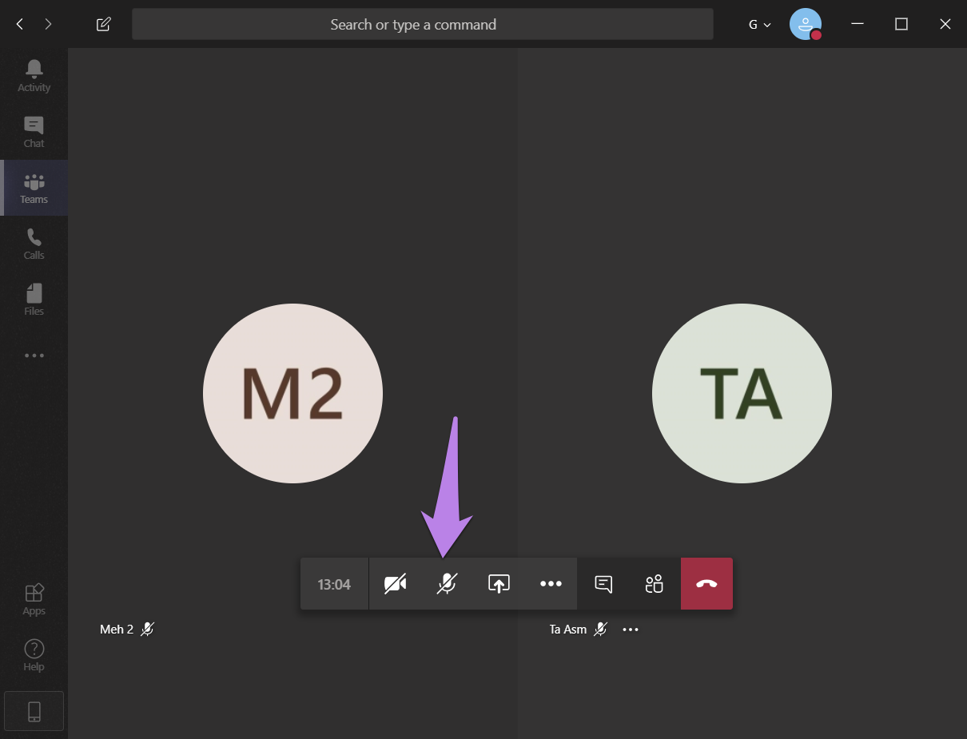
If you have a question and you have ‘raised your hand’, the teacher might ask you to unmute your microphone so that you can speak.
Remember, everyone in the virtual classroom can hear you!
After you have asked your question, you must mute the microphone again so that everyone can hear the teacher.

Slide 8

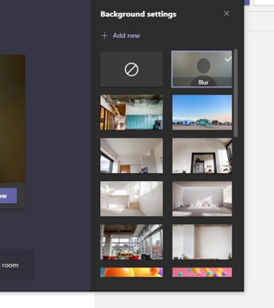
Changing the background
To keep everyone really safe, we ask that you change the background behind you to an imaginative one.
Click on the 3 dots,
Then background settings, select the background. Click on apply. It does seem to save this so you don’t need to do this each time.

Slide 9

Although it would be really nice to see everyone on a Teams call, we need to keep everyone safe.
Please ensure the microphone is always muted.
Turn off your camera after you have said ‘Hello’.
Ensure the background is on – so we don’t show each other where we live.
Always ensure children are fully dressed.
We will be recording every session.

Slide 10

Bubble closure
We fully understand that some parents have to work during a bubble closure, and we understand how difficult this must be to juggle work/schooling and home life. If you have any problems….please let us know and we will do our best to help!

Slide 11
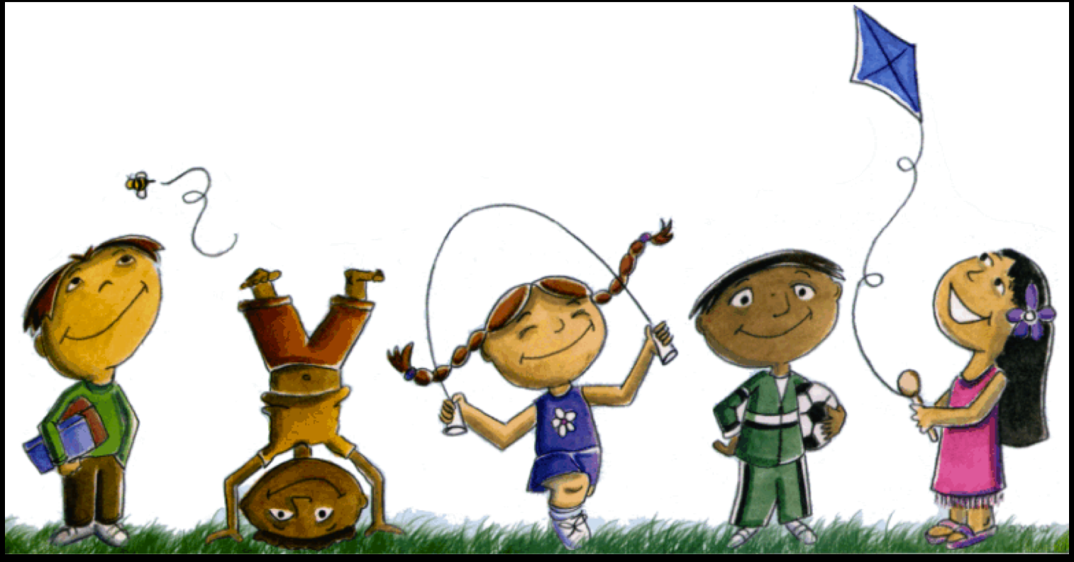
We intend to provide a session and activity for Literacy, Numeracy and Phonics everyday. Mrs Hanson and Mrs Exley will be reading a story and this will be added to our class dojo at the end of each day.

Slide 12
What a typical day will look like
A daily lesson overview will be uploaded to Dojo and the class page on the school website each morning which will also contain any worksheets or resources needed for the day.
9.50 – 10.10 – Teams call - Register & Hello – Introduce the literacy session.
10.50 – 11.10 – Teams call – Introduce the numeracy session.
1.30pm – 1.50pm – Teams call – Phonics and introduction to afternoon activity.
I will mark all work daily that is uploaded onto class dojo. Anything uploaded after 3.30pm will not be marked until the next day.

Slide 13

Please be patient with us, this is all very new to us too!

Slide 14

Any questions ?

