Slide 1
Henry VIII
A Non-chronological Report.

Slide 2
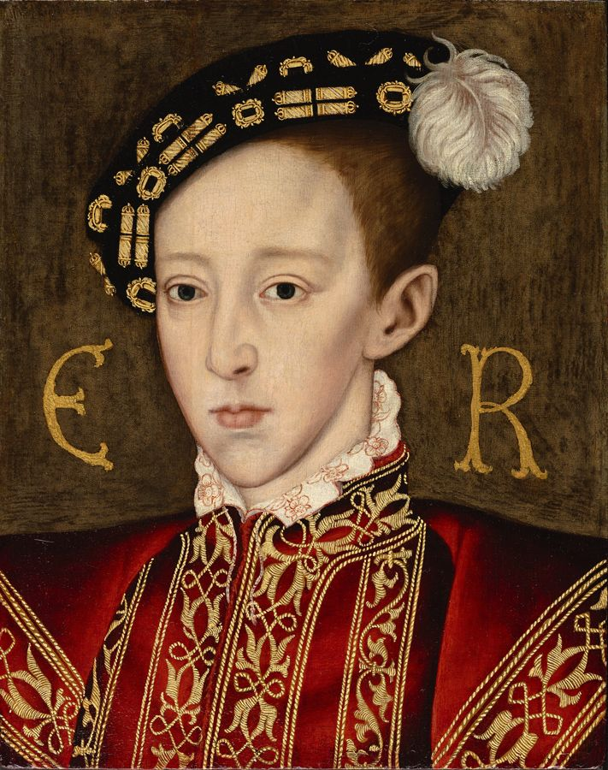
Henry VIII – his early life
Prince Henry was born on June 28th 1491 in Greenwich Palace. His parents were Henry VII the King of England and Elizabeth York the Queen of England. Henry had an older brother, Arthur, and two sisters, Mary and Margaret.
Unlike his sickly older brother Arthur, Henry was a healthy and athletic boy. He loved to play sports and ride horses. However, it was Arthur who, as the oldest son, was being raised to be king. Henry was being raised to enter the church. He received an excellent education and learned how to speak Latin, French, Spanish, and Greek. When Henry was ten years old, his life was dramatically changed. His older brother Arthur died and Henry was named the crown prince. He would be the next king of England.

Slide 3
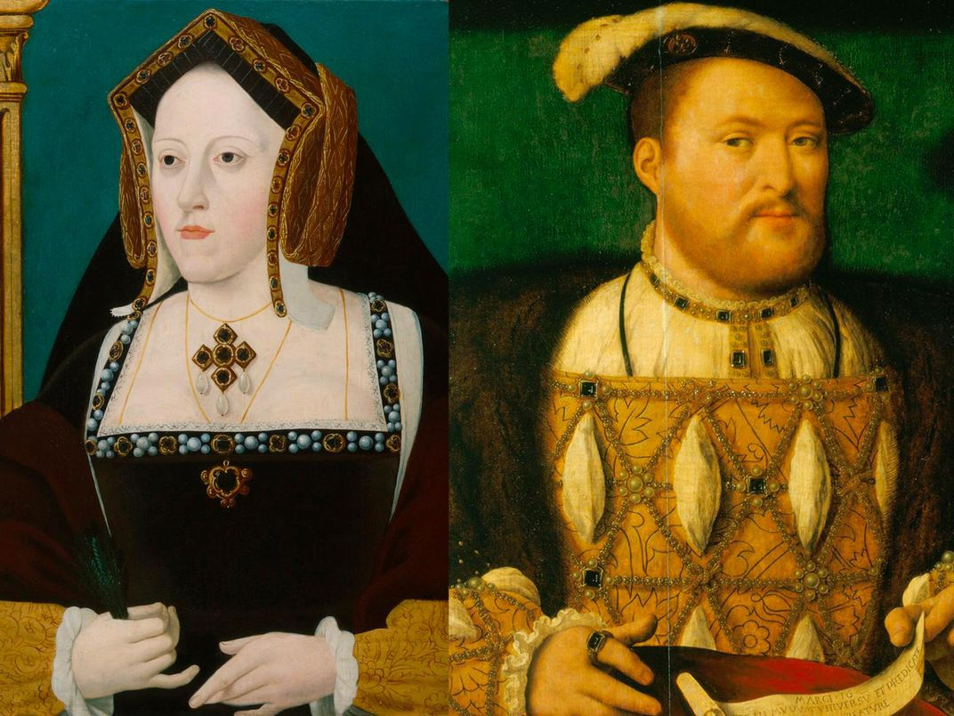
A Popular King
Upon the death of his father, Henry was coronated on 24 June 1509 — he was just 17 years old. He immediately set about marrying his elder brother’s widow, Catherine of Aragon.
The young King Henry was said to be handsome, clever and fun in contrast to his boring father. He was over six feet tall and loved jousting, hunting, composing music and throwing big, expensive parties!

Slide 4
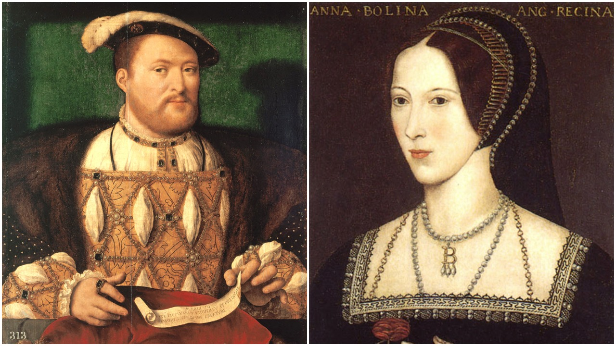
Divorce!
Henry was desperate for a son and heir. Catherine had a son but he died aged 7 weeks, then she had a daughter, Mary but Henry was still not happy. After 24 years of marriage, Henry decided he needed a new wife and he set about divorcing Catherine so he could marry Anne Boleyn. To achieve this aim he split England from the Roman Catholic Church and became head of the Church of England – this was called The Reformation.

