Slide 1
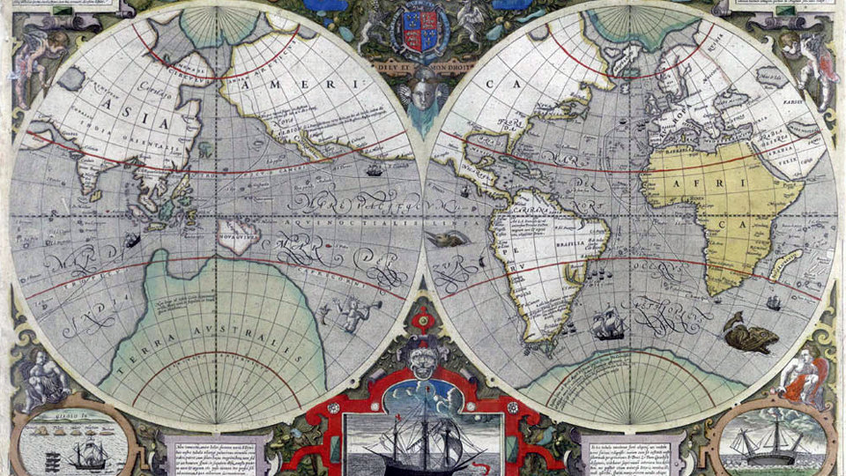
Tudor Exploration

Slide 2
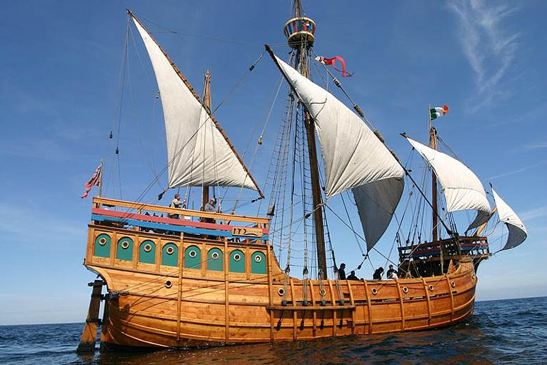
Galleons

Slide 3
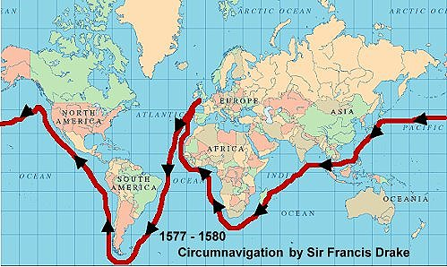
In around 1500 European sailors started to explore oceans and lands that were new to the people of Europe. They sailed around Africa to India and across the Atlantic to America. Sometimes they traded in a friendly way with the people they met. Sometimes they fought, they turned these foreign lands into colonies.

Slide 4
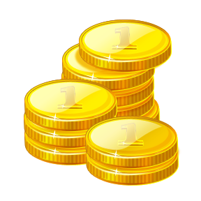
Dividing up the world
European sailors did not go exploring just for fun. They wanted to learn of new lands in Asia – which they called ‘the Indies’. The merchants from their own countries could get rich by buying and selling goods there. They also wanted to find new routes to lands they already knew about, like China.
Some European monarchs paid for voyages of exploration. The first were the rulers of Portugal and Spain. The Spanish king paid for Christopher Columbus to explore for him.

Slide 5
In early Tudor times, lots of goods were shipped in and out of England. From abroad came luxury goods like fine French wines and spices, silks and precious stones from the Indies, plus important raw materials like iron. England’s main export was cloth made from wool.
By 1500 more English woollen cloth was being sold abroad than ever before, and at very good prices. This made many merchants rich. It also helped the monarchs of England: they got merchants to pay a tax called ‘customs duty’ on many traded goods.

Slide 6
Some Tudor explorers wanted to make foreign peoples Christians. They also wanted to save foreigners from the ‘wrong’ sort of Christianity. For English explorers that meant spreading the Protestant version of the faith, not the Catholic one. By the end of the Tudor times, England had become Europe’s leading Protestant nation, while Spain was the main Catholic power. This meant that they clashed, both in Europe and beyond.

Slide 7
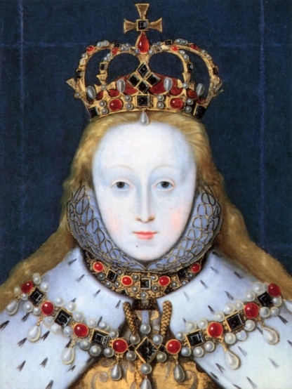
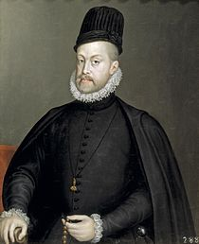
Under Elizabeth’s rule, England became, and stayed a Protestant country. From 1585 until 1604 England was at war with Spain.
During that time, English seaman felt freer to do as they liked overseas. They explored and traded with Spain and Portugal’s hugely wealthy colonies in north and south America. They even became pirates, robbed enemy ships, and brought treasure back to Europe across the Atlantic Ocean.

Slide 8
Early Tudor ships were not suitable for long ocean expeditions that might involve fighting as well as trading. Later, Tudor ships were designed to be stronger, easier to steer and with enough weapons to make them fearsome. (Tudor England was famous for its brass cannons.)
The ships were built with timbers of English oak, elm and pine. Main masts could be 18 metres tall. That meant cutting down healthy trees with no branches or flaws for their first 18 metres.

Slide 9
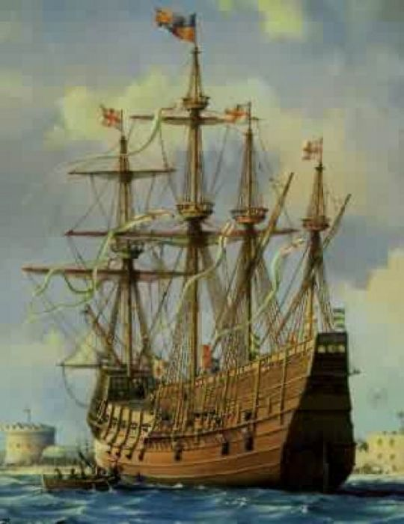
The Mary Rose
The Mary Rose was King Henry VIII's favourite warship and
he named the ship after his sister. The ship was built in 1509,
the year Henry VIII came to the throne. On 19 July 1545,
disaster struck the Mary Rose. The French had landed on the
Isle of Wight. Henry came to Southsea Castle to watch his
fleet leave Portsmouth and engage with the French force in
the Solent. At the head of the English fleet was his pride and
joy the Mary Rose.
From his advantage point on top of Southsea castle, Henry had
a commanding view of the impending battle. Unfortunately,
right before his eyes he watched one of the greatest naval
tragedies, the sinking of his flagship, the Mary Rose. It is not
known exactly what happened to cause the sinking of the ship,
but one theory suggests that the crew fired the guns on one
side of the ship and were turning the ship to fire the guns on
the other side. Unfortunately, they failed to close the gun
ports and a combination of this and the wind caused the ship
to tilt, fill with water and sink. The Mary Rose sank within a
matter of minutes with seven hundred sailors lost.

Slide 10
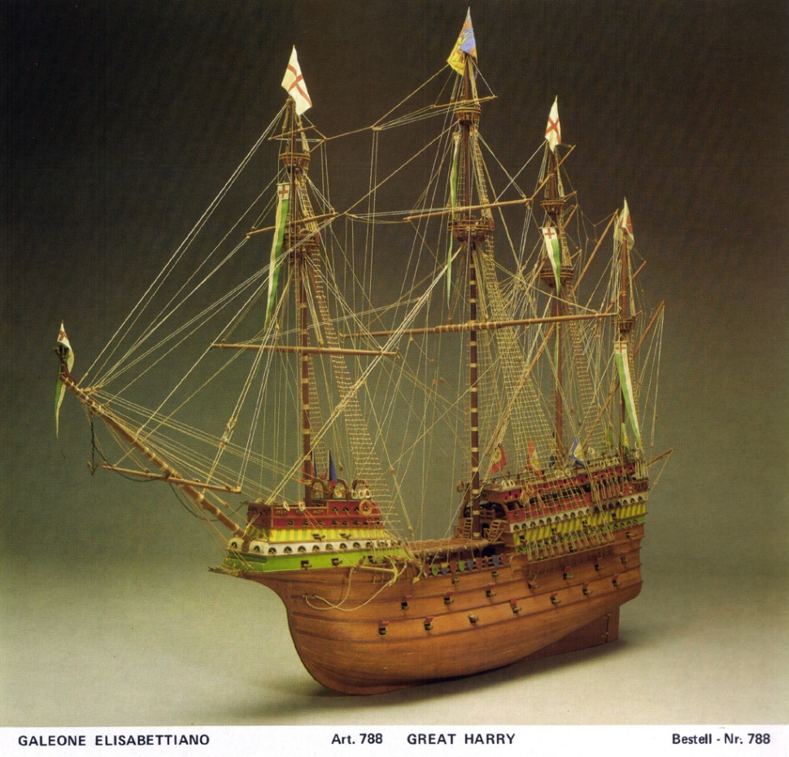
The Great Harry
Tudor ships varied in size. Great ships, such as the Great Harry took three years to build. The Great Harry was launched in 1515. It measured 90 metres by 50 metres. It was made of oak, which was sealed with turpentine, resin and oils. It carried 21 heavy cannons, which could be fired through gun ports. The cannons would shoot down the masts of other ships. During the reign of Elizabeth I the design of ships began to change, and they became smaller. The new ships were called galleons and were faster to sail.

Slide 11
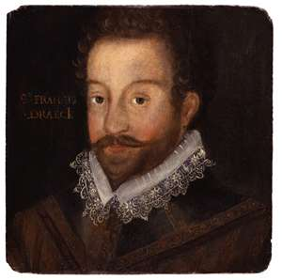
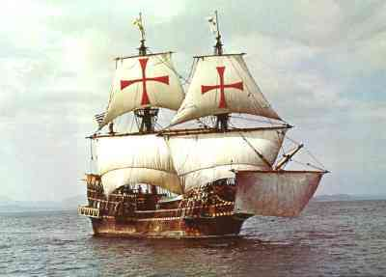
The Golden Hind
The Golden hind was 37 metres long and 6 metres across. She carried 20 officers and between 40 & 60 crew member. The average height of a sailor in Tudor times was 1.60m (5.3”), but many of the members of the crew were shorter. Shorter people found it easier to move around the ship than taller people. Imagine what it would be like to live on board a ship like this with some 60 to 70 other people!

Slide 12
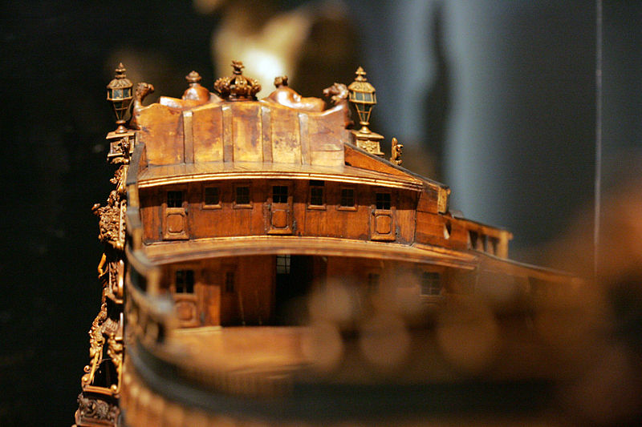
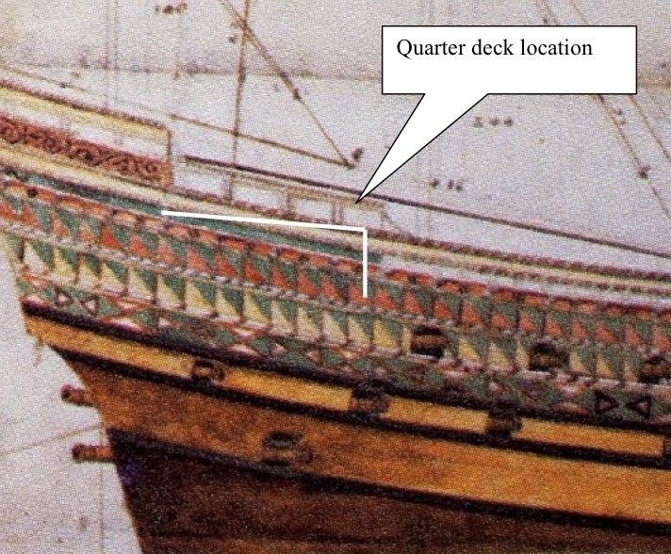
Did you know?
Poop deck
The word poop deck originates from the
French word for stern, la poupe.
Thus the poop deck is technically called
the stern deck, which is an elevated
deck at the rear of the ship, ideal for
navigation and observing the crew and
sails.
The quarter deck
There are ancient traditions of offering respect
to the quarter deck. Greek and Roman warships all
called pagan shrines which were were given special
respect. This continued into Christian times and n
Medieval British warships, the religious shrines
was set up on the quarter deck. All hands were
required to salute it by taking off their hats or
caps. This led to the habit of saluting whenever
one entered the quarter deck.

Slide 13
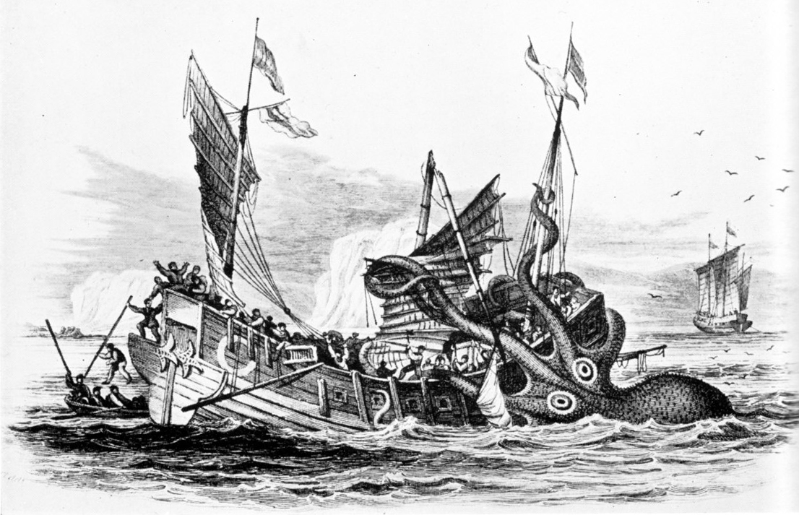
Superstition

Slide 14
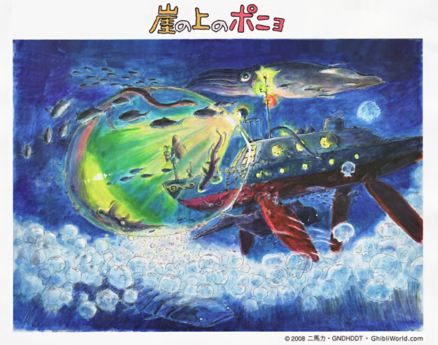
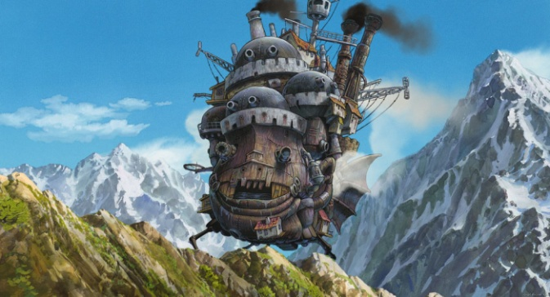
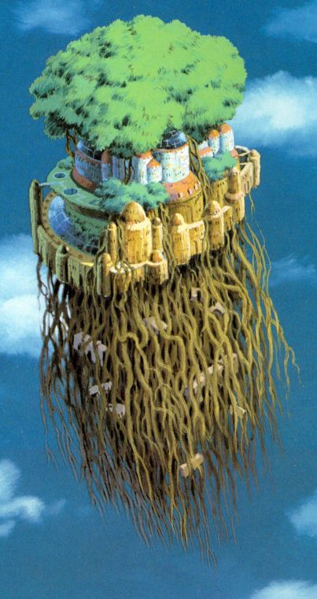
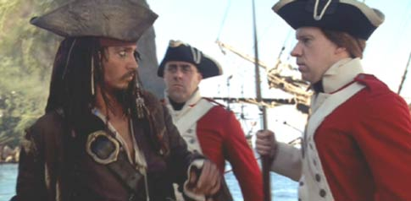
Sailors gathered information from wherever they could.
Some information came from other sailors’ stories. These
could, however, be misleading. One story told of a region in
The far north called ‘Thule’. It was said to be neither land
nor sea nor air, but a weird mixture of all three!

Slide 15
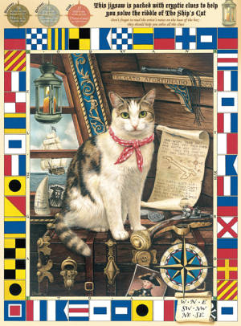
Many different creatures play a role in the superstitious nature of mariners. A great distance flier of the South Pacific, many believe Albatrosses carry the immortal souls of lost sailors and woe to the seaman that kills one of them. A black cat appears to be a good omen to most sailors, much the opposite of society since the Middle Ages. Many mariners strive to keep a content and well-fed black cat onboard during their voyages. A pod of dolphins following the wake of a vessel is thought a sign of good luck, while malingering shoals of sharks can only spell doom for the ill fated crew. A skipper finding a rabbit or hare onboard is likely to forestall his journey for another day. Ultimately, rats leaving a ship are a definite sign of trouble ahead.
Animal Influences

Slide 16
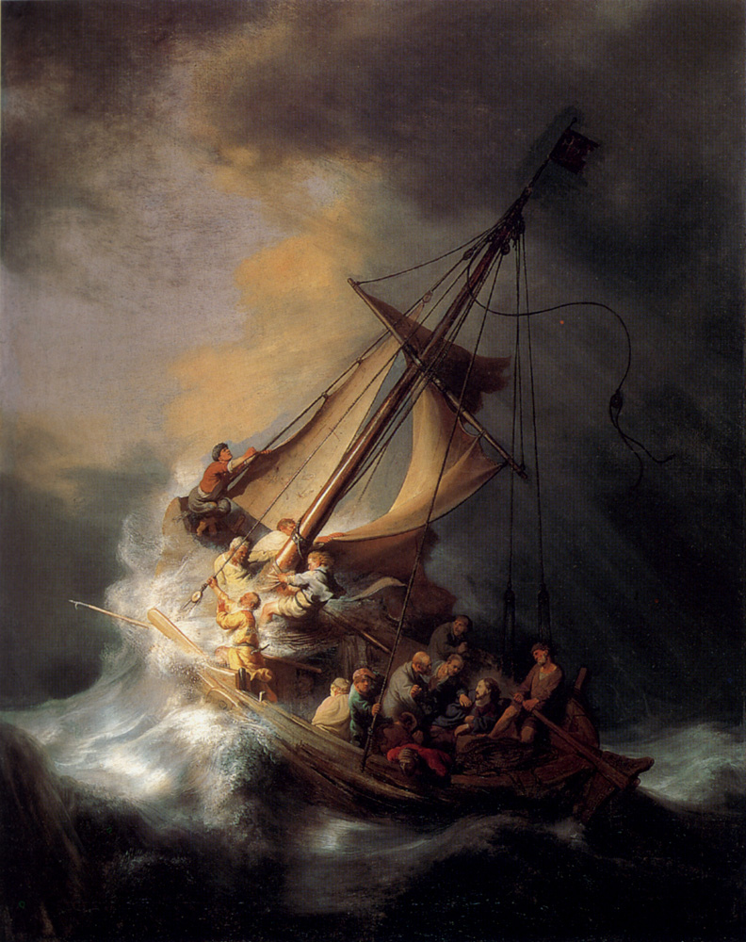
Avoid people with red hair when going to the ship to begin a journey.
Red heads bring bad luck to a ship, which can be averted if you speak to the red-head before they speak to you.
Avoid Flat-footed people when beginning a trip.
They, like red heads, are bad luck. The danger can be avoided by speaking to them before they speak to you.
Throwing stones into the sea will cause great waves and storms, as will whistling.
A sign of disrespect to the sea, ensuring retaliation in the form of stormy seas. Whistling up a storm.
It is unlucky to start a cruise on Friday.
This is the day Christ was crucified on.
Sailors wore golden hoop earrings all the time. It is said that this was done so they would have gold to pay their fare in the underworld if ever they sink and drown
Other superstitions
You at the front! Stop Whistling!!!

Slide 17
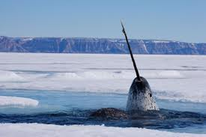
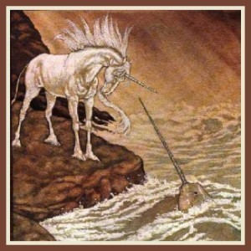
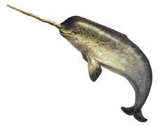
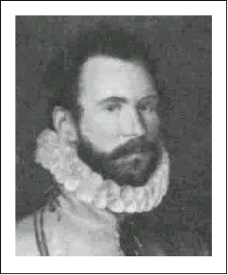
Sailors also heard tales about beasts and monsters that lived in the oceans.
Martin Frobisher found a ‘sea unicorn’. It was in fact a narwhal, a member of the whale and dolphin family. Sir Frobisher still presented the ‘unicorns’ horn as a gift to Queen Elizabeth I!

Slide 18
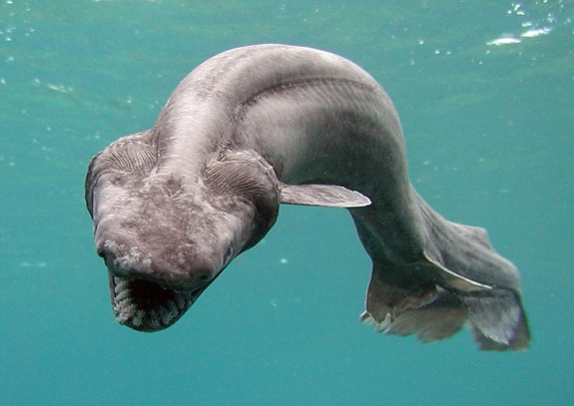
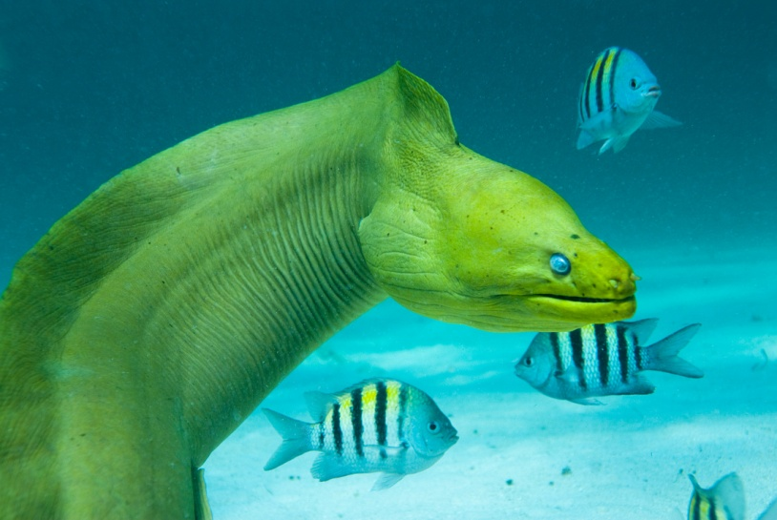
Other strange sea creatures were also sighted by sailors. Many of these creatures are still around today. Tudor sailors thought they looked so unusual that they were thought to be sea monsters.
The frill shark, usually lives in waters 600 meters deep. It's body shape and it's number of gills are similar to fossils of sharks which lived 350,000,000 years ago.
In relation to it's size and 300 teeth, the frill shark is usually referred to as a sea serpent or Loch Ness Monster

Slide 19
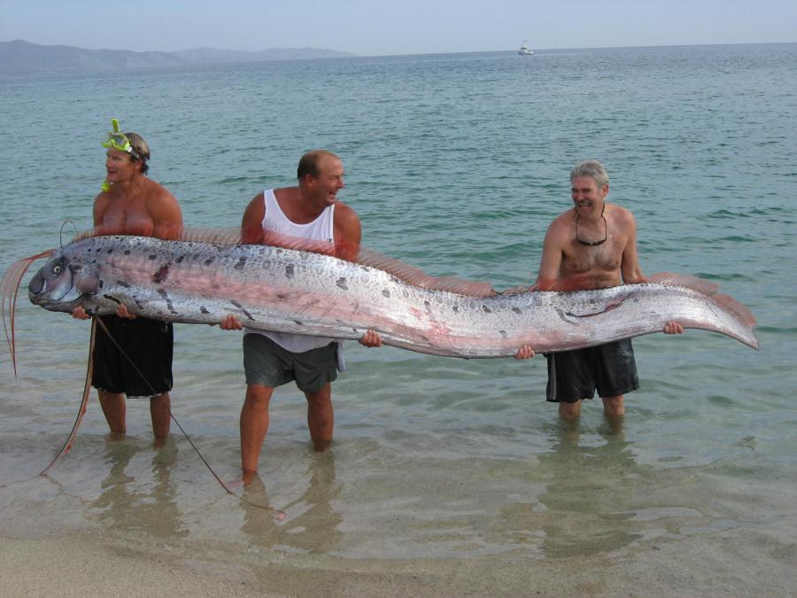
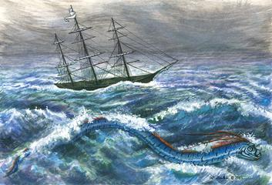
Oarfish (Right) are one of the world's longest fish reaching 17m.
Their strange appearance may have provided the basis for the sea serpent myths told by early ocean travellers.
Not only are they elongated, they also have a prominent dorsal fin which gives it an unusual "serpent" appearance.

Slide 20
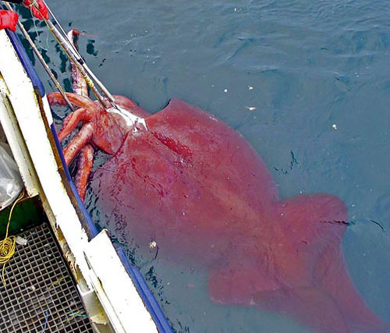
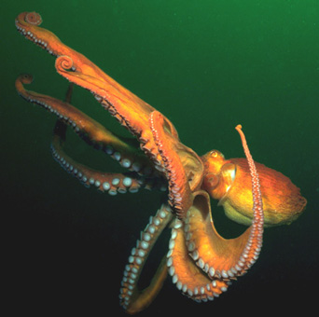
Although the giant, colossal squid and giant octopus were probably the strangest creatures of them all!
The Colossal Squid is a larger version of the Giant Squid, reaching lengths of 12 – 14 metres. It is extremely clever and has the biggest eyeball in the animal kingdom.

Slide 21
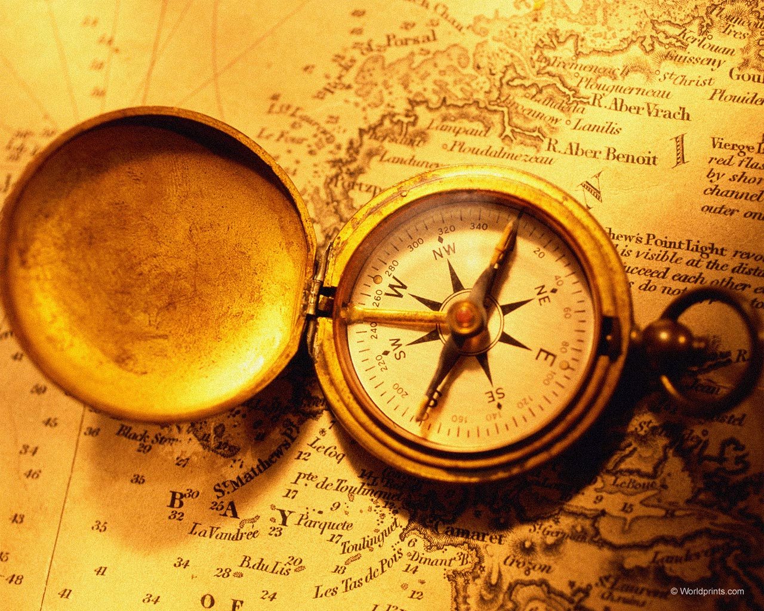
Navigation

Slide 22
Tudor seaman often sailed where few Europeans had sailed before. On such voyages, they had little idea what they would find.
To measure the depth of the sea, for example, they used a long cable hung with lead weights. And although there were no clocks at sea, they could keep time with a sandglass (like an egg timer). They also tried to work out where they were by checking the positions of the sun and well-known stars. Tools called ‘astrolabes’ and ‘cross-staffs’ let them work out how far north or south they were.

Slide 23
One of the most important improvements to ocean navigation was
the invention of the compass. There is some disagreement about
who should get credit for this invention. It’s pretty clear that the
Chinese knew about magnetism as early as 2637 BC, but the first
written description of a compass for navigation didn’t appear in
Europe until 1190.
A compass will always point towards the North Pole. No matter
where you stand on Earth, you can hold a compass in your hand and
it will point toward the North Pole. Long before GPS satellites and
other high-tech navigational aids, the compass gave humans an easy
inexpensive way to orient themselves.

Slide 24
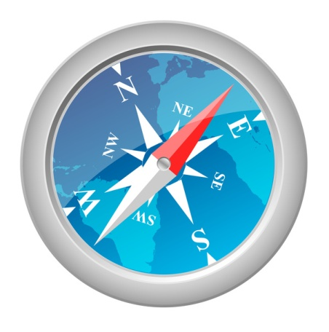
How does a compass work?
A compass is an extremely simple device. A magnetic
compass consists of a small, lightweight magnet balanced on
a nearly frictionless pivot point. The magnet is generally
called a needle. One end of the needle is often marked ‘N’,
for the north or coloured in some way to indicate that it
points north.

Slide 25
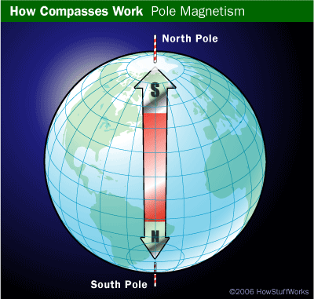
Earth’s magnetic field
It turns out that you can think of the Earth as having a gigantic bar magnet buried inside. In order for the north end of the compass to point toward the North Pole, you have to assume that the buried bar magnet has its south end at the North Pole, as shown in the diagram at the right. If you think the world this way , then you can see the normal “opposites attract” rule of magnets would cause the north end of the compass needle to point toward the south end of the buried bar magnet. So the compass points towards the North Pole.

Slide 26
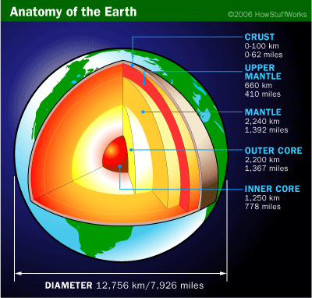
The magnetic field of the Earth is fairly weak on surface. After all, the planet Earth is almost 8,000 miles in diameter, so the magnetic field has to travel a long way to affect your compass. That is why a compass needs to have a lightweight magnet and a frictionless bearing. Otherwise, there just isn’t enough strength in the Earth’s magnetic field to turn the needle
The “big bar magnet buried in the core” analogy works to explain why the Earth has a magnetic field, but obviously that is not what is really happening. So what is really happening?
One theory suggests that the Earth’s core is thought to consist largely of molten iron. But at the very core, the pressure is so great that the superhot iron crystallizes into a solid. Convection caused by hear radiating from the core, along with rotation of the Earth, causes the liquid iron to move in a rotational pattern. It is believed that these rotational forces in the liquid iron layer lead to weak magnetic forces around the axis of spin.

Slide 27
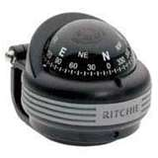
Gyroscopic Compass
A magnetic compass like the one before has several problems when used on moving platforms like ships and airplanes. It must be level, and it tends to correct itself rather slowly when the platform turns. Because of this tendency, most ships and airplanes use gyroscopic compasses instead.
A motor inside the gyrocompass keeps the gyroscope spinning, so the gyrocompass will continue pointing toward north and will adjust itself swiftly and accurately even if the boat is in rough seas or the plane hits turbulence.

Slide 28
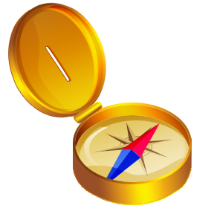
Historical Points of Interest
1st century: The Chinese invent the compass.
A.D. 720: The Chinese recognize the existence of magnetic declination.
12th century: Compass technology reaches Europe.
1520: George Hartman measures magnetic declination.
1700: Edmund Halley charts the world's first known magnetic declination map.
1851: The magnetic north pole is discovered.

Slide 29
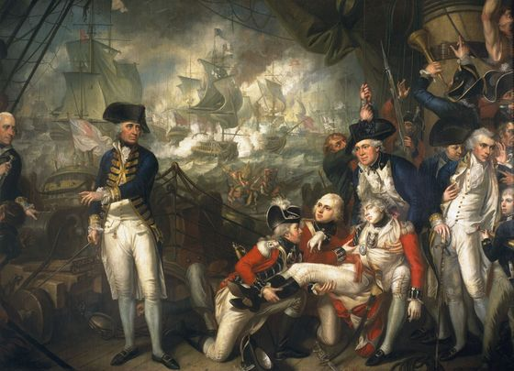
Sailors
Lord Howe on the Deck of The 'Queen Charlotte', 1 June 1794

Slide 30
A sailors life
In Tudor times, merchant ships were made of wood. They had three masts with canvas sails. Most ships carried a few cannon, to fight off attacking pirates.
Life was hard for the ordinary seaman. They had to sleep on the deck, where they could find a space. They were usually wet and cold, with no fires to warm them.

Slide 31
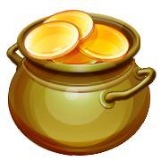
During the Tudor period people sailed around the world for the first time. They were looking for new lands. Sailing was a very dangerous thing to do in Tudor times. They had lots of different reasons for wanting to discover new lands.
Most explorers wanted to get rich. They were looking for gold or valuable cargoes to bring back home to sell.
They were looking for silk, sugar and spices.
Others went to tell people in distant lands about the Christian religion. These people were called missionaries.

Slide 32
Sleeping
Where you slept depended on your rank. A captain or an officer would have their own cabins to sleep in. An ordinary seaman would have to share one room. This room was very small and there would hardly be enough room to lie down. There were no windows and it got very hot and smelly.

Slide 33
Pirates & Privateers
Trading ships were often attacked by well-armed pirates and privateers who stole their cargo. Spanish and Portuguese ships were frequent victims because of the valuable cargoes. English privateers sailed down the coasts of Spain and Portugal searching for treasure ships to attack and plunder.
The most feared privateer of all was Francis Drake. He attacked many treasure ships and even a Spanish town in South America.

Slide 34
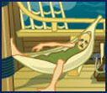
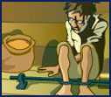
Health
Many sailors suffered ilnesses and some even died. The poor food that they ate had no Vitamin C in it and led to illnesses such as anaemia and scurvy.
Discipline
Discipline was strict and punishment was severe. The sailor were often flogged. Some sailors were even dragged by a rope under the boat!

Slide 35
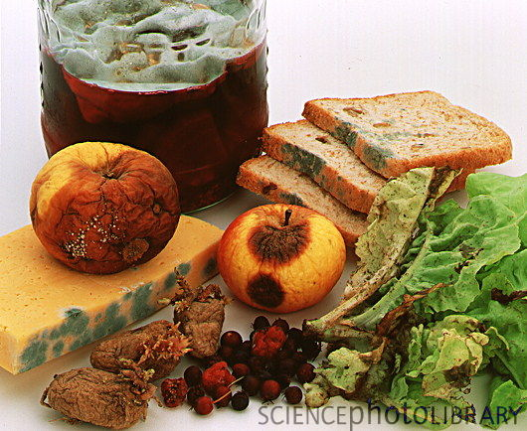
Food and Disease

Slide 36
Diseases
Two of the most famous diseases found on board ships were scurvy and typhus.
Scurvy is caused by a lack of vitamin C. This vitamin is found in fresh fruit and vegetables.
On long sea voyages, the supply of fruit and vegetables soon ran out, and after about thirty weeks the crew would start to show signs of scurvy.
Their gums would start to go spongy and bleed, and their teeth would fall out.
If the disease went on long enough, old wounds would open up and eventually the sailor would die.

Slide 37
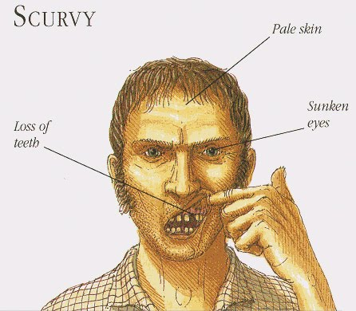
Scurvy was a real problem on the long voyages of discovery and trade to Asia, killing nearly the whole crew of some ships.
Typhus was a fever, spread by mites, lice and fleas. It was very common in crowded places like ships and prisons. It was even known as ship fever and gaol fever.
Epidemics of typhus could destroy whole armies. One French army attacking the Italian city of Naples lost 30,000 men to the disease and had to retreat.

Slide 38
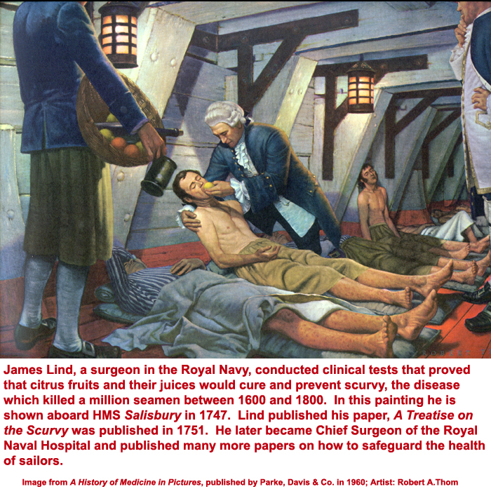

Slide 39
It was finally discovered in the early 18th Century that drinking the juice of citrus fruits—which is high in vitamin C—would prevent scurvy, and the work of James Lind (above) proved the curative and preventative powers of citrus fruits, especially limes, in treating this condition.
The Royal Navy promptly adopted a regulation that required all its men to drink a weekly ration of lime juice. This practice was so rigorously enforced, and became so strongly associated with British sailors, that to this day Englishmen are still known by the nickname given to them by other Navies: "Limeys."

Slide 40
Food
It was hard to keep food fresh on long journeys. They had no refrigerators or freezers. They ate dried or salted meat or fish. They also ate dried biscuits, butter or cheese. They didn’t eat any fresh fruit or vegetables. Maggots would be crawling in the food. They drank beer because it was easier to keep fresh than water.
On long voyages meat often went rotten, the ship’s biscuits became full of worms, and the drinking water turned green. There was no fresh food. Many sailors died of diseases due to poor diet, or food poisoning.
Their food was stored in the hold below decks, along with the cargo. This was the dirtiest part of the ship. It was infested with rats and mice!

Slide 41
Food
The sailors in the Tudor navy lived mostly on salted beef, salted fish and ship's biscuits.
They were given meat on four days a week and fish on the other three.
Other foods like cheese and butter would have been eaten by the crew, but no evidence of these survived on the wreck of the ship.
Beef
The English were famous for their love of beef.
It formed one of the main parts of the men's' diet on the Mary Rose.
Each man got about a kilo of meat every day.
The meat was salted and packed in barrels so it would last a long time.
Barrels full of cattle bones where found on the orlop deck of the Mary Rose.
co

Slide 42
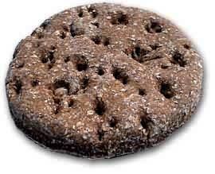
Bread
Ordinary bread wouldn't keep very well on board ship, so the navy had special bread made for it.
Ship's biscuits are made of flour and water. They are baked twice to make them as dry and hard as possible.
The crew of the Mary Rose would be given half a kilo a day each. They probably put them in their plates or bowls and put the meat and fish on top.

Slide 43
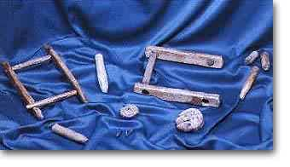
Fish
In 1522 the Navy said that the sailors should have one fish between 4 men on the three fish days in a week (Wednesday, Friday and Saturday).
Royal MS. 7. C. xvi. f.127. BM
These fish were big salted cod, which would have been cut up and boiled to make a sort of fish stew.
One man on the Mary Rose caught his own fresh fish. In one of the wooden chests on board we found his fishing gear.
There were wooden handlines and floats made from cork and willow. There was also a disgorger (a thing for getting the hook out of the fish) in the same chest.

Slide 44
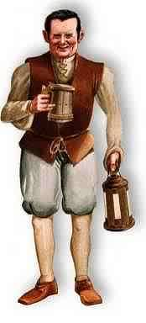
In Tudor times water often wasn't safe to drink. Milk was usually made into butter or cheese and fruit juice wouldn't keep for long.
The English hadn't discovered tea and coffee yet, so everybody drank beer.
Even children drank beer at breakfast!
The sailors on the Mary Rose had a ration of a gallon of beer a day, that's nearly four litres.
Beer was a very important part of the sailors diet. It contains lots of calories and is a good source of vitamin B.
The navy needed to buy huge amounts of beer to keep the ships' crews happy. A lot of the navy's beer was made in royal breweries.

Slide 45
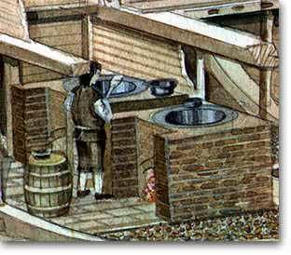
This is what we think the galley looked like when it was in use.
The walls and floors of the ovens are made of brick.
They sit on the gravel ballast that was put in the hold of the ship to help keep her stable.
The sides and back of the ovens were supported by strong wooden walls.

