Slide 1
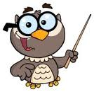
Learning intention:
Measure and compare using
Standard units.

Slide 2
Choose the units
kilometres
millimetres
centimetres
metres
Vote for A, B or C on your whiteboard

Slide 3
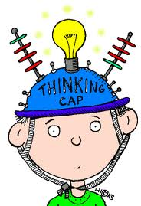
TRUe or false

Slide 4

You would measure a pencil in cm.
TRUE OR FALSE?

Slide 5

You would measure a football pitch in metres.
TRUE OR FALSE?

Slide 6

You would measure an aeroplane in km.
TRUE OR FALSE?

Slide 7

YOU would measure a car journey in km.
TRUE OR FALSE?

Slide 8
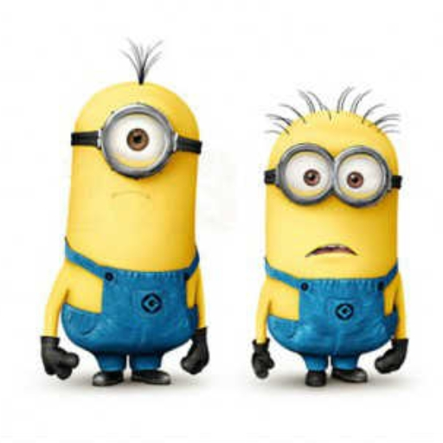
YOU WOULD MEASURE A MINION IN MM?
TRUE OR FALSE?

Slide 9

CHOOSE THE CORRECT UNITS

Slide 10
The length of a pencil case…
Centimetres (cm)
Millimetres (mm)
Metres (m)
Choose A, B or C!
A

Slide 11
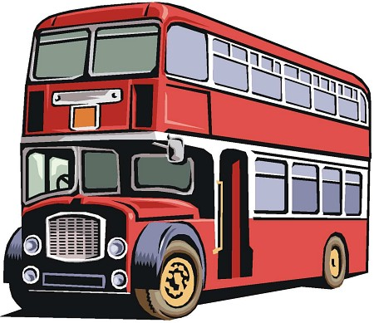
The length of a bus…
Centimetres (cm)
Millimetres (mm)
Metres (m)
C

Slide 12

The length of a Frisbee throw
Centimetres (cm)
Metres (m)
Kilometres (km)
B

Slide 13

The length of a mini beast
Centimetres (cm)
Millilitres (ml)
Millimetres (mm)
C

Slide 14
The length of a spoon…
Centimetres (cm)
Millimetres (mm)
Centilitres (cl)
A

Slide 15

The length of a ROAD…
Centimetres (cm)
Metres (m)
Kilometres (km)
C

Slide 16
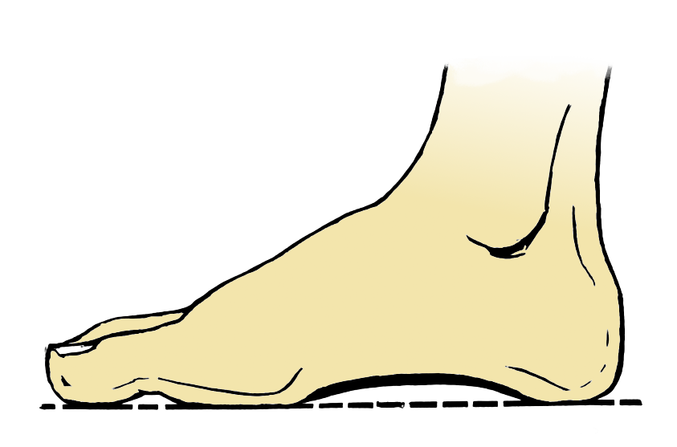
Length of your foot…
Millimetres (mm)
Centimetres (cm)
Metres (m)
B

Slide 17


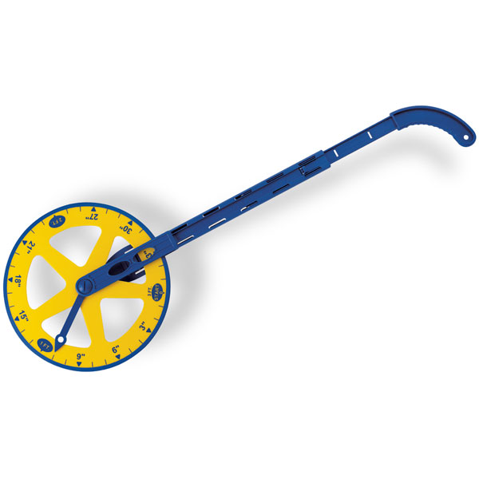
Measure the length of the following lines and shapes

Slide 21
http://www.iboard.co.uk/iwb/Animal-Length-Labels-579

