Slide 1
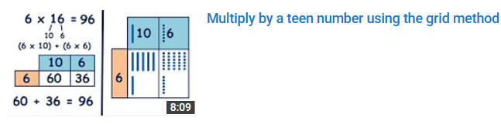

Slide 2
7 x 12 =
84
10
2
10
2
(7 x 10) + (7 x 2)
10
2
7
70
14
7
70 + 14 = 84

Slide 3
6 x 16 =
96
10
6
10
6
(6 x 10) + (6 x 6)
10
6
6
60
36
6
60 + 36 = 96

Slide 4
9 x 16 =
144
10
6
10
6
(9 x 10) + (9 x 6)
10
6
9
90
54
9
90 + 54 = 144

Slide 5
+
=
10x table
6x table
16x table
1 x 10 = 10
2 x 10 = 20
3 x 10 = 30
4 x 10 = 40
5 x 10 = 50
6 x 10 = 60
7 x 10 = 70
8 x 10 = 80
9 x 10 = 90
10 x 10 = 100
1 x 6 = 6
2 x 6 = 12
3 x 6 = 18
4 x 6 = 24
5 x 6 = 30
6 x 6 = 36
7 x 6 = 42
8 x 6 = 48
9 x 6 = 54
10 x 6 = 60
1 x 16 = 16
2 x 16 = 32
3 x 16 = 48
4 x 16 = 64
5 x 16 = 80
6 x 16 = 96
7 x 16 = 112
8 x 16 = 128
9 x 16 = 144
10 x 16 = 160

Slide 6
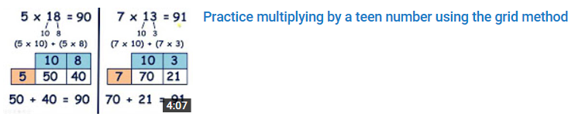

Slide 7
5 x 18 =
90
7 x 13 =
91
10
8
10
3
(5 x 10) + (5 x 8)
(7 x 10) + (7 x 3)
10
8
10
3
5
50
40
7
70
21
50 + 40 = 90
70 + 21 = 91

Slide 8
8 x 19 =
152
9 x 17 =
153
10
9
10
7
(8 x 10) + (8 x 9)
(9 x 10) + (9 x 7)
10
9
10
7
8
80
72
9
90
63
80 + 72 = 152
90 + 63 = 153

Slide 9
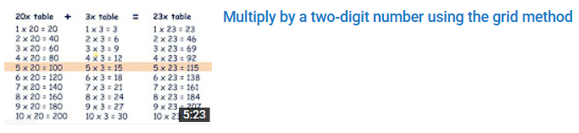

Slide 10
5 x 23 =
115
20
3
20
3
(5 x 20) + (5 x 3)
20
3
5
5
100
15
100 + 15 = 115

Slide 11
+
=
20x table
3x table
23x table
1 x 20 = 20
2 x 20 = 40
3 x 20 = 60
4 x 20 = 80
5 x 20 = 100
6 x 20 = 120
7 x 20 = 140
8 x 20 = 160
9 x 20 = 180
10 x 20 = 200
1 x 3 = 3
2 x 3 = 6
3 x 3 = 9
4 x 3 = 12
5 x 3 = 15
6 x 3 = 18
7 x 3 = 21
8 x 3 = 24
9 x 3 = 27
10 x 3 = 30
1 x 23 = 23
2 x 23 = 46
3 x 23 = 69
4 x 23 = 92
5 x 23 = 115
6 x 23 = 138
7 x 23 = 161
8 x 23 = 184
9 x 23 = 207
10 x 23 = 230

Slide 12
6 x 34 =
204
30
4
30
4
(6 x 30) + (6 x 4)
30
4
6
6
180
24
180 + 24 = 204

Slide 13
+
=
30x table
4x table
34x table
1 x 30 = 30
2 x 30 = 60
3 x 30 = 90
4 x 30 = 120
5 x 30 = 150
6 x 30 = 180
7 x 30 = 210
8 x 30 = 240
9 x 30 = 270
10 x 30 = 300
1 x 4 = 4
2 x 4 = 8
3 x 4 = 12
4 x 4 = 16
5 x 4 = 20
6 x 4 = 24
7 x 4 = 28
8 x 4 = 32
9 x 4 = 36
10 x 4 = 40
1 x 34 = 34
2 x 34 = 68
3 x 34 = 102
4 x 34 = 136
5 x 34 = 170
6 x 34 = 204
7 x 34 = 238
8 x 34 = 272
9 x 34 = 306
10 x 34 = 340

Slide 14
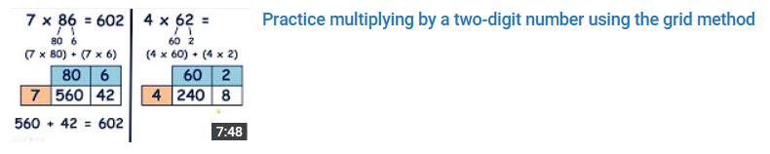

Slide 15
5 x 46 =
230
8 x 55 =
440
40
6
50
5
(5 x 40) + (5 x 6)
(8 x 50) + (8 x 5)
40
6
50
5
5
200
30
8
400
40
200 + 30 = 230
400 + 40 = 440

Slide 16
7 x 86 =
602
4 x 62 =
248
80
6
60
2
(7 x 80) + (7 x 6)
(4 x 60) + (4 x 2)
80
6
60
2
7
560
42
4
240
8
560 + 42 = 602
240 + 8 = 248

Slide 17
4 x 56 =
224
9 x 67 =
603
50
6
60
7
(4 x 50) + (4 x 6)
(9 x 60) + (9 x 7)
50
6
60
7
4
200
24
9
540
63
200 + 24 = 224
540 + 63 = 603

Slide 18
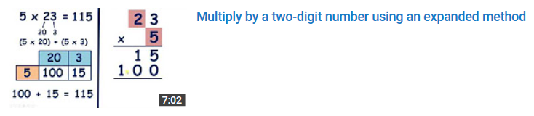

Slide 19
9 x 16 =
144
1 6
10
6
9
x
(9 x 10) + (9 x 6)
5
4
10
6
9
0
9
90
54
1
4
4
90 + 54 = 144
1

Slide 20
5 x 23 =
115
2 3
20
3
5
x
(5 x 20) + (5 x 3)
1 5
20
3
1 0
0
5
100
15
1
1
5
100 + 15 = 115

Slide 21
6 x 34 =
204
3 4
30
4
6
x
(6 x 30) + (6 x 4)
2 4
30
4
1 8
0
6
180
24
2
0
4
180 + 24 = 204
1

Slide 22
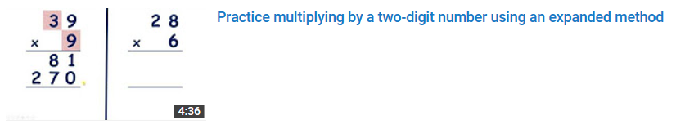

Slide 23
7 1
3 5
2
4
x
x
2
2 0
1 4
0
1 2
0
1
4
2
1
4
0

Slide 24
3 9
2 8
9
6
x
x
8 1
4 8
2 7
0
1 2
0
3
5
1
1
6
8
1

Slide 25
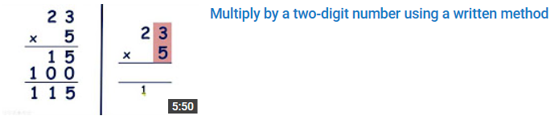

Slide 26
1 6
1 6
9
x
9
5
4
x
9
0
1 4
4
1
4
4
5
1

Slide 27
2 3
2 3
5
x
5
1 5
x
1 0
0
1 1
5
1
1
5
1

Slide 28
3 4
3 4
6
x
6
2 4
x
1 8
0
2 0
4
2
0
4
2
1

Slide 29
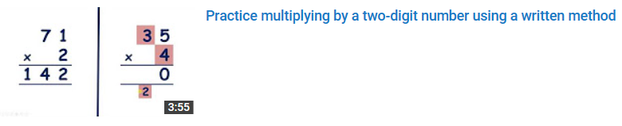

Slide 30
7 1
3 5
2
4
x
x
1 4
2
1 4
0
2

Slide 31
3 9
2 8
9
6
x
x
3 5
1
1 6
8
8
4

