Slide 1

Non-Chronological Reports
Year 3
Lesson 1

Slide 2





It means you should do three things before asking your teacher!
BRAIN
BOARD
BUDDY
BOSS
3B4ME
Using this strategy also helps you to become a more INDEPENDENT LEARNER!
Using this strategy means you will learn to depend on EACH OTHER for support, information and instructions.
It creates LESS disruptions in the classroom and means your teacher doesn’t have to repeat instructions multiple times!
Do you know what this means?
Mr McSchemey

Slide 3

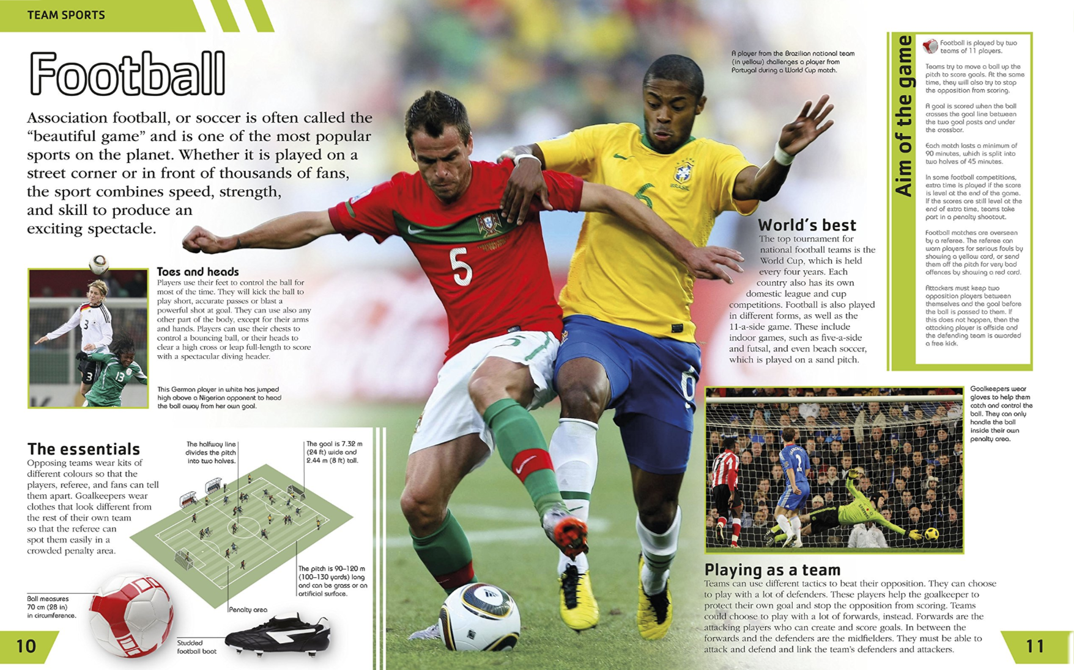

LO:To identify features of non-chronological reports
1
FICTION
NONFICTION
Who has read this book before?
What is different about this type of text and the Horrid Henry book?
Starter

Slide 4
1
LET’S READ...
Extract taken from the DK Children’s Book of Sport

Slide 5

1
What are the FEATURES of a non-chronological report?
Title
Fact Box
Sub-headings
Where else can you see an example of a:
Sub-heading?
Paragraph?
Introduction
Paragraphs
Now let’s take an even closer look...
Extract taken from the DK Children’s Book of Sport

Slide 6
1
What are the FEATURES of a non-chronological report?
Association football
Is this information true or false?
True.
This feature is known as ‘factual writing’.
Association football, or soccer is often called the ‘beautiful game’ and is one of the most popular sports on the planet. Whether it is played on a street corner or in front of thousands of fans, the sport combines speed, strength, and skill to produce an exciting spectacle.
is
is
Which tense is this written in?
The present tense.
speed
strength
skill
What do we class this language as?
Technical language.
Third person!
Do you think ‘spectacle’, ‘accurate’ and ‘powerful’ are examples of formal or informal language?
Is this written in first or third person?
Formal!
Players use their feet to control the ball most of the time. They will kick the ball to play short, accurate passes or blast a powerful shot at the goal.
Extract taken from the DK Children’s Book of Sport

Slide 7

1
The FEATURES of a Non-Chronological Report
FEATURE |  | FEATURE
Topic Title (The subject) |  | Factual Language
Brief Introduction (who, what, where) |  | Present Tense
Paragraphs |  | Technical Language
Sub-headings |  | Third Person
Fact Boxes or Bullet-points |  | Formal Tone
So here are our features!

Slide 8

1
3B4ME
Activity
Success Criteria
To recognise the differences between fiction and nonfiction texts
To read and discuss the features of a non-chronological report
To identify features of non-chronological reports
You will now be given an example of a non-chronological report to stick into your books.
On your ‘tick sheet’, look for examples of each feature and complete the sheet.
Stick in your tick sheet when you’re finished!

Slide 9
See Resources
The FEATURES of a Non-Chronological Report
Tick the relevant features as you identify them in your example text
FEATURE |  | Example(s) | FEATURE |  | Example(s)
Topic Title (The subject) |  |  | Factual Language
Brief Introduction (who, what, where) |  |  | Present Tense
Paragraphs |  |  | Technical Language
Sub-headings |  |  | Third Person
Fact Boxes or Bullet-points |  |  | Formal Tone

Slide 10

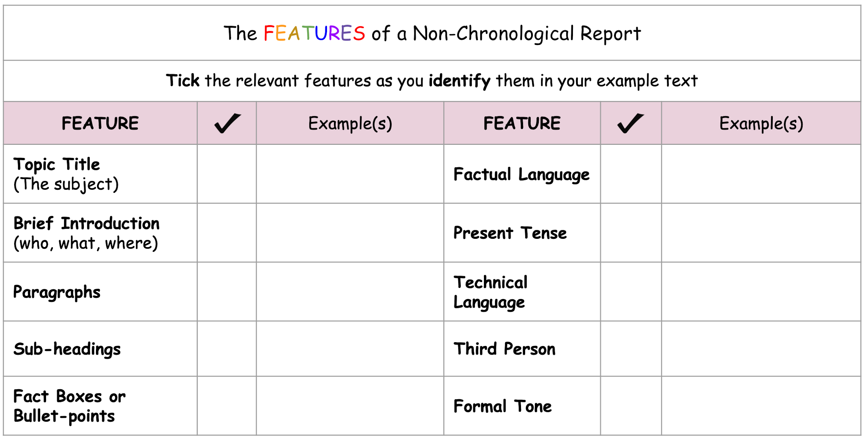
1
What did
you find?
Plenary

