Slide 1
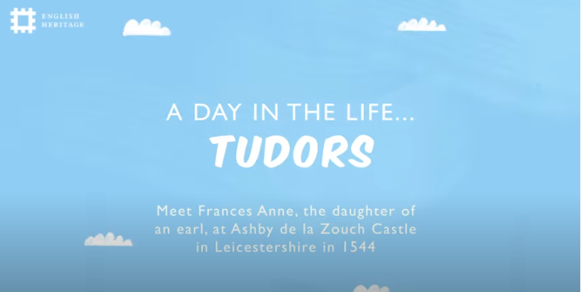

Slide 2
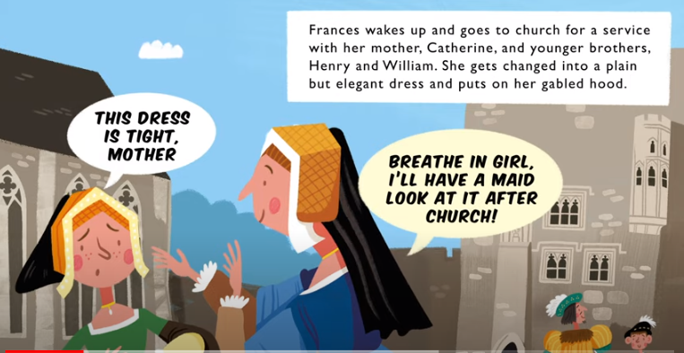

Slide 3
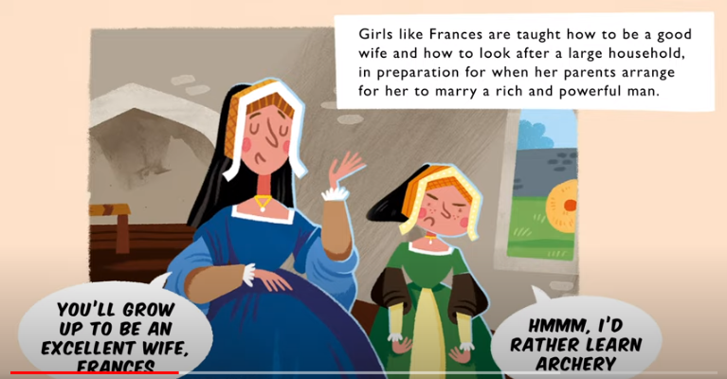

Slide 4
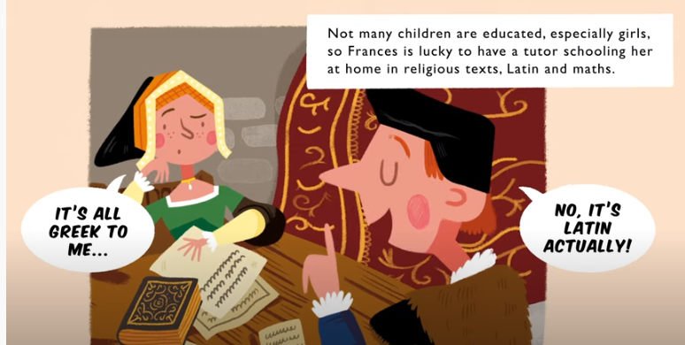

Slide 5
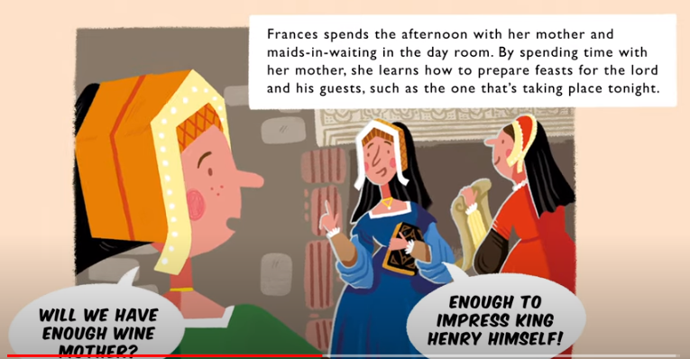

Slide 6
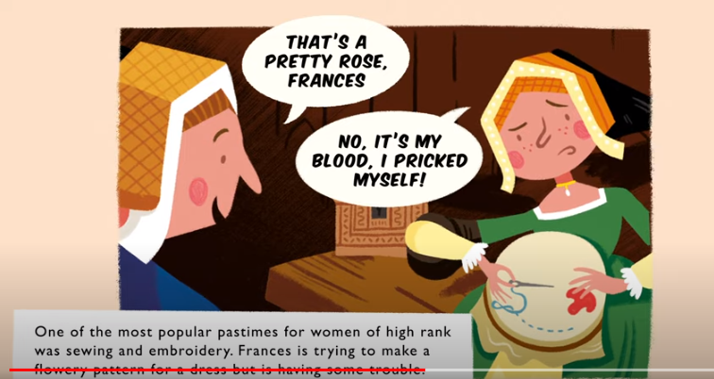

Slide 7
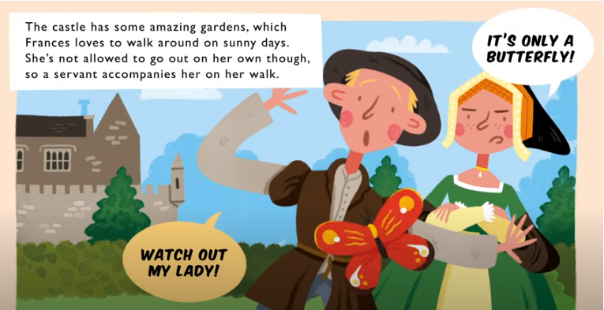

Slide 8
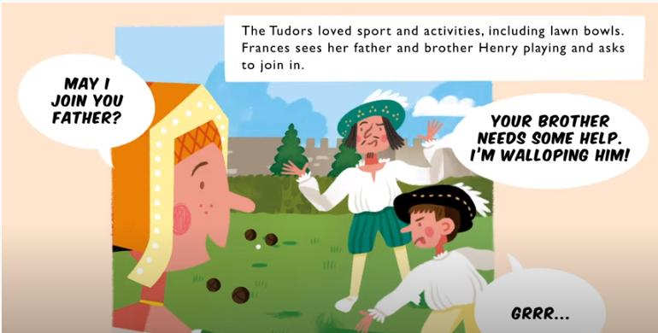

Slide 9
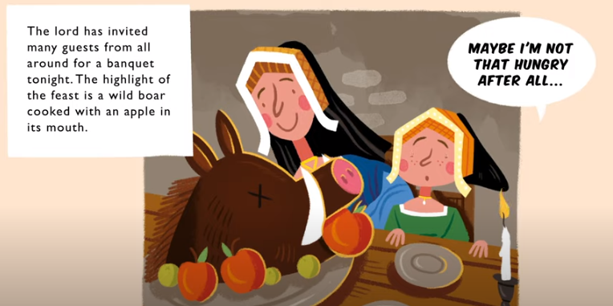

Slide 10
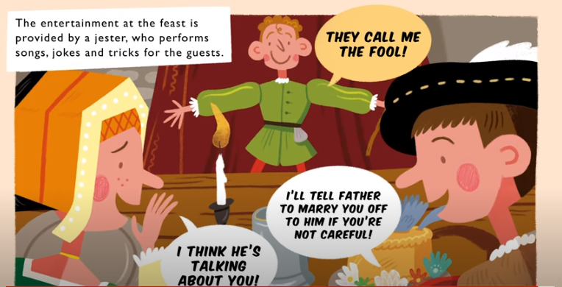

Slide 11
Dear Diary,
What a busy day I have had! First thing this morning, we had to go to Church and I had to wear the green frock that is really too small. I moaned a lot and Mother said she would get the maid to look at it. It pinches and is so uncomfortable.
After that I had to help Mother and do my good wife learning – it's SO boring, I wish I could be out shooting arrows like my brothers. Life is very unfair. To make matters worse, then it was time for my Latin lesson, which I really hate even though they tell me I am very lucky to be book learned.
Later on it was time to check the kitchens were prepared for the feast Father had planned for the evening. Mother said we've got enough food to feed an army!
I finally got the chance to get out into the gardens although I did have to put up with drippy John, he's such a bag of nerves even a butterfly frightened him, the wimp! Father was beating Henry at bowls so we joined forces and tried to turn the game, without success, Dad is a demon bowls player.
The feast was spectacular with great entertainment from the jester. I teased Henry and he got really grumpy. The food was glorious – roast boar and apple – delicious! I was more than ready for bed by the end of the evening and have only just managed to scrawl my entry for today.
Love Frances

