Slide 1
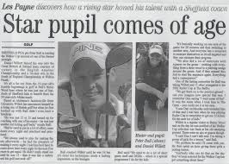
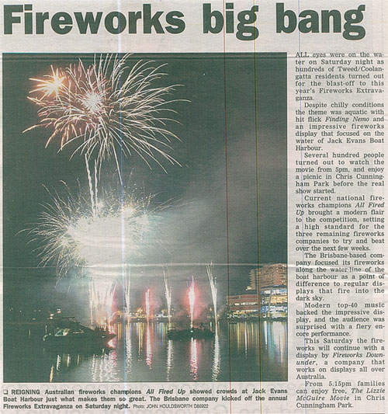

Slide 2
LI: I am able to write an effective headline.

Slide 3
Steps to Success
I can match a headline to a story.
I can discuss what makes an effective/catchy headline.
I can write an effective headline.
I can write headlines with contrasting viewpoints and/or bias.

Slide 4


What is a headline?
What could this be headline be about?

Slide 5
What makes a good headline?
Discuss between you…

Slide 6

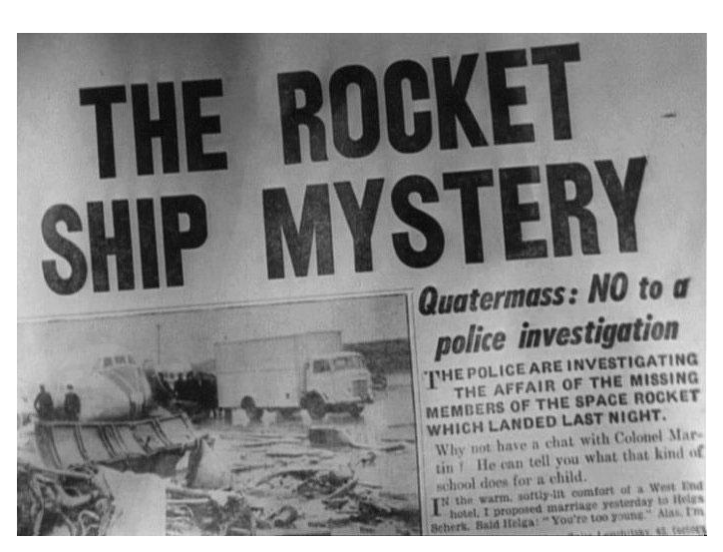
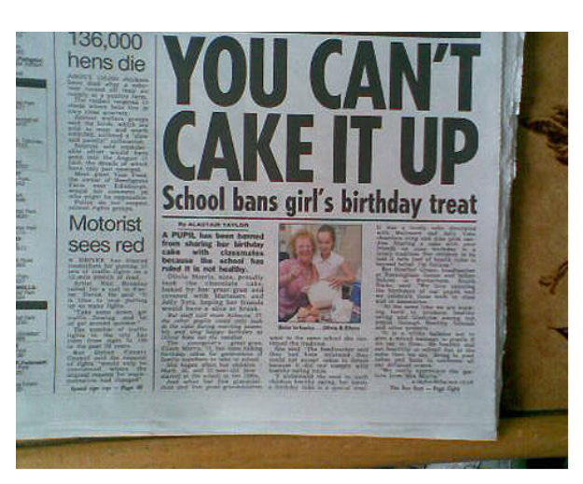
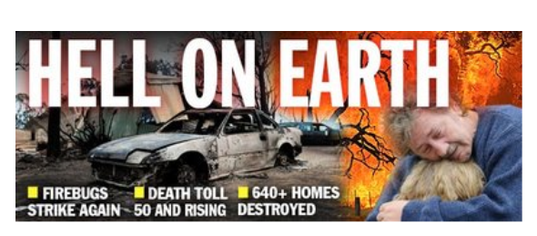

Slide 7
Headlines should be…
Short
To the point.
Eye-Catching
BIG
Bold
Interesting

Slide 8
Puns
A word in a sentence that can have two meanings.
This word is called a Homophone – this is a word that sounds the same as another but is spelt differently and has a different meaning
For example – Write/right, Bare/bear, Flower/flour, Hare/Hair.

Slide 9
Examples
Peace of cake
Sew it’s time
Bare face liars
Christmas shoppers stocking up
Witch Halloween costume is for you

Slide 10
Letter play (play on words)
Sometimes writer will change a letter or a part of the word to give a double meaning.
Examples…
Truck by lightning
Tantastic!
A jab well done.

Slide 11
Alliteration
Often using the same letter sound at the start of your words can create an interesting effect.
Examples…
Sending up the stars and stripes.
Greedy girl gobbles gruel.
Big bad bear bites boy.

Slide 12
Rhyme
Green queen, glass with class.
Hare affair.
Tissue issue.

Slide 13
Now your turn…
With your learning partner! Choose one of these pictures and create a headline.
Try to use one of the language effects in headlines of your own:
Puns
Letter Play
Alliteration
Rhyme

Slide 14
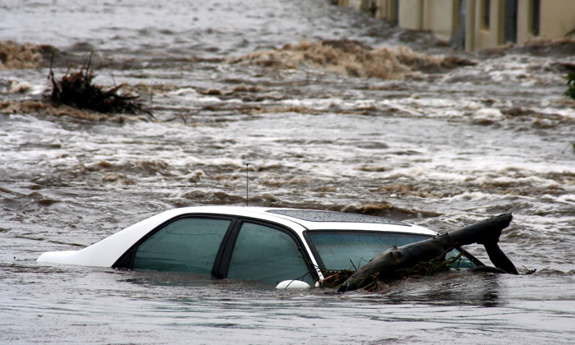
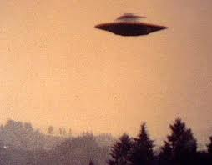
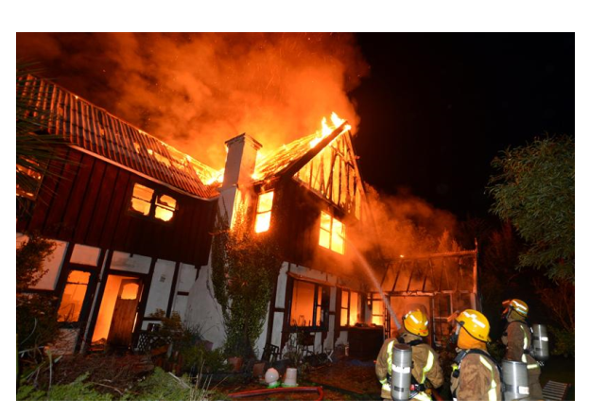
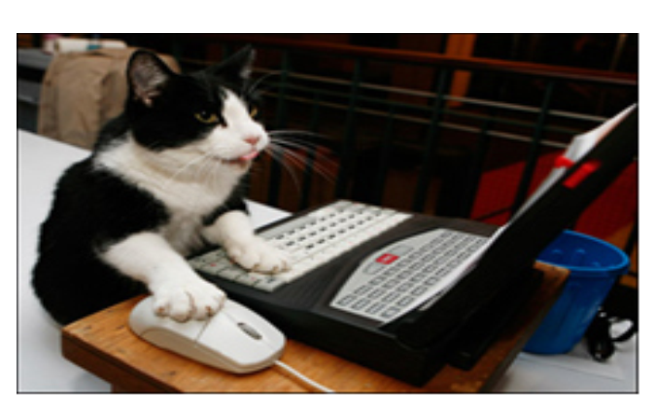

Slide 15
Are you making your headline for...
Tabloid
Mid range newspaper
Broadsheet

Slide 16
LI: I can discuss the use of images in newspapers.

Slide 17
Steps to Success
I can explain why pictures are used.
I can explain what is happening in the background, middle and foreground on a picture.
I can write an effective caption for a picture.
I can discuss how different parts of a picture can show a different viewpoint/bias.

Slide 18
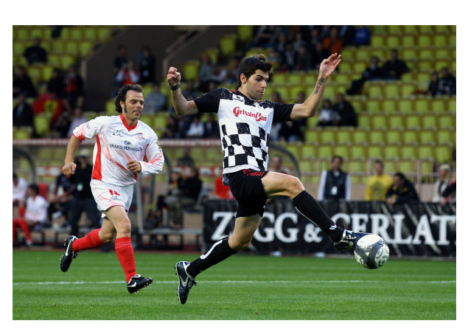
You have 5 seconds!

Slide 19
What do you remember?
What do you remember most?
Look again, examine the…
Background
Middle
Foreground
What is going on
Is it posed or unposed
What do you think happened before/after?

Slide 20
What is a caption?
A brief description or explanation.
Describes an illustration, graph or picture.
The main purpose of a caption is to help the newspaper reader to understand what they see in the newspaper.
It should be brief, witty, and straight to the point.

Slide 21
Example
Young leaps to the finish, scoring in a nail biting game.

Slide 22
Can you write a caption for one of these photos?

