Slide 1

Fractions
A starter guide to understanding fractions

Slide 2
Star words
Whole
Part
Split
Divide
Equal
Unequal
Vinculum
Denominator
Numerator
Quantity
Array

Slide 3
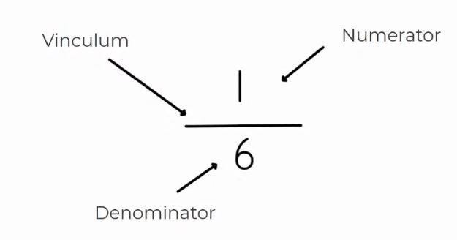

Slide 4
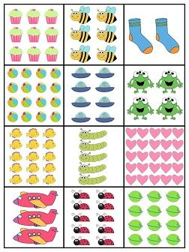
How many cakes? (The whole) What is 1/3 of this number?
There are 6 bees, half the number of bees is 3. True or false?
Could we find 1/5 of the socks?
What is half the number of balls?
What is ¼ of the spaceships?
1 frog is equal to ¼ of all the frogs. True or false?
Who can come up with some fraction statements for the other arrays?

