Slide 1
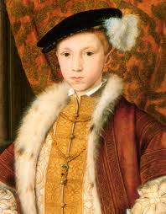
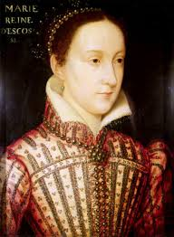
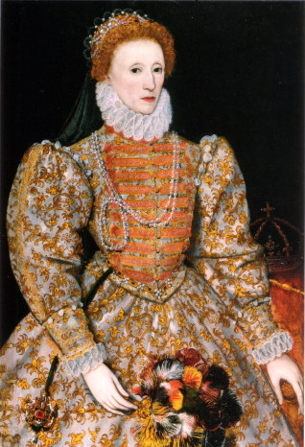
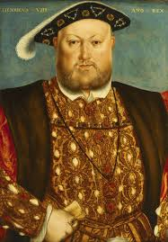
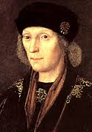
 | Henry VIII | 1553 - 1558
 | Edward VI | 1509 - 1547
 | Henry VII | 1558 - 1603
 | Elizabeth I | 1485 - 1509
 | Mary I | 1547 - 1553
Notes:
Here are all the Tudor monarchs but the pictures, names and dates are all jumbled. Can you sort them out? Either cut and paste or draw your own versions on paper.

