Slide 1


Thursday
Step: Four operations with lengths

Slide 2


Problem
solving
A balloon is 23 cm in length.
The string is 32 cm in length.
What is the combined length of the balloon and the string?
23 cm
+
32 cm
=
55 cm
55
The total length of the balloon and string is __________ cm.

Slide 3
Problem
solving
String A measures 17 cm long.
String B measures 16 cm long.
What is the combined length of both strings?
17 cm
+
16 cm
=
33 cm
33
The total length of string is __________ cm.

Slide 4

Problem
solving
Each sweet measures 3 cm in length.
There are 9 sweets in total.
What is the total length of 9 sweets?
3 cm
x
9
=
27 cm
27
The total length of 9 sweets is __________ cm.

Slide 5

Problem
solving
A length of rope measures 8m.
5m is cut off the rope.
How much rope is left?
8 m
-
5 m
=
3 m
3
There is _______ m of rope left.

Slide 6
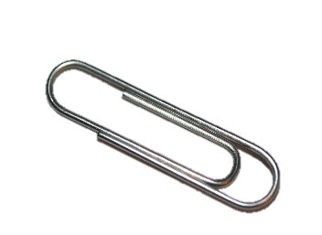
Problem
solving
Kat put 12 paper clips in a straight line.
Each paper clip is 3 cm long.
How long is the line?
3 cm
x
12
=
36 cm
36
The total length of the line is __________ cm.

