Slide 2

What Is Shabbat?
Shabbat is an exciting and important day that
Jewish people look forward to all week.
For Jewish people, Saturday is a special
day, just like Sunday is special to
Christians.
Shabbat is the fourth commandment: ‘You shall remember to keep the Sabbath day Holy.’ Saturday was the seventh day of the week and the day that God rested after creating the world. Ever since ancient times, Jewish people have kept the Sabbath day Holy by celebrating Shabbat.

Slide 3
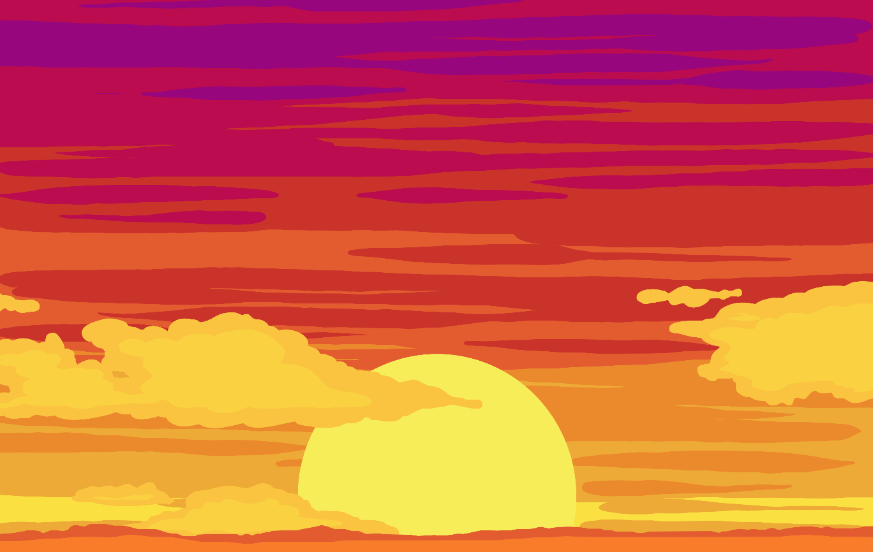
When Is Shabbat?
It happens every weekend, beginning on Friday evening, and ending Saturday evening.
On Friday, families work hard to prepare food, clean their houses and lay their dining tables ready for Shabbat.

Slide 4
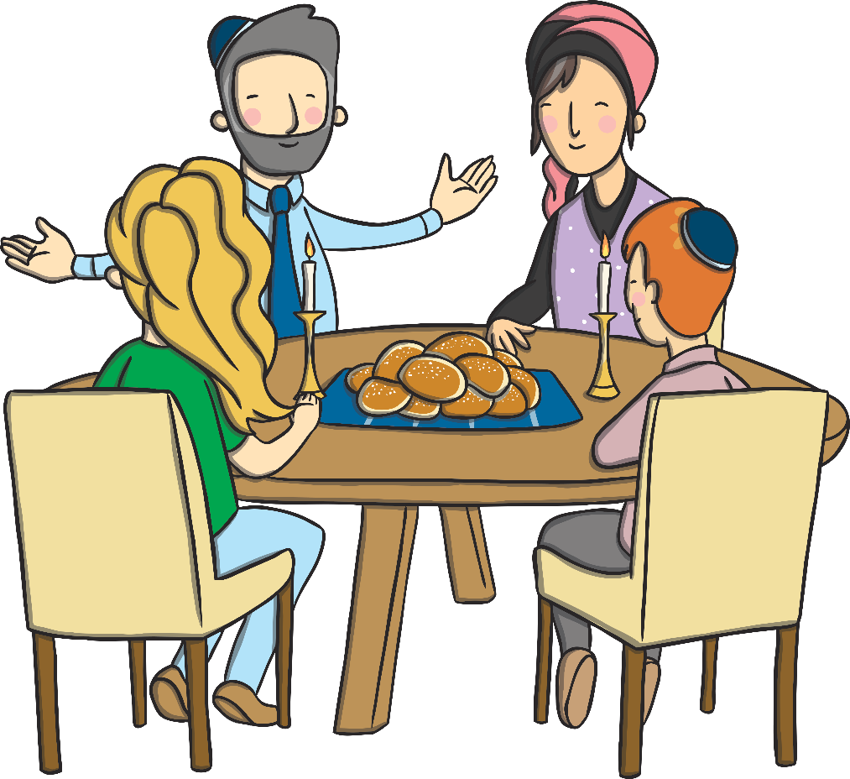
How Is Shabbat Celebrated?
When Shabbat begins on Friday evening,
everyone puts on their best clothes and
gather for a special meal. Other
family members or friends may
join the family for this special
occasion.
There are lots of traditions that take place at a Shabbat meal.

Slide 5
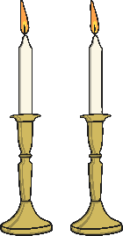
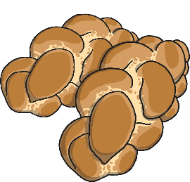

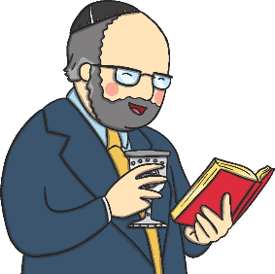
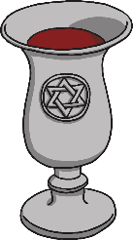
Shabbat Traditions
Shabbat Candles
are lit on the
dinner table.
Challah bread
is eaten.
Wine (or grape juice) is shared in a Kiddush cup.
Blessings
are recited.

Slide 6
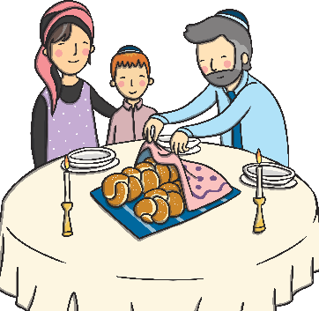
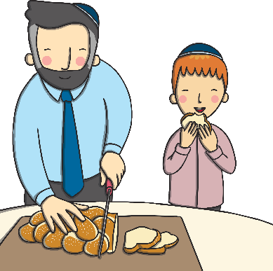
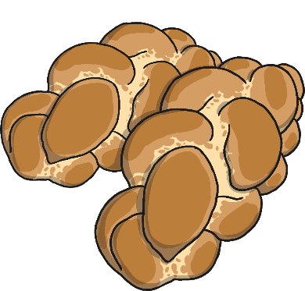
Challah Bread
Challah is a special plaited loaf that is bought fresh on Friday morning, ready for the Shabbat.
Two loaves are always bought together.
The loaves are covered with a special Challah cover, so they can’t ‘see’ the wine when it is blessed.
Challah tastes much sweeter than normal bread. This helps remind people that Shabbat is special.

Slide 7
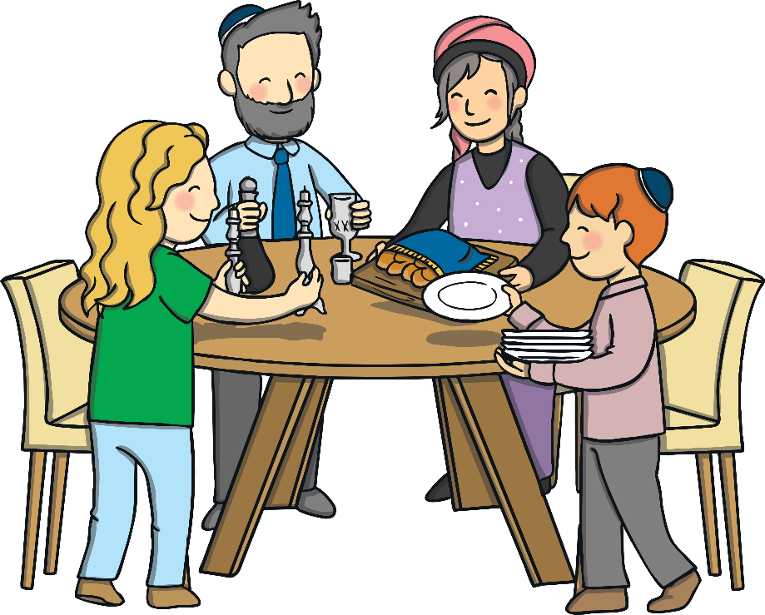

Other Customs
Families will visit a Synagogue during Shabbat.
No work can be done. Including homework!
Havdalah is the end of Shabbat. A special plaited candle is lit and prayers are read. Special spices are smelt and finally the candle is put out in the wine.
Families enjoy talking together. Children can stay up late and tell and listen to stories. Songs
are sung.

