Slide 1


Tuesday
Step: Make tally charts

Slide 2



Fluency
Complete the tally chart:
Colour | Tally | Total
Red
Blue
Green
8
9
4

Slide 3
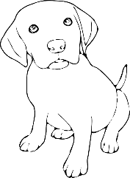




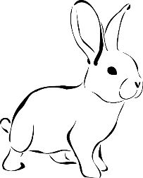

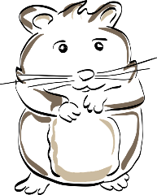
Fluency
Complete the tally chart:
Animal | Tally | Total
Dog
Cat
Rabbit
Hamster
9
8
6
4

Slide 4






Fluency
Complete the tally chart:
Fruit | Tally | Total
Apple
Banana
Orange
Grapes
Pear
12
6
3
9
2

Slide 5




Fluency
Complete the tally chart:
Colour | Tally | Total
Red
Blue
Green
13
11
9

Slide 6

Fluency
Complete the tally chart:
Animal | Tally | Total
Dog
Cat
Rabbit
Hamster
14
15
11
8

Slide 7







Fluency
Complete the tally chart:
Fruit | Tally | Total
Apple
Banana
Orange
Grapes
Pear
20
9
8
17
6

Slide 8





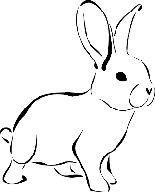

The tally chart I have created is correct.
Animal | Tally | Total
Dog |  | 10
Cat |  | 9
Rabbit |  | 6
Is Matt correct? Explain your answer.
No. The total for the dog row is wrong it should be 9.

Slide 9
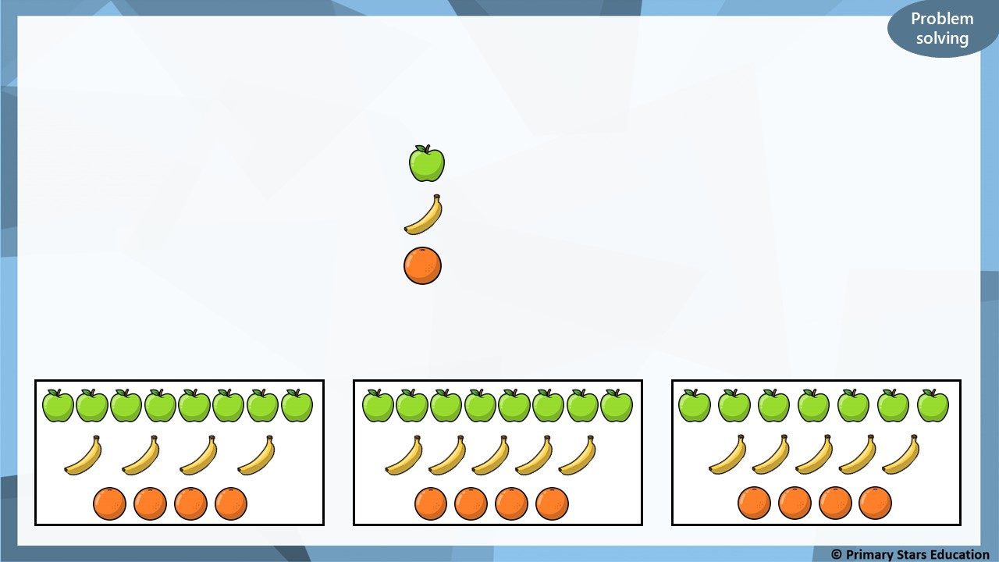




Tick (✓) the box that represents the tally chart.
Fruit | Tally
Apple
Banana
Orange
✓

