Slide 1
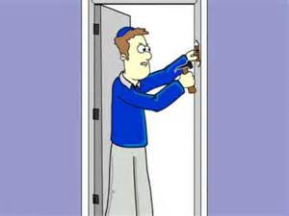
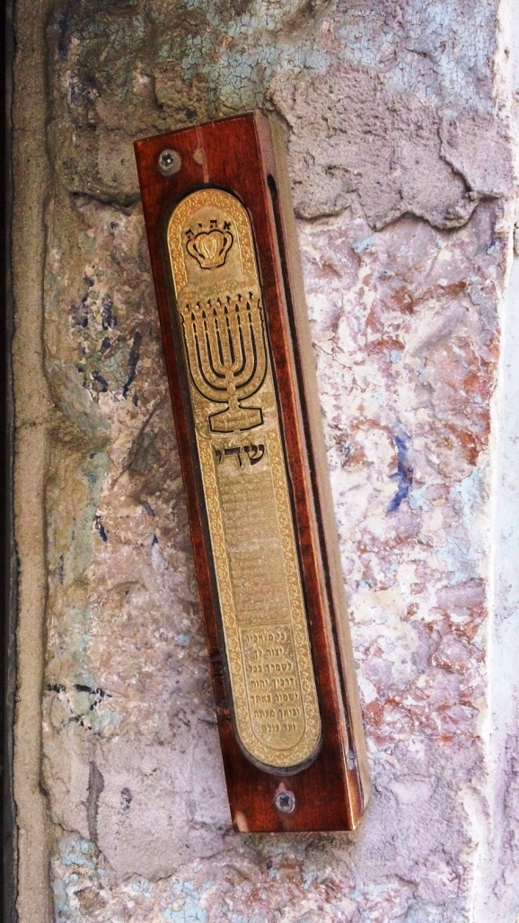
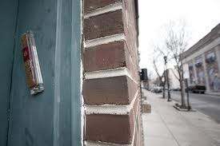
The Mezuzah
Aim: To investigate the purpose and symbolism of the Mezuzah.

Slide 2
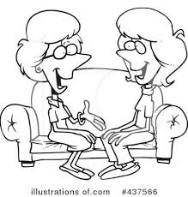
Q. When you visit a friends house. What do you do before you go in?

Slide 3
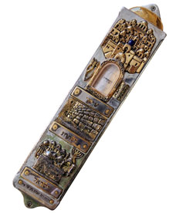
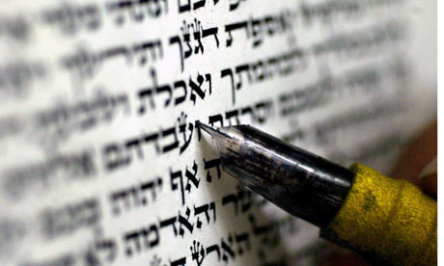
What is a Mezuzah?
The Mezuzah is a decorated box which Jewish people attach to their door posts.
It contains the ‘Shema’ a very important Jewish Prayer.
Jewish people will touch it when entering their homes.

Slide 4
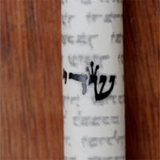
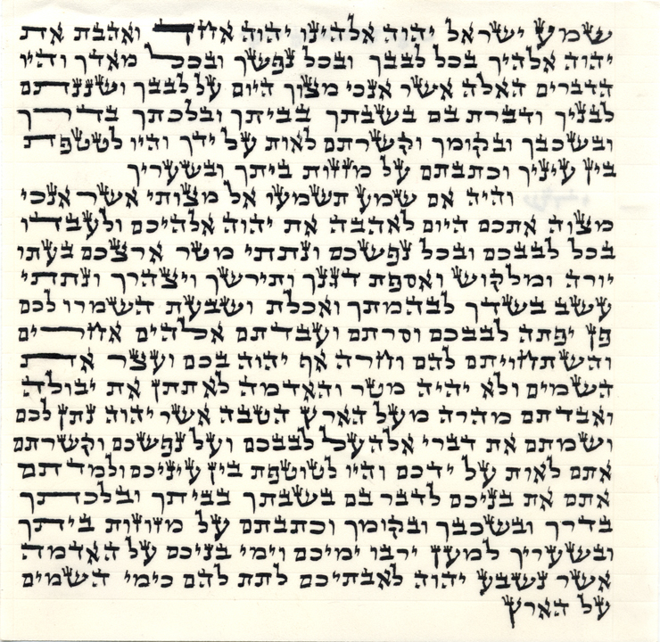
What is inside a Mezuzah?
Hear, O Israel, the Lord is our God, the Lord is one. You shall love the Lord, your God, with all your heart, with all your soul.

Slide 5

The Mezuzah attaches to the door post.
The mezuzah can be found on the door frames of many Jewish homes. It is placed on a slight angle on the right-hand side of every door frame in the house. The only door frame in the house that it is not placed on is the bathroom door.
Notes:
https://youtu.be/7xH35pa8L1k

Slide 6
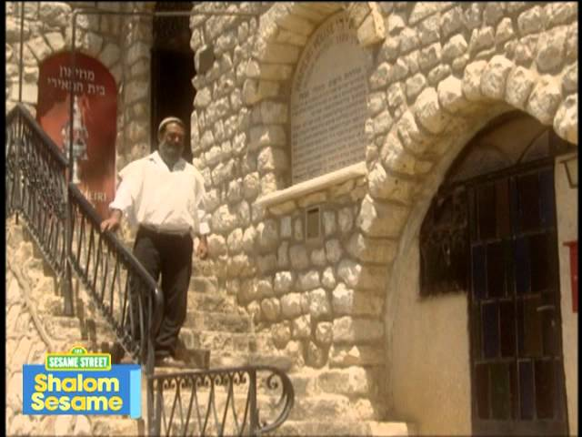
Let’s find out more…
https://youtu.be/DiMUYnhDYDo
Notes:
https://youtu.be/7xH35pa8L1k
https://youtu.be/DiMUYnhDYDo

Slide 7
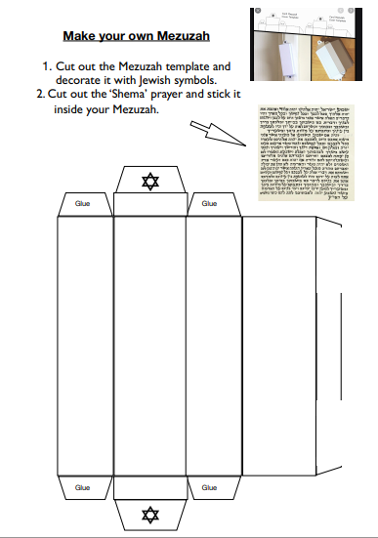
Make your own Mezuzah
Follow the instructions on the sheet to create your own Mezuzah.
Decorate it with Jewish symbols.
Put the Shema scroll inside the Mezuzah before you glue it together.

Slide 8
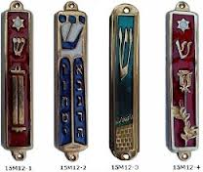
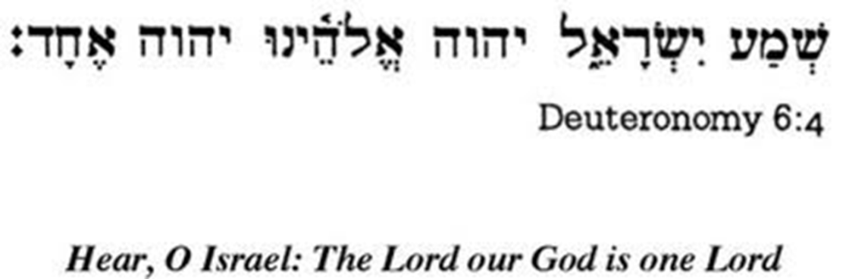
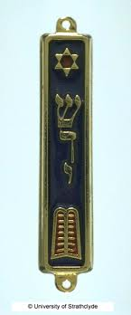
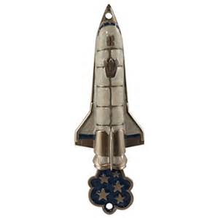
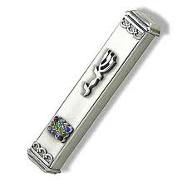
Ideas how to
decorate your
Mezzuah

