Slide 1


Monday
Step: Make tally charts
What is a tally?
What is a tally chart?

Slide 2



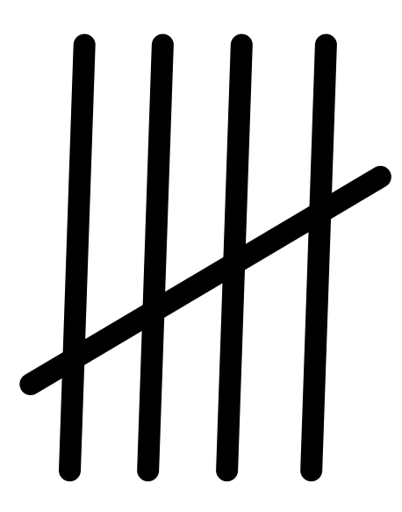

Fluency
What does each tally represent?
= 1
= 4
= 2
= 5
= 3

Slide 3
Fluency
What is this tally showing?
=
5

Slide 4
Fluency
What number does the tally represent?
=
2

Slide 5
Fluency
What number does the tally represent?
=
1

Slide 6
Fluency
What number does the tally represent?
=
4

Slide 7
Fluency
What number does the tally represent?
=
3

Slide 8
Fluency
What number does the tally represent?
=
8

Slide 9
Fluency
What number does the tally represent?
=
7

Slide 10
Fluency
What number does the tally represent?
=
13

Slide 11
Fluency
What number does the tally represent?
=
11

Slide 12
Fluency
Why do we use tally charts?
It makes it easier to count data as the data can be grouped in 5s.

Slide 13
Fluency
Let’s make a tally chart

Slide 14
Problem solving
Questions from practical lesson:
How many voted for each option? | What was the most popular? How many votes? | What was the least popular? How many votes?
How many people voted in total? | What was the difference in votes between the most popular and least popular? | Can you represent this data in another way? Show it.

