Slide 1


Tuesday
Step: Divide by 10

Slide 2
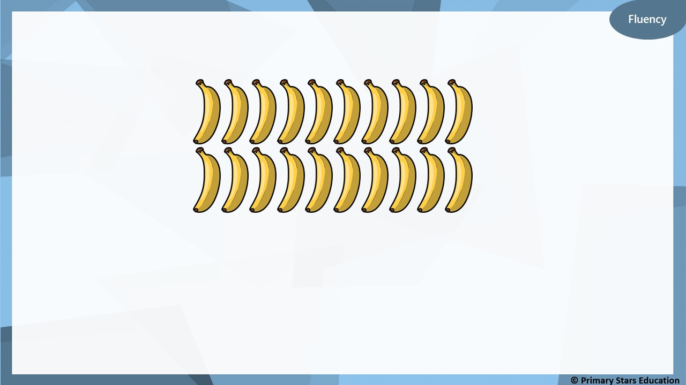
Bananas can be sold in packs of 10.
How many packs can be made?
2
When 20 bananas are sold in packs of 10, _____ packs of bananas can be made.
20
10
10

Slide 3
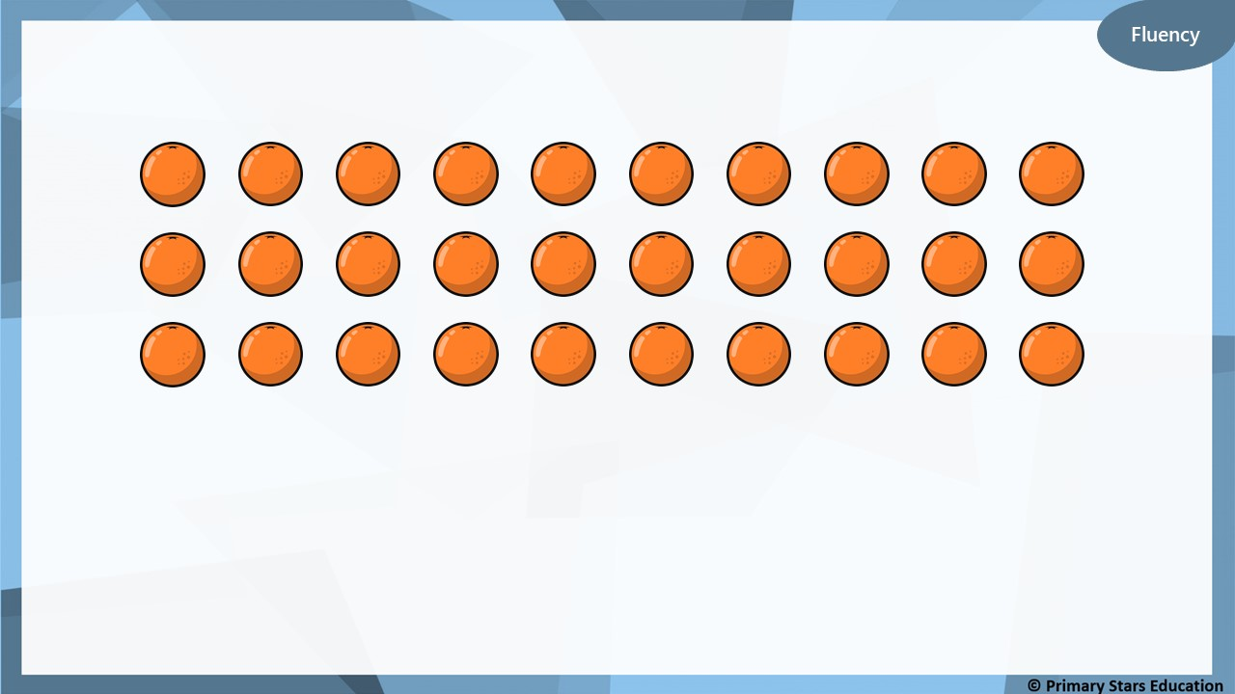
Oranges can be sold in packs of 10
How many packs can be made?
3
When 30 oranges are sold in packs of 10, _____ packs of
oranges can be made. Complete the bar model.
30
10
10
10

Slide 4
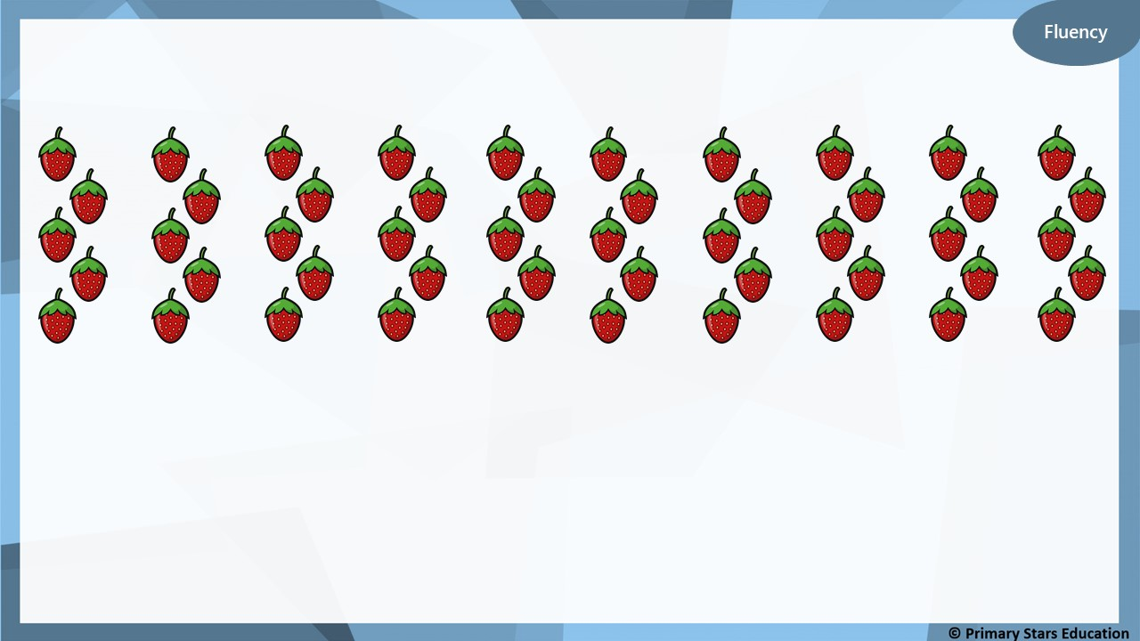
Strawberries can be sold in packs of 10
How many packs can be made?
5
When 50 strawberries are sold in packs of 10, _____ packs of
bananas can be made. Complete the bar model.
50
10
10
10
10
10

Slide 5
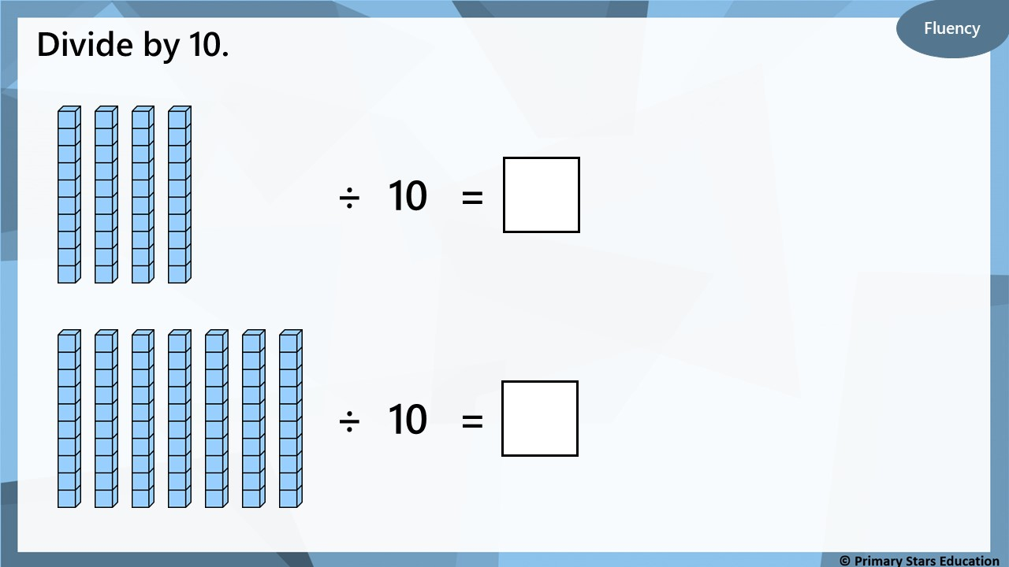
4
7

Slide 6
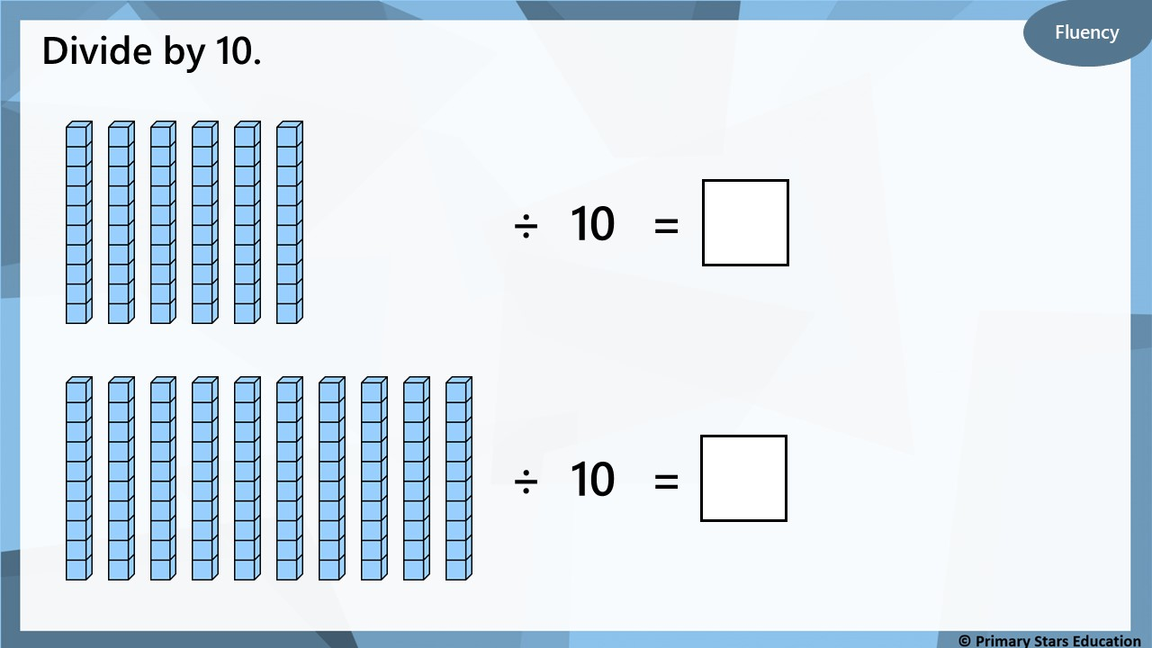
6
10

Slide 7
Fluency
Use the multiplication calculation to create a division
calculation.
3
x
10
=
30
9
x
10
=
90
30
÷
10
=
3
90
÷
10
=
9

Slide 8
Fluency
Use the multiplication calculation to create a division
calculation.
1
x
10
=
10
10
x
10
=
100
10
÷
1
=
10
100
÷
10
=
10

Slide 9

Which number sentence is incorrect and how do you know?
A) 4 x 10 = 40
B) 4 lots of 10 = 40
C) 40 ÷ 10 = 4
D) Forty ÷ ten = three
D is incorrect.
Forty divided by ten is 4 (not 3).

Slide 10
Problem solving
How many multiplication and division calculations can
you make?
List your calculations.
4
10
40
40 ÷ 10 = 4
40 ÷ 4 = 10
4 x 10 = 40
10 x 4 = 40

