Slide 1


Friday
Step: Divide by 5

Slide 2

Take 20 cubes.
How many towers of 5 can you make?
4
You can make _____ towers of 5.
_____ towers of 5 is the same as 20.
20 is the same as _____ towers of 5.
4
4

Slide 3

Take 30 cubes.
How many towers of 5 can you make?
6
You can make _____ towers of 5.
_____ towers of 5 is the same as 30.
30 is the same as _____ towers of 5.
6
6

Slide 4

How many towers of 5 can you make from 45 cubes?
9
You can make _____ towers of 5.
_____ towers of 5 is the same as 45.
45 is the same as _____ towers of 5.
9
9

Slide 5
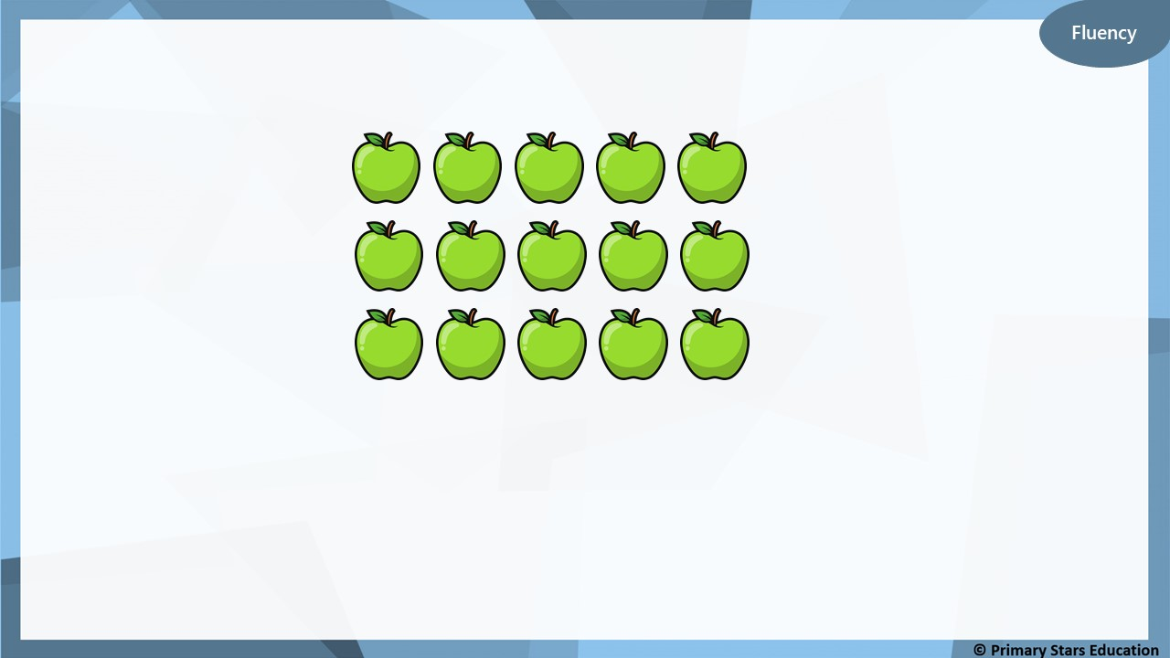
15 apples are shared between 5 horses.
3
How many apples will each horse get? _____
15
÷
5
=
3

Slide 6

Fluency
35 acorns are shared between 5 squirrels.
7
How many acorns will each squirrel get? _____
35
÷
5
=
7

Slide 7

50 pencils are shared between 5 children.
10
How many pencils will each child get? _____
50
÷
5
=
10

Slide 8

Group the 1p coins into 5s.
How many groups of 5 do we need to make 15p?
3
_____ groups of 5 1ps = 15 x 1p coins.
_____ groups of 5p = 15p.
15p = _____ x 5p.
15p ÷ 5p = _____.
3
3
3

Slide 9

Group the 1p coins into 5s.
How many groups of 5 do we need to make 25p?
5
_____ groups of 5 1ps = 25 x 1p coins.
_____ groups of 5p = 25p.
25p = _____ x 5p.
25p ÷ 5p = _____.
5
5
5

Slide 10
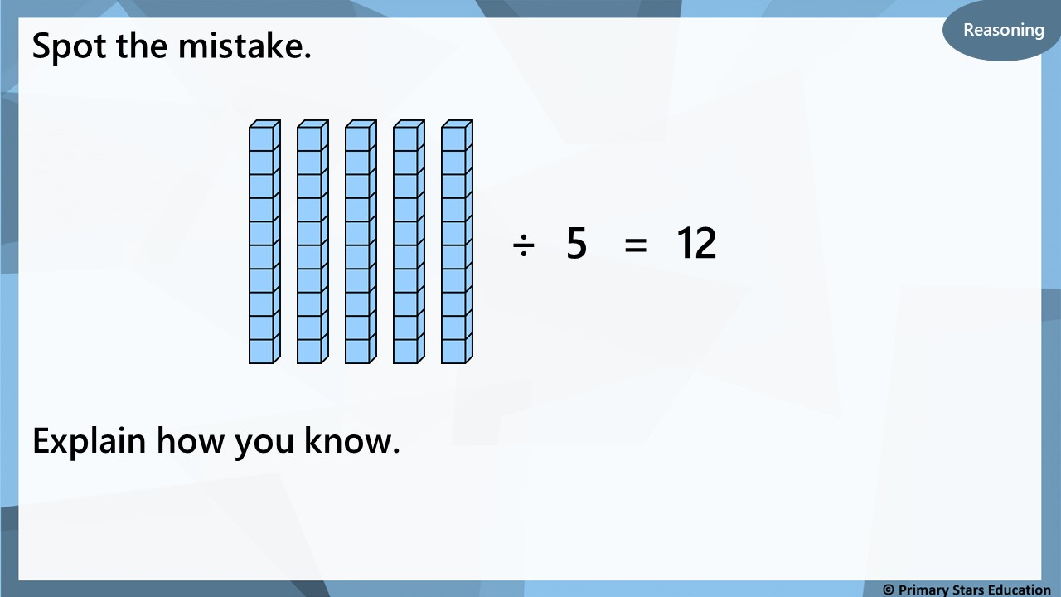
50 ÷ 5 = 10 (not 12).

Slide 11

My number is greater between 10 and 40. I have 5 equal groups.
What number could Ben have started with and how many
would be in each group?
Start with 35 ÷ 5 = 7 in each group.
Start with 30 ÷ 5 = 6 in each group.
Start with 25 ÷ 5 = 5 in each group.
Start with 20 ÷ 5 = 4 in each group.
Start with 15 ÷ 5 = 3 in each group.

