Slide 1


Thursday
Step: Divide by 5

Slide 2
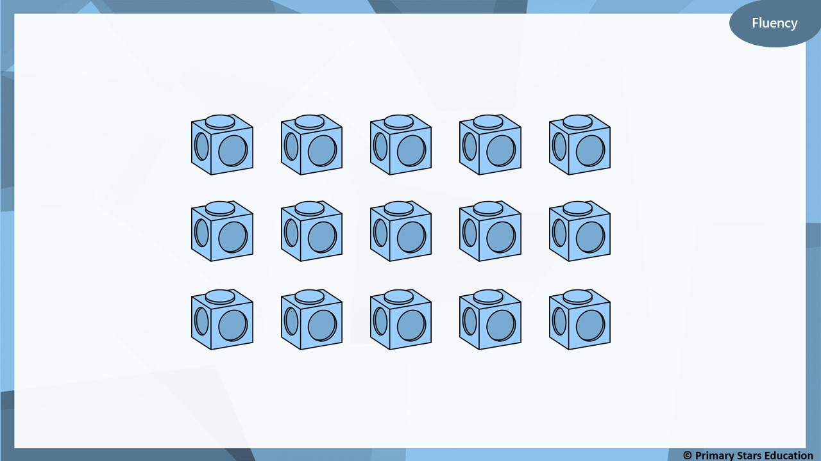
How many groups of 5 can you make?
3 groups of 5

Slide 3
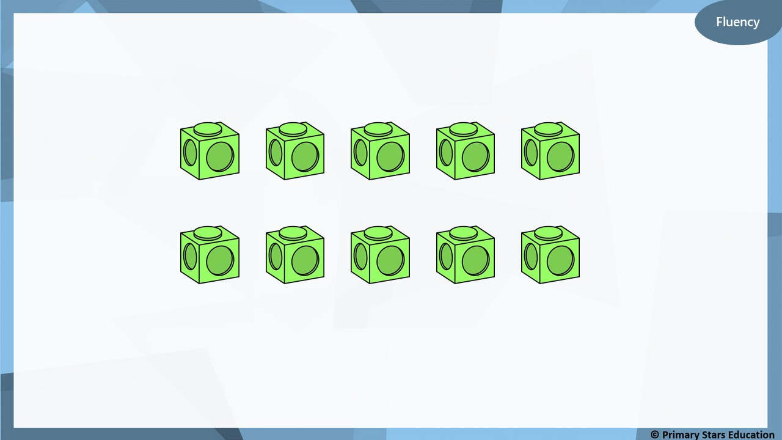
How many groups of 5 can you make?
2 groups of 5

Slide 4
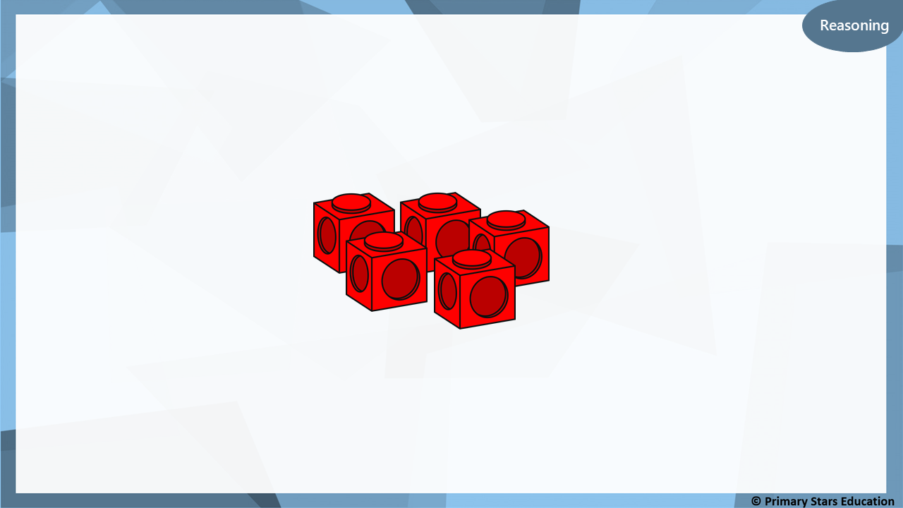
30 cubes will make 7 towers of 5.
True or false?
Explain your answer.
False.
30 cubes will make 6 towers of 5 as 30 ÷ 5 = 6 (not 7).

Slide 5
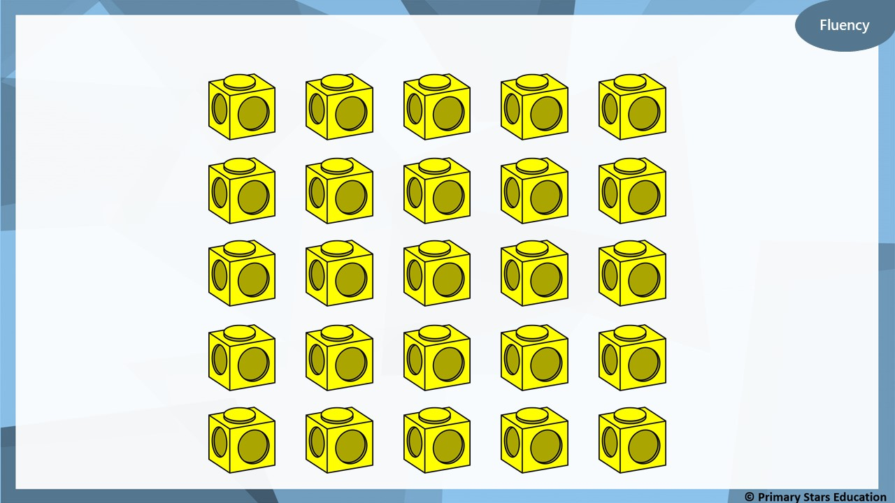
How many groups of 5 can you make?
5 groups of 5

Slide 6

Dom built a number of towers that are 5 cubes high.
How many towers could Dom have built?
List all possible answers.
The amount of cubes I started with was between 40 and 60.
9, 10 or 11 towers.

