Slide 1


Tuesday
Step: Odd and even numbers

Slide 2
Fluency
Put the numbers under the correct heading.
Odd | Even
1
11
6
14
3
15
8
16
9
17
12
20
3
17
20
6
14
11
16
8
15
9
12
1

Slide 3

Fluency
Which numbers are even?
15 1 60 19 22
40 29 50 9 5
58 25 3 10 7
30 87 12 11

Slide 4
Fluency
23? _______________
39? _______________
42? _______________
14? _______________
27? _______________
54? _______________
11? _______________
28? _______________
13? _______________
36? _______________
Are these numbers odd or even?
odd
even
odd
odd
even
even
even
odd
odd
even

Slide 5
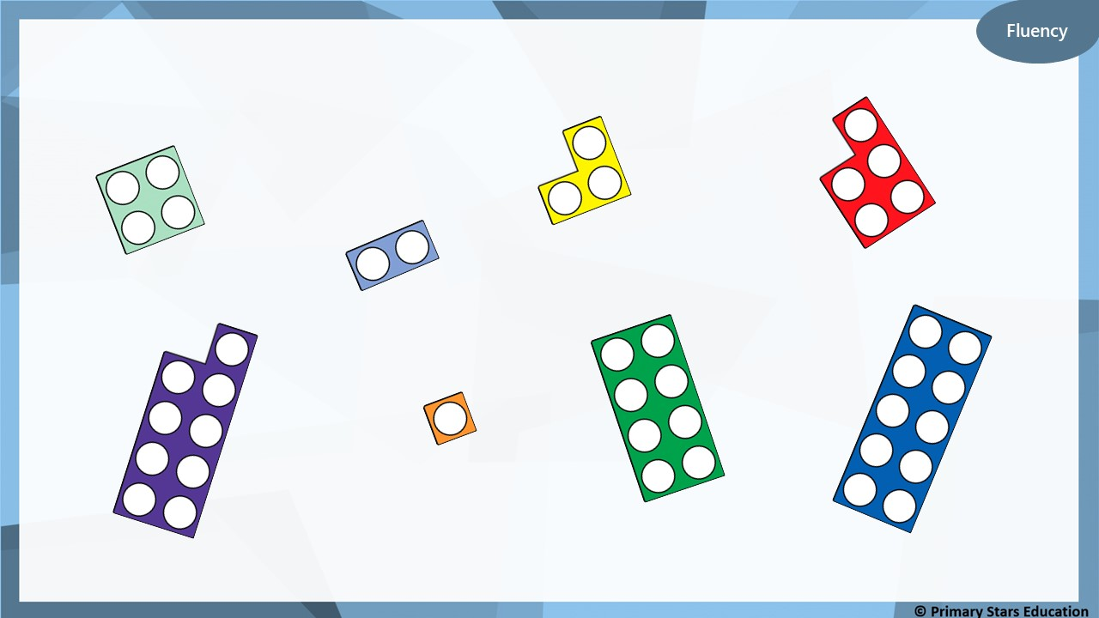
Which number frames are odd?

Slide 6
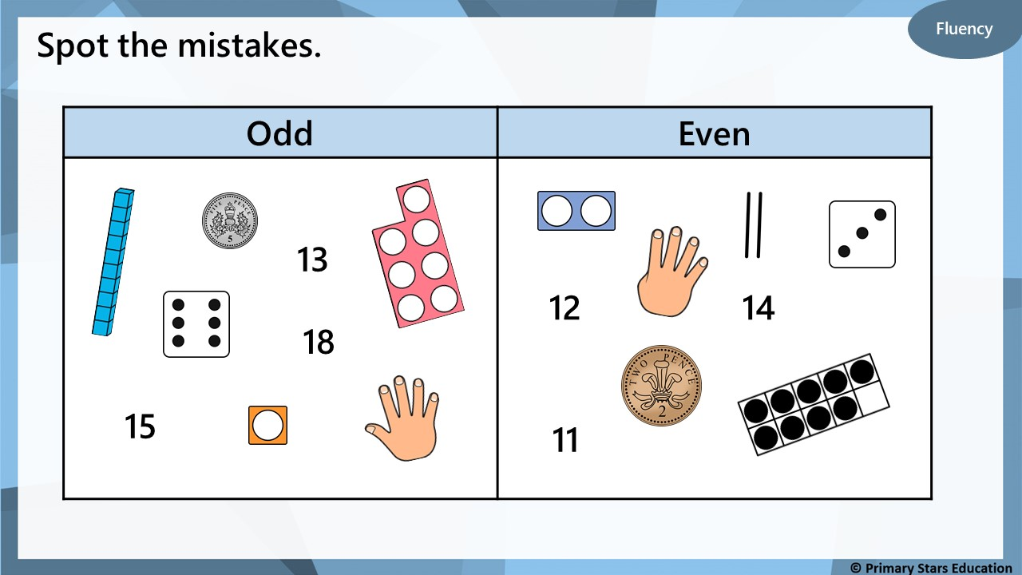

Slide 7
Reasoning
Jack has coloured 3 odd numbers yellow and 3 even
numbers red. What mistake has Jack made?
36 | 28 | 17 | 11 | 3 | 44
10 | 26 | 5 | 8 | 13 | 29
15 | 9 | 48 | 39 | 37 | 50
Jack has coloured 44 yellow.
It should not be yellow as it not an odd number.
44 is an even number.

Slide 8
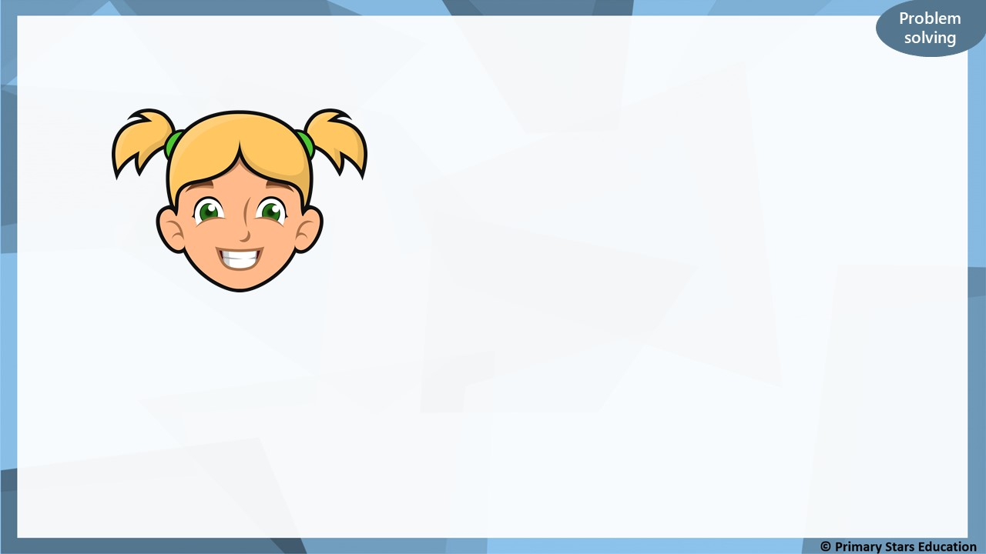
Kat says,
I am thinking of an odd number between
16 and 28.
What could Kat’s numbers be?
17, 19, 21, 23, 25, 27

