Slide 1


Monday
Step: Divide by 2

Slide 2
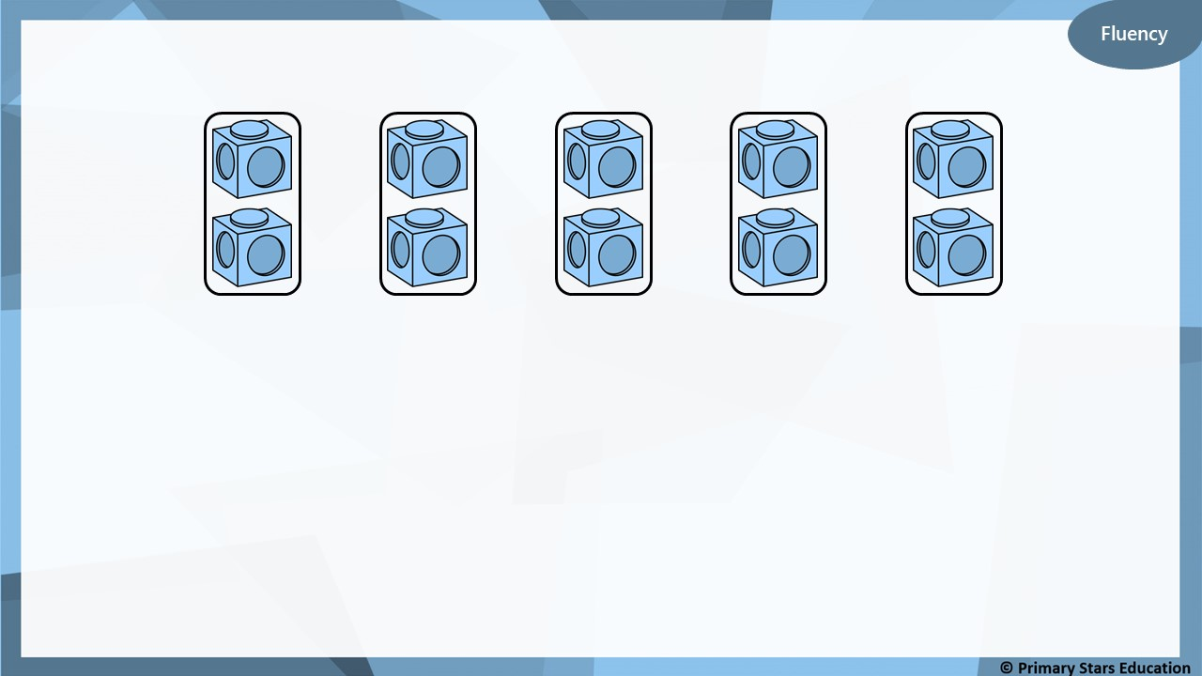
Complete the stem sentences.
10
10
5
2
There are ______ cubes altogether.
There are ______ in each group.
There are ______ groups.
÷
=
2
5
x
2
=
10
5

Slide 3
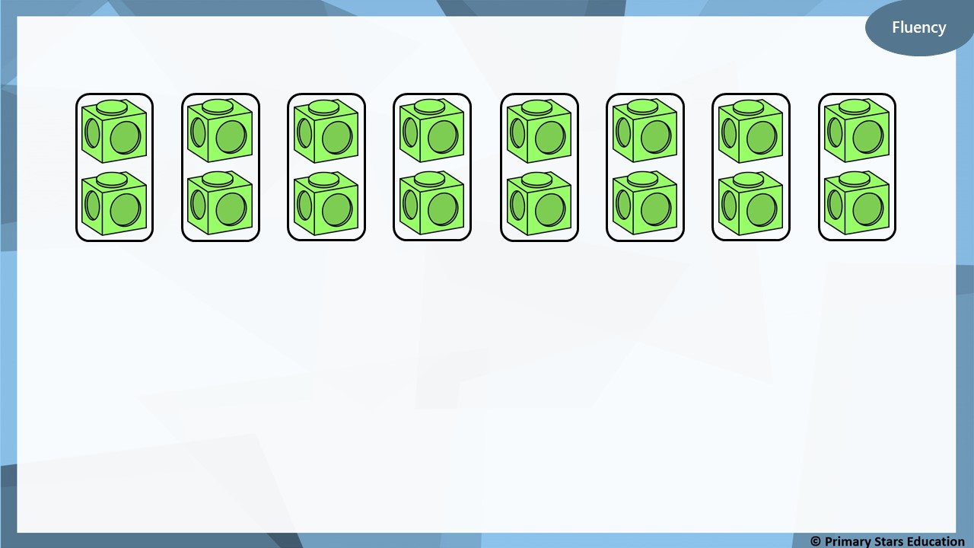
Complete the stem sentences.
16
16
8
2
There are ______ cubes altogether.
There are ______ in each group.
There are ______ groups.
÷
=
2
8
x
2
=
16
8

Slide 4
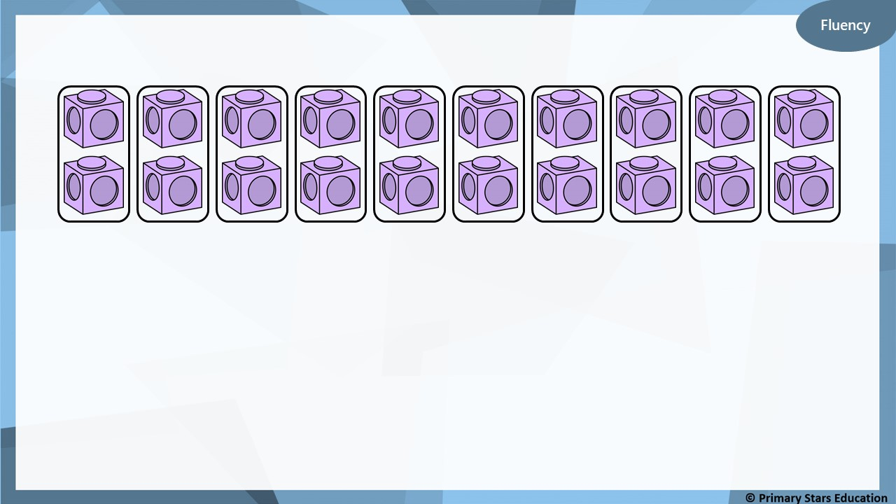
Complete the stem sentences.
20
20
10
2
There are ______ cubes altogether.
There are ______ in each group.
There are ______ groups.
÷
=
2
10
x
2
=
20
10

Slide 5
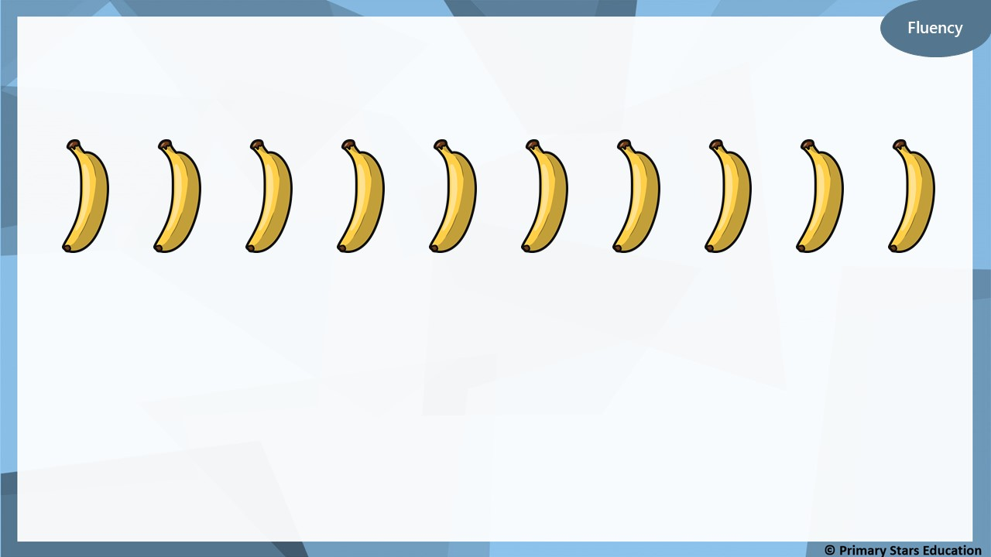
Group the bananas into pairs.
10
÷
5
=
2
5
x
2
=
10

Slide 6
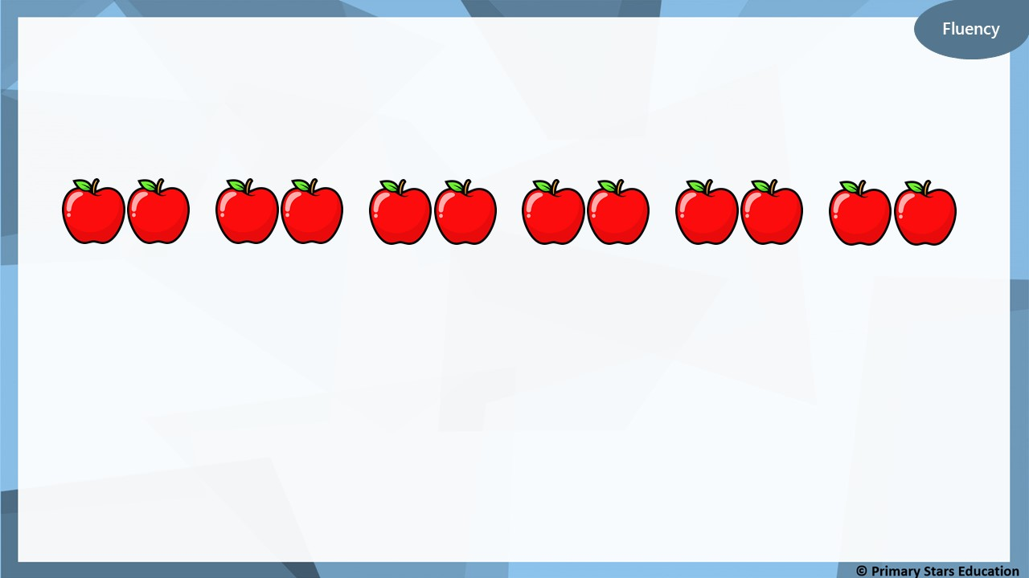
Group the apples into pairs.
12
÷
6
=
2
6
x
2
=
12

Slide 7
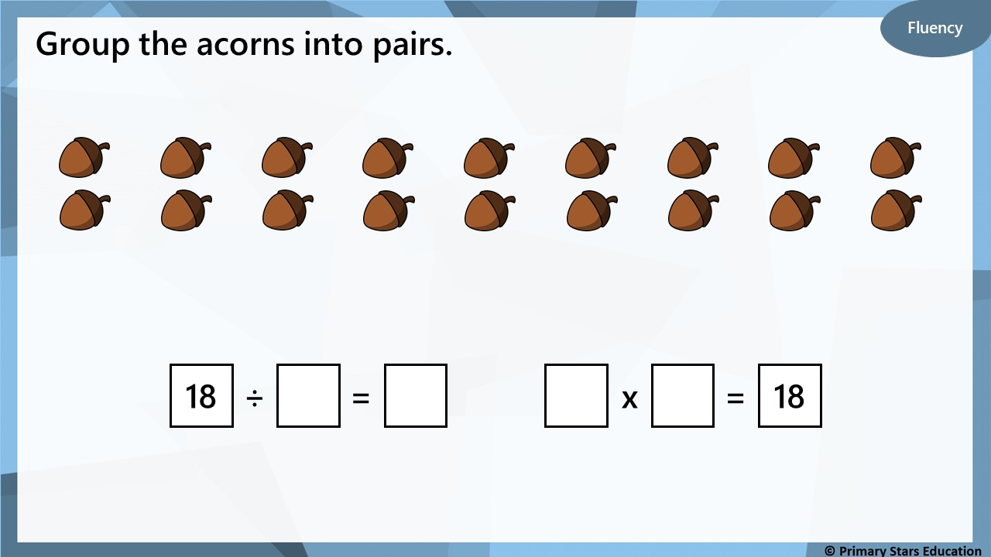
9
2
9
2

Slide 8
Jenny and Pete share 16 sweets between them equally.
Reasoning
There are 16 sweets altogether.
There are 2 groups.
There are 8 sweets in each group.
16
2 | 2 | 2 | 2 | 2 | 2 | 2 | 2
Does the bar model show this calculation?
No.
The bar model shows 8 groups of 2. There should be 2 groups of 8.

Slide 9
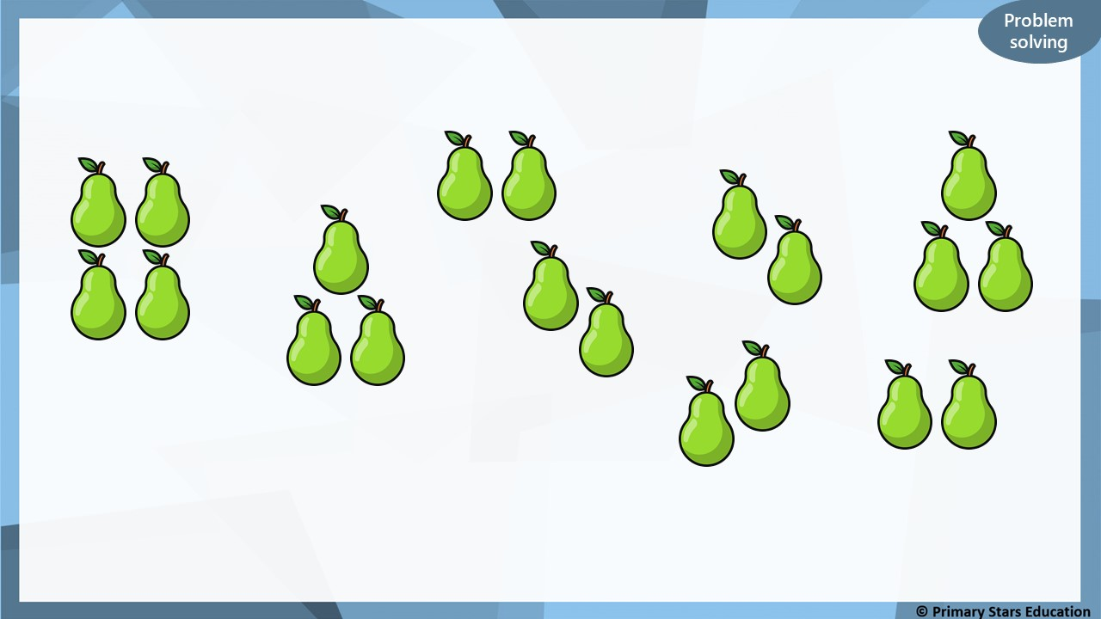
Sue and Jason share these pears equally.
How many pears will they get each?
There are 20 pears in total.
They will get 10 pears each.

