Slide 1


Lesson 4
Step: Make equal groups - Grouping

Slide 2

Fluency
There are 24 apples.
We need to put 2 apples in each basket.
How many baskets will we need?
24
There are ______ apples altogether.
There are ______ apples in each basket.
There are ______ baskets.
2
12

Slide 3

Fluency
Sweets come in packs of 20.
We need to put 5 sweets in each jar.
How many jars will we need?
20
There are ______ sweets altogether.
There are ______ sweets in each jar.
There are ______ jars.
5
4

Slide 4
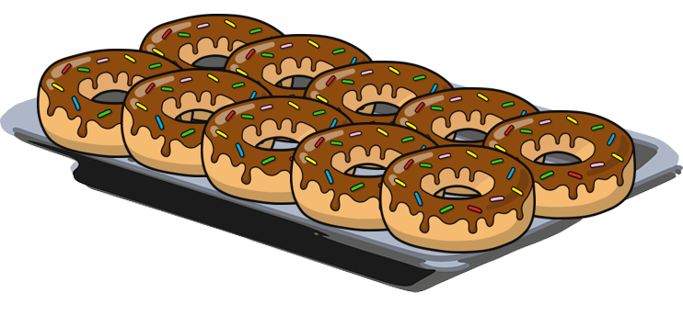
Fluency
Doughnuts come in packs of 100.
We need to put 10 doughnuts on each tray.
How many trays will we need?
100
There are ______ doughnuts altogether.
There are ______ doughnuts on each tray.
There are ______ trays.
10
10

Slide 5


Fluency
Lee has 15 eggs.
He puts 3 eggs in each box.
How many boxes can he fill?
15
÷
5
=
3
15
5
x
3
=
15
3
3
3
3
3
Lee can fill 5 boxes.

Slide 6



Fluency
John has 20 fish.
He puts 4 fish in each tank.
How many tanks can he fill?
20
÷
5
=
4
20
5
x
4
=
20
4
4
4
4
4
John can fill 5 tanks.

Slide 7
Fluency
Use the number line to work out how many equal
groups of 2 can be made from 16.
2
2
2
2
2
2
2
2
0
1
2
3
4
5
6
7
8
9
10
11
12
13
14
15
16
8 equal groups of 2 can be made.

Slide 8
Fluency
Use the number line to work out how many equal
groups of 5 can be made from 20.
5
5
5
5
0
1
2
3
4
5
6
7
8
9
10
11
12
13
14
15
16
17
18
19
20
4 equal groups of 5 can be made.

Slide 9

Che says,
5 equal groups of 5 will be made from 30.
True or false?
False.
6 equal groups of 5 will be made from 30.

Slide 10

The amount he started with is: greater than 10 but less than 24.
How many could be in each group?
Ben has 4 equal groups.
20 ÷ 4 = 5 in each group.
16 ÷ 4 = 4 in each group.
12 ÷ 4 = 3 in each group.

