Slide 1
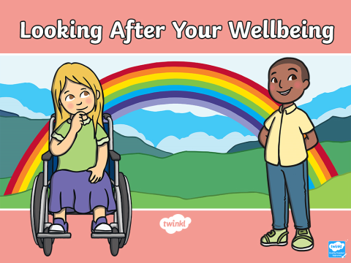

Slide 2

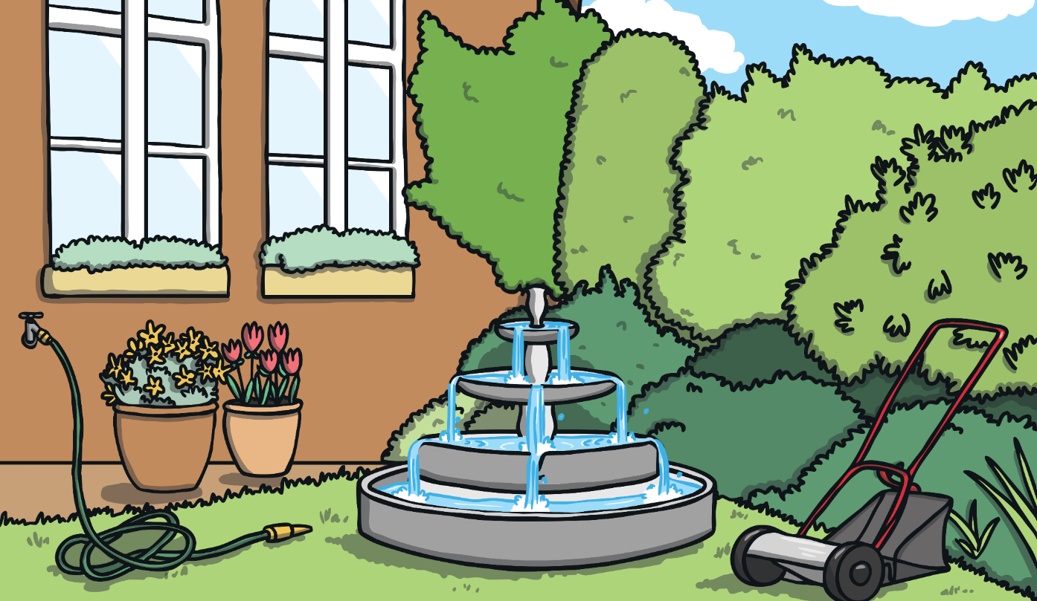
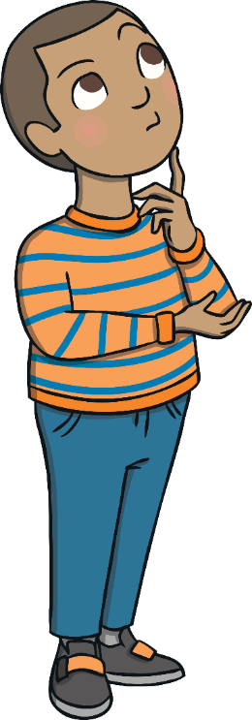
The Big Questions
What is wellbeing?
How can I look after my own wellbeing?

Slide 3
What is Wellbeing?
Wellbeing means feeling…
comfortable, healthy or happy.
When you try to look after your own wellbeing, you think about:
how comfortable you are (both in your body and in your mind);
how healthy you are (both in your body
and mind);
and how happy you are.
If life changes, you may feel like you can’t control things and this can feel a bit uncomfortable.
This can stop you feeling good which means your wellbeing doesn’t feel good.

Slide 4

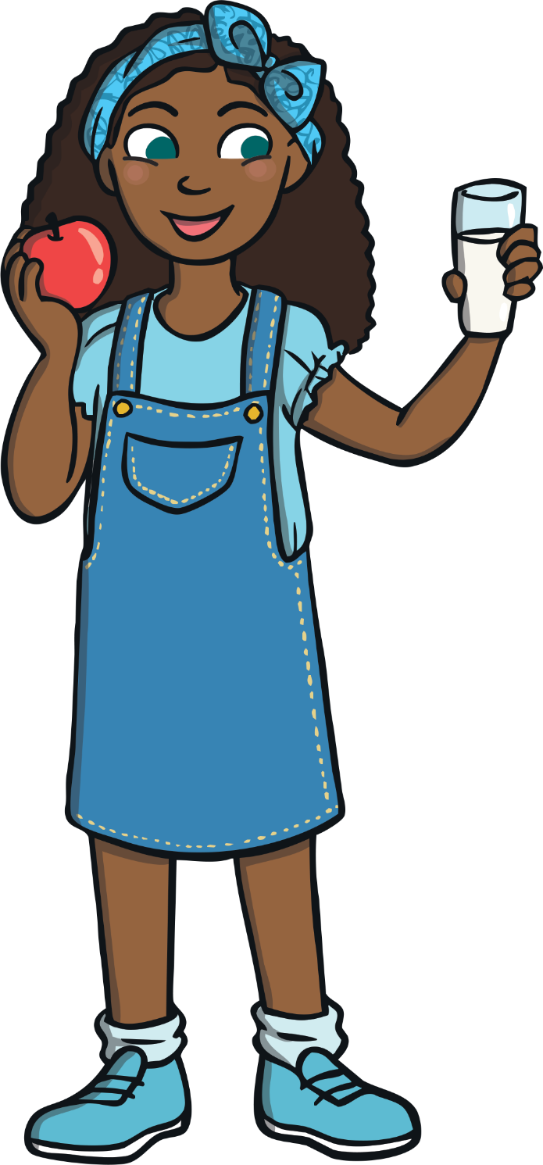

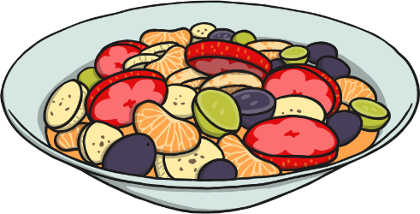

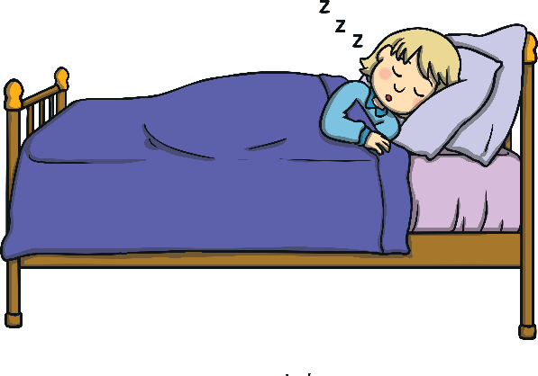
Healthy Bodies
Being healthy means that our body and our mind are in good condition and that we feel well.
What can we do to help our body to
be healthy, be in good condition and
feel well?
With your partner, think of three different things and then, when asked, share one of your ideas with the class.

Slide 5


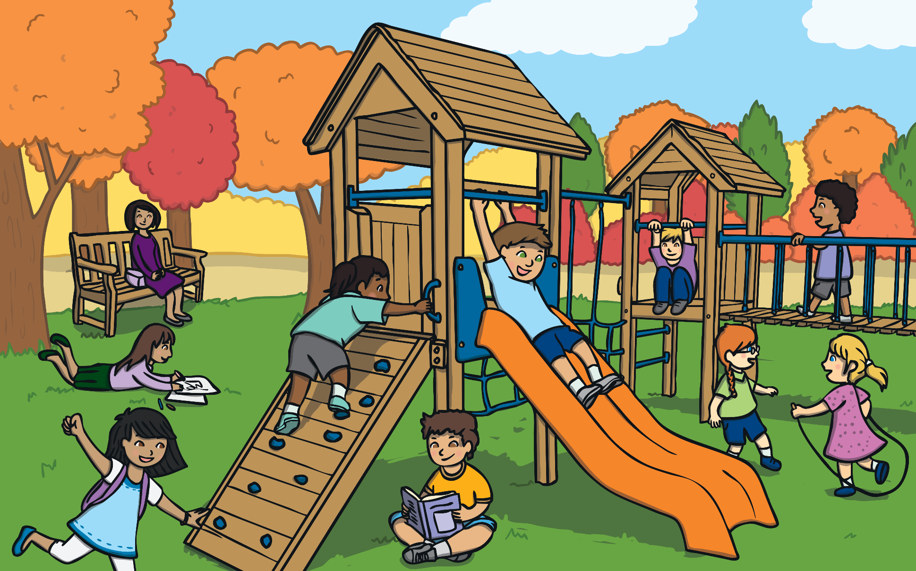
Healthy Bodies
Why do you think it is important to make choices and take actions to keep our bodies healthy?
It is important to make healthy choices so our body works as well as it can.
Doing all we can to keep our body healthy can help us to feel happy too.

Slide 6
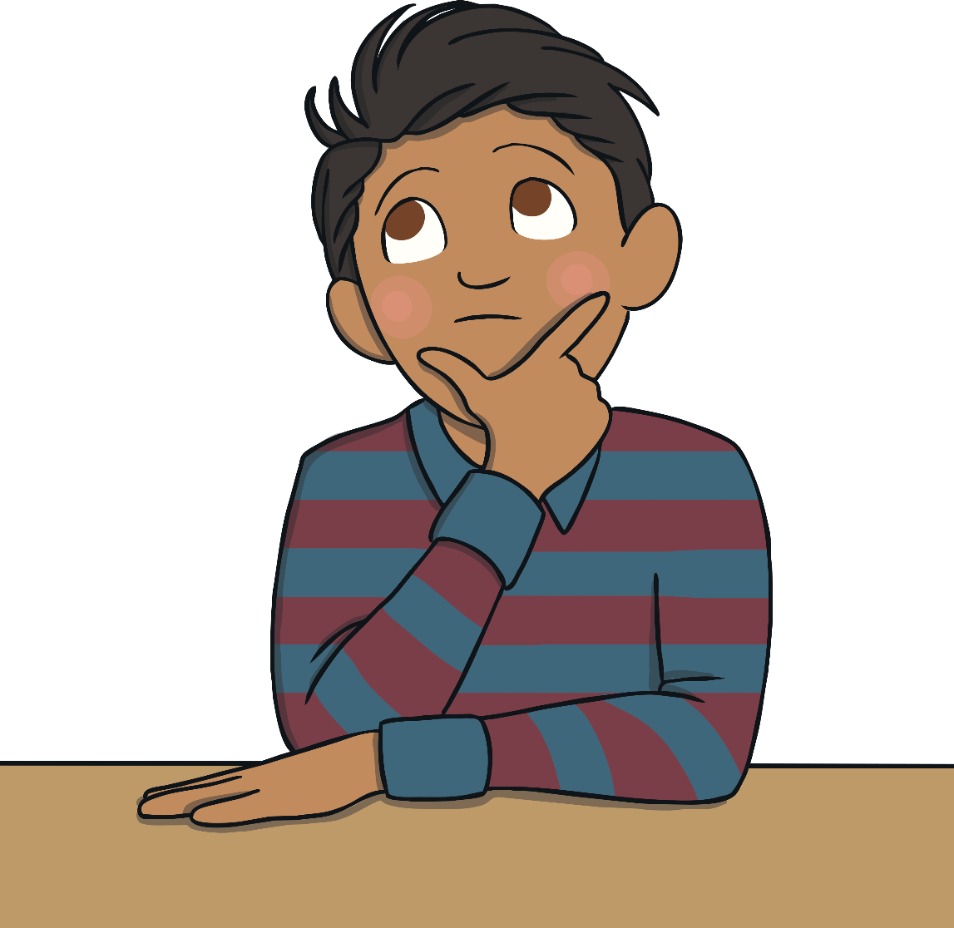
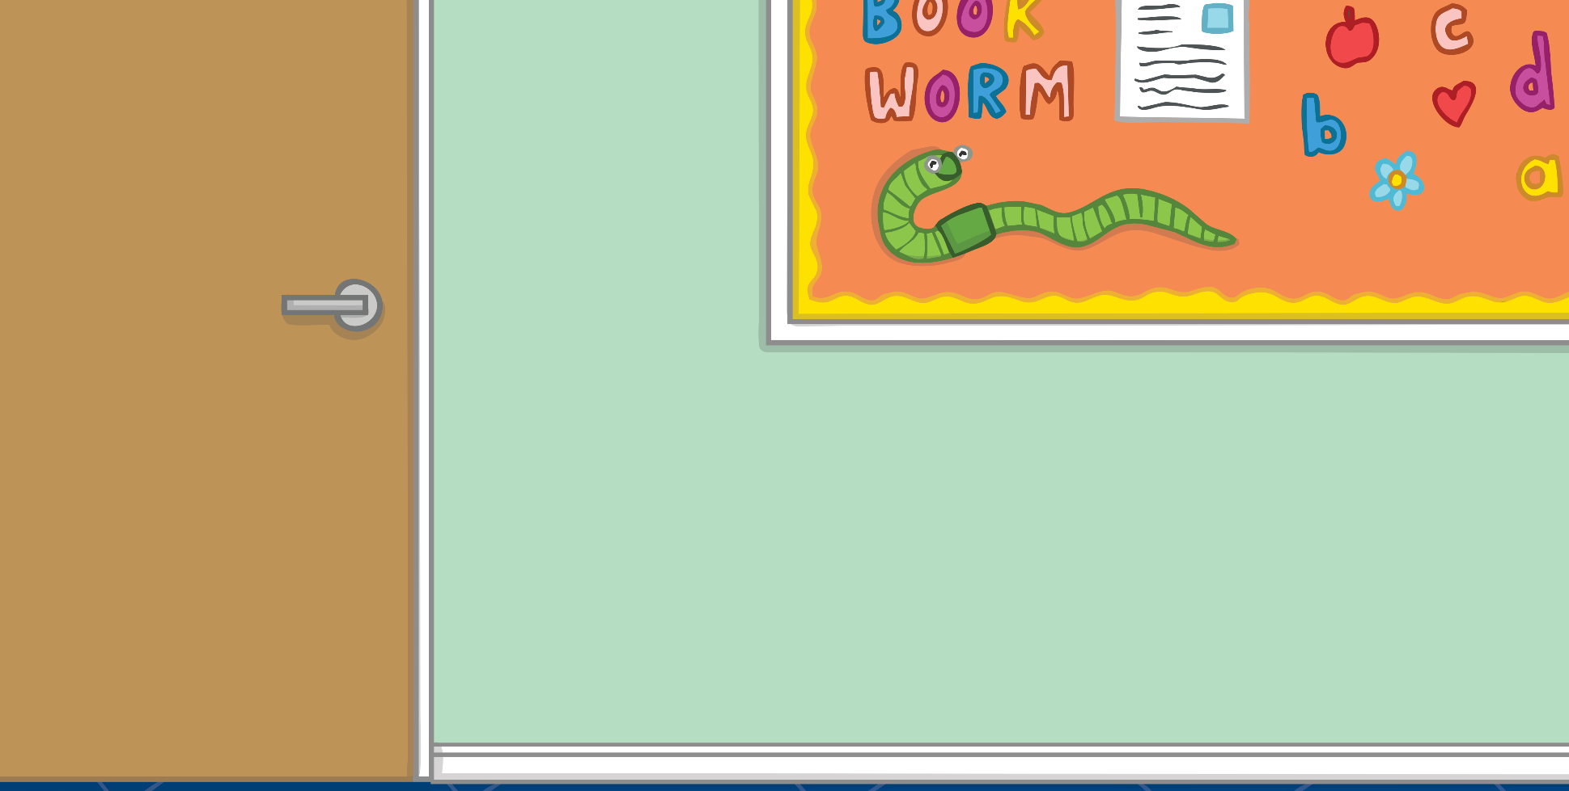
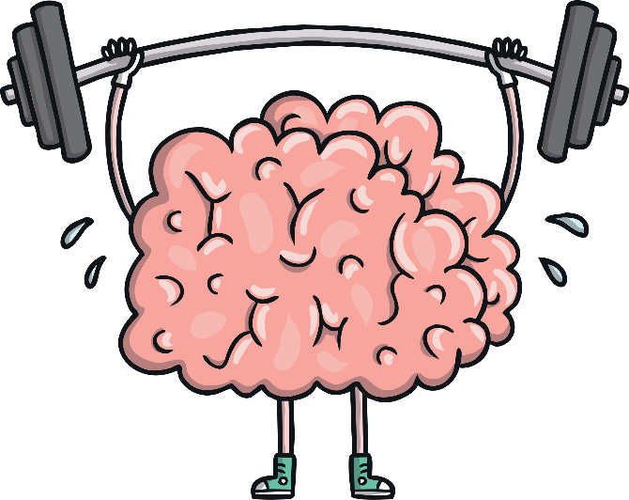
Healthy Minds
Mental health is all about how we are feeling and the thoughts we are having. It can affect how we behave and the choices we make.
Just like with our body, it is important we do things to help our minds to be healthy, be in good condition and feel well.

Slide 7
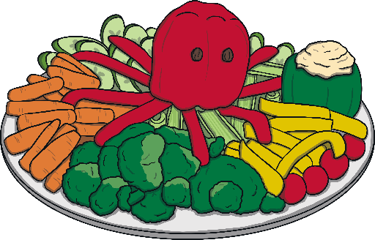


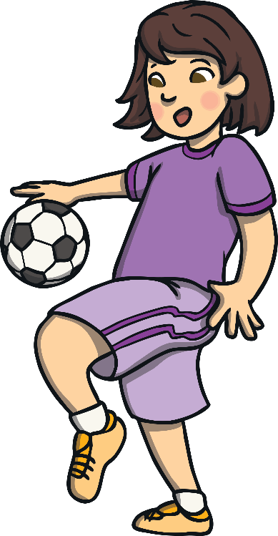
Healthy Minds
What can we do to help our minds be healthy?
We can keep active.
We can eat healthily.
We can drink enough water.
We can ask for help if something is troubling us.
We can make sure we have time each day when we can be calm and quiet.

Slide 8
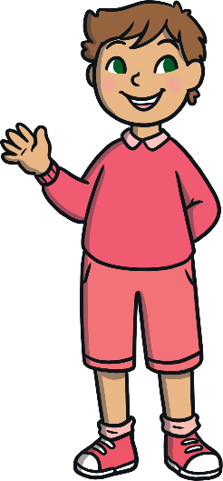

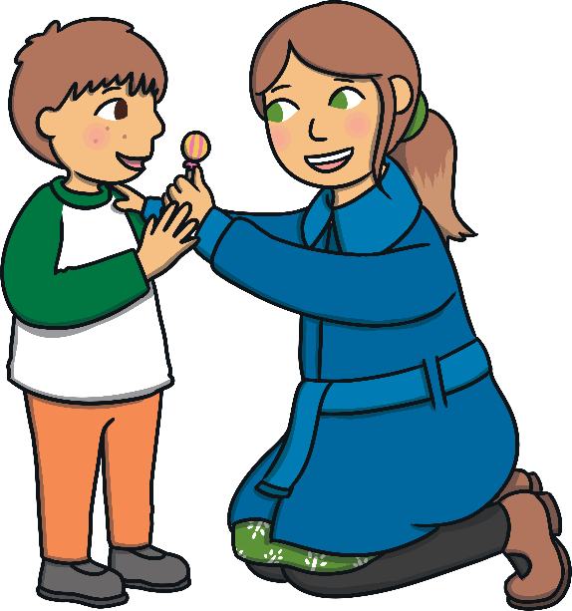
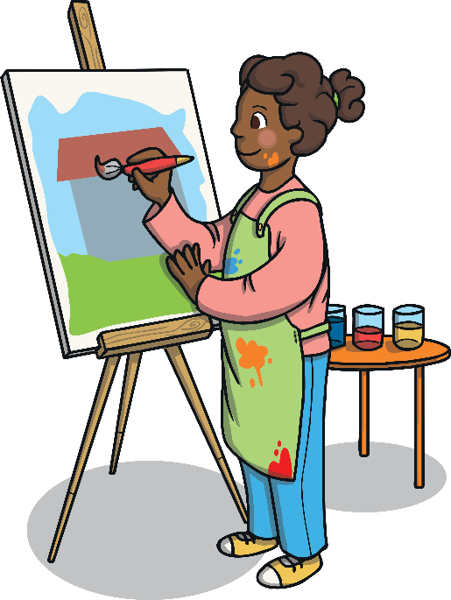
Healthy Minds
We can spend time each day doing something we love.
We can spend time outside.
We can be creative.
We can help others.
We can make sure we get enough sleep.
We can spend time with people who make us smile.
We can remember we are special just the way we are.

Slide 9

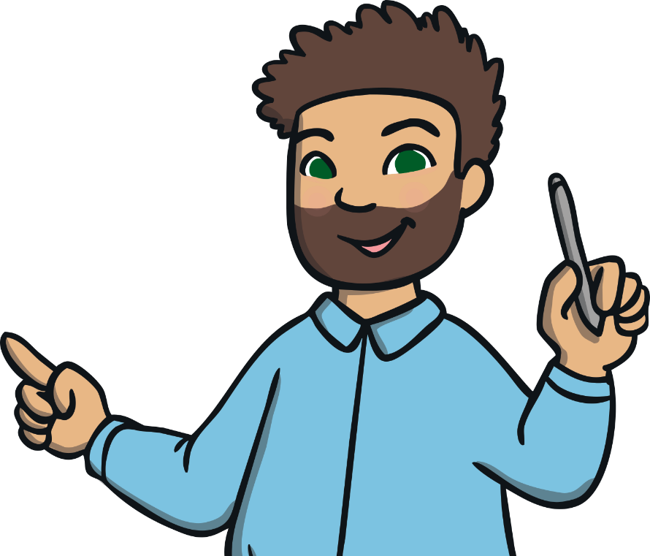
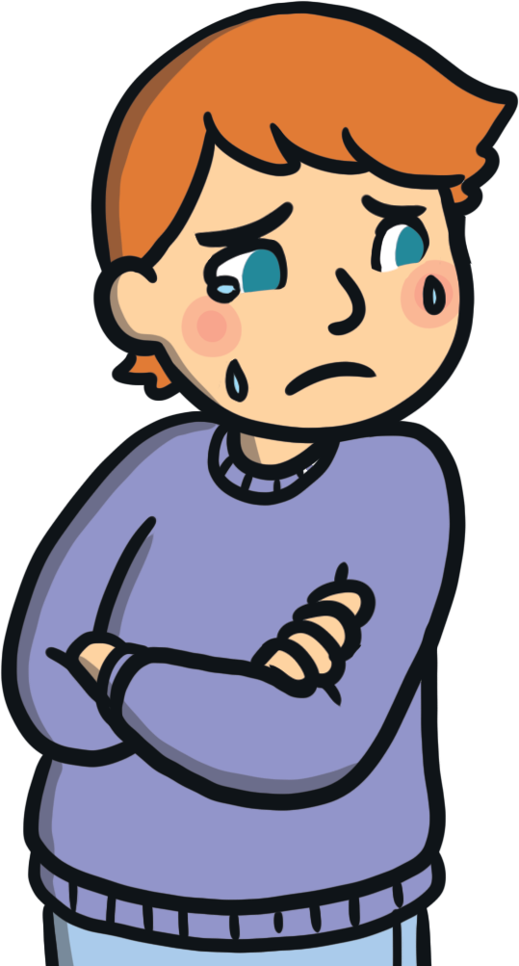
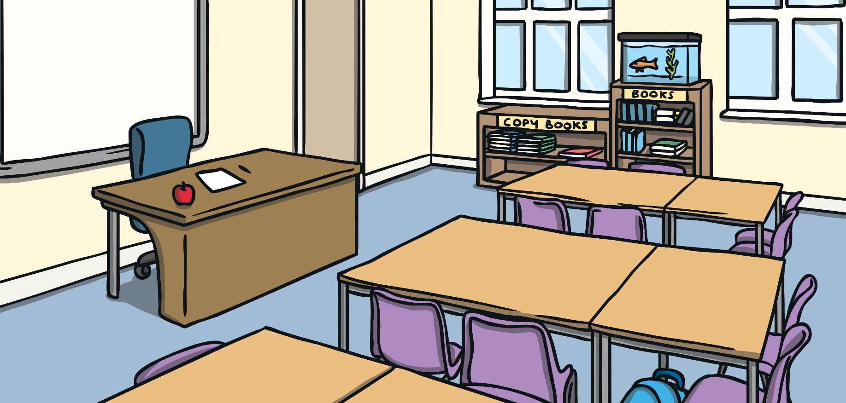
Healthy Minds
Sometimes, just like our body, our mind doesn’t feel well. We might feel very worried, frightened or extremely sad. We might have thoughts which feel uncomfortable and that make us behave in a way that hurts ourselves or others.
If you are feeling worried or sad, talking to someone you trust is a good place to start.
Positive mental health is not about being happy all of the time. It is about feeling well, being able to enjoy life and knowing what to do if we have troubling thoughts and feelings.

Slide 10

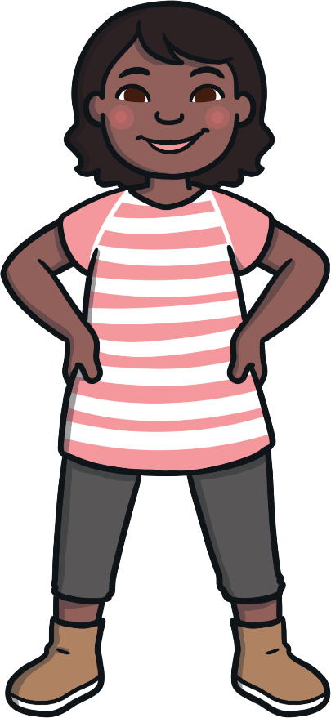

Taking Positive Action
It is important that we do all we can to look after our mental health.
Having a healthy mind can help us feel good on the inside and can help us do well in lots of different situations.
Consolidating
Reflecting

Slide 11
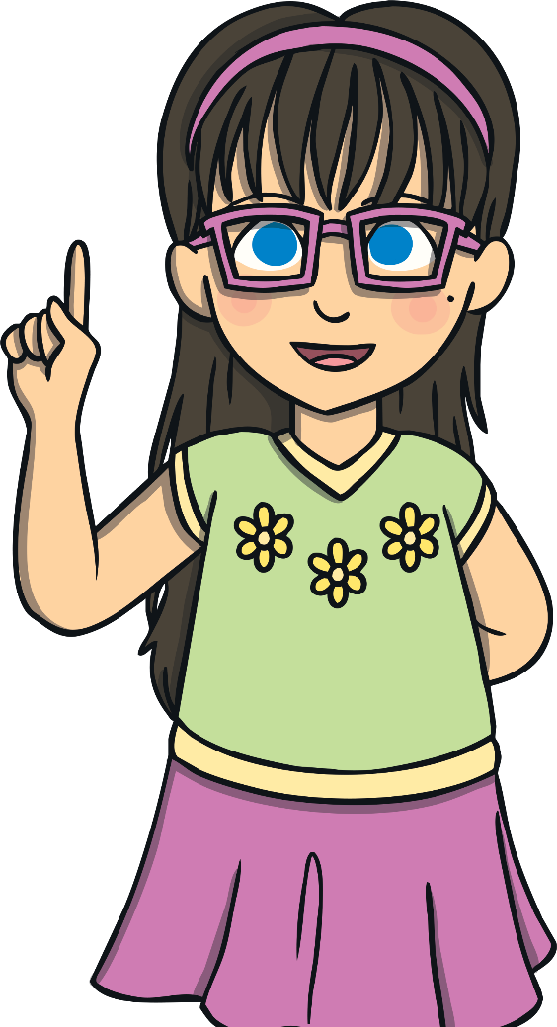


Helping Others
There is a lot we can do to help keep our minds healthy and help us cope when have uncomfortable feelings.
It is important we think, act and behave in a way that helps others feel good on the inside too.
What could you do to help others feel happy and have a healthy mind?

