Slide 1


Lesson 5
Step: 10x tables

Slide 2


Fluency
How many apples altogether?
30
There are ________ apples in total.
3
10
________ x ________

Slide 3
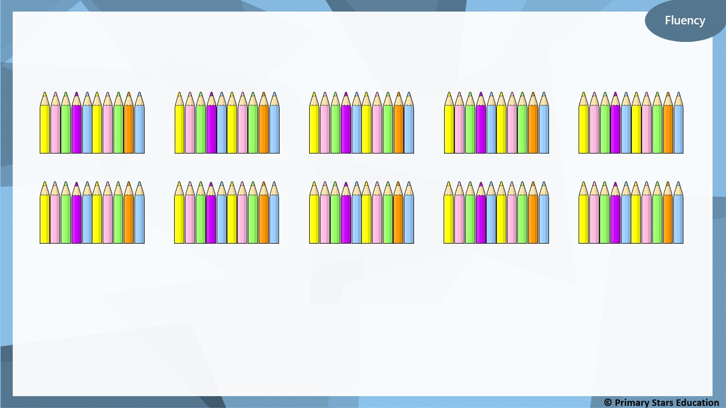
How many pencils altogether?
100
There are ________ pencils in total.
10
10
________ x ________

Slide 4


Fluency
How many cakes altogether?
50
There are ________ cakes in total.
5
10
________ x ________

Slide 5


Fluency
There are 80 fish.
How many tanks are there?
8
______ x 10 = 80
How did you work this out?
What was the easiest method?

Slide 6
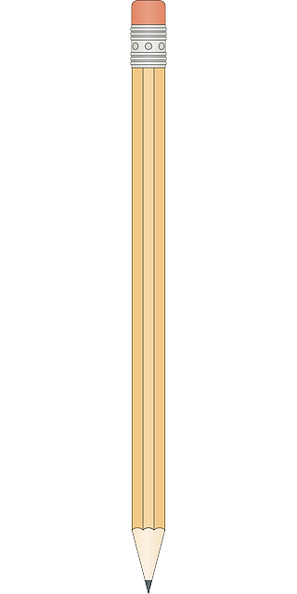

Fluency
How many pencil pots are there if there are 70 pencils?
7
______ x 10 = 70
How did you work this out?
What was the easiest method?

Slide 7
Fluency
There are 120 cupcakes.
How plates are there?
12
______ x 10 = 120
How did you work this out?
What was the easiest method?

Slide 8
Fluency
Write a number sentence to make the ordered number sentences true.
2 x 10
5 x 10
3 x 10 or 4 x 10
smallest
greatest

Slide 9
Fluency
Write a number sentence to make the ordered number sentences true.
4 x 10
5 x 10, 6 x 10
or 7 x 10
8 x 10
smallest
greatest

Slide 10
Reasoning
Che creates a number track counting up in 10s from 50.
50 | 60 | 70 | 80 | 90 | 110 | 120
What mistake has Che made?
Che has missed the number 100 from the number track.
The number track goes up in 10s.

Slide 11

Help Asha complete the following problem:
Can you help me find a multiplication fact for this problem?
2 x 10
3 x 10, 5 x 5,
6 x 5 or 7 x 5
8 x 5
smallest
greatest

