Slide 1


Lesson 4
Step: 5x tables

Slide 2


Fluency
How many marbles altogether?
20
There are ________ marbles in total.
4
5
________ x ________

Slide 3

How many fingers altogether?
25
There are ________ fingers in total.
5
5
________ x ________

Slide 4

Fluency
How many petals altogether?
35
There are ________ petals in total.
7
5
________ x ________

Slide 5


Fluency
How many balloons altogether?
15
There are ________ balloons in total.
3
5
________ x ________

Slide 6
Fluency
Match the number sentences to the correct answer.
8 x 5 =
45
10 x 5 =
50
9 x 5 =
40
2 x 5 =
25
5 x 5 =
10

Slide 7
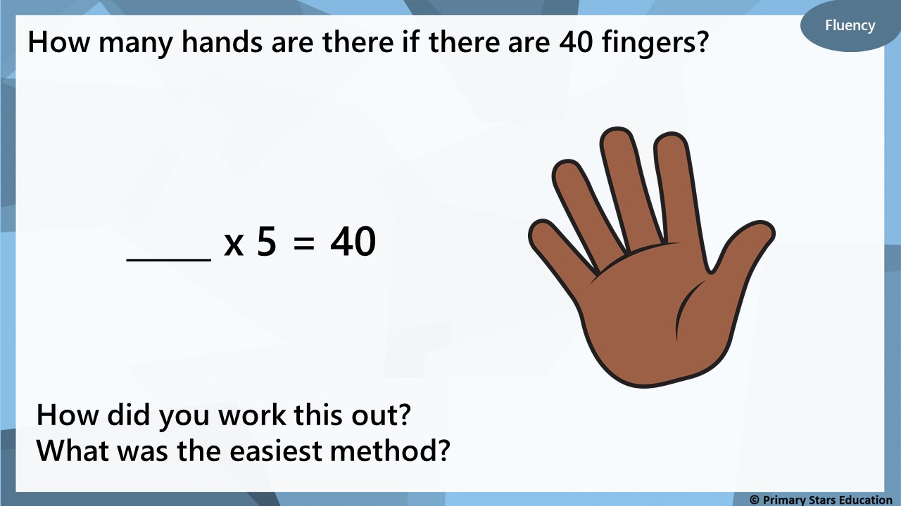
8

Slide 8
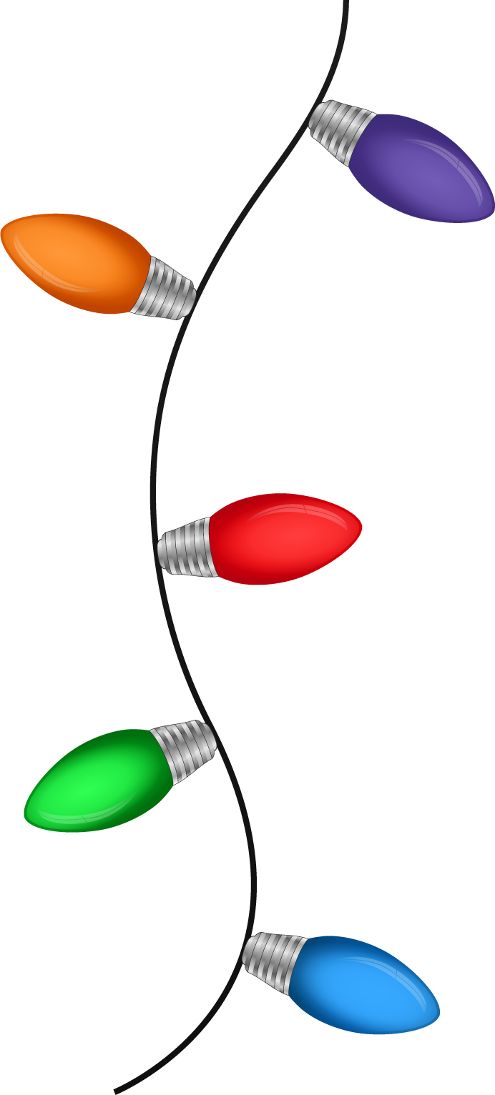
Fluency
There are 45 Christmas lights.
How sets of lights are there?
9
_____ x 5 = 45
How did you work this out?
What was the easiest method?

Slide 9
Fluency
Compare the multiplications using <, > or =.
>
3 x 5
5 x 2
=
10 x 5
5 x 10
<
4 x 5
11 x 2

Slide 10

Reasoning
Kat says,
The bar model shows 5 lots of 6.
30
5 | 5 | 5 | 5 | 5 | 5
No
Is Kat correct? ________
Explain how you know.
The bar model shows 6 lots of 5 (6 x 5).

Slide 11
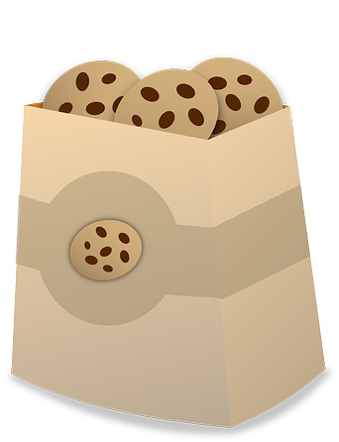
Problem solving
Cookies come in packs of 5.
Mo has 18 cookies.
How many full packs can be made and how many left over?
Mo can make 3 full packs of 5 cookies with 3 left over.

