Slide 1


Lesson 5
Step: Multiplication sentences using pictures

Slide 2

Fluency
Complete:
______ x ______ = ______
3
3
9
______ lots of 3 = ______
3
9
______ multiplied by ______ = 9
3
3

Slide 3
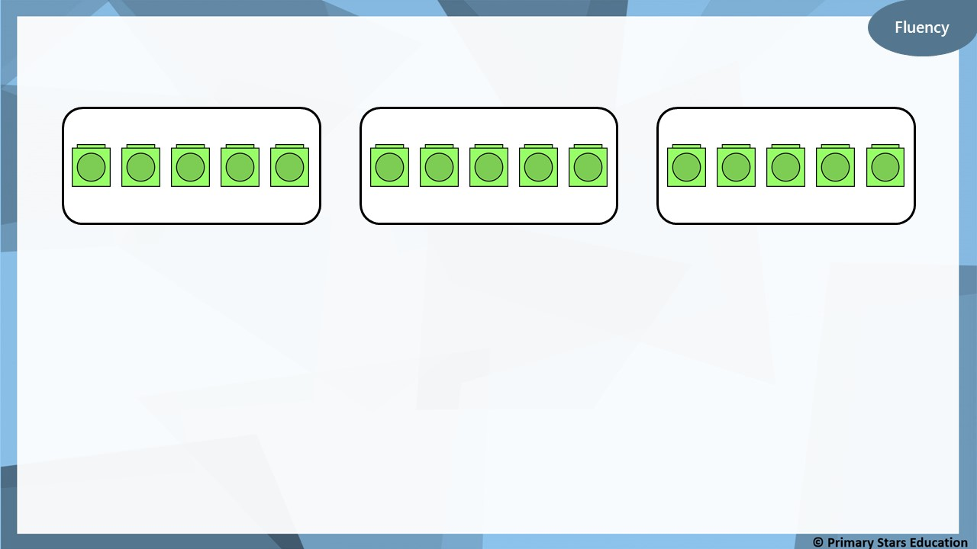
Complete:
______ x ______ = ______
3
5
15
______ lots of 5 = ______
3
15
3
5
_____ multiplied by ______ = 15

Slide 4
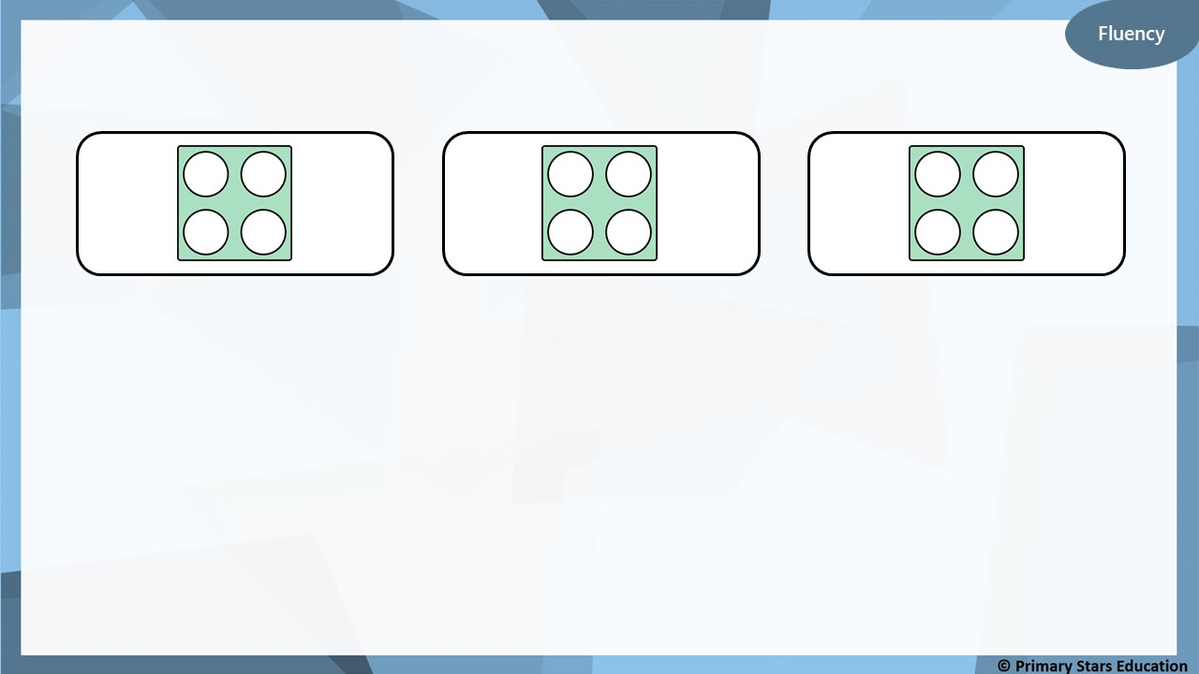
Complete:
______ x ______ = ______
3
4
12
______ lots of 4 = ______
3
12
______ multiplied by ______ = 12
3
4

Slide 5
Fluency
Complete:
______ x ______ = ______
3
6
18
______ lots of 6 = ______
3
18
______ multiplied by ______ = 18
3
6

Slide 6
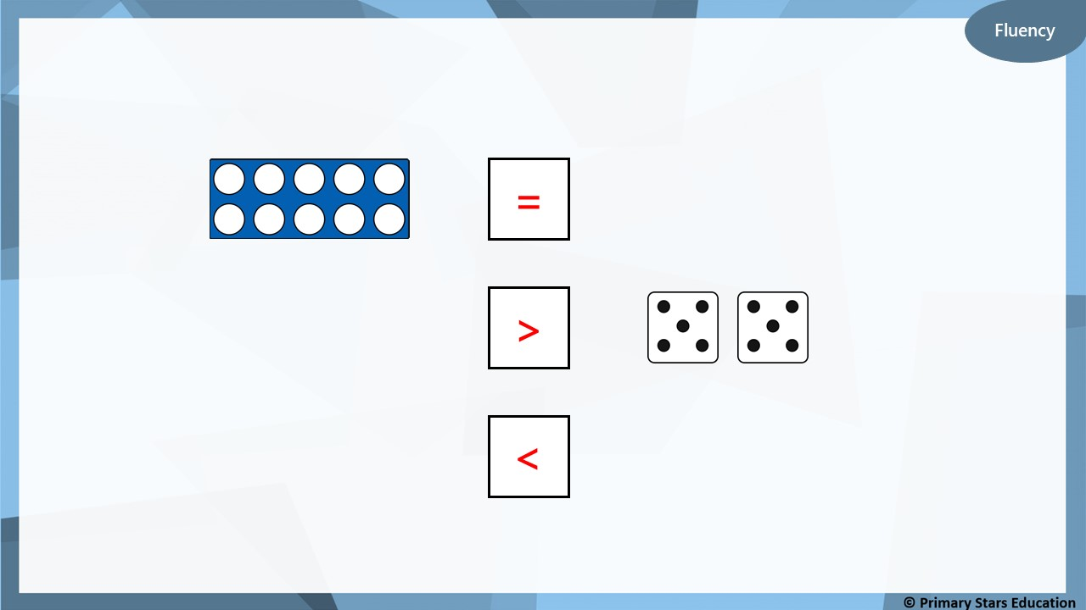
Complete using <, > or =.
=
2 x 5
3 lots of 4
>
<
3 multiplied by 3

Slide 7
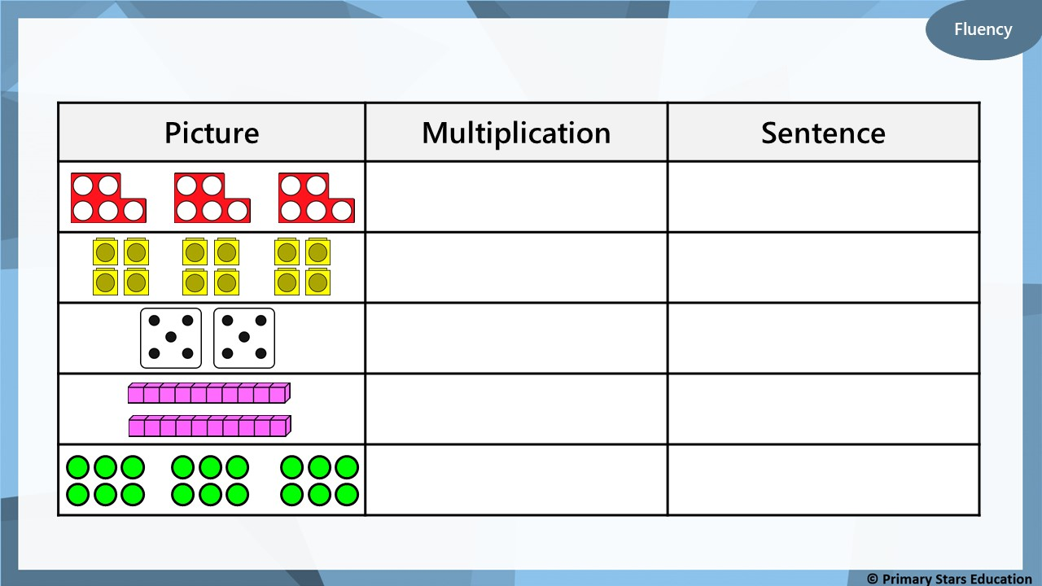
Complete the table.
3 x 5
3 lots of 5 is equal to 15
3 x 4
3 lots of 4 is equal to 12
2 x 5
2 lots of 5 is equal to 10
2 x 10
2 lots of 10 is equal to 20
3 x 6
3 lots of 6 is equal to 18

Slide 8
Reasoning
True
False
Explain your answer.
5 x 3 is the same as 5 lots of 3.
✓
True.
5 x 3 is the same as 5 lots of 3 or three 5s.
5 x 3 = 15 and 5 lots of 3 = 15

Slide 9


Problem solving
Write a sensible story for the calculation 6 x 3 = 18.
Draw a picture to represent this.
Example story:
There are 6 plates. There are 3 bananas on each plate.
There are 18 bananas altogether.

