Slide 1
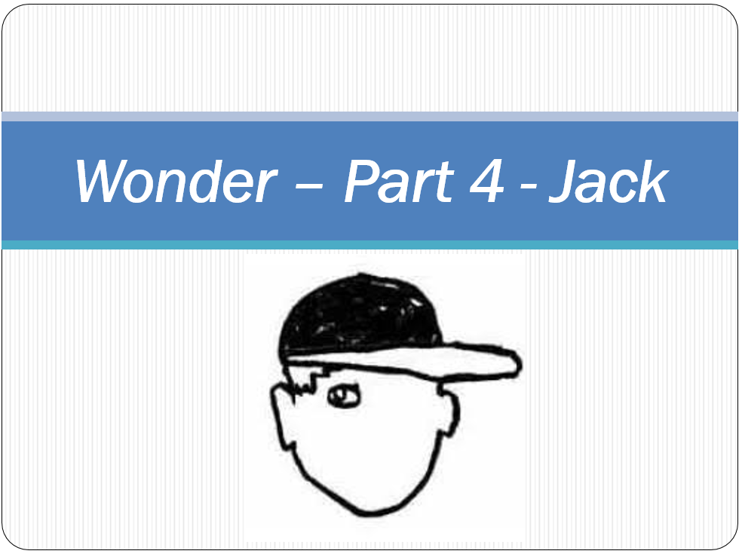

Slide 2
Read:
Back From Winter Break
The War
Switching Tables
LG: To give my opinion using the text to support my answer
1.Do you think the other children should act differently around Jack Will when he returns to school?
2. What do you think to Julian’s mom asking for Auggie’s school place to be reviewed?
3. Do you think Jack Will did the right thing to ignore the adult calling his name in the cafeteria?

