Slide 1
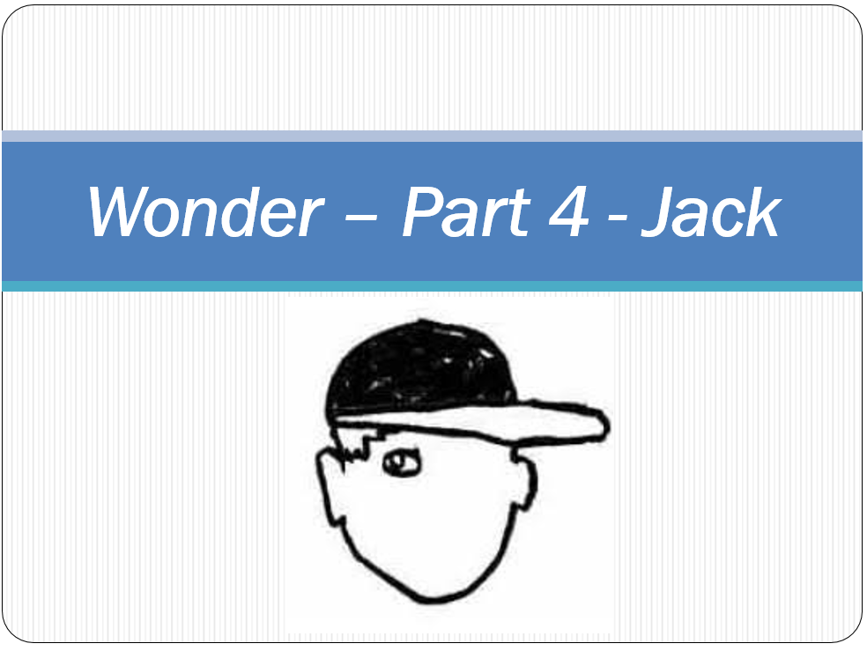

Slide 2
Read:
Letters, Emails, Facebook, Texts
LG: To retrieve information from the text.
Who says what?
Mr Tushman | Julian’s mom | Jack Will’s mom | Jack Will | August

