Slide 1
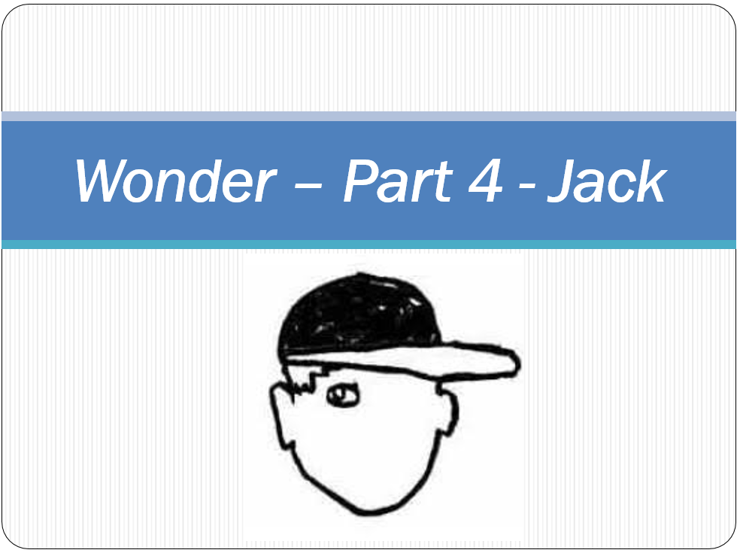

Slide 2
Read:
Why I changed my mind
Four Things
LG: To infer a character’s thoughts and feelings.
Your task today is to write a diary entry as though you are Jack Will. You have known August for a few weeks now and your opinion of him has changed. Think about
Why did you decide to show August around the school?
How has your opinion of August changed?
How do you feel now about the way you initially felt?

Slide 3
Dear diary,
I ended up going and showing August around school that day before school started in September. We’d been sat in the kitchen and me and Jamie were telling Mom about August and how we had seen him that day. Jamie was telling Mom about how August’s face gave him nightmares and then he started running around shouting ‘ahhh’ and saying how much August’s face freaked him out. It made me feel really bad. I mean, you expect kids like Julian to be pretty awful to kids like August but if nice kids like Jamie do it then you have to worry about what kind of change August is going to have at middle school.
I’m pleased I went because it turns out that Auggie is a really cool dude. Yeah he looks a bit weird but that doesn’t really matter. He’s really funny and he’s a good friend too. He let me copy him homework once and then when we got in trouble for it, he didn’t drop me in it, he pretended that we had worked together on it and that’s why we had both got the same answers right (and the same answers wrong!).
I’ve totally go used to his face now. I hardly notice it any more. August is a really cool guy. He’s my friend.
Jack

Slide 4
Read:
Why I changed my mind
Four Things
LG: To infer a character’s thoughts and feelings.
Your task today is to write a diary entry as though you are Jack Will. You have known August for a few weeks now and your opinion of him has changed. Think about
Why did you decide to show August around the school?
How has your opinion of August changed?
How do you feel now about the way you initially felt?

