Slide 1
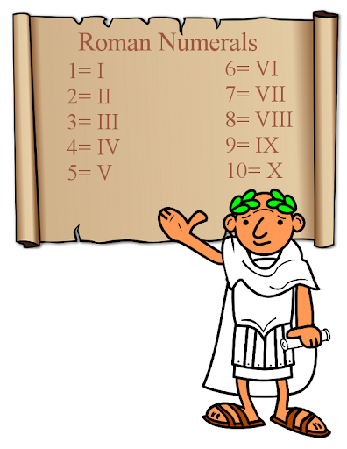
LG: I understand Roman numerals to 1000

Slide 2
There are four basic principles for reading and writing Roman numerals:
1. A letter repeats its value
XXX = 30
CC = 200, etc.
A letter can only be repeated three times.

Slide 3
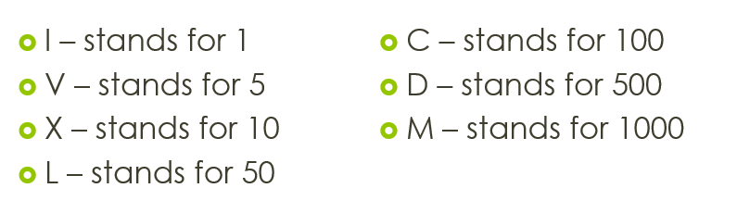
III

Slide 4
XX

Slide 5
CCC

Slide 6
2. If one or more letters are placed after another letter of greater value, add that amount.
VI = 6 (5 + 1 = 6)
LXX = 70 (50 + 10 + 10 = 70)
MCC = 1200 (1000 + 100 + 100 = 1200)

Slide 7
VII

Slide 8
XII

Slide 9
CX

Slide 10
3. If a letter is placed before another letter of greater value, subtract that amount.
IV = 4 (5 – 1 = 4)
XC = 90 (100 – 10 = 90)
CM = 900 (1000 – 100 = 900)

Slide 11
IV

Slide 12
4. A bar placed on top of a letter or string of letters increases the numeral's value by 1,000 times.
XV = 15, = X V 15,000

Slide 13
--
IV

Slide 14
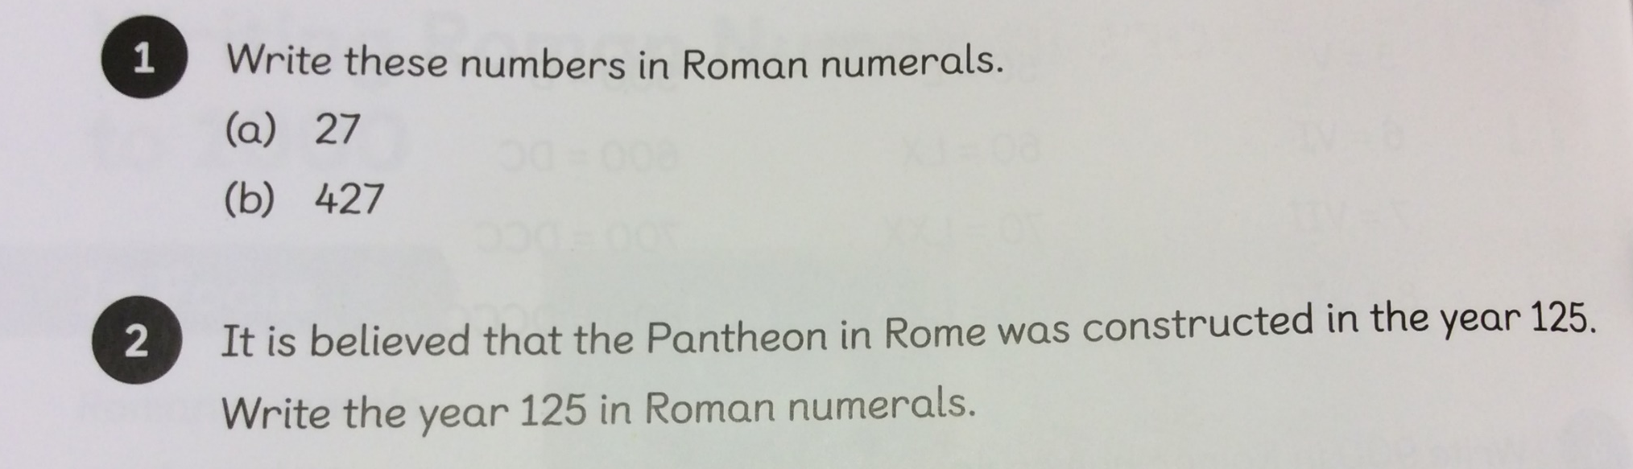
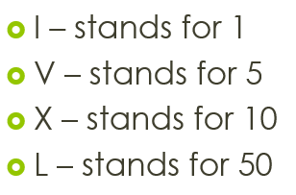
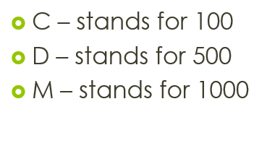

Slide 15



1a)
b)
2

Slide 16
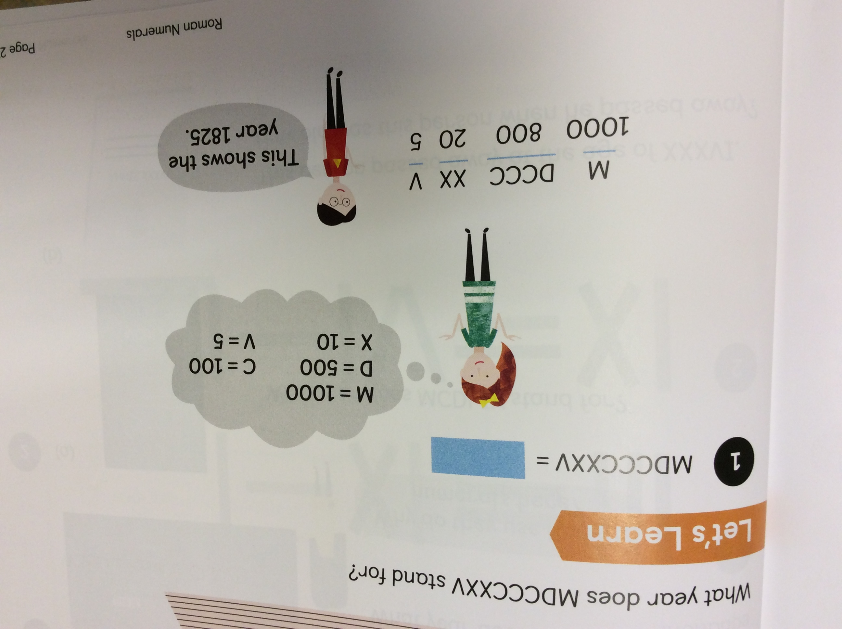

Slide 18
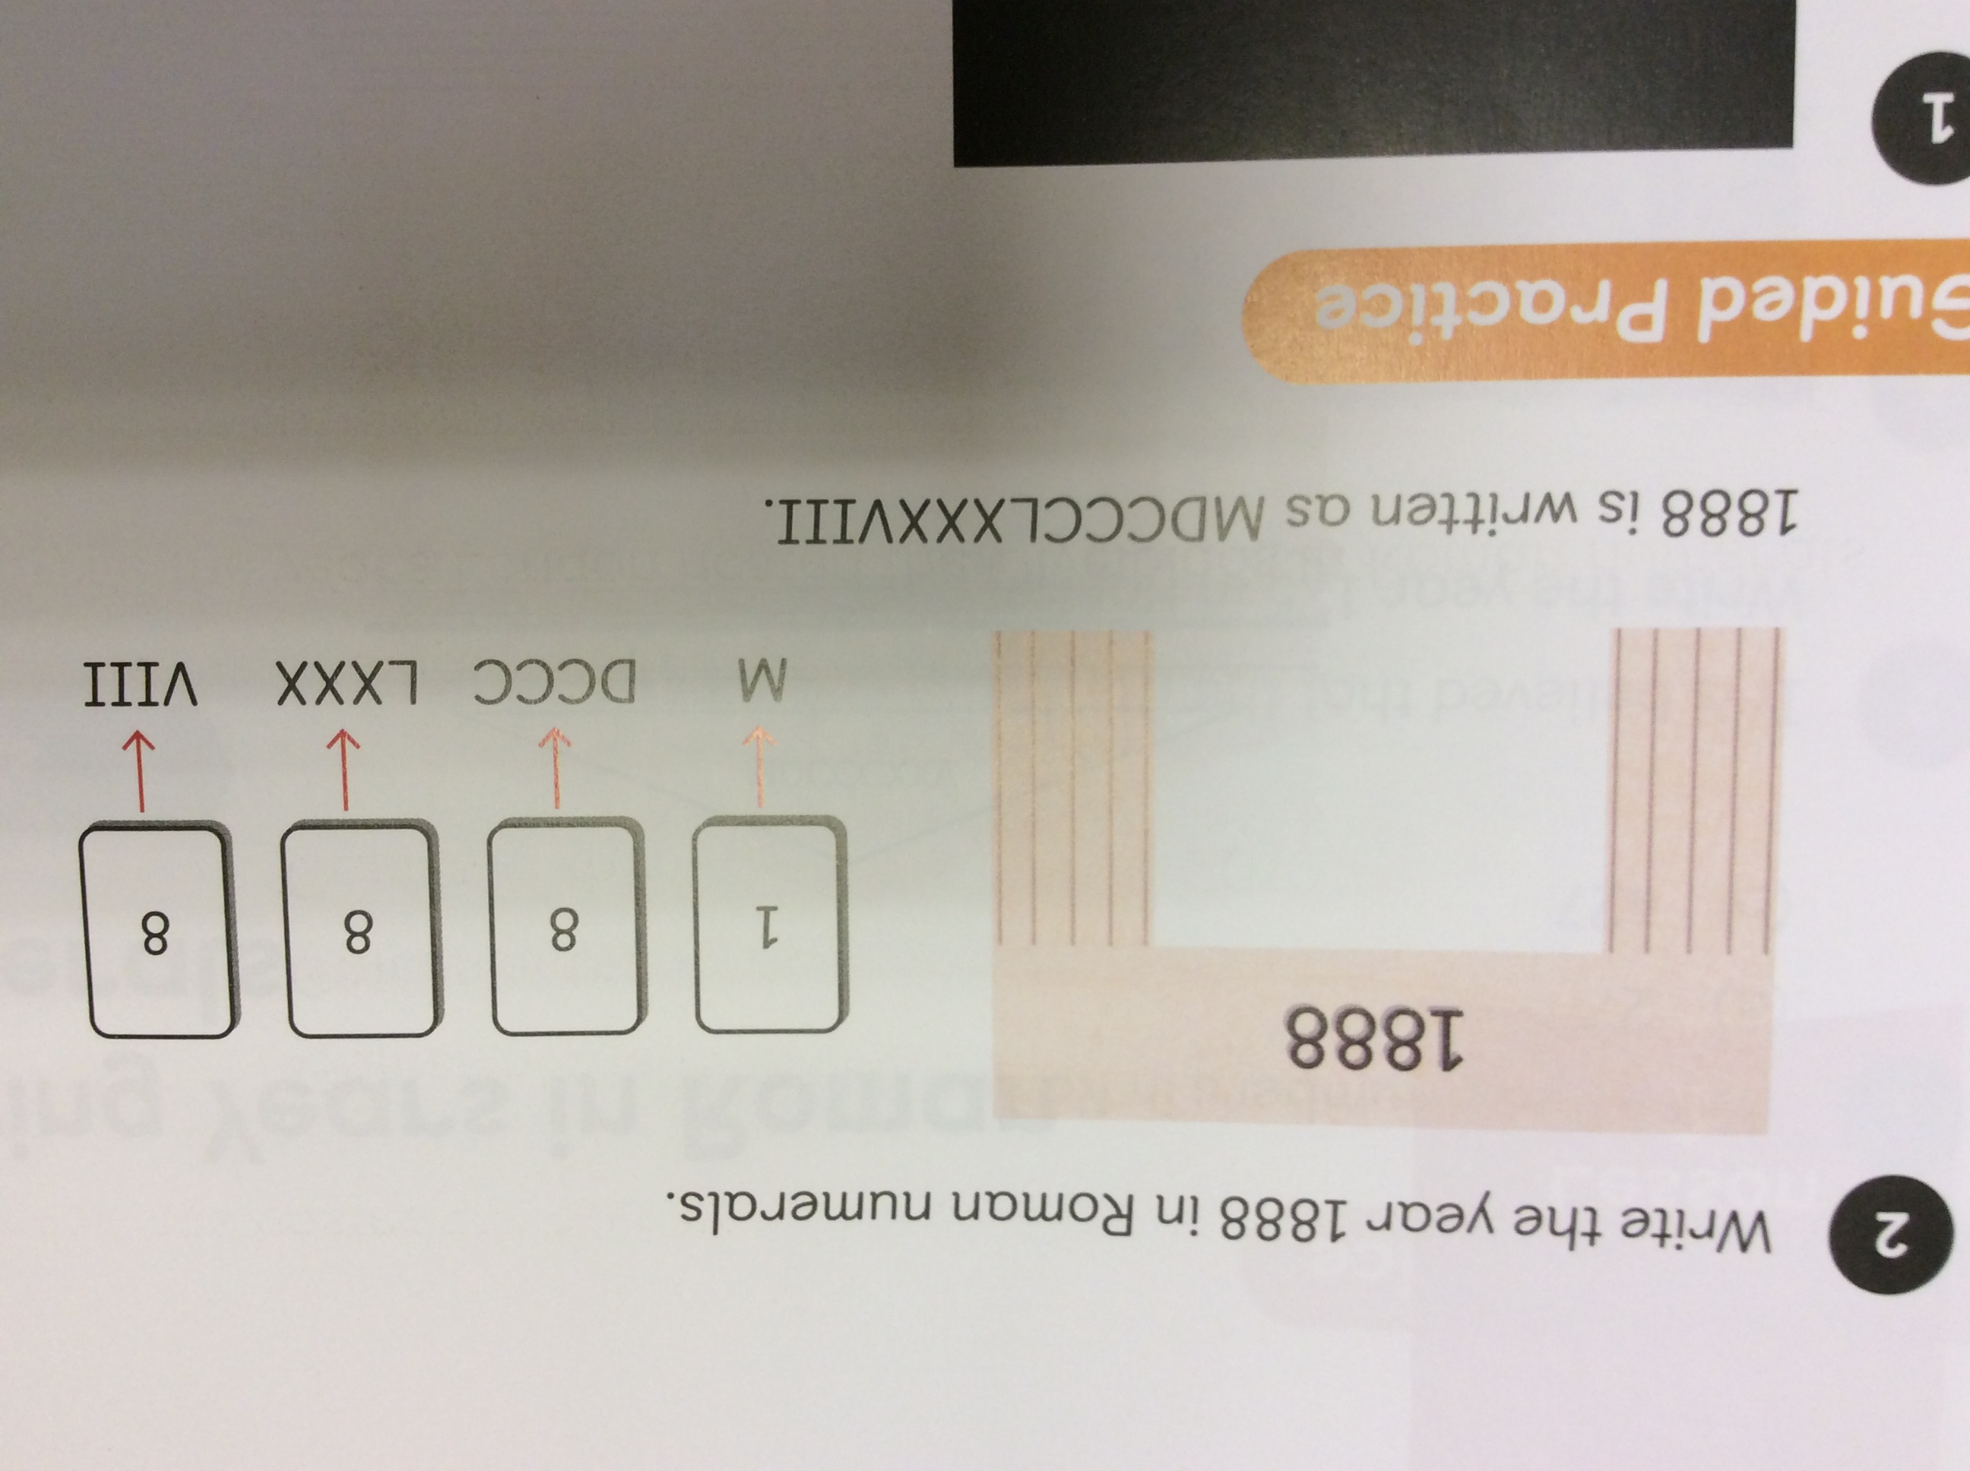
Can you write this number in Roman numerals?

Slide 20
= 322 =
=
740 =

Slide 21
= CXVII 322 = CCCXXII
= CCXXXV
740 = DCCXL

Slide 22


