Slide 1
LG: To write a character description.

Slide 2
Read the first two pages and answer these questions.
What do you think Jub’s job is?
What does she keep in her big, green sack?
What colour is the air?
Why was she good at shaking out the happy endings?
On page 2, what simile is used to describe how the endings ‘fluttered upwards’?
What two words are used to describe how Jub moves when all of the happy endings are out of the sack?
What sometimes makes her jump?
What skims her head like a Frisbee?
What words describe Jub’s home?
What time of day is this piece of writing set? How do you know?

Slide 3
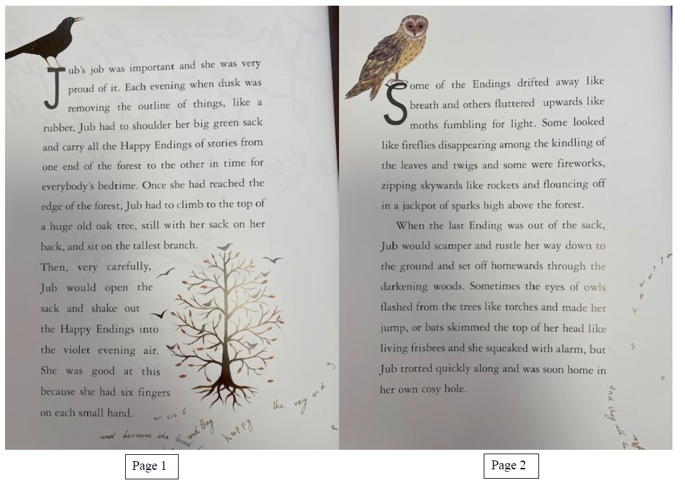

Slide 4
Read the first two pages and answer these questions.
What do you think Jub’s job is?
What does she keep in her big, green sack?
What colour is the air?
Why was she good at shaking out the happy endings?
On page 2, what simile is used to describe how the endings ‘fluttered upwards’?
What two words are used to describe how Jub moves when all of the happy endings are out of the sack?
What sometimes makes her jump?
What skims her head like a Frisbee?
What words describe Jub’s home?
What time of day is this piece of writing set? How do you know?

Slide 5
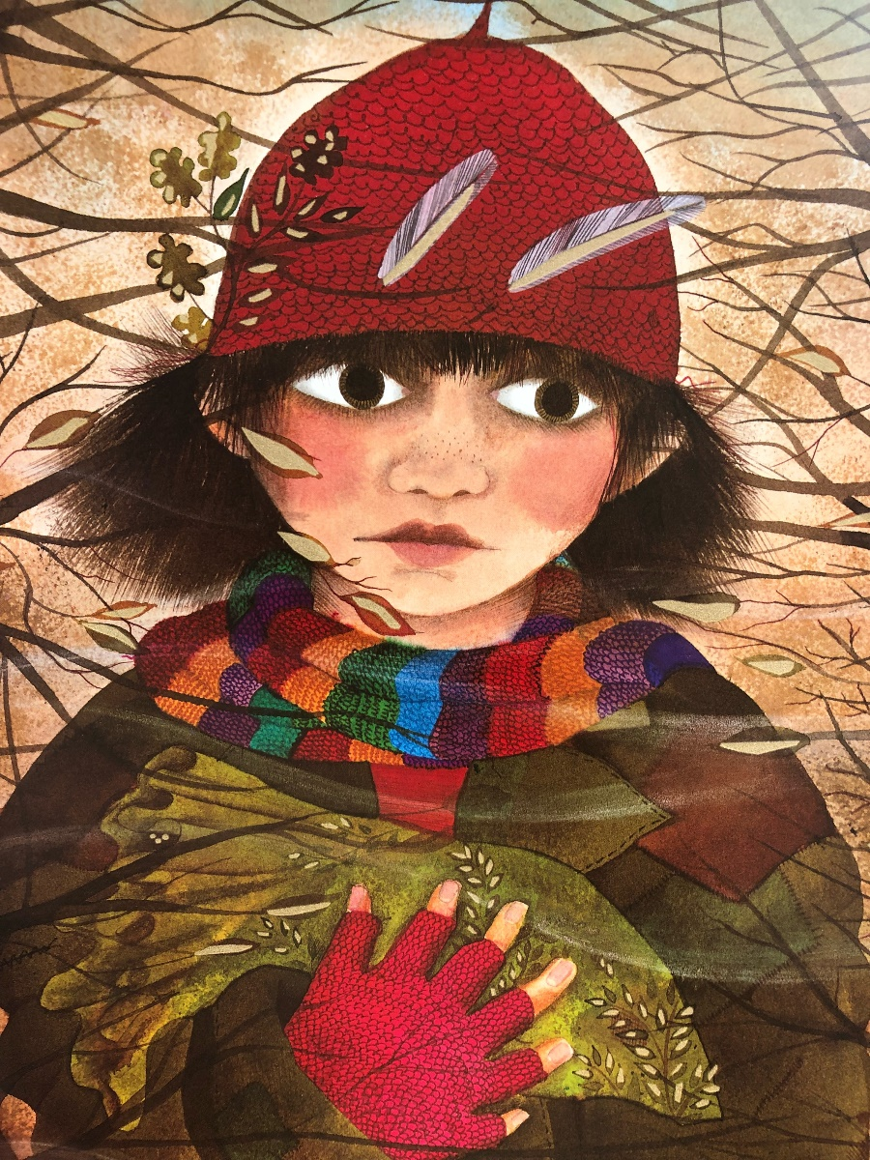
How can we describe this picture?

Slide 6
Jub is a young girl with big responsibilities. She has huge brown eyes and chestnut brown hair. The girl, who wears a red hat, is always busy. If you look closely, she has six fingers that wear a pink coloured glove. Her scarf is multi-coloured and is dances in the cold breeze. She has rosy pink cheeks and faint freckles that sit upon her nose. Jub’s clothes are a patchwork of unusual green and brown materials all stitched together.

