Slide 1
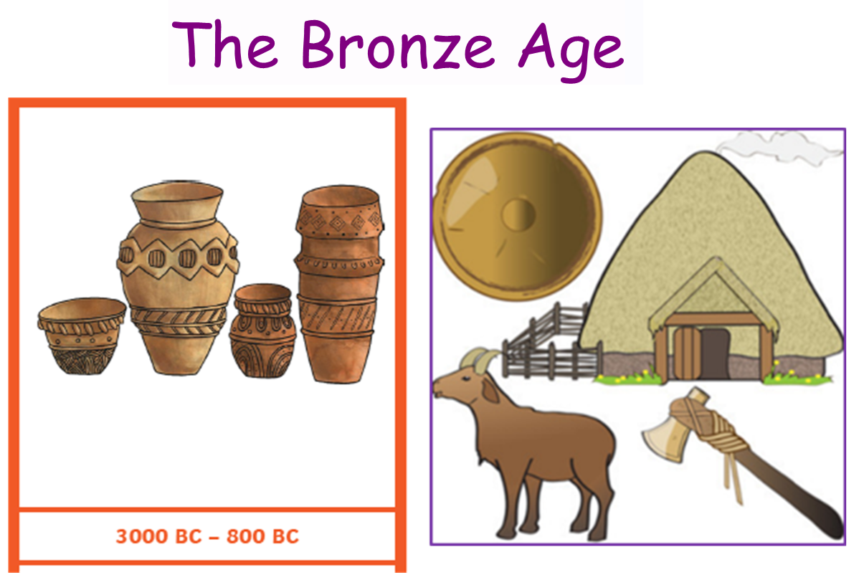

Slide 2
There is a large period of time for which we have no written records, we call this ‘prehistory’.
Starting from evidence of the first early humans, it is split into three sections.
The Stone Age
The Bronze Age
The Iron Age

Slide 3
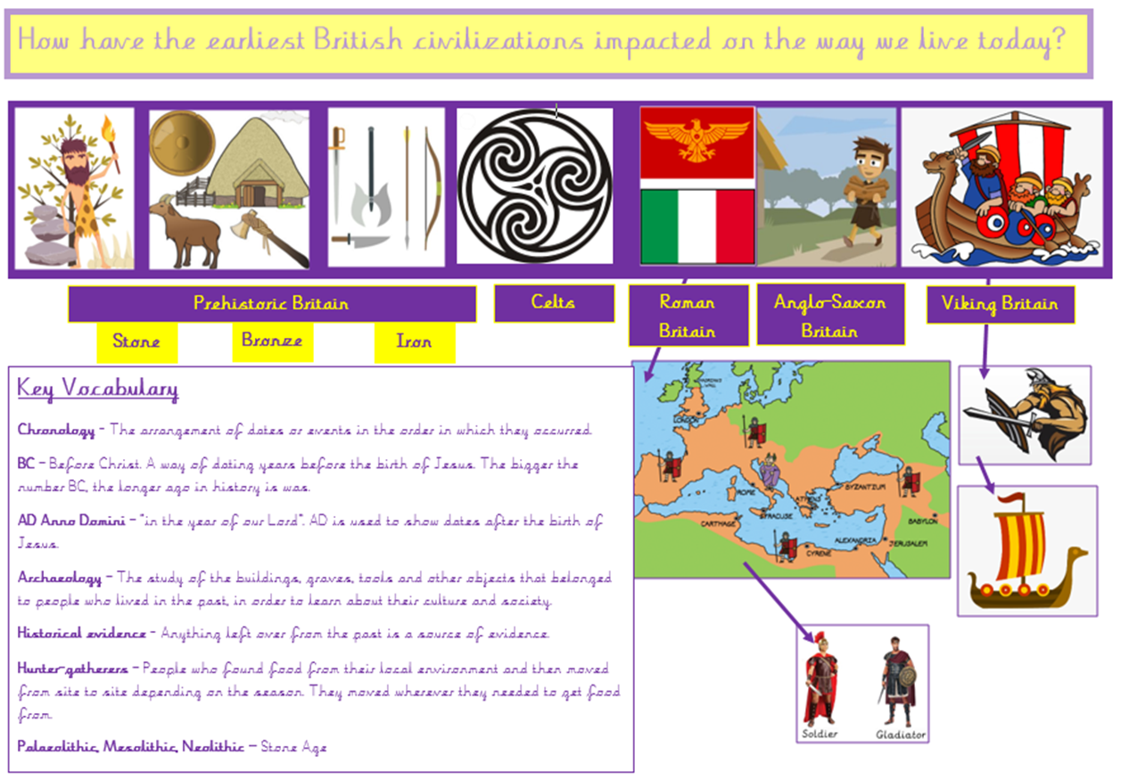

Slide 4
The Bronze Age signalled a big leap forward for the human race. The discovery of bronze meant tools and weapons were stronger and more effective. And that's not all - from the first writing systems to the wheel, the Bronze Age produced some of the most important inventions in human history.

Slide 5
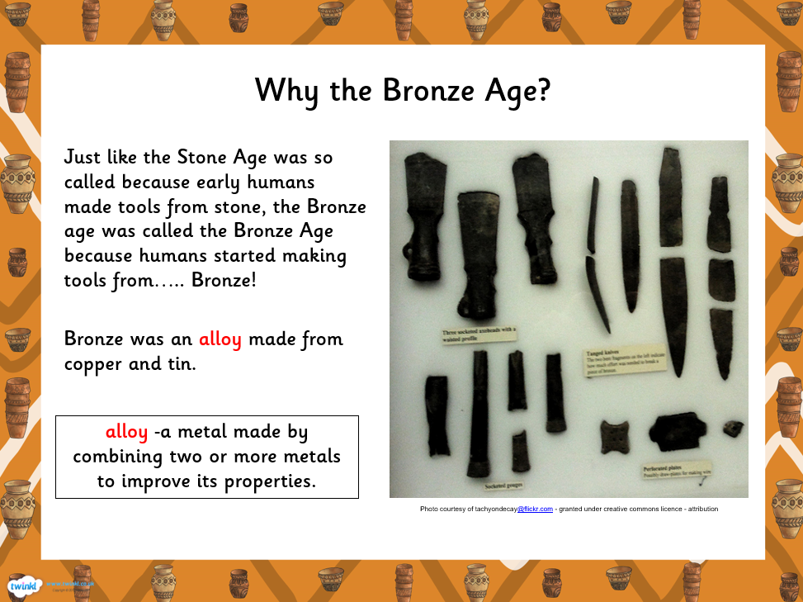

Slide 6
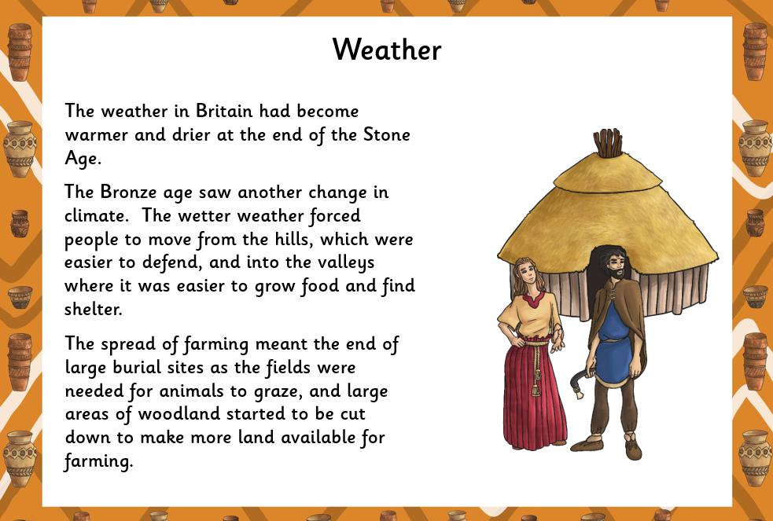



Slide 7
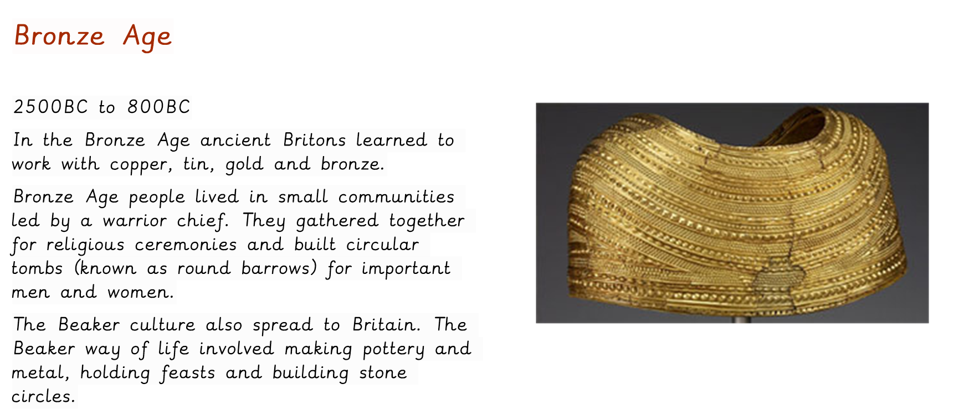

Slide 8
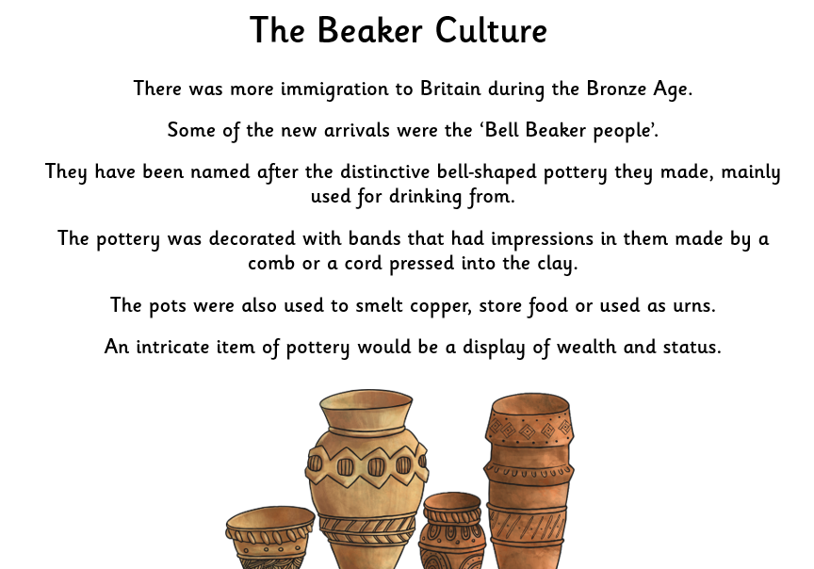

Slide 9
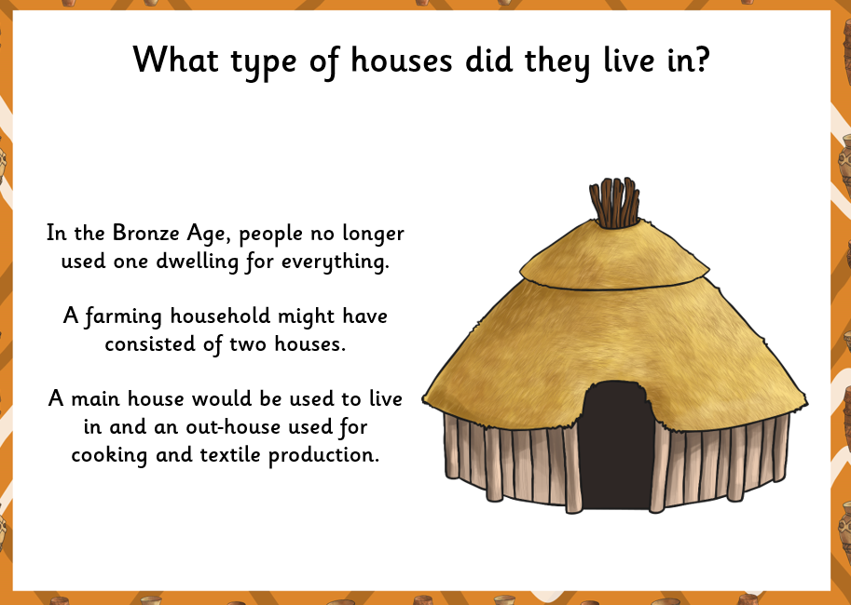

Slide 10
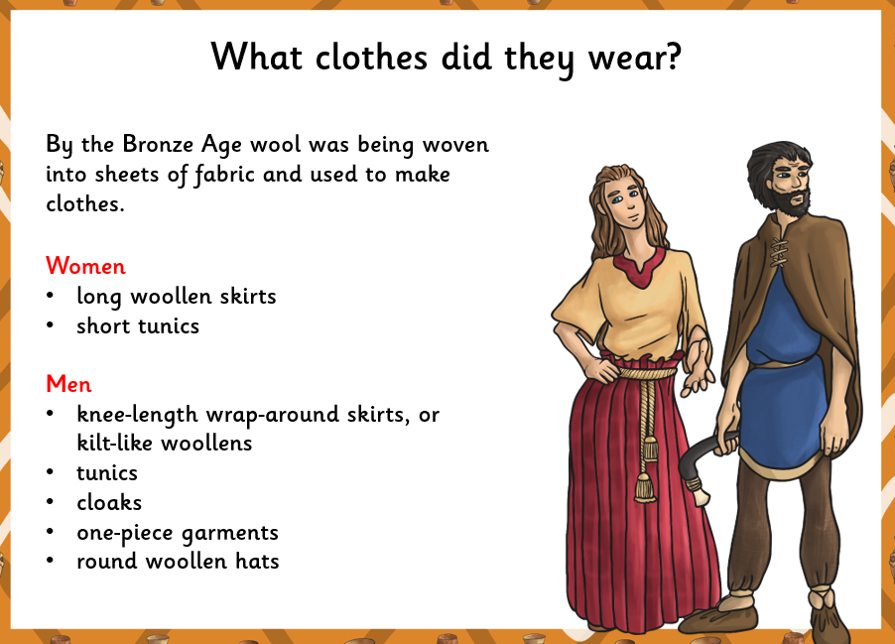

Slide 11
5 important facts…
Bronze is a mixture of tin and copper. Bronze is harder than either of the metals from which it is made. It could be used to make a greater range of tools and weapons than had previously been possible in the Stone Age.
2. Where societies developed early writing they are said to be part of a historic time. The ancient Egyptians could record their histories and laws using hieroglyphs.
3. Some Bronze Age societies developed a ruling class who were supported by military power. Some Bronze Age kings ruled empires and administered laws.
The Bronze Age is the name given to the time between the Stone and Iron Ages.
5. Between 4000BC and 2000BC different societies around the world entered the Bronze Age. In Britain, the Bronze Age started around 3000BC and ended around 800BC.

Slide 12
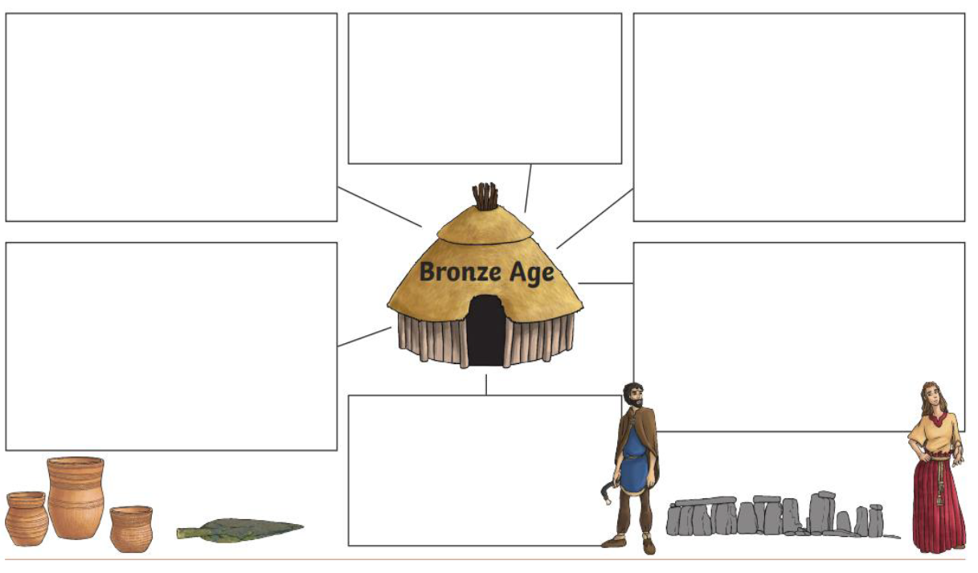

Slide 13
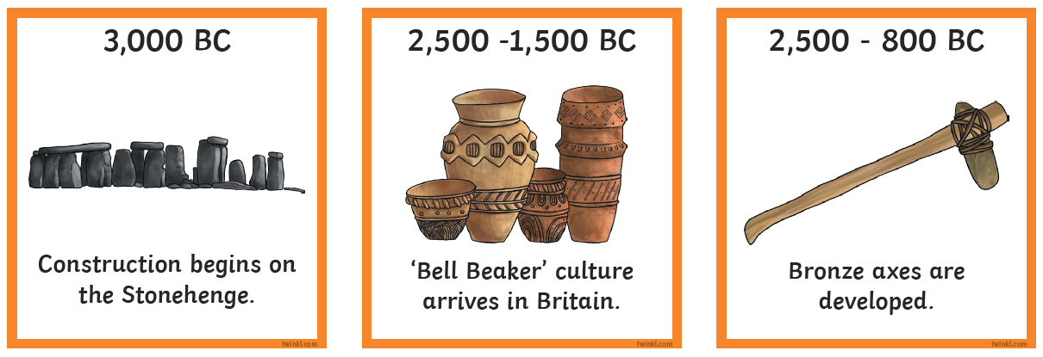
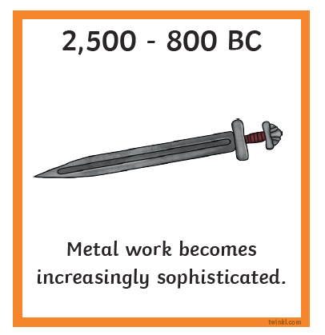

Slide 14
LG:I know about the Bronze Age.

