Slide 2
Let’s Pick a Category
In Fewer Than 200 Words
20-Minute Tales
Imagine a World…

Slide 3
20-Minute Tales
You have 20 minutes to write a story based on the image that you’re about to be shown. Some suggestions have been added to give you ideas about what you could include.
Have fun!
Continue to 20-Minute Tales Challenges
Back to Main Categories

Slide 4
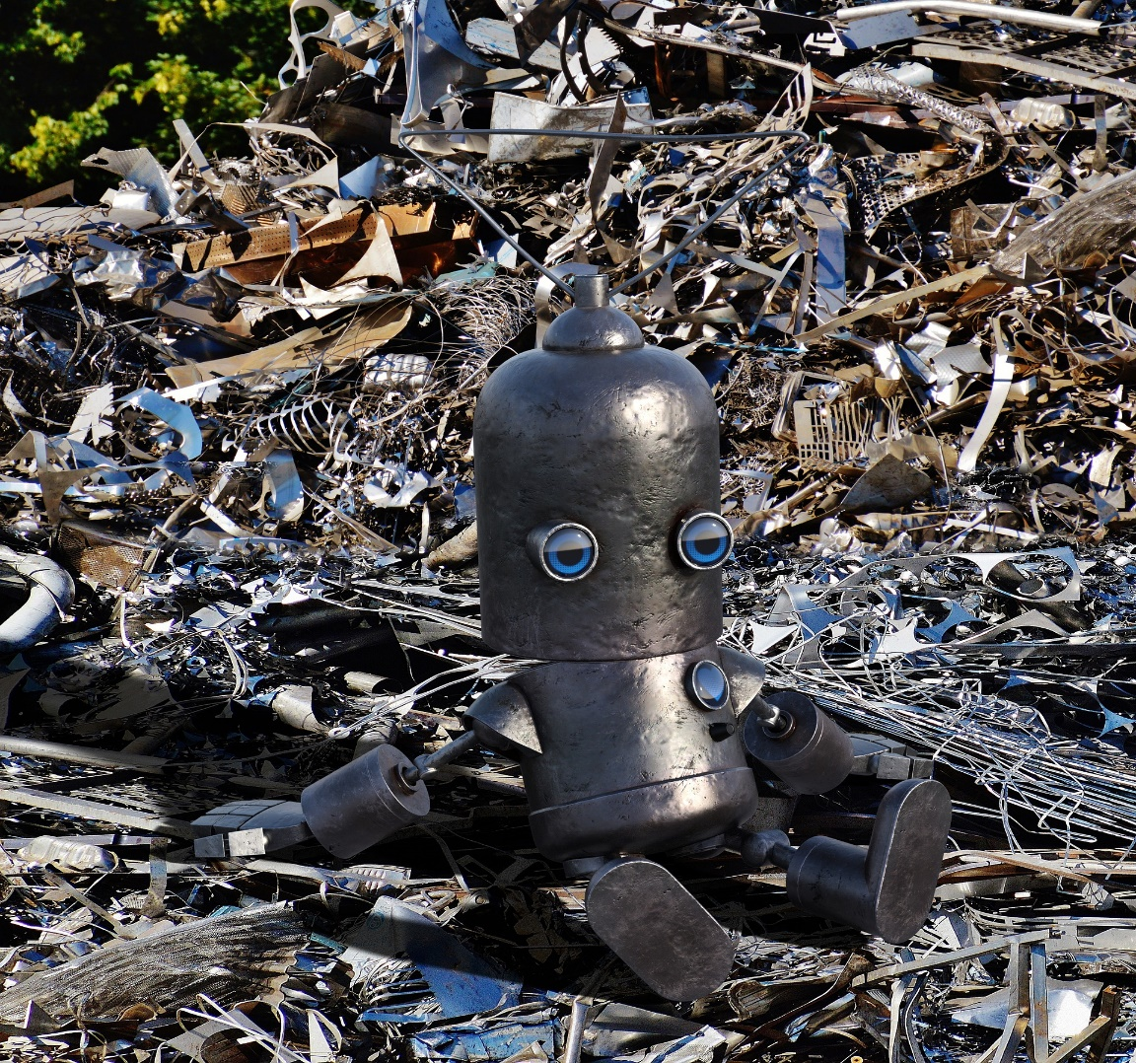
20-Minute Tales
1
2
3
4
One night, you’re told about a secret scrap metal yard. This magical place is full of charged batteries and pieces of metal in every shape and size that you could possibly imagine. Using the contents of the yard, you can make any moving metal object that you like. In this tale, your job is to help people who are in dangerous situations by using one of your creations.
Try to include:
different sentence starters;
interesting adjectives;
powerful verbs;
a variety of conjunctions;
correct punctuation;
complex sentences..
Back to Main Categories
Next
Challenge

Slide 5
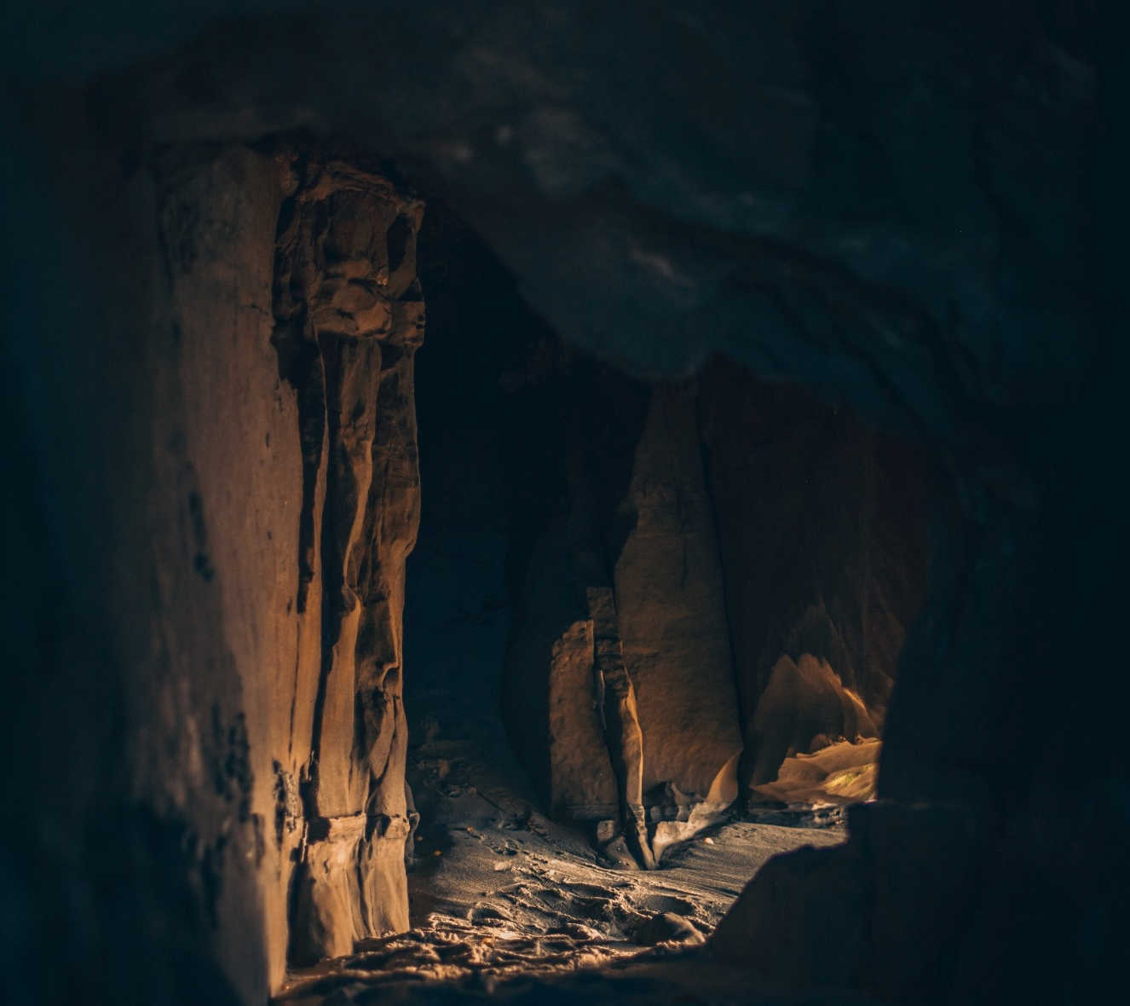
20-Minute Tales
1
2
3
4
You’re lost in a cave and the batteries in your torch are getting low on charge. Strange, echoing sounds fill the air. There are four tunnels to choose from. How do you get out of the cave and what do you encounter along the way?
Try to include:
different sentence starters;
interesting adjectives;
powerful verbs;
a variety of conjunctions;
correct punctuation;
complex sentences.
Back to Main Categories
Next
Challenge

Slide 6
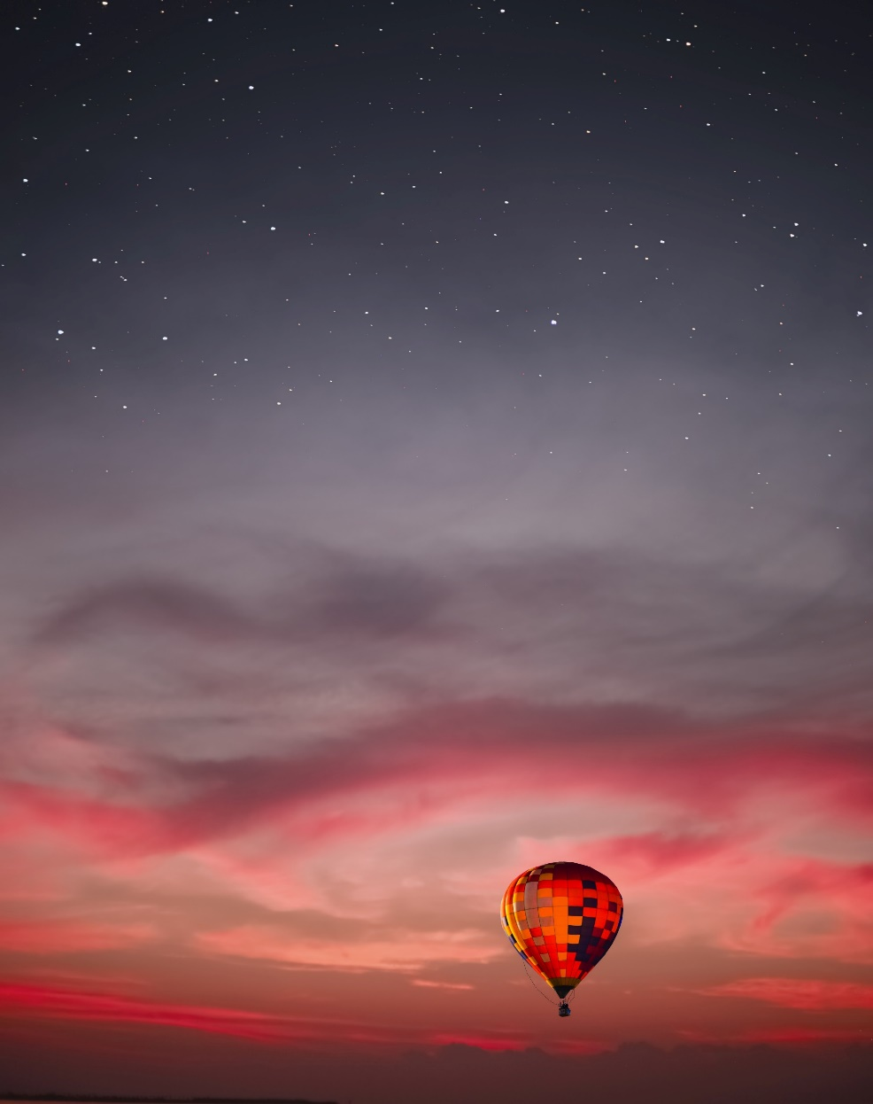
20-Minute Tales
1
2
3
4
You’re on a hot-air balloon ride. The controls are broken and this makes the balloon keep rising. What do you see? How do you feel? How do you solve the problem and get back to the ground safely?
Try to include:
different sentence starters;
interesting adjectives;
powerful verbs;
a variety of conjunctions;
correct punctuation;
complex sentences.
Back to Main Categories
Next
Challenge

Slide 7
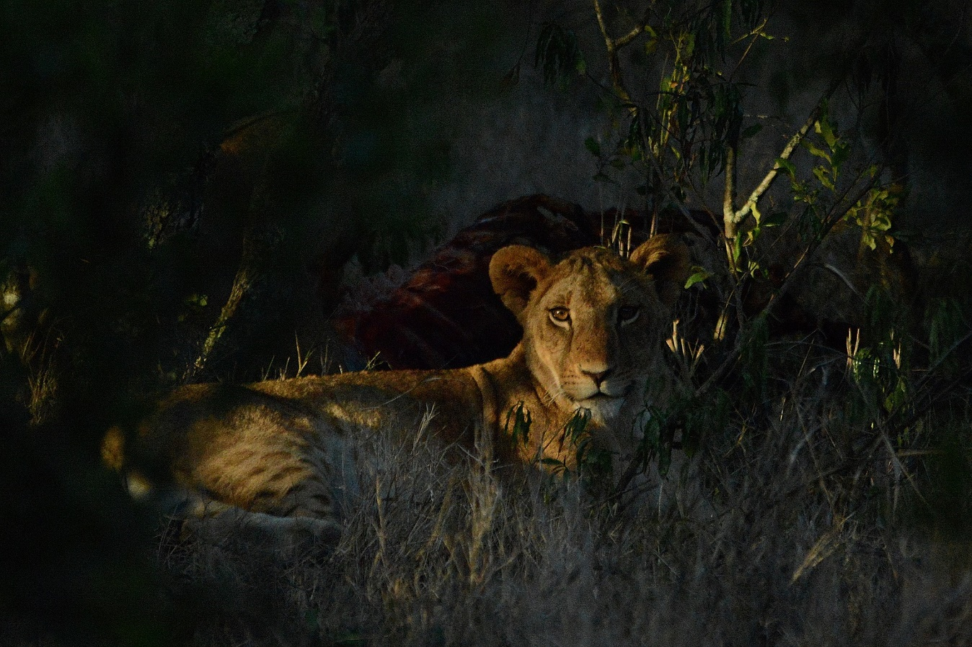
20-Minute Tales
1
2
3
4
As you walk down a lane in the centre of town, you find a friendly lion hiding behind some bushes. You have no idea where the lion has come from. What do you do?
Try to include:
different sentence starters;
interesting adjectives;
powerful verbs;
a variety of conjunctions;
correct punctuation;
complex sentences.
Back to Main Categories

Slide 8
In Fewer Than 200 Words
Your challenge is to write a text to meet the brief using no more than 200 words.
Have fun!
Back to Main Categories
Continue to Challenges

Slide 9
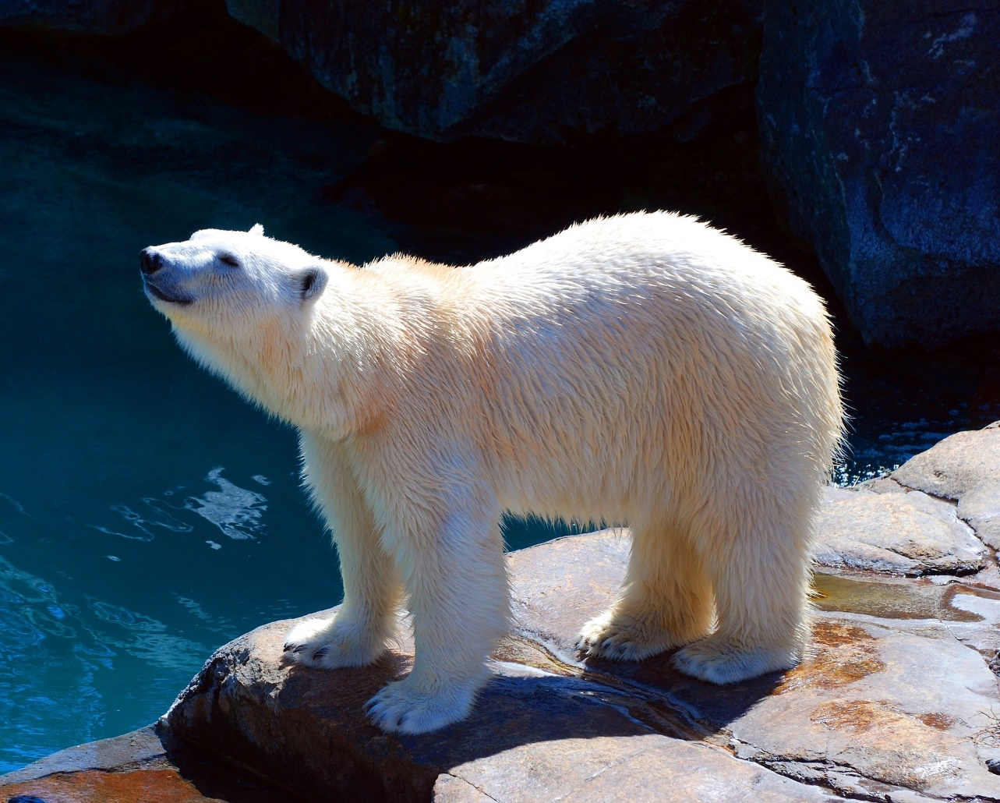
In Fewer Than 200 Words
1
2
3
4
An alien has just arrived on Earth for the first time. It has never seen a polar bear before. Describe everything that you can about this animal to them.
Try to include:
different sentence starters;
interesting adjectives;
powerful verbs;
a variety of conjunctions;
correct punctuation;
complex sentences.
Back to Main Categories
Next
Challenge

Slide 10
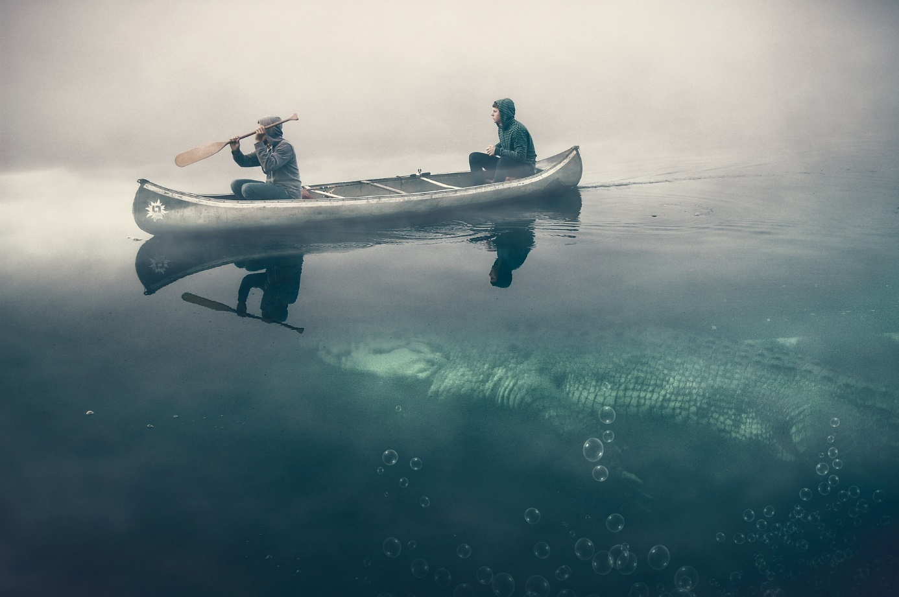
In Fewer Than 200 Words
1
2
3
4
You are in a canoe that’s slowly leaking. Although you can see the riverbank in the distance, there’s also a huge crocodile lurking beneath the water! What happens? How do you get to the riverbank safely?
Try to include:
different sentence starters;
interesting adjectives;
powerful verbs;
a variety of conjunctions;
correct punctuation;
complex sentences.
Back to Main Categories
Next
Challenge

Slide 11

In Fewer Than 200 Words
1
2
3
4
You find the key to a magical safe that grants you an unlimited amount of money for the day. Where would you go and what would you do?
Try to include:
different sentence starters;
interesting adjectives;
powerful verbs;
a variety of conjunctions;
correct punctuation;
complex sentences.
Back to Main Categories
Next
Challenge

Slide 12
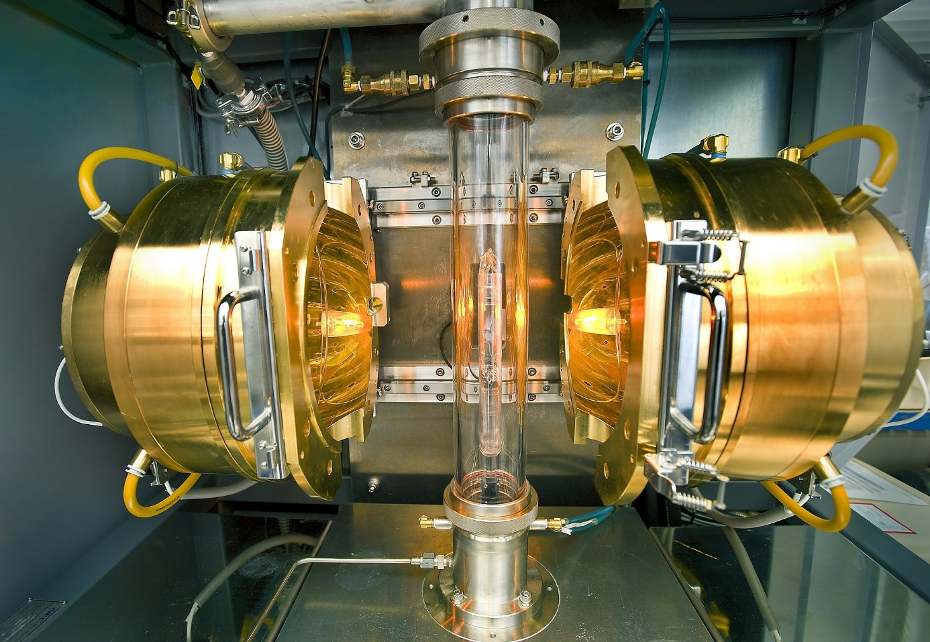
In Fewer Than 200 Words
1
2
3
4
You discover a time machine in an old, neglected science lab. Which period of history do you visit? Describe what you see and do.
Try to include:
different sentence starters;
interesting adjectives;
powerful verbs;
a variety of conjunctions;
correct punctuation;
complex sentences.
Back to Main Categories

Slide 13
Imagine a World…
Your challenge is to create an exciting piece of writing about our world. However, instead of the normal life that you are used to, you are faced with a range of different problems.
Have fun!
Back to Main Categories
Continue to Challenges

Slide 14
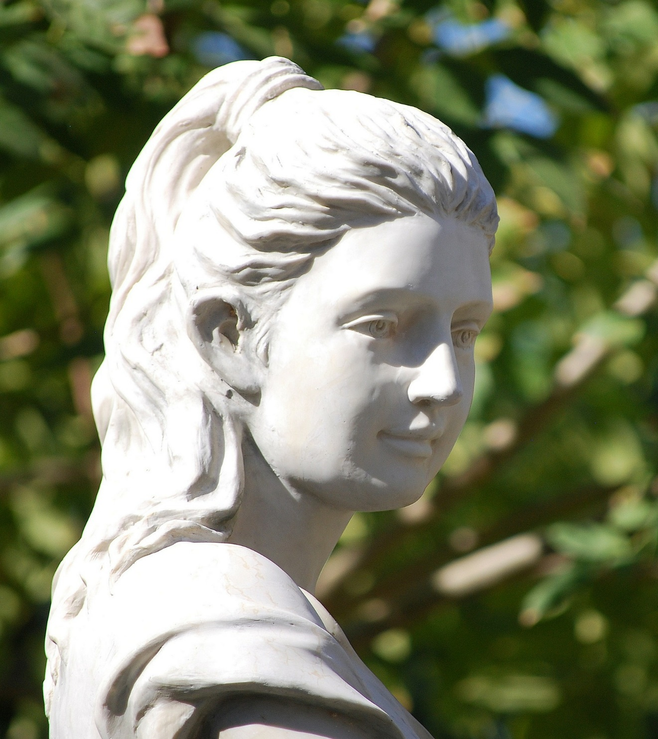
Imagine a World…
1
2
3
4
Where Everything That You Touch Turns to Stone!
Try to include:
different sentence starters;
interesting adjectives;
powerful verbs;
a variety of conjunctions;
correct punctuation;
complex sentences.
Next
Challenge
What do you do?
Where do you go?
How do you feel?
How is the problem solved?
Back to Main Categories

Slide 15

Imagine a World…
1
2
3
4
Where You Can Step Inside Your TV!
Try to include:
different sentence starters;
interesting adjectives;
powerful verbs;
a variety of conjunctions;
correct punctuation;
complex sentences.
Where do you go?
What happens?
How do you feel?
How do you return to normal life?
Try to include:
different sentence starters;
interesting adjectives;
powerful verbs;
a variety of conjunctions;
correct punctuation;
complex sentences.
Next
Challenge
Back to Main Categories

Slide 16
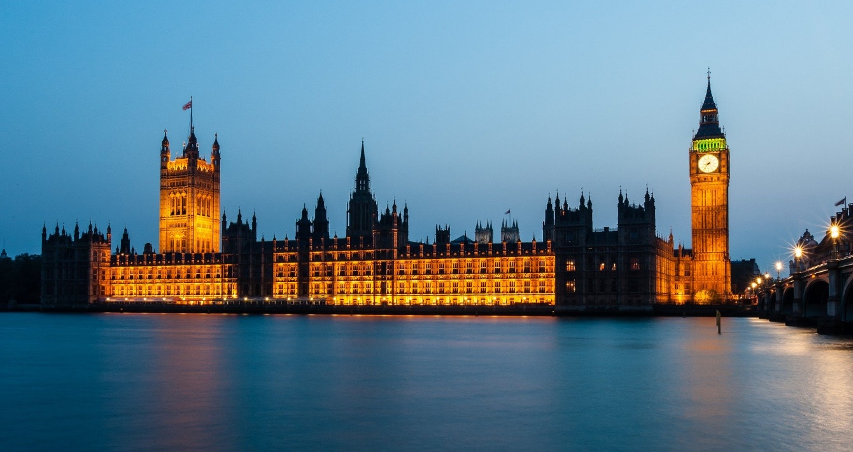
Imagine a World…
1
2
3
4
Where You’re Chosen to Be the Prime Minister!
Try to include:
different sentence starters;
interesting adjectives;
powerful verbs;
a variety of conjunctions;
correct punctuation;
complex sentences.
What do you do?
Do you change anything?
How do you feel?
When and why does life return
to normal?
Next
Challenge
Back to Main Categories

Slide 17

Imagine a World…
1
2
3
4
With No Gravity for a Day!
Try to include:
different sentence starters;
interesting adjectives;
powerful verbs;
a variety of conjunctions;
correct punctuation;
complex sentences.
When do you first realise that there’s no gravity?
Where do you go?
How do you feel?
What happens when gravity suddenly returns?
Back to Main Categories

