Slide 1




More or less than 8?
Girls
6
$$\frac{5}{4}$$
tea
÷ 2 < 4
£1.30
Boys
girls that join
biscuit
I SEE PROBLEM-SOLVING - UKS2
WORKED EXAMPLES
isosceles triangle
1
(8,9)
3
9
edges
faces
32°
4
5
angles the same size
-
2
7
5
(4,5)
1
8
4
vertices
the same length
(7,2)
90 kg
Ben | Sam
40
4cm
?
Ben | Jack
-10
30
9cm
GARETH METCALFE
Available as PowerPoint and PDF from www.iseemaths.com

Slide 2

I SEE PROBLEM-SOLVING – UKS2
WORKED EXAMPLES
Task 1: Sum of the digits
Task 2: Decimal number line
Task 3: Rounding money
Task 4: Rounding puzzles
Task 5: Negatives on a number line
Task 6: Number sequences
Task 7: More, less, equal
Task 8: Four number sentences
Task 9: Subtraction number sentences
Task 10: Missing digits addition
Task 11: Missing digits subtraction
Task 12: Sum and difference
Task 13: Four numbers challenge
Task 14: Café calculations
Task 15: Multiplication missing digits
Task 16: Remainder of one-half
Task 17: Find the factors
Task 18: Number detective
Task 19: Athletics club ratios
Task 20: Shot accuracy statistics
CONTENTS
I SEE PROBLEM-SOLVING – UKS2

Slide 3
I SEE PROBLEM-SOLVING – UKS2
WORKED EXAMPLES
Task 21: Pages read, pages left
Task 22: Clothes shop sale
Task 23: Fractions of a square
Task 24: Adding fractions
Task 25: Make one and a quarter
Task 26: Fractions of an amount
Task 27: Improper fractions
Task 28: Make two and a quarter
Task 29: Part-finished book
Task 30: Fractions and decimals
Task 31, Algebra: Combined weights
Task 32, Algebra: Sports ball weights
Task 33, Algebra: Hiring a surfboard
Task 34, Algebra: Dot pattern sequence
Task 35, Algebra: My secret number
Task 36, Measures: Sorting measures
Task 37, Measures: Time spent driving
Task 38, Measures: Lengths of time
Task 39, Measures: Ticket prices
Task 40, Angle: Missing angles
CONTENTS
I SEE PROBLEM-SOLVING – UKS2

Slide 4
I SEE PROBLEM-SOLVING – UKS2
WORKED EXAMPLES
Task 41: Isosceles triangle angles
Task 42: Clock hands angles
Task 43: Change the perimeter
Task 44: Rectangle length
Task 45: Compound shape
Task 46: Combined shapes
Task 47: Triangle area
Task 48: Inside, edge or outside?
Task 49: Which vertices?
Task 50: Branching database
Task 51: Cube nets
Task 52: Cuboid dimensions
Task 53: Faces, edges, vertices
Task 54: Before/now pie charts
Task 55: Bike race line graphs
Task 56: Train timetables
Task 57: Average of 3 numbers
Task 58: Average ages
CONTENTS
I SEE PROBLEM-SOLVING – UKS2

Slide 5
Task 1: Sum of the digits
To make the smallest possible number:
PLACE VALUE
I SEE PROBLEM-SOLVING – UKS2

Slide 6
Task 1: Sum of the digits
To make the smallest possible number:
Must be a 2-digit number
Make the tens value as small as possible
PLACE VALUE
I SEE PROBLEM-SOLVING – UKS2

Slide 7
Task 1: Sum of the digits
To make the smallest possible number:
Must be a 2-digit number
Make the tens value as small as possible
15
PLACE VALUE
I SEE PROBLEM-SOLVING – UKS2

Slide 8
Task 1: Sum of the digits
To make the largest possible number:
PLACE VALUE
I SEE PROBLEM-SOLVING – UKS2

Slide 9
Task 1: Sum of the digits
To make the largest possible number:
Use as many digits as possible
Use the digit 0
PLACE VALUE
I SEE PROBLEM-SOLVING – UKS2

Slide 10
Task 1: Sum of the digits
To make the largest possible number:
Use as many digits as possible
Use the digit 0
Use four digits: 0, 1, 2, 3
PLACE VALUE
I SEE PROBLEM-SOLVING – UKS2

Slide 11
Task 1: Sum of the digits
To make the largest possible number:
Use as many digits as possible
Use the digit 0
Largest → smallest digits put left → right
Use four digits: 0, 1, 2, 3
PLACE VALUE
I SEE PROBLEM-SOLVING – UKS2

Slide 12
Task 1: Sum of the digits
To make the largest possible number:
Use as many digits as possible
Use the digit 0
Largest → smallest digits put left → right
Use four digits: 0, 1, 2, 3
3 210
PLACE VALUE
I SEE PROBLEM-SOLVING – UKS2

Slide 13
Task 2: Decimal number line
Example 1:
0.19
PLACE VALUE
I SEE PROBLEM-SOLVING – UKS2

Slide 14
Task 2: Decimal number line
Example 1:
0.1
0.1
0.19
PLACE VALUE
I SEE PROBLEM-SOLVING – UKS2

Slide 15
Task 2: Decimal number line
Example 1:
0.1
0.1
0.09
0.19
0.29
PLACE VALUE
I SEE PROBLEM-SOLVING – UKS2

Slide 16
Task 2: Decimal number line
Example 2:
0.01
0.01
0.19
PLACE VALUE
I SEE PROBLEM-SOLVING – UKS2

Slide 17
Task 2: Decimal number line
Example 2:
0.01
0.01
0.18
0.19
0.2
PLACE VALUE
I SEE PROBLEM-SOLVING – UKS2

Slide 18
Task 2: Decimal number line
Example 3:
0.05
0.05
0.19
PLACE VALUE
I SEE PROBLEM-SOLVING – UKS2

Slide 19
Task 2: Decimal number line
Example 3:
0.05
0.05
0.14
0.19
0.24
PLACE VALUE
I SEE PROBLEM-SOLVING – UKS2

Slide 20
Task 3: Rounding money
Alex has £250, rounded to the nearest £10
£200
£300
£400
£500
£245→£254
ROUNDING
I SEE PROBLEM-SOLVING – UKS2

Slide 21
Task 3: Rounding money
Alex has £250, rounded to the nearest £10
Jim has £400, rounded to the nearest £100
£200
£300
£400
£500
£245→£254
£350→£449
ROUNDING
I SEE PROBLEM-SOLVING – UKS2

Slide 22
Task 3: Rounding money
Alex has £250, rounded to the nearest £10
Jim has £400, rounded to the nearest £100
greatest possible difference
£200
£300
£400
£500
£245→£254
£350→£449
ROUNDING
I SEE PROBLEM-SOLVING – UKS2

Slide 23
Task 3: Rounding money
Alex has £250, rounded to the nearest £10
Jim has £400, rounded to the nearest £100
greatest possible difference
£200
£300
£400
£500
£449 - £245 = £204
ROUNDING
I SEE PROBLEM-SOLVING – UKS2

Slide 24
Task 4: Rounding puzzles
Part 1: nearest 100 is 4 000
3 800
3 900
4 000
4 100
4 200
ROUNDING
I SEE PROBLEM-SOLVING – UKS2

Slide 25
Task 4: Rounding puzzles
Part 1: nearest 100 is 4 000
Numbers in this range, to the nearest 100, are 4000
3 800
3 900
4 000
4 100
4 200
ROUNDING
I SEE PROBLEM-SOLVING – UKS2

Slide 26
Task 4: Rounding puzzles
Part 1: nearest 100 is 4 000
Numbers in this range, to the nearest 100, are 4000
3 800
3 900
4 000
4 100
4 200
Largest possible whole number = 4049
ROUNDING
I SEE PROBLEM-SOLVING – UKS2

Slide 27
Task 4: Rounding puzzles
Part 2: nearest 200 is 4 000
3 600
3 800
4 000
4 200
4 400
ROUNDING
I SEE PROBLEM-SOLVING – UKS2

Slide 28
Task 4: Rounding puzzles
Part 2: nearest 200 is 4 000
Numbers in this range, to the nearest 200, are 4000
3 600
3 800
4 000
4 200
4 400
ROUNDING
I SEE PROBLEM-SOLVING – UKS2

Slide 29
Task 4: Rounding puzzles
Part 2: nearest 200 is 4 000
Numbers in this range, to the nearest 200, are 4000
3 600
3 800
4 000
4 200
4 400
Largest possible whole number = 4099
ROUNDING
I SEE PROBLEM-SOLVING – UKS2

Slide 30
Task 5: Negatives on number line
30
negative
positive
NEGATIVE NUMBERS
I SEE PROBLEM-SOLVING – UKS2

Slide 31
Task 5: Negatives on number line
more than 30
30
negative
positive
NEGATIVE NUMBERS
I SEE PROBLEM-SOLVING – UKS2

Slide 32
Task 5: Negatives on number line
more than 30
double orange length
30
negative
positive
NEGATIVE NUMBERS
I SEE PROBLEM-SOLVING – UKS2

Slide 33
Task 5: Negatives on number line
Example answer 1:
35
70
30
negative
positive
NEGATIVE NUMBERS
I SEE PROBLEM-SOLVING – UKS2

Slide 34
Task 5: Negatives on number line
Example answer 1:
35
70
-5
30
100
negative
positive
NEGATIVE NUMBERS
I SEE PROBLEM-SOLVING – UKS2

Slide 35
Task 5: Negatives on number line
Example answer 2:
50
100
30
negative
positive
NEGATIVE NUMBERS
I SEE PROBLEM-SOLVING – UKS2

Slide 36
Task 5: Negatives on number line
Example answer 2:
50
100
-20
30
130
negative
positive
NEGATIVE NUMBERS
I SEE PROBLEM-SOLVING – UKS2

Slide 37
Task 6: Number sequences
Can the difference between the numbers in the sequence be 3?
8, 5, 2…
NEGATIVE NUMBERS
I SEE PROBLEM-SOLVING – UKS2

Slide 38
Task 6: Number sequences
Can the difference between the numbers in the sequence be 3?
8, 5, 2…
-7
-4
-1
2
No: -7 is the third negative number in this sequence
NEGATIVE NUMBERS
I SEE PROBLEM-SOLVING – UKS2

Slide 39
Task 6: Number sequences
Can the difference between the numbers in the sequence be 4?
9, 5, 1…
NEGATIVE NUMBERS
I SEE PROBLEM-SOLVING – UKS2

Slide 40
Task 6: Number sequences
Can the difference between the numbers in the sequence be 4?
9, 5, 1…
-7
-3
1
Yes: -7 is the second negative number in this sequence
NEGATIVE NUMBERS
I SEE PROBLEM-SOLVING – UKS2

Slide 41
Task 6: Number sequences
Can the difference between the numbers in the sequence be 5?
13, 8, 3…
NEGATIVE NUMBERS
I SEE PROBLEM-SOLVING – UKS2

Slide 42
Task 6: Number sequences
Can the difference between the numbers in the sequence be 5?
13, 8, 3…
-7
-2
3
Yes: -7 is the second negative number in this sequence
NEGATIVE NUMBERS
I SEE PROBLEM-SOLVING – UKS2

Slide 43
Task 6: Number sequences
Can the difference between the numbers in the sequence be 6?
17, 11, 5…
NEGATIVE NUMBERS
I SEE PROBLEM-SOLVING – UKS2

Slide 44
Task 6: Number sequences
Can the difference between the numbers in the sequence be 6?
17, 11, 5…
-7
-1
5
Yes: -7 is the second negative number in this sequence
NEGATIVE NUMBERS
I SEE PROBLEM-SOLVING – UKS2

Slide 45
Task 6: Number sequences
Can the difference between the numbers in the sequence be 7?
21, 14, 7…
NEGATIVE NUMBERS
I SEE PROBLEM-SOLVING – UKS2

Slide 46
Task 6: Number sequences
Can the difference between the numbers in the sequence be 7?
21, 14, 7…
-7
0
7
No: -7 is the first negative number in this sequence
NEGATIVE NUMBERS
I SEE PROBLEM-SOLVING – UKS2

Slide 47
Task 7: More, less, equal
4, 5, 6, 7, 8
–
10 – 8 <
20 >
+ 4 = 15 –
× 3
EQUALS, GREATER & LESS THAN
I SEE PROBLEM-SOLVING – UKS2

Slide 48
Task 7: More, less, equal
4, 5, 6, 7, 8
Where can 8 go?
–
10 – 8 <
20 >
+ 4 = 15 –
× 3
EQUALS, GREATER & LESS THAN
I SEE PROBLEM-SOLVING – UKS2

Slide 49
Task 7: More, less, equal
4, 5, 6, 7, 8
This is the only place the 8 can go, so it must go there.
Where can 7 go?
–
10 – 8 <
20 >
+ 4 = 15 –
8
× 3
EQUALS, GREATER & LESS THAN
I SEE PROBLEM-SOLVING – UKS2

Slide 50
Task 7: More, less, equal
4, 5, 6, 7
The 7 can’t go in the top two lines. It must go on the bottom line.
4 must be in the other bottom box to make the number sentence balance.
The 7 and 4 can go in either bottom box.
Where can 6 go?
–
10 – 8 <
20 >
+ 4 = 15 –
8
× 3
7
4
EQUALS, GREATER & LESS THAN
I SEE PROBLEM-SOLVING – UKS2

Slide 51
Task 7: More, less, equal
This is solution 1
6 must go in the middle line space.
This leaves a space for 5. The top number sentence is now correct.
–
10 – 8 <
20 >
+ 4 = 15 –
8
5
6
× 3
7
4
EQUALS, GREATER & LESS THAN
I SEE PROBLEM-SOLVING – UKS2

Slide 52
Task 7: More, less, equal
This is solution 2
–
10 – 8 <
20 >
+ 4 = 15 –
8
5
6
× 3
4
7
EQUALS, GREATER & LESS THAN
I SEE PROBLEM-SOLVING – UKS2

Slide 53
Task 8: Four number sentences
3, 6, 7, 8, 9
× 3 = 18 +
2 < 9 -
÷ 2 < 4
2 × 2 × 2 × 2 < + 8
EQUALS, GREATER & LESS THAN
I SEE PROBLEM-SOLVING – UKS2

Slide 54
Task 8: Four number sentences
3, 6, 7, 8, 9
Which number can go in the orange box?
× 3 = 18 +
2 < 9 -
÷ 2 < 4
2 × 2 × 2 × 2 < + 8
EQUALS, GREATER & LESS THAN
I SEE PROBLEM-SOLVING – UKS2

Slide 55
Task 8: Four number sentences
3, 6, 7, 8
9 is the only number that can go in the orange box.
Where can 8 go?
× 3 = 18 +
2 < 9 -
÷ 2 < 4
2 × 2 × 2 × 2 < + 8
9
EQUALS, GREATER & LESS THAN
I SEE PROBLEM-SOLVING – UKS2

Slide 56
Task 8: Four number sentences
3, 7
This is the only place that the 8 can go.
To complete the number sentence, 6 must go in the other box on the top line.
Where can 7 go?
× 3 = 18 +
2 < 9 -
÷ 2 < 4
2 × 2 × 2 × 2 < + 8
8
6
9
EQUALS, GREATER & LESS THAN
I SEE PROBLEM-SOLVING – UKS2

Slide 57
Task 8: Four number sentences
This is the solution
This is the only place that the 7 can go.
This leaves a space for 3. The second number sentence is now correct.
× 3 = 18 +
2 < 9 -
÷ 2 < 4
2 × 2 × 2 × 2 < + 8
8
6
3
7
9
EQUALS, GREATER & LESS THAN
I SEE PROBLEM-SOLVING – UKS2

Slide 58
Task 9: Subtraction number sentences
H – 25 < 35 60 – 25 = 35 H is 59 or less
80 – H < 39 80 – 41 = 39 H is 42 or more
H is a multiple of 6
EQUALS, GREATER & LESS THAN
I SEE PROBLEM-SOLVING – UKS2

Slide 59
Task 9: Subtraction number sentences
H – 25 < 35 60 – 25 = 35 H is 59 or less
80 – H < 39 80 – 41 = 39 H is 42 or more
H is a multiple of 6
EQUALS, GREATER & LESS THAN
I SEE PROBLEM-SOLVING – UKS2

Slide 60
Task 9: Subtraction number sentences
H – 25 < 35 59 – 25 < 35 H is 59 or less
80 – H < 39 80 – 41 = 39 H is 42 or more
H is a multiple of 6
EQUALS, GREATER & LESS THAN
I SEE PROBLEM-SOLVING – UKS2

Slide 61
Task 9: Subtraction number sentences
H – 25 < 35 59 – 25 < 35 H is 59 or less
80 – H < 39 80 – 41 = 39 H is 42 or more
H is a multiple of 6
EQUALS, GREATER & LESS THAN
I SEE PROBLEM-SOLVING – UKS2

Slide 62
Task 9: Subtraction number sentences
H – 25 < 35 59 – 25 < 35 H is 59 or less
80 – H < 39 80 – 41 = 39 H is 42 or more
H is a multiple of 6
EQUALS, GREATER & LESS THAN
I SEE PROBLEM-SOLVING – UKS2

Slide 63
Task 9: Subtraction number sentences
H – 25 < 35 59 – 25 < 35 H is 59 or less
80 – H < 39 80 – 41 = 39 H is 42 or more
H is a multiple of 6
EQUALS, GREATER & LESS THAN
I SEE PROBLEM-SOLVING – UKS2

Slide 64
Task 9: Subtraction number sentences
H – 25 < 35 59 – 25 < 35 H is 59 or less
80 – H < 39 80 – 42 < 39 H is 42 or more
H is a multiple of 6
EQUALS, GREATER & LESS THAN
I SEE PROBLEM-SOLVING – UKS2

Slide 65
Task 9: Subtraction number sentences
H – 25 < 35 59 – 25 < 35 H is 59 or less
80 – H < 39 80 – 42 < 39 H is 42 or more
H is a multiple of 6
EQUALS, GREATER & LESS THAN
I SEE PROBLEM-SOLVING – UKS2

Slide 66
Task 9: Subtraction number sentences
H – 25 < 35 59 – 25 < 35 H is 59 or less
80 – H < 39 80 – 42 < 39 H is 42 or more
H is a multiple of 6
EQUALS, GREATER & LESS THAN
I SEE PROBLEM-SOLVING – UKS2

Slide 67
Task 9: Subtraction number sentences
H – 25 < 35 59 – 25 < 35 H is 59 or less
80 – H < 39 80 – 42 < 39 H is 42 or more
H is a multiple of 6 42, 48, 54
EQUALS, GREATER & LESS THAN
I SEE PROBLEM-SOLVING – UKS2

Slide 68
Task 10: Missing digits addition
8
+
3
5
1
0
5
2
ADDITION AND SUBTRACTION
I SEE PROBLEM-SOLVING – UKS2

Slide 69
Task 10: Missing digits addition
8
7
+
3
5
1
0
5
2
1
ADDITION AND SUBTRACTION
I SEE PROBLEM-SOLVING – UKS2

Slide 70
Task 10: Missing digits addition
8
7
+
3
6
5
1
0
5
2
1
1
ADDITION AND SUBTRACTION
I SEE PROBLEM-SOLVING – UKS2

Slide 71
Task 10: Missing digits addition
6
8
7
+
3
6
5
1
0
5
2
1
1
ADDITION AND SUBTRACTION
I SEE PROBLEM-SOLVING – UKS2

Slide 72
Task 11: Missing digits subtraction
6
2
-
3
2
4
3
ADDITION AND SUBTRACTION
I SEE PROBLEM-SOLVING – UKS2

Slide 73
Task 11: Missing digits subtraction
6
1
2
-
3
9
2
4
3
ADDITION AND SUBTRACTION
I SEE PROBLEM-SOLVING – UKS2

Slide 74
Task 11: Missing digits subtraction
7
6
8
1
2
-
3
9
2
4
3
ADDITION AND SUBTRACTION
I SEE PROBLEM-SOLVING – UKS2

Slide 75
Task 11: Missing digits subtraction
7
6
8
1
2
-
4
3
9
2
4
3
ADDITION AND SUBTRACTION
I SEE PROBLEM-SOLVING – UKS2

Slide 76

Task 12: Sum and difference
Two numbers: sum = 9, difference = 4
6
6 and 3
6
3
3
sum = 9
difference = 3
ADDITION AND SUBTRACTION
I SEE PROBLEM-SOLVING – UKS2

Slide 77
Task 12: Sum and difference
Two numbers: sum = 9, difference = 4
6
6 and 3
6
3
3
sum = 9
difference = 3
7
7 and 2
7
2
2
sum = 9
difference = 5
ADDITION AND SUBTRACTION
I SEE PROBLEM-SOLVING – UKS2

Slide 78
Task 12: Sum and difference
Two numbers: sum = 9, difference = 4
6
6 and 3
6
3
3
sum = 9
difference = 3
6.5
6.5 and 2.5
6.5
2.5
2.5
sum = 9
difference = 4
7
7 and 2
7
2
2
sum = 9
difference = 5
ADDITION AND SUBTRACTION
I SEE PROBLEM-SOLVING – UKS2

Slide 79
Task 13: Four numbers challenge
sum = 23
smallest
largest
difference = 6
ADDITION AND SUBTRACTION
I SEE PROBLEM-SOLVING – UKS2

Slide 80
Task 13: Four numbers challenge
sum = 23
1
7
smallest
largest
difference = 6
ADDITION AND SUBTRACTION
I SEE PROBLEM-SOLVING – UKS2

Slide 81
Task 13: Four numbers challenge
sum = 23
1
7
smallest
largest
sum = 15
difference = 6
ADDITION AND SUBTRACTION
I SEE PROBLEM-SOLVING – UKS2

Slide 82
Task 13: Four numbers challenge
sum = 23
1
7
smallest
largest
sum = 15
difference = 6
Not possible with two whole numbers less than 7
ADDITION AND SUBTRACTION
I SEE PROBLEM-SOLVING – UKS2

Slide 83
Task 13: Four numbers challenge
sum = 23
2
8
smallest
largest
sum = 13
difference = 6
ADDITION AND SUBTRACTION
I SEE PROBLEM-SOLVING – UKS2

Slide 84
Task 13: Four numbers challenge
sum = 23
Answers
2, 6, 7, 8
2
6
7
8
smallest
largest
sum = 13
difference = 6
ADDITION AND SUBTRACTION
I SEE PROBLEM-SOLVING – UKS2

Slide 85
Task 13: Four numbers challenge
sum = 23
Answers
2, 6, 7, 8
2
6
7
8
smallest
largest
sum = 13
difference = 6
7 and 6 only numbers less than 8 with sum of 13
ADDITION AND SUBTRACTION
I SEE PROBLEM-SOLVING – UKS2

Slide 86
Task 13: Four numbers challenge
sum = 23
Answers
2, 6, 7, 8
3
9
smallest
largest
sum = 11
difference = 6
ADDITION AND SUBTRACTION
I SEE PROBLEM-SOLVING – UKS2

Slide 87
Task 13: Four numbers challenge
sum = 23
Answers
2, 6, 7, 8
3, 5, 6, 9
3
5
6
9
smallest
largest
sum = 11
difference = 6
ADDITION AND SUBTRACTION
I SEE PROBLEM-SOLVING – UKS2

Slide 88
Task 13: Four numbers challenge
sum = 23
Answers
2, 6, 7, 8
3, 5, 6, 9
3, 4, 7, 9
3
4
7
9
smallest
largest
sum = 11
difference = 6
ADDITION AND SUBTRACTION
I SEE PROBLEM-SOLVING – UKS2

Slide 89
Task 13: Four numbers challenge
sum = 23
Answers
2, 6, 7, 8
3, 5, 6, 9
3, 4, 7, 9
4
10
smallest
largest
sum = 9
difference = 6
ADDITION AND SUBTRACTION
I SEE PROBLEM-SOLVING – UKS2

Slide 90
Task 13: Four numbers challenge
sum = 23
Answers
2, 6, 7, 8
3, 5, 6, 9
3, 4, 7, 9
4
10
smallest
largest
sum = 9
difference = 6
Not possible with two whole numbers greater than 4
ADDITION AND SUBTRACTION
I SEE PROBLEM-SOLVING – UKS2

Slide 91
Task 13: Four numbers challenge
sum = 23
Answers
2, 6, 7, 8
3, 5, 6, 9
3, 4, 7, 9
4
10
smallest
largest
sum = 9
All possible answers
difference = 6
Not possible with two whole numbers greater than 4
ADDITION AND SUBTRACTION
I SEE PROBLEM-SOLVING – UKS2

Slide 92
Task 14: Café calculations
Tea costs more than biscuit
tea
biscuit
ADDITION AND SUBTRACTION
I SEE PROBLEM-SOLVING – UKS2

Slide 93
Task 14: Café calculations
Tea and biscuit = £1.30
tea
£1.30
biscuit
ADDITION AND SUBTRACTION
I SEE PROBLEM-SOLVING – UKS2

Slide 94
Task 14: Café calculations
Tea 60p more than biscuit
tea
£1.30
biscuit
60p
ADDITION AND SUBTRACTION
I SEE PROBLEM-SOLVING – UKS2

Slide 95
Task 14: Café calculations
Two sections : £1.30 – 60p = 70p
tea
£1.30
biscuit
60p
ADDITION AND SUBTRACTION
I SEE PROBLEM-SOLVING – UKS2

Slide 96
Task 14: Café calculations
Each section: 70p ÷ 2 = 35p
35p
tea
£1.30
biscuit
35p
60p
ADDITION AND SUBTRACTION
I SEE PROBLEM-SOLVING – UKS2

Slide 97
Task 14: Café calculations
A biscuit costs 35p
35p
tea
£1.30
biscuit
35p
60p
ADDITION AND SUBTRACTION
I SEE PROBLEM-SOLVING – UKS2

Slide 98
Task 15: Multiplication missing digits
6
×
3
2 0 4
2 7 2 0
2 9 2 4
MULTIPLICATION AND DIVISION
I SEE PROBLEM-SOLVING – UKS2

Slide 99
Task 15: Multiplication missing digits
6
6 × 3 = 204
×
3
2 0 4
2 7 2 0
2 9 2 4
MULTIPLICATION AND DIVISION
I SEE PROBLEM-SOLVING – UKS2

Slide 100
Task 15: Multiplication missing digits
6
6 × 3 = 204
60 × 3 = 180
×
3
2 0 4
2 7 2 0
2 9 2 4
MULTIPLICATION AND DIVISION
I SEE PROBLEM-SOLVING – UKS2

Slide 101
Task 15: Multiplication missing digits
6
6 × 3 = 204
60 × 3 = 180
8 × 3 = 24
×
3
2 0 4
2 7 2 0
2 9 2 4
MULTIPLICATION AND DIVISION
I SEE PROBLEM-SOLVING – UKS2

Slide 102
Task 15: Multiplication missing digits
6
8
6 × 3 = 204
60 × 3 = 180
8 × 3 = 24
180 + 24 = 204
×
3
2 0 4
2 7 2 0
2 9 2 4
MULTIPLICATION AND DIVISION
I SEE PROBLEM-SOLVING – UKS2

Slide 103
Task 15: Multiplication missing digits
6
8
68 × 0 = 2720
×
3
2 0 4
2 7 2 0
2 9 2 4
MULTIPLICATION AND DIVISION
I SEE PROBLEM-SOLVING – UKS2

Slide 104
Task 15: Multiplication missing digits
6
8
68 × 0 = 2720
×
3
2 0 4
2 7 2 0
2 9 2 4
Round 68 to 70 to do an estimate.
MULTIPLICATION AND DIVISION
I SEE PROBLEM-SOLVING – UKS2

Slide 105
Task 15: Multiplication missing digits
6
8
68 × 0 = 2720
×
3
2 0 4
2 7 2 0
2 9 2 4
Round 68 to 70 to do an estimate.
How can I make the 2 tens?
MULTIPLICATION AND DIVISION
I SEE PROBLEM-SOLVING – UKS2

Slide 106
Task 15: Multiplication missing digits
6
8
68 × 0 = 2720
×
4
3
2 0 4
2 7 2 0
2 9 2 4
70 × 40 = 2800
8 × 4 = 32
MULTIPLICATION AND DIVISION
I SEE PROBLEM-SOLVING – UKS2

Slide 107
Task 15: Multiplication missing digits
6
8
×
4
3
2 0 4
2 7 2 0
2 9 2 4
MULTIPLICATION AND DIVISION
I SEE PROBLEM-SOLVING – UKS2

Slide 108
Task 16: Remainder of one-half
1
÷
8
=
2
When ÷ 8, a remainder of is equivalent to $\frac{1}{2}$
MULTIPLICATION AND DIVISION
I SEE PROBLEM-SOLVING – UKS2

Slide 109
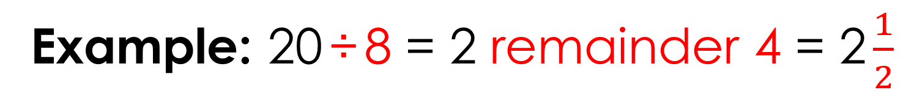
Task 16: Remainder of one-half
1
÷
8
=
2
When ÷ 8, a remainder of is equivalent to $\frac{1}{2}$
4
Example: 20 ÷ 8 = 2 remainder 4 = 2 $\frac{1}{2}$
MULTIPLICATION AND DIVISION
I SEE PROBLEM-SOLVING – UKS2

Slide 110
Task 16: Remainder of one-half
0
1
2
3
4
5
6
7
8
9
Example method: work out which digits can go in this place.
1
÷
8
=
2
MULTIPLICATION AND DIVISION
I SEE PROBLEM-SOLVING – UKS2

Slide 111
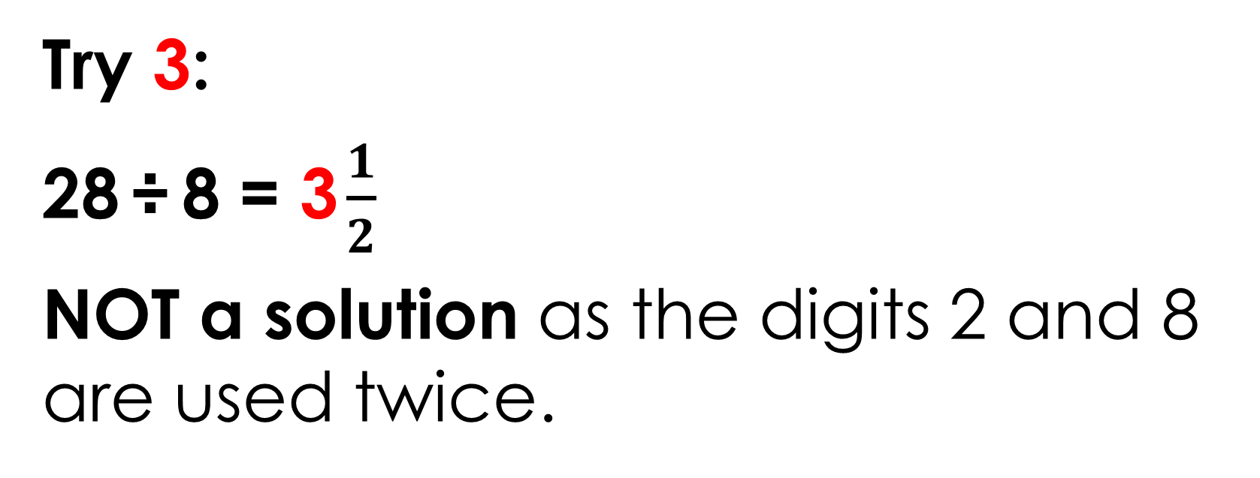
Task 16: Remainder of one-half
0
1
2
3
4
5
6
7
8
9
Example method: work out which digits can go in this place.
1
÷
8
=
2
Try 3:
28 ÷ 8 = 3 $\frac{1}{2}$
NOT a solution as the digits 2 and 8 are used twice.
MULTIPLICATION AND DIVISION
I SEE PROBLEM-SOLVING – UKS2

Slide 112
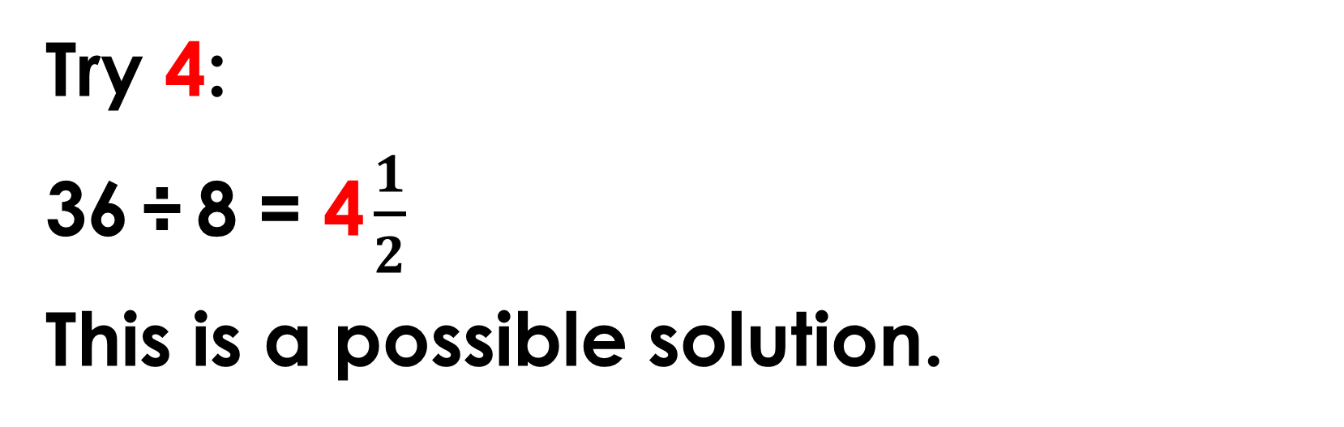
Task 16: Remainder of one-half
0
1
2
3
4
5
6
7
8
9
Example method: work out which digits can go in this place.
1
÷
8
=
2
Try 4:
36 ÷ 8 = 4 $\frac{1}{2}$
This is a possible solution.
MULTIPLICATION AND DIVISION
I SEE PROBLEM-SOLVING – UKS2

Slide 113
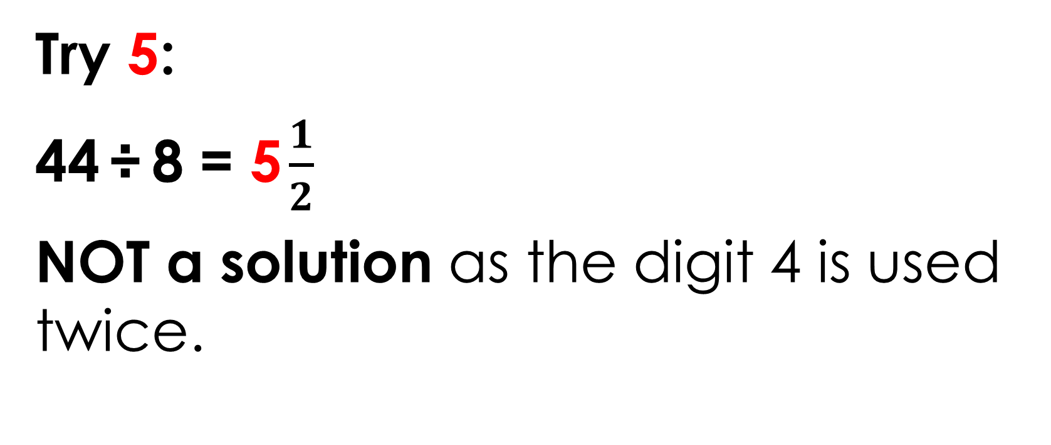
Task 16: Remainder of one-half
0
1
2
3
4
5
6
7
8
9
Example method: work out which digits can go in this place.
1
÷
8
=
2
Try 5:
44 ÷ 8 = 5 $\frac{1}{2}$
NOT a solution as the digit 4 is used twice.
MULTIPLICATION AND DIVISION
I SEE PROBLEM-SOLVING – UKS2

Slide 114
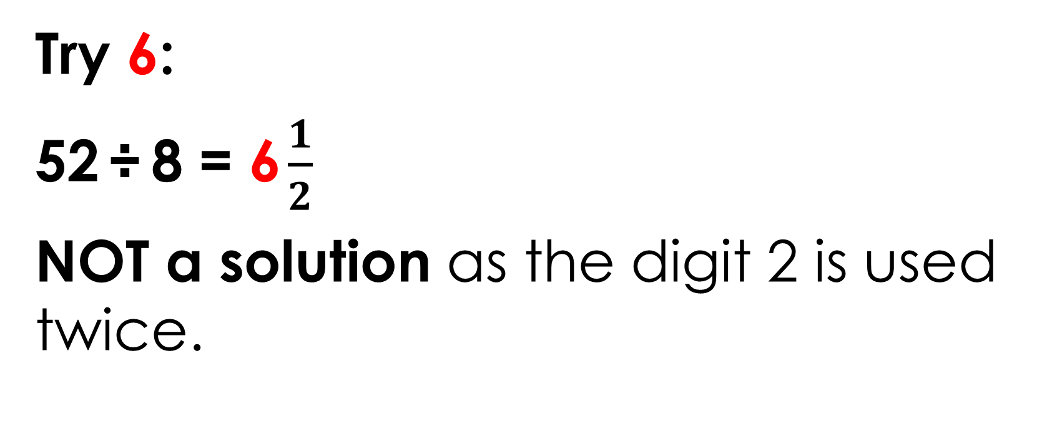
Task 16: Remainder of one-half
0
1
2
3
4
5
6
7
8
9
Example method: work out which digits can go in this place.
1
÷
8
=
2
Try 6:
52 ÷ 8 = 6 $\frac{1}{2}$
NOT a solution as the digit 2 is used twice.
MULTIPLICATION AND DIVISION
I SEE PROBLEM-SOLVING – UKS2

Slide 115
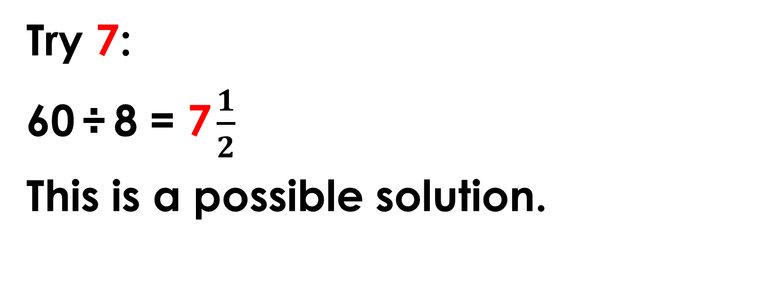
Task 16: Remainder of one-half
0
1
2
3
4
5
6
7
8
9
Example method: work out which digits can go in this place.
1
÷
8
=
2
Try 7:
60 ÷ 8 = 7 $\frac{1}{2}$
This is a possible solution.
MULTIPLICATION AND DIVISION
I SEE PROBLEM-SOLVING – UKS2

Slide 116
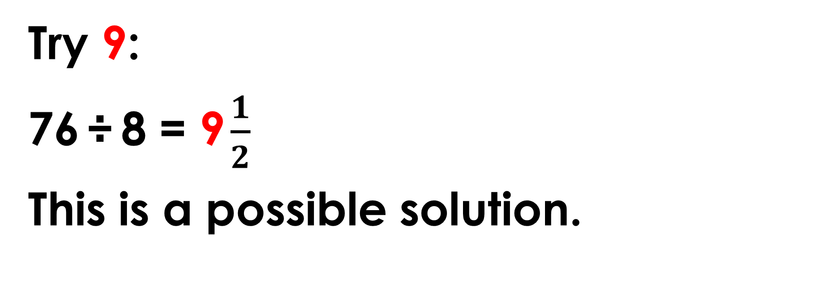
Task 16: Remainder of one-half
0
1
2
3
4
5
6
7
8
9
Example method: work out which digits can go in this place.
1
÷
8
=
2
Try 9:
76 ÷ 8 = 9 $\frac{1}{2}$
This is a possible solution.
MULTIPLICATION AND DIVISION
I SEE PROBLEM-SOLVING – UKS2

Slide 117
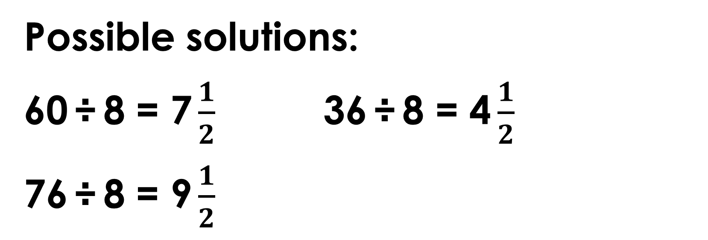
Task 16: Remainder of one-half
0
1
2
3
4
5
6
7
8
9
Example method: work out which digits can go in this place.
1
÷
8
=
2
Possible solutions:
60 ÷ 8 = 7 $\frac{1}{2}$ 36 ÷ 8 = 4 $\frac{1}{2}$
76 ÷ 8 = 9 $\frac{1}{2}$
MULTIPLICATION AND DIVISION
I SEE PROBLEM-SOLVING – UKS2

Slide 118
Task 17: Find the factors
5 3 2
1 2 3 4 5 6 7 8 9
Without calculating we know…
MULTIPLICATION AND DIVISION
I SEE PROBLEM-SOLVING – UKS2

Slide 119
Task 17: Find the factors
5 3 2
1 2 3 4 5 6 7 8 9
Without calculating we know…
MULTIPLICATION AND DIVISION
I SEE PROBLEM-SOLVING – UKS2

Slide 120
Task 17: Find the factors
5 3 2
1 2 3 4 5 6 7 8 9
600 is a multiple of 3
60 is a multiple of 3
540 is therefore a multiple of 3
MULTIPLICATION AND DIVISION
I SEE PROBLEM-SOLVING – UKS2

Slide 121
Task 17: Find the factors
5 3 2
1 2 3 4 5 6 7 8 9
600 is a multiple of 3
60 is a multiple of 3
540 is therefore a multiple of 3
So 3 is not a factor of 532.
540 – 532 = 8. 8 is not a multiple of 3.
MULTIPLICATION AND DIVISION
I SEE PROBLEM-SOLVING – UKS2

Slide 122
Task 17: Find the factors
5 3 2
1 2 3 4 5 6 7 8 9
3 is not a factor of 532, therefore
6 and 9 are not factors of 532.
MULTIPLICATION AND DIVISION
I SEE PROBLEM-SOLVING – UKS2

Slide 123
Task 17: Find the factors
5 3 2
1 2 3 4 5 6 7 8 9
3 is not a factor of 532, therefore
6 and 9 are not factors of 532.
MULTIPLICATION AND DIVISION
I SEE PROBLEM-SOLVING – UKS2

Slide 124
Task 17: Find the factors
5 3 2
1 2 3 4 5 6 7 8 9
4 is a factor of 100 (4 × 25 = 100)
This means 4 is a factor of 500
MULTIPLICATION AND DIVISION
I SEE PROBLEM-SOLVING – UKS2

Slide 125
Task 17: Find the factors
5 3 2
1 2 3 4 5 6 7 8 9
4 is a factor of 100 (4 × 25 = 100)
This means 4 is a factor of 500
4 is a factor of 32 (4 × 8 = 32)
So 4 is a factor of 532 (500 + 32 = 532)
MULTIPLICATION AND DIVISION
I SEE PROBLEM-SOLVING – UKS2

Slide 126
Task 17: Find the factors
5 3 2
1 2 3 4 5 6 7 8 9
7 is a factor of 490 (7 × 70 = 490)
MULTIPLICATION AND DIVISION
I SEE PROBLEM-SOLVING – UKS2

Slide 127
Task 17: Find the factors
5 3 2
1 2 3 4 5 6 7 8 9
7 is a factor of 490 (7 × 70 = 490)
532 – 490 = 42
MULTIPLICATION AND DIVISION
I SEE PROBLEM-SOLVING – UKS2

Slide 128
Task 17: Find the factors
5 3 2
1 2 3 4 5 6 7 8 9
7 is a factor of 490 (7 × 70 = 490)
532 – 490 = 42
7 is a factor of 42 (7 × 6 = 42)
So 7 is a factor of 532 (490 + 42 = 532)
MULTIPLICATION AND DIVISION
I SEE PROBLEM-SOLVING – UKS2

Slide 129
Task 17: Find the factors
5 3 2
1 2 3 4 5 6 7 8 9
8 is a factor of 480 (8 × 60 = 480)
MULTIPLICATION AND DIVISION
I SEE PROBLEM-SOLVING – UKS2

Slide 130
Task 17: Find the factors
5 3 2
1 2 3 4 5 6 7 8 9
8 is a factor of 480 (8 × 60 = 480)
532 – 480 = 52
MULTIPLICATION AND DIVISION
I SEE PROBLEM-SOLVING – UKS2

Slide 131
Task 17: Find the factors
5 3 2
1 2 3 4 5 6 7 8 9
8 is a factor of 480 (8 × 60 = 480)
532 – 480 = 52
8 is a not a factor of 52
So 8 is not a factor of 532
MULTIPLICATION AND DIVISION
I SEE PROBLEM-SOLVING – UKS2

Slide 132
Task 18: Number detective
Digits with sum of 13:
9 and 4
8 and 5
7 and 6
PROPERTY OF NUMBER
I SEE PROBLEM-SOLVING – UKS2

Slide 133
Task 18: Number detective
Digits with sum of 13: | Number made with these digits:
9 and 4 | 94 and 49
8 and 5 | 85 and 58
7 and 6 | 76 and 67
PROPERTY OF NUMBER
I SEE PROBLEM-SOLVING – UKS2

Slide 134
Task 18: Number detective
Digits with sum of 13: | Number made with these digits:
9 and 4 | 94 and 49
8 and 5 | 85 and 58
7 and 6 | 76 and 67
Multiple of 4
PROPERTY OF NUMBER
I SEE PROBLEM-SOLVING – UKS2

Slide 135
Task 19: Athletics club ratios
Athletics Club, Week 1:
Girls
Boys
Twice as many girls as boys.
RATIO
I SEE PROBLEM-SOLVING – UKS2

Slide 136
Task 19: Athletics club ratios
Athletics Club, Week 2:
6
Girls
girls that join
Boys
For every boy there are three girls.
RATIO
I SEE PROBLEM-SOLVING – UKS2

Slide 137
Task 19: Athletics club ratios
Athletics Club, Week 2:
6
6
6
Girls
6
girls that join
Boys
For every boy there are three girls.
There are 24 children at athletics club.
RATIO
I SEE PROBLEM-SOLVING – UKS2

Slide 138
Task 20: Shot accuracy statistics
Julia’s average shots per match:
12 per match
12
shots scored per match
shots missed per match
shots taken per match
shots scored
shots missed
RATIO
I SEE PROBLEM-SOLVING – UKS2

Slide 139
Task 20: Shot accuracy statistics
Julia’s average shots per match:
12 per match
12
shots scored per match
shots missed per match
shots taken per match
shots scored
4
4
4
shots missed
RATIO
I SEE PROBLEM-SOLVING – UKS2

Slide 140
Task 20: Shot accuracy statistics
Julia’s average shots per match:
12 per match
12
shots scored per match
shots missed per match
shots taken per match
shots scored
4
4
4
4
shots missed
4
RATIO
I SEE PROBLEM-SOLVING – UKS2

Slide 141
Task 20: Shot accuracy statistics
Julia’s average shots per match:
12 per match
12
shots scored per match
shots missed per match
shots taken per match
shots scored
4
4
4
4
shots missed
4
16
RATIO
I SEE PROBLEM-SOLVING – UKS2

Slide 142
Task 20: Shot accuracy statistics
Julia’s average shots per match:
12 per match
12
shots scored per match
shots missed per match
shots taken per match
shots scored
4
4
4
4
shots missed
4
16
16 shots per match × 12 matches
= 192 shots in the season
RATIO
I SEE PROBLEM-SOLVING – UKS2

Slide 143
Task 21: Pages read, pages left
pages read
pages left
 | 90 pages
40 %
PERCENTAGES
I SEE PROBLEM-SOLVING – UKS2

Slide 144
Task 21: Pages read, pages left
pages read
pages left
 | 90 pages
40 %
60 %
PERCENTAGES
I SEE PROBLEM-SOLVING – UKS2

Slide 145
Task 21: Pages read, pages left
pages read
pages left
30 pages
30 pages
30 pages
40 %
20 %
20 %
20 %
PERCENTAGES
I SEE PROBLEM-SOLVING – UKS2

Slide 146
Task 21: Pages read, pages left
pages read
pages left
60 pages
30 pages
30 pages
30 pages
40 %
20 %
20 %
20 %
60 pages have been read
PERCENTAGES
I SEE PROBLEM-SOLVING – UKS2

Slide 147
Task 22: Clothes shop sales
start price
£32
£24
sale price
PERCENTAGES
I SEE PROBLEM-SOLVING – UKS2

Slide 148
Task 22: Clothes shop sales
start price
£32
£24
sale price
£8
£8 off in the sale.
Next step: £8 is what fraction of £32?
PERCENTAGES
I SEE PROBLEM-SOLVING – UKS2

Slide 149
Task 22: Clothes shop sales
start price
£32
£24
£8
£8
£8
£8
£8 is one-quarter of £32. One-quarter is 25%.
There is 25% off in the sale.
PERCENTAGES
I SEE PROBLEM-SOLVING – UKS2

Slide 150
Task 23: Fraction of square
Split blue shape into sections
FRACTIONS
I SEE PROBLEM-SOLVING – UKS2

Slide 151
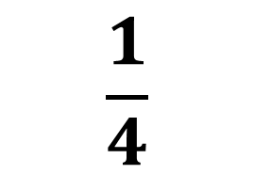
Task 23: Fraction of square
$$\frac{1}{4}$$
FRACTIONS
I SEE PROBLEM-SOLVING – UKS2

Slide 152
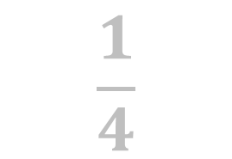
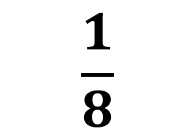
Task 23: Fraction of square
$$\frac{1}{4}$$
$$\frac{1}{8}$$
FRACTIONS
I SEE PROBLEM-SOLVING – UKS2

Slide 153
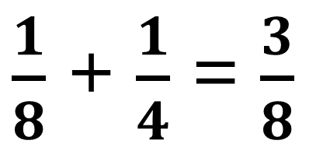
Task 23: Fraction of square
$$\frac{1}{4}$$
$$\frac{1}{8}$$
$\frac{1}{8}$ + $\frac{1}{4}$ = $\frac{3}{8}$
FRACTIONS
I SEE PROBLEM-SOLVING – UKS2

Slide 154
Task 24: Adding fractions
Example system to find all possible answers:
1
+
=
6
3
FRACTIONS
I SEE PROBLEM-SOLVING – UKS2

Slide 155

Task 24: Adding fractions
Example system to find all possible answers:
1
Find all the ways to make $\frac{1}{3}$
1
+
=
6
3
FRACTIONS
I SEE PROBLEM-SOLVING – UKS2

Slide 156
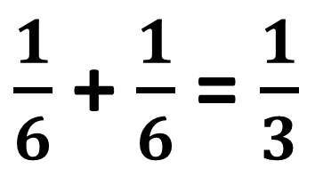
Task 24: Adding fractions
Example system to find all possible answers:
1
1
Find all the ways to make $\frac{1}{3}$
1
+
=
6
6
3
$\frac{1}{6}$+ $\frac{1}{6}$= $\frac{1}{3}$
FRACTIONS
I SEE PROBLEM-SOLVING – UKS2

Slide 157
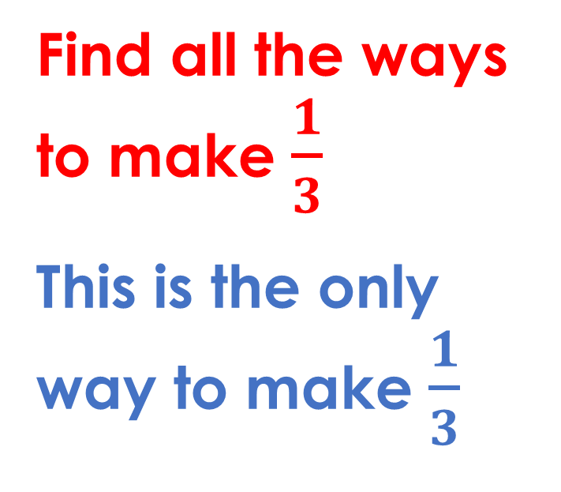
Task 24: Adding fractions
Example system to find all possible answers:
1
1
Find all the ways to make $\frac{1}{3}$
This is the only way to make $\frac{1}{3}$
1
+
=
6
6
3
$\frac{1}{6}$+ $\frac{1}{6}$= $\frac{1}{3}$
FRACTIONS
I SEE PROBLEM-SOLVING – UKS2

Slide 158

Task 24: Adding fractions
Example system to find all possible answers:
2
Find all the ways to make $\frac{2}{3}$
1
+
=
6
3
$\frac{1}{6}$+ $\frac{1}{6}$= $\frac{1}{3}$
FRACTIONS
I SEE PROBLEM-SOLVING – UKS2

Slide 159
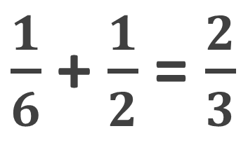
Task 24: Adding fractions
Example system to find all possible answers:
1
2
Find all the ways to make $\frac{2}{3}$
1
+
=
6
2
3
$\frac{1}{6}$+ $\frac{1}{6}$= $\frac{1}{3}$
$\frac{1}{6}$+ $\frac{1}{2}$= $\frac{2}{3}$
FRACTIONS
I SEE PROBLEM-SOLVING – UKS2

Slide 160
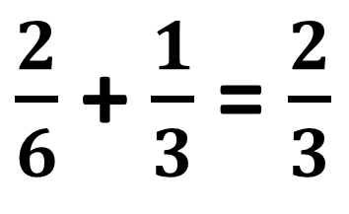
Task 24: Adding fractions
Example system to find all possible answers:
2
2
Find all the ways to make $\frac{2}{3}$
1
+
=
6
3
3
$\frac{1}{6}$+ $\frac{1}{6}$= $\frac{1}{3}$
$\frac{1}{6}$+ $\frac{1}{2}$= $\frac{2}{3}$
$\frac{2}{6}$+ $\frac{1}{3}$= $\frac{2}{3}$
FRACTIONS
I SEE PROBLEM-SOLVING – UKS2

Slide 161
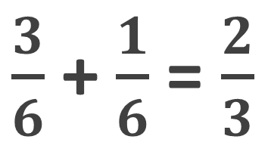
Task 24: Adding fractions
Example system to find all possible answers:
3
2
Find all the ways to make $\frac{2}{3}$
1
+
=
6
6
3
$\frac{1}{6}$+ $\frac{1}{6}$= $\frac{1}{3}$
$\frac{1}{6}$+ $\frac{1}{2}$= $\frac{2}{3}$
$\frac{2}{6}$+ $\frac{1}{3}$= $\frac{2}{3}$
$\frac{3}{6}$+ $\frac{1}{6}$= $\frac{2}{3}$
FRACTIONS
I SEE PROBLEM-SOLVING – UKS2

Slide 162
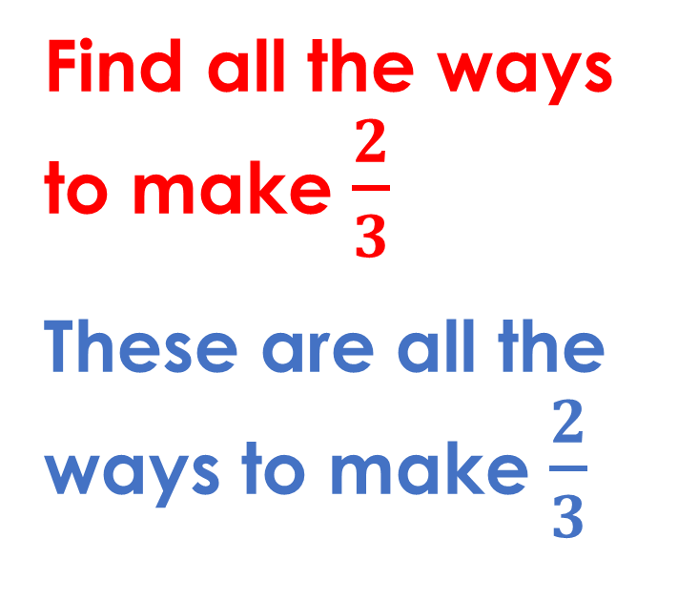
Task 24: Adding fractions
Example system to find all possible answers:
3
2
Find all the ways to make $\frac{2}{3}$
These are all the ways to make $\frac{2}{3}$
1
+
=
6
6
3
$\frac{1}{6}$+ $\frac{1}{6}$= $\frac{1}{3}$
$\frac{1}{6}$+ $\frac{1}{2}$= $\frac{2}{3}$
$\frac{2}{6}$+ $\frac{1}{3}$= $\frac{2}{3}$
$\frac{3}{6}$+ $\frac{1}{6}$= $\frac{2}{3}$
FRACTIONS
I SEE PROBLEM-SOLVING – UKS2

Slide 163
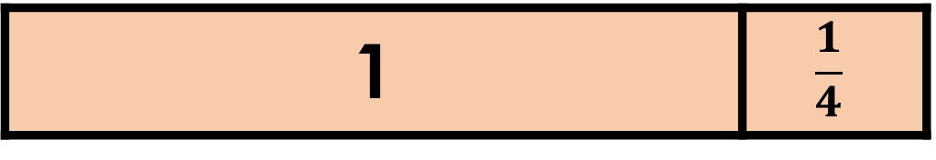
Task 25: Make one and a quarter
Example answer 1:
3
1
+
=
1
4
1 | $$\frac{1}{4}$$
FRACTIONS
I SEE PROBLEM-SOLVING – UKS2

Slide 164
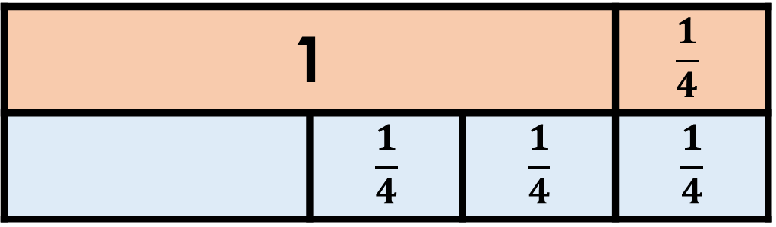
Task 25: Make one and a quarter
Example answer 1:
3
1
+
=
1
4
4
1 |  |  | $$\frac{1}{4}$$
 | $$\frac{1}{4}$$ | $$\frac{1}{4}$$ | $$\frac{1}{4}$$
FRACTIONS
I SEE PROBLEM-SOLVING – UKS2

Slide 165
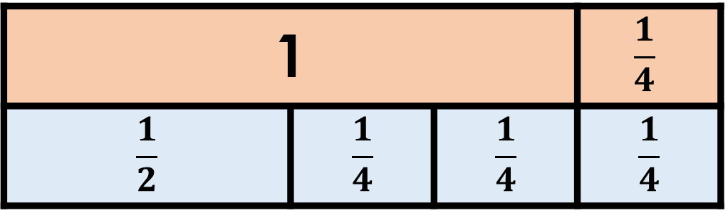
Task 25: Make one and a quarter
Example answer 1:
3
1
1
+
=
1
4
2
4
1 |  |  | $$\frac{1}{4}$$
$$\frac{1}{2}$$ | $$\frac{1}{4}$$ | $$\frac{1}{4}$$ | $$\frac{1}{4}$$
FRACTIONS
I SEE PROBLEM-SOLVING – UKS2

Slide 166
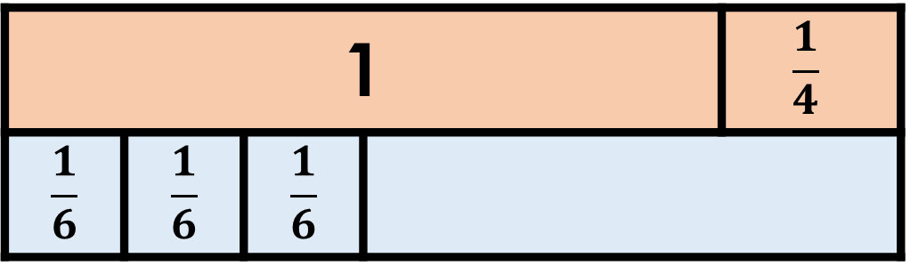
Task 25: Make one and a quarter
Example answer 2:
3
1
+
=
1
6
4
1 |  |  |  | $$\frac{1}{4}$$
$$\frac{1}{6}$$ | $$\frac{1}{6}$$ | $$\frac{1}{6}$$
FRACTIONS
I SEE PROBLEM-SOLVING – UKS2

Slide 167
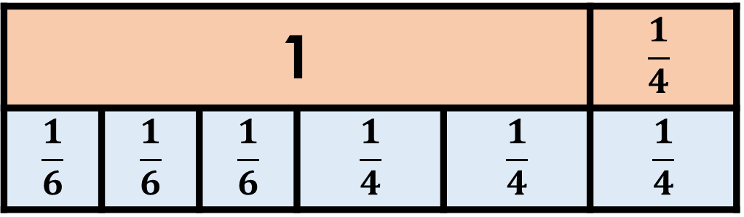
Task 25: Make one and a quarter
Example answer 2:
3
3
1
+
=
1
6
4
4
1 |  |  |  |  | $$\frac{1}{4}$$
$$\frac{1}{6}$$ | $$\frac{1}{6}$$ | $$\frac{1}{6}$$ | $$\frac{1}{4}$$ | $$\frac{1}{4}$$ | $$\frac{1}{4}$$
FRACTIONS
I SEE PROBLEM-SOLVING – UKS2

Slide 168
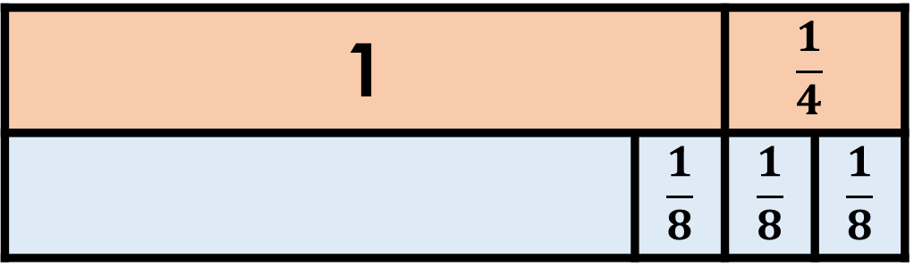
Task 25: Make one and a quarter
Example answer 3:
3
1
+
=
1
8
4
1 |  | $$\frac{1}{4}$$
 | $$\frac{1}{8}$$ | $$\frac{1}{8}$$ | $$\frac{1}{8}$$
FRACTIONS
I SEE PROBLEM-SOLVING – UKS2

Slide 169
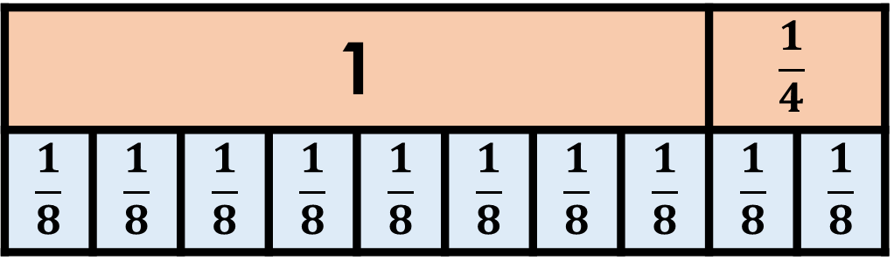
Task 25: Make one and a quarter
Example answer 3:
3
7
1
+
=
1
8
8
4
1 |  |  |  |  |  |  |  | $$\frac{1}{4}$$
$$\frac{1}{8}$$ | $$\frac{1}{8}$$ | $$\frac{1}{8}$$ | $$\frac{1}{8}$$ | $$\frac{1}{8}$$ | $$\frac{1}{8}$$ | $$\frac{1}{8}$$ | $$\frac{1}{8}$$ | $$\frac{1}{8}$$ | $$\frac{1}{8}$$
FRACTIONS
I SEE PROBLEM-SOLVING – UKS2

Slide 170
Task 26: Fractions of an amount
2
Example answer 1:
of
= 32
32
FRACTIONS
I SEE PROBLEM-SOLVING – UKS2

Slide 171
Task 26: Fractions of an amount
2
Example answer 1:
of
= 32
3
32
FRACTIONS
I SEE PROBLEM-SOLVING – UKS2

Slide 172
Task 26: Fractions of an amount
2
Example answer 1:
of
= 32
3
16 | 16
32
FRACTIONS
I SEE PROBLEM-SOLVING – UKS2

Slide 173
Task 26: Fractions of an amount
2
Example answer 1:
of
48
= 32
3
48
16 | 16 | 16
32
FRACTIONS
I SEE PROBLEM-SOLVING – UKS2

Slide 174
Task 26: Fractions of an amount
2
Example answer 2:
of
= 32
4
32
FRACTIONS
I SEE PROBLEM-SOLVING – UKS2

Slide 175
Task 26: Fractions of an amount
2
Example answer 2:
of
= 32
4
16 | 16
32
FRACTIONS
I SEE PROBLEM-SOLVING – UKS2

Slide 176
Task 26: Fractions of an amount
2
Example answer 2:
of
64
= 32
4
64
16 | 16 | 16 | 16
32
FRACTIONS
I SEE PROBLEM-SOLVING – UKS2

Slide 177
Task 26: Fractions of an amount
2
Example answer 3:
of
= 32
5
32
FRACTIONS
I SEE PROBLEM-SOLVING – UKS2

Slide 178
Task 26: Fractions of an amount
2
Example answer 3:
of
= 32
5
16 | 16
32
FRACTIONS
I SEE PROBLEM-SOLVING – UKS2

Slide 179
Task 26: Fractions of an amount
2
Example answer 3:
of
80
= 32
5
80
16 | 16 | 16 | 16 | 16
32
FRACTIONS
I SEE PROBLEM-SOLVING – UKS2

Slide 180
Task 27: Improper fractions
17
Can it be fifths?
=
2
5
FRACTIONS
I SEE PROBLEM-SOLVING – UKS2

Slide 181
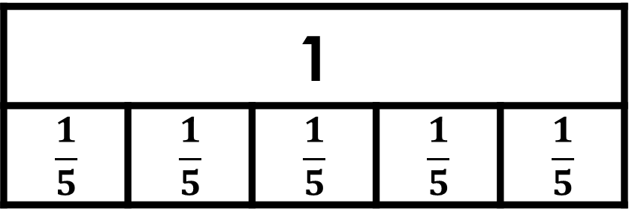
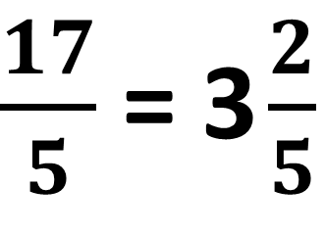
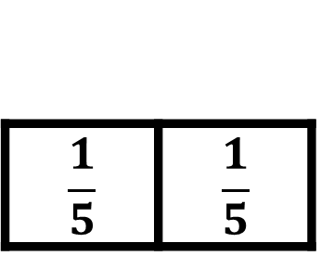
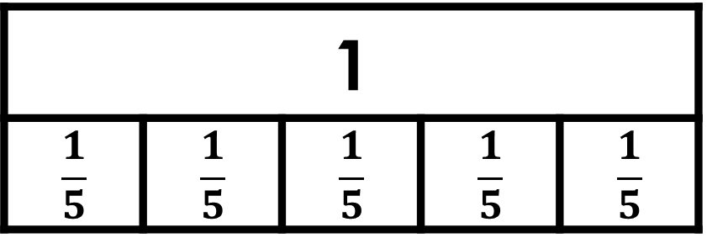
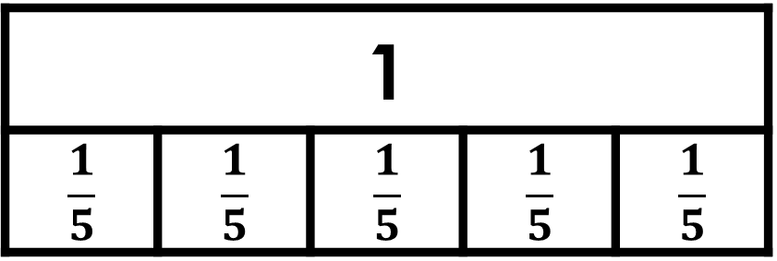
Task 27: Improper fractions
17
Can it be fifths?
=
2
5
1
$$\frac{1}{5}$$ | $$\frac{1}{5}$$ | $$\frac{1}{5}$$ | $$\frac{1}{5}$$ | $$\frac{1}{5}$$
1
$$\frac{1}{5}$$ | $$\frac{1}{5}$$ | $$\frac{1}{5}$$ | $$\frac{1}{5}$$ | $$\frac{1}{5}$$
1
$$\frac{1}{5}$$ | $$\frac{1}{5}$$ | $$\frac{1}{5}$$ | $$\frac{1}{5}$$ | $$\frac{1}{5}$$
$$\frac{1}{5}$$ | $$\frac{1}{5}$$
$\frac{17}{5}$ = 3 $\frac{2}{5}$
NOT a solution
FRACTIONS
I SEE PROBLEM-SOLVING – UKS2

Slide 182
Task 27: Improper fractions
17
Can it be sixths?
=
2
6
FRACTIONS
I SEE PROBLEM-SOLVING – UKS2

Slide 183
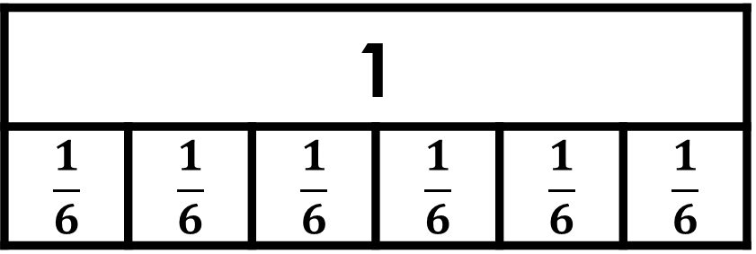
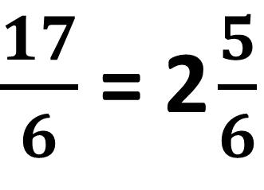
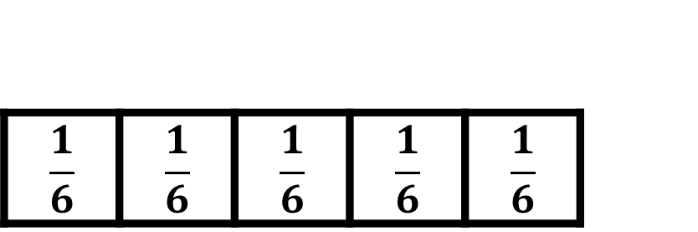
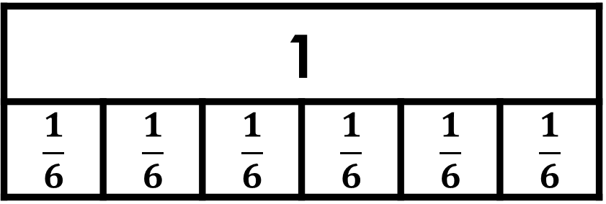
Task 27: Improper fractions
17
5
Can it be sixths?
=
2
6
6
1
$$\frac{1}{6}$$ | $$\frac{1}{6}$$ | $$\frac{1}{6}$$ | $$\frac{1}{6}$$ | $$\frac{1}{6}$$ | $$\frac{1}{6}$$
1
$$\frac{1}{6}$$ | $$\frac{1}{6}$$ | $$\frac{1}{6}$$ | $$\frac{1}{6}$$ | $$\frac{1}{6}$$ | $$\frac{1}{6}$$
$$\frac{1}{6}$$ | $$\frac{1}{6}$$ | $$\frac{1}{6}$$ | $$\frac{1}{6}$$ | $$\frac{1}{6}$$
$\frac{17}{6}$ = 2 $\frac{5}{6}$
Solution 1
FRACTIONS
I SEE PROBLEM-SOLVING – UKS2

Slide 184
Task 27: Improper fractions
17
Can it be sevenths?
=
2
7
FRACTIONS
I SEE PROBLEM-SOLVING – UKS2

Slide 185
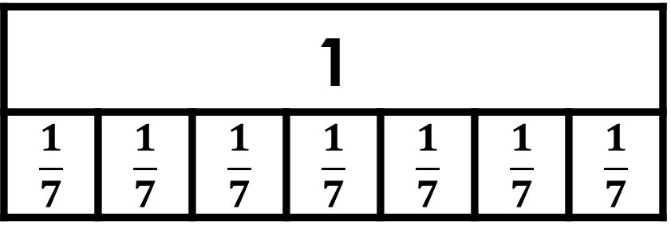
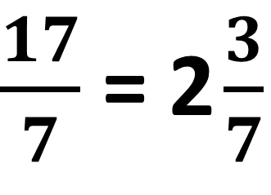
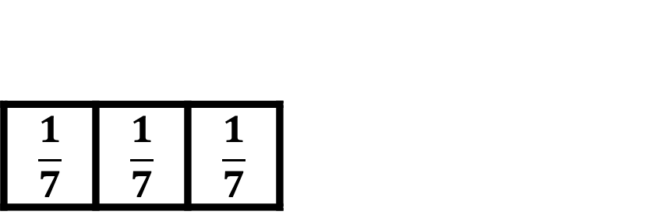
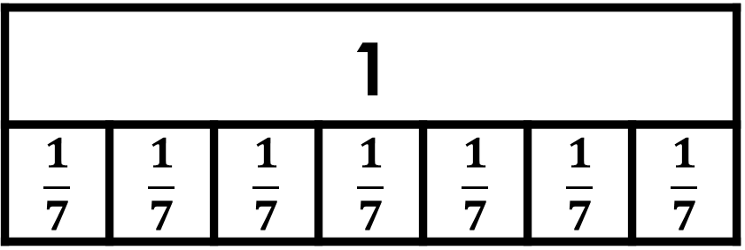
Task 27: Improper fractions
17
3
Can it be sevenths?
=
2
7
7
1
$$\frac{1}{7}$$ | $$\frac{1}{7}$$ | $$\frac{1}{7}$$ | $$\frac{1}{7}$$ | $$\frac{1}{7}$$ | $$\frac{1}{7}$$ | $$\frac{1}{7}$$
1
$$\frac{1}{7}$$ | $$\frac{1}{7}$$ | $$\frac{1}{7}$$ | $$\frac{1}{7}$$ | $$\frac{1}{7}$$ | $$\frac{1}{7}$$ | $$\frac{1}{7}$$
$$\frac{1}{7}$$ | $$\frac{1}{7}$$ | $$\frac{1}{7}$$
$\frac{17}{7}$ = 2 $\frac{3}{7}$
Solution 2
FRACTIONS
I SEE PROBLEM-SOLVING – UKS2

Slide 186
Task 27: Improper fractions
17
Can it be eighths?
=
2
8
FRACTIONS
I SEE PROBLEM-SOLVING – UKS2

Slide 187
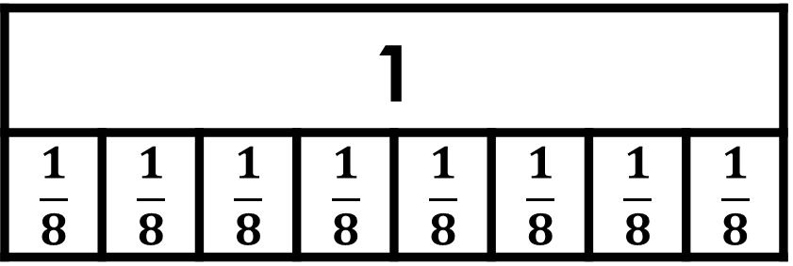
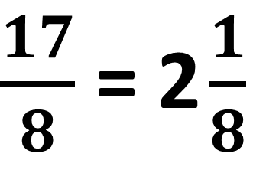
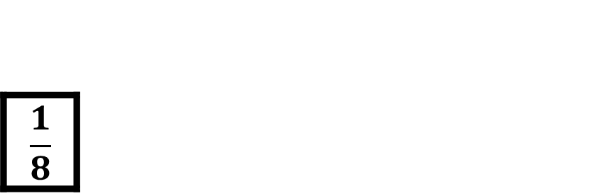

Task 27: Improper fractions
17
1
Can it be eighths?
=
2
8
8
1
$$\frac{1}{8}$$ | $$\frac{1}{8}$$ | $$\frac{1}{8}$$ | $$\frac{1}{8}$$ | $$\frac{1}{8}$$ | $$\frac{1}{8}$$ | $$\frac{1}{8}$$ | $$\frac{1}{8}$$
1
$$\frac{1}{8}$$ | $$\frac{1}{8}$$ | $$\frac{1}{8}$$ | $$\frac{1}{8}$$ | $$\frac{1}{8}$$ | $$\frac{1}{8}$$ | $$\frac{1}{8}$$ | $$\frac{1}{8}$$
$$\frac{1}{8}$$
$\frac{17}{8}$ = 2 $\frac{1}{8}$
Solution 3
FRACTIONS
I SEE PROBLEM-SOLVING – UKS2

Slide 188
Task 27: Improper fractions
17
Can it be ninths?
=
2
9
FRACTIONS
I SEE PROBLEM-SOLVING – UKS2

Slide 189
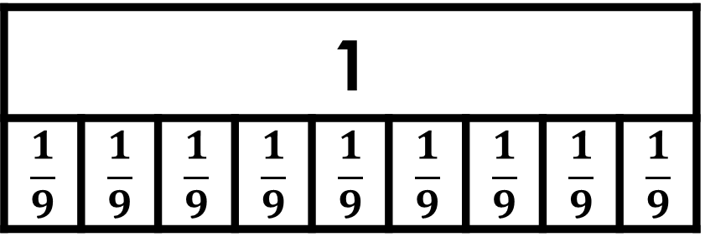
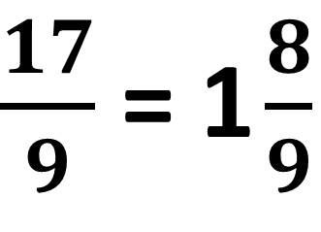
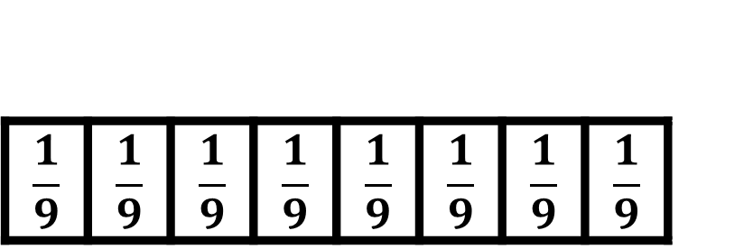
Task 27: Improper fractions
17
Can it be ninths?
=
2
9
1
$$\frac{1}{9}$$ | $$\frac{1}{9}$$ | $$\frac{1}{9}$$ | $$\frac{1}{9}$$ | $$\frac{1}{9}$$ | $$\frac{1}{9}$$ | $$\frac{1}{9}$$ | $$\frac{1}{9}$$ | $$\frac{1}{9}$$
$$\frac{1}{9}$$ | $$\frac{1}{9}$$ | $$\frac{1}{9}$$ | $$\frac{1}{9}$$ | $$\frac{1}{9}$$ | $$\frac{1}{9}$$ | $$\frac{1}{9}$$ | $$\frac{1}{9}$$
$\frac{17}{9}$ = 1 $\frac{8}{9}$
NOT a solution
FRACTIONS
I SEE PROBLEM-SOLVING – UKS2

Slide 190
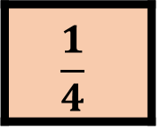
Task 28: Make two and a quarter
Example answer 1:
1
×
=
2
4
1
1
$$\frac{1}{4}$$
FRACTIONS
I SEE PROBLEM-SOLVING – UKS2

Slide 191
Task 28: Make two and a quarter
Example answer 1:
1
1
×
=
2
4
4
1
1
$$\frac{1}{4}$$
FRACTIONS
I SEE PROBLEM-SOLVING – UKS2

Slide 192
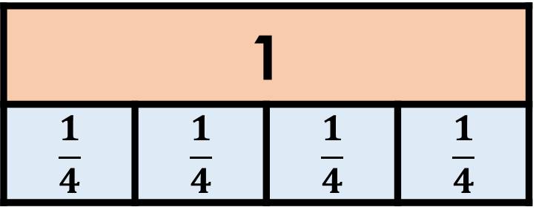
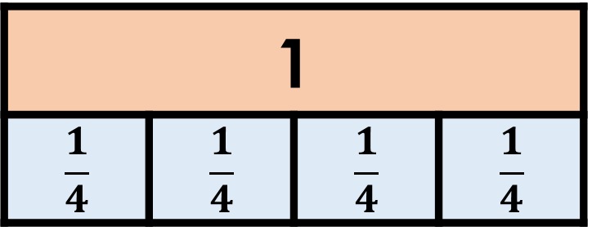
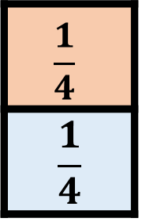
Task 28: Make two and a quarter
Example answer 1:
1
1
×
9
=
2
4
4
1
$$\frac{1}{4}$$ | $$\frac{1}{4}$$ | $$\frac{1}{4}$$ | $$\frac{1}{4}$$
1
$$\frac{1}{4}$$ | $$\frac{1}{4}$$ | $$\frac{1}{4}$$ | $$\frac{1}{4}$$
$$\frac{1}{4}$$
$$\frac{1}{4}$$
FRACTIONS
I SEE PROBLEM-SOLVING – UKS2

Slide 193
Task 28: Make two and a quarter
Example answer 2:
3
1
×
=
2
4
4
1
1
$$\frac{1}{4}$$
FRACTIONS
I SEE PROBLEM-SOLVING – UKS2

Slide 194
Task 28: Make two and a quarter
Example answer 2:
3
1
×
3
=
2
4
4
1
$$\frac{1}{4}$$ | $$\frac{1}{4}$$ | $$\frac{1}{4}$$ | $$\frac{1}{4}$$
1
$$\frac{1}{4}$$ | $$\frac{1}{4}$$ | $$\frac{1}{4}$$ | $$\frac{1}{4}$$
$$\frac{1}{4}$$
$$\frac{1}{4}$$
FRACTIONS
I SEE PROBLEM-SOLVING – UKS2

Slide 195
Task 28: Make two and a quarter
Example answer 3:
3
1
×
=
2
8
4
1
1
$$\frac{1}{4}$$
FRACTIONS
I SEE PROBLEM-SOLVING – UKS2

Slide 196
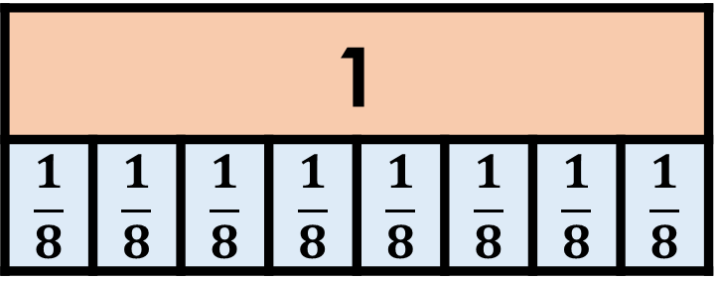
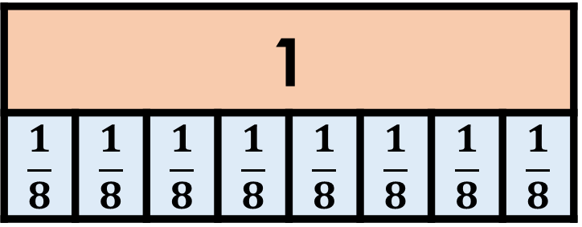

Task 28: Make two and a quarter
Example answer 3:
3
1
×
6
=
2
8
4
1
$$\frac{1}{8}$$ | $$\frac{1}{8}$$ | $$\frac{1}{8}$$ | $$\frac{1}{8}$$ | $$\frac{1}{8}$$ | $$\frac{1}{8}$$ | $$\frac{1}{8}$$ | $$\frac{1}{8}$$
1
$$\frac{1}{8}$$ | $$\frac{1}{8}$$ | $$\frac{1}{8}$$ | $$\frac{1}{8}$$ | $$\frac{1}{8}$$ | $$\frac{1}{8}$$ | $$\frac{1}{8}$$ | $$\frac{1}{8}$$
$$\frac{1}{4}$$
$$\frac{1}{8}$$ | $$\frac{1}{8}$$
FRACTIONS
I SEE PROBLEM-SOLVING – UKS2

Slide 197
Task 29: Part-finished book
total pages
pages Megan has read
FRACTIONS
I SEE PROBLEM-SOLVING – UKS2

Slide 198
Task 29: Part-finished book
total pages
pages Megan has read
90 pages left
FRACTIONS
I SEE PROBLEM-SOLVING – UKS2

Slide 199
Task 29: Part-finished book
total pages
 |  |  | 45 | 45
pages Megan has read
90 pages left
FRACTIONS
I SEE PROBLEM-SOLVING – UKS2

Slide 200
Task 29: Part-finished book
total pages
45 | 45 | 45 | 45 | 45
pages Megan has read
90 pages left
FRACTIONS
I SEE PROBLEM-SOLVING – UKS2

Slide 201
Task 29: Part-finished book
total pages
225
45 | 45 | 45 | 45 | 45
pages Megan has read
90 pages left
Megan’s book is 225 pages long.
FRACTIONS
I SEE PROBLEM-SOLVING – UKS2

Slide 202
Task 30: Fractions and decimals
0
0.1
0.2
0.3
0.4
0.5
0.6
0.7
0.8
0.9
1
FRACTIONS
I SEE PROBLEM-SOLVING – UKS2

Slide 203


Task 30: Fractions and decimals
0
0.1
0.2
0.3
0.4
0.5
0.6
0.7
0.8
0.9
1
0
$$\frac{1}{3}$$
$$\frac{2}{3}$$
1
FRACTIONS
I SEE PROBLEM-SOLVING – UKS2

Slide 204



Task 30: Fractions and decimals
0
0.1
0.2
0.3
0.4
0.5
0.6
0.7
0.8
0.9
1
0
$$\frac{1}{3}$$
$$\frac{2}{3}$$
1
0
$$\frac{1}{4}$$
$$\frac{2}{4}$$
$$\frac{3}{4}$$
1
FRACTIONS
I SEE PROBLEM-SOLVING – UKS2

Slide 205




Task 30: Fractions and decimals
0
0.1
0.2
0.3
0.4
0.5
0.6
0.7
0.8
0.9
1
0
$$\frac{1}{3}$$
$$\frac{2}{3}$$
1
0
$$\frac{1}{4}$$
$$\frac{2}{4}$$
$$\frac{3}{4}$$
1
0
$$\frac{1}{5}$$
$$\frac{2}{5}$$
$$\frac{3}{5}$$
$$\frac{4}{5}$$
1
FRACTIONS
I SEE PROBLEM-SOLVING – UKS2

Slide 206
Task 30: Fractions and decimals
0
0.1
0.2
0.3
0.4
0.5
0.6
0.7
0.8
0.9
1
0
$$\frac{1}{3}$$
$$\frac{2}{3}$$
1
0
$$\frac{1}{4}$$
$$\frac{2}{4}$$
$$\frac{3}{4}$$
1
0
$$\frac{1}{5}$$
$$\frac{2}{5}$$
$$\frac{3}{5}$$
$$\frac{4}{5}$$
1
FRACTIONS
I SEE PROBLEM-SOLVING – UKS2

Slide 207




Task 30: Fractions and decimals
0
0.1
0.2
0.3
0.4
0.5
0.6
0.7
0.8
0.9
1
0
$$\frac{1}{3}$$
$$\frac{2}{3}$$
1
0
$$\frac{1}{4}$$
$$\frac{2}{4}$$
$$\frac{3}{4}$$
1
0
$$\frac{1}{5}$$
$$\frac{2}{5}$$
$$\frac{3}{5}$$
$$\frac{4}{5}$$
1
More than 0.5 and less than 0.8: $\frac{2}{3}$ $\frac{3}{4}$ $\frac{3}{5}$
FRACTIONS
I SEE PROBLEM-SOLVING – UKS2

Slide 208
Task 31: Combined weights
90 kg
Ben | Sam
Ben + Sam = 90 kg
Ben | Jack
Ben + Jack = 100 kg
100 kg
ALGEBRA
I SEE PROBLEM-SOLVING – UKS2

Slide 209
Task 31: Combined weights
90 kg
Ben | Sam
10 kg
Ben + Sam = 90 kg
Ben | Jack
Ben + Jack = 100 kg
100 kg
Jack weighs 10 kg more than Sam.
ALGEBRA
I SEE PROBLEM-SOLVING – UKS2

Slide 210
Task 31: Combined weights
Sam
80 kg
Jack
10 kg
Jack weighs 10 kg more than Sam.
Sam and Jack weigh 80 kg in total.
ALGEBRA
I SEE PROBLEM-SOLVING – UKS2

Slide 211
Task 31: Combined weights
Sam
Two sections
= 70 kg
80 kg
Jack
10 kg
Jack weighs 10 kg more than Sam.
Sam and Jack weigh 80 kg in total.
ALGEBRA
I SEE PROBLEM-SOLVING – UKS2

Slide 212
Task 31: Combined weights
35 kg
Sam
80 kg
Jack
35 kg
10 kg
Sam weighs 35 kg
Jack weighs 10 kg more than Sam.
Sam and Jack weigh 80 kg in total.
ALGEBRA
I SEE PROBLEM-SOLVING – UKS2

Slide 213
Task 32: Sports ball weights
218 g
tennis ball | cricket ball | golf ball
264 g
ALGEBRA
I SEE PROBLEM-SOLVING – UKS2

Slide 214
Task 32: Sports ball weights
218 g
46 g
tennis ball | cricket ball | golf ball
264 g
A golf ball weighs 46 g
ALGEBRA
I SEE PROBLEM-SOLVING – UKS2

Slide 215
Task 32: Sports ball weights
46 g
tennis ball | golf ball
104 g
ALGEBRA
I SEE PROBLEM-SOLVING – UKS2

Slide 216
Task 32: Sports ball weights
58 g
46 g
tennis ball | golf ball
104 g
A tennis ball weighs 58 g
ALGEBRA
I SEE PROBLEM-SOLVING – UKS2

Slide 217
Task 32: Sports ball weights
58 g
tennis ball | cricket ball
218 g
ALGEBRA
I SEE PROBLEM-SOLVING – UKS2

Slide 218
Task 32: Sports ball weights
58 g
160 g
tennis ball | cricket ball
218 g
A cricket ball weighs 160 g
ALGEBRA
I SEE PROBLEM-SOLVING – UKS2

Slide 219
Task 33 Question: Hiring a surfboard
£7 to hire a surfboard plus £3 per half-hour.
starting cost
£7
ALGEBRA
I SEE PROBLEM-SOLVING – UKS2

Slide 220
Task 33 Question: Hiring a surfboard
£7 to hire a surfboard plus £3 per half-hour.
starting cost
cost for six half-hours
£7
£3
£3
£3
£3
£3
£3
ALGEBRA
I SEE PROBLEM-SOLVING – UKS2

Slide 221
Task 33 Question: Hiring a surfboard
£7 to hire a surfboard plus £3 per half-hour.
starting cost
cost for six half-hours
£7
£3
£3
£3
£3
£3
£3
£25
Total cost = £25
ALGEBRA
I SEE PROBLEM-SOLVING – UKS2

Slide 222
Task 33 Question: Hiring a surfboard
£7 to hire a surfboard plus £3 per half-hour.
starting cost
£7
£34
ALGEBRA
I SEE PROBLEM-SOLVING – UKS2

Slide 223
Task 33 Question: Hiring a surfboard
£7 to hire a surfboard plus £3 per half-hour.
starting cost
£7
£27
£34
ALGEBRA
I SEE PROBLEM-SOLVING – UKS2

Slide 224
Task 33 Question: Hiring a surfboard
£7 to hire a surfboard plus £3 per half-hour.
starting cost
How many £3s in £27?
£7
£27
£34
ALGEBRA
I SEE PROBLEM-SOLVING – UKS2

Slide 225
Task 33 Question: Hiring a surfboard
£7 to hire a surfboard plus £3 per half-hour.
starting cost
9 half-hours costing £3 each
£7
£3
£3
£3
£3
£3
£3
£3
£3
£3
£34
ALGEBRA
I SEE PROBLEM-SOLVING – UKS2

Slide 226

Task 33 Question: Hiring a surfboard
£7 to hire a surfboard plus £3 per half-hour.
starting cost
9 half-hours costing £3 each
£7
£3
£3
£3
£3
£3
£3
£3
£3
£3
£34
Jack goes surfing for 4 $\frac{1}{2}$ hours
ALGEBRA
I SEE PROBLEM-SOLVING – UKS2

Slide 227
Task 34: Dot pattern sequence
Method 1:
Picture 1:
Picture 2:
Picture 3:
4 dots
7 dots
10 dots
ALGEBRA
I SEE PROBLEM-SOLVING – UKS2

Slide 228
Task 34: Dot pattern sequence
Method 1: 4 dots plus 3 more dots each picture
Picture 1:
Picture 2:
Picture 3:
4 dots
7 dots
10 dots
4 dots
4 + 3 dots
4 + 1 × 3 dots
4 + 3 + 3 dots
4 + 2 × 3 dots
ALGEBRA
I SEE PROBLEM-SOLVING – UKS2

Slide 229
Task 34: Dot pattern sequence
Method 1: 4 dots plus 3 more dots each picture
Picture 1:
Picture 2:
Picture 3:
4 dots
7 dots
10 dots
4 dots
4 + 3 dots
4 + 1 × 3 dots
4 + 3 + 3 dots
4 + 2 × 3 dots
Picture 8: 4 + 7 × 3
= 25 dots
Picture 16: 4 + 15 × 3
= 49 dots
ALGEBRA
I SEE PROBLEM-SOLVING – UKS2

Slide 230
Task 34: Dot pattern sequence
Method 2:
Picture 1:
Picture 2:
Picture 3:
4 dots
7 dots
10 dots
ALGEBRA
I SEE PROBLEM-SOLVING – UKS2

Slide 231
Task 34: Dot pattern sequence
Method 2: 3 more dots each picture plus 1
Picture 1:
Picture 2:
Picture 3:
4 dots
7 dots
10 dots
1 + 3 dots
1 + 2 × 3 dots
1 + 3 × 3 dots
ALGEBRA
I SEE PROBLEM-SOLVING – UKS2

Slide 232
Task 34: Dot pattern sequence
Method 2: 3 more dots each picture plus 1
Picture 1:
Picture 2:
Picture 3:
4 dots
7 dots
10 dots
1 + 3 dots
1 + 2 × 3 dots
1 + 3 × 3 dots
Picture 8: 8 × 3 + 1
= 25 dots
Picture 16: 16 × 3 + 1
= 49 dots
ALGEBRA
I SEE PROBLEM-SOLVING – UKS2

Slide 233
Task 35: My secret number
Could the secret number be 4?
4 | 4 | 4
7
ALGEBRA
I SEE PROBLEM-SOLVING – UKS2

Slide 234
Task 35: My secret number
Could the secret number be 4?
4 | 4 | 4
7
19
Less than 20.
The secret number is more than 4.
ALGEBRA
I SEE PROBLEM-SOLVING – UKS2

Slide 235
Task 35: My secret number
Could the secret number be 5?
5 | 5 | 5
7
ALGEBRA
I SEE PROBLEM-SOLVING – UKS2

Slide 236
Task 35: My secret number
Could the secret number be 5?
5 | 5 | 5
7
22
The secret number could be 5.
Next try 6.
ALGEBRA
I SEE PROBLEM-SOLVING – UKS2

Slide 237
Task 35: My secret number
Could the secret number be 6?
6 | 6 | 6
7
ALGEBRA
I SEE PROBLEM-SOLVING – UKS2

Slide 238
Task 35: My secret number
Could the secret number be 6?
6 | 6 | 6
7
25
The secret number could be 6.
Next try 7.
ALGEBRA
I SEE PROBLEM-SOLVING – UKS2

Slide 239
Task 35: My secret number
Could the secret number be 7?
7 | 7 | 7
7
28
The secret number could be 7.
Next try 8.
ALGEBRA
I SEE PROBLEM-SOLVING – UKS2

Slide 240
Task 35: My secret number
Could the secret number be 8?
8 | 8 | 8
7
ALGEBRA
I SEE PROBLEM-SOLVING – UKS2

Slide 241
Task 35: My secret number
Could the secret number be 8?
8 | 8 | 8
7
31
More than 29.
The secret number can be 5, 6 or 7.
ALGEBRA
I SEE PROBLEM-SOLVING – UKS2

Slide 242
Task 36: Sorting measures
measures of length
metric measures
measures of weight
ounces
litres
gallons
Position these measures: inches, metres
MEASURES
I SEE PROBLEM-SOLVING – UKS2

Slide 243
Task 36: Sorting measures
measures of length
metric measures
measures of weight
ounces
metres
inches
litres
gallons
Position these measures: inches, metres
MEASURES
I SEE PROBLEM-SOLVING – UKS2

Slide 244
Task 36: Sorting measures
measures of length
metric measures
measures of weight
ounces
metres
inches
litres
gallons
Position these measures: hours, millilitres (ml)
MEASURES
I SEE PROBLEM-SOLVING – UKS2

Slide 245
Task 36: Sorting measures
measures of length
metric measures
measures of weight
millilitres
ounces
metres
inches
litres
hours
gallons
Position these measures: hours, millilitres (ml)
MEASURES
I SEE PROBLEM-SOLVING – UKS2

Slide 246
Task 36: Sorting measures
measures of length
metric measures
measures of weight
millilitres
ounces
metres
inches
litres
hours
gallons
Position these measures: grams, stones
MEASURES
I SEE PROBLEM-SOLVING – UKS2

Slide 247
Task 36: Sorting measures
measures of length
metric measures
measures of weight
millilitres
ounces
metres
grams
inches
stones
litres
hours
gallons
Position these measures: grams, stones
MEASURES
I SEE PROBLEM-SOLVING – UKS2

Slide 248

Task 37: Time spent driving
Example Method 1:
$\frac{3}{4}$ hour drive each way = 1 $\frac{1}{2}$ hours driving per day
MEASURES
I SEE PROBLEM-SOLVING – UKS2

Slide 249

Task 37: Time spent driving
Example Method 1:
$\frac{3}{4}$ hour drive each way = 1 $\frac{1}{2}$ hours driving per day
5 days × 1 $\frac{1}{2}$ hours = 7 $\frac{1}{2}$ hours per week
7 hours 30 minutes driving to work each week
MEASURES
I SEE PROBLEM-SOLVING – UKS2

Slide 250

Task 37: Time spent driving
Example Method 2:
$\frac{3}{4}$ hour drive each way, 10 journeys
$\frac{3}{4}$ × 10
MEASURES
I SEE PROBLEM-SOLVING – UKS2

Slide 251

Task 37: Time spent driving
Example Method 2:
$\frac{3}{4}$ hour drive each way, 10 journeys
$\frac{3}{4}$ × 10 = $\frac{30}{4}$
$\frac{30}{4}$ = 7 $\frac{2}{4}$ hours per week
7 hours 30 minutes driving to work each week
MEASURES
I SEE PROBLEM-SOLVING – UKS2

Slide 252

Task 37: Time spent driving
Example Method 3:
$\frac{3}{4}$ hour drive each way (45 minutes), 10 journeys
45 minutes × 10
MEASURES
I SEE PROBLEM-SOLVING – UKS2

Slide 253

Task 37: Time spent driving
Example Method 3:
$\frac{3}{4}$ hour drive each way (45 minutes), 10 journeys
45 minutes × 10 = 450 minutes
450 minutes = 7 hours 30 minutes
7 hours 30 minutes driving to work each week
MEASURES
I SEE PROBLEM-SOLVING – UKS2

Slide 254
Task 38: Lengths of time
minutes → hours → days → weeks
5400 minutes $\frac{1}{2}$ week 72 hours 4 days
shortest
longest
MEASURES
I SEE PROBLEM-SOLVING – UKS2

Slide 255
Task 38: Lengths of time
minutes → hours → days → weeks
5400 minutes $\frac{1}{2}$ week 72 hours 4 days
5400 mins ÷ 60
= 90 hours
shortest
longest
MEASURES
I SEE PROBLEM-SOLVING – UKS2

Slide 256

Task 38: Lengths of time
minutes → hours → days → weeks
5400 minutes $\frac{1}{2}$ week 72 hours 4 days
5400 mins ÷ 60
= 90 hours
3 $\frac{1}{2}$ days × 24
= 84 hours
shortest
longest
MEASURES
I SEE PROBLEM-SOLVING – UKS2

Slide 257
Task 38: Lengths of time
minutes → hours → days → weeks
5400 minutes $\frac{1}{2}$ week 72 hours 4 days
5400 mins ÷ 60
= 90 hours
3 $\frac{1}{2}$ days × 24
= 84 hours
4 days × 24
= 96 hours
shortest
longest
MEASURES
I SEE PROBLEM-SOLVING – UKS2

Slide 258

Task 38: Lengths of time
minutes → hours → days → weeks
5400 minutes $\frac{1}{2}$ week 72 hours 4 days
5400 mins ÷ 60
= 90 hours
3 $\frac{1}{2}$ days × 24
= 84 hours
4 days × 24
= 96 hours
72 hours
$\frac{1}{2}$ week
5400 minutes
4 days
shortest
longest
MEASURES
I SEE PROBLEM-SOLVING – UKS2

Slide 259
Task 39: Ticket prices
£14.10
Adult | Child
Adult | Child | Child | Child
£23.50
MONEY
I SEE PROBLEM-SOLVING – UKS2

Slide 260
Task 39: Ticket prices
£23.50 - £14.10
= £9.40
£14.10
Adult | Child
£9.40
Adult | Child | Child | Child
£23.50
Two child tickets = £9.40
MONEY
I SEE PROBLEM-SOLVING – UKS2

Slide 261
Task 39: Ticket prices
£23.50 - £14.10
= £9.40
£14.10
Adult | Child
£9.40
Adult | Child | Child | Child
£23.50
One child ticket = £9.40 ÷ 2 = £4.70
MONEY
I SEE PROBLEM-SOLVING – UKS2

Slide 262
Task 40: Missing angles
What is the size of angle a?
a
70°
145°
ANGLE
I SEE PROBLEM-SOLVING – UKS2

Slide 263
Task 40: Missing angles
What is the size of angle a?
a
70°
145°
ANGLE
I SEE PROBLEM-SOLVING – UKS2

Slide 264
Task 40: Missing angles
What is the size of angle a?
a
70°
145°
180°
145°
ANGLE
I SEE PROBLEM-SOLVING – UKS2

Slide 265
Task 40: Missing angles
What is the size of angle a?
a
70°
145°
35°
180°
145°
35°
ANGLE
I SEE PROBLEM-SOLVING – UKS2

Slide 266
Task 40: Missing angles
What is the size of angle a?
a
70°
35°
ANGLE
I SEE PROBLEM-SOLVING – UKS2

Slide 267
Task 40: Missing angles
What is the size of angle a?
a
70°
35°
180°
a°
70°
35°
ANGLE
I SEE PROBLEM-SOLVING – UKS2

Slide 268
Task 40: Missing angles
What is the size of angle a?
a
a = 75°
70°
35°
180°
75°
70°
35°
ANGLE
I SEE PROBLEM-SOLVING – UKS2

Slide 269
Task 41: Isosceles triangle angles
Isosceles triangles have two identical angles
32°
e°
ANGLE
I SEE PROBLEM-SOLVING – UKS2

Slide 270
Task 41: Isosceles triangle angles
32°
These are the identical angles
e°
180°
32° | 74° | 74°
ANGLE
I SEE PROBLEM-SOLVING – UKS2

Slide 271
Task 41: Isosceles triangle angles
32°
(180° - 32°) ÷ 2
= 74°
e°
180°
32° | 74° | 74°
ANGLE
I SEE PROBLEM-SOLVING – UKS2

Slide 272
Task 41: Isosceles triangle angles
32°
74°
74°
e°
360°
e° | 74°
ANGLE
I SEE PROBLEM-SOLVING – UKS2

Slide 273
Task 41: Isosceles triangle angles
32°
74°
360° - 74° = 286°
74°
e°
360°
e = 286°
286° | 74°
ANGLE
I SEE PROBLEM-SOLVING – UKS2

Slide 274

Task 42: Clock hands angles
Clock face split into 12 equally sized parts
Whole turn is 360°
ANGLE
I SEE PROBLEM-SOLVING – UKS2

Slide 275
Task 42: Clock hands angles
Clock face split into 12 equally sized parts
Whole turn is 360°
Angle between hands:
360° ÷ 12 = 30°
ANGLE
I SEE PROBLEM-SOLVING – UKS2

Slide 276
Task 42: Clock hands angles
Angle between 4 and 6 = 60°
ANGLE
I SEE PROBLEM-SOLVING – UKS2

Slide 277
Task 42: Clock hands angles
Half-way between
3 and 4
= 15°
Angle between 4 and 6 = 60°
ANGLE
I SEE PROBLEM-SOLVING – UKS2

Slide 278
Task 42: Clock hands angles
60° + 15° = 75°
ANGLE
I SEE PROBLEM-SOLVING – UKS2

Slide 279
Task 43: Change the perimeter
6
8
3
4
area = 24 squares
perimeter = 22
area = 24 squares
perimeter = 20
AREA AND PERIMETER
I SEE PROBLEM-SOLVING – UKS2

Slide 280
Task 43: Change the perimeter
6
8
3
4
area = 24 squares
perimeter = 22
area = 24 squares
perimeter = 20
‘For rectangles with the same area,
thinner rectangles have a larger perimeter.’
AREA AND PERIMETER
I SEE PROBLEM-SOLVING – UKS2

Slide 281
Task 43: Change the perimeter
6
8
3
4
area = 24 squares
perimeter = 22
area = 24 squares
perimeter = 20
‘For rectangles with the same area,
thinner rectangles have a larger perimeter.’
24
1
area = 24 squares perimeter = 50
AREA AND PERIMETER
I SEE PROBLEM-SOLVING – UKS2

Slide 282
Task 44: Rectangle length
Length is double width.
Area to nearest 100cm² is 200cm².
Smallest length of rectangle.
Trial 1: length = 20cm, width = 10cm
10cm
0
100
200
300
20cm
AREA AND PERIMETER
I SEE PROBLEM-SOLVING – UKS2

Slide 283
Task 44: Rectangle length
Length is double width.
Area to nearest 100cm² is 200cm².
Smallest length of rectangle.
Trial 1: length = 20cm, width = 10cm
10cm
Area = 200cm²
0
100
200
300
20cm
AREA AND PERIMETER
I SEE PROBLEM-SOLVING – UKS2

Slide 284
Task 44: Rectangle length
Length is double width.
Area to nearest 100cm² is 200cm².
Smallest length of rectangle.
Trial 1: length = 20cm, width = 10cm
10cm
Area = 200cm²
0
100
200
300
Does round to 200.
Next try a smaller rectangle.
20cm
AREA AND PERIMETER
I SEE PROBLEM-SOLVING – UKS2

Slide 285
Task 44: Rectangle length
Length is double width.
Area to nearest 100cm² is 200cm².
Smallest length of rectangle.
Trial 2: length = 16cm, width = 8cm
8cm
0
100
200
300
16cm
AREA AND PERIMETER
I SEE PROBLEM-SOLVING – UKS2

Slide 286
Task 44: Rectangle length
Length is double width.
Area to nearest 100cm² is 200cm².
Smallest length of rectangle.
Trial 2: length = 16cm, width = 8cm
8cm
Area = 128cm²
0
100
200
300
16cm
AREA AND PERIMETER
I SEE PROBLEM-SOLVING – UKS2

Slide 287
Task 44: Rectangle length
Length is double width.
Area to nearest 100cm² is 200cm².
Smallest length of rectangle.
Trial 2: length = 16cm, width = 8cm
8cm
Area = 128cm²
0
100
200
300
Does not round to 200.
Next try a larger rectangle.
16cm
AREA AND PERIMETER
I SEE PROBLEM-SOLVING – UKS2

Slide 288
Task 44: Rectangle length
Length is double width.
Area to nearest 100cm² is 200cm².
Smallest length of rectangle.
Trial 3: length = 18cm, width = 9cm
9cm
0
100
200
300
18cm
AREA AND PERIMETER
I SEE PROBLEM-SOLVING – UKS2

Slide 289
Task 44: Rectangle length
Length is double width.
Area to nearest 100cm² is 200cm².
Smallest length of rectangle.
Trial 3: length = 18cm, width = 9cm
9cm
Area = 162cm²
0
100
200
300
18cm
AREA AND PERIMETER
I SEE PROBLEM-SOLVING – UKS2

Slide 290
Task 44: Rectangle length
Length is double width.
Area to nearest 100cm² is 200cm².
Smallest length of rectangle.
Trial 3: length = 18cm, width = 9cm
9cm
Area = 162cm²
0
100
200
300
Does round to 200.
This is the smallest possible rectangle. Length = 18cm
18cm
AREA AND PERIMETER
I SEE PROBLEM-SOLVING – UKS2

Slide 291
Task 45: Compound shape
Lengths of missing sides
12m
6m
9m
6m
AREA AND PERIMETER
I SEE PROBLEM-SOLVING – UKS2

Slide 292
Task 45: Compound shape
Lengths of missing sides
12m
6m
9m
?
6m
AREA AND PERIMETER
I SEE PROBLEM-SOLVING – UKS2

Slide 293
Task 45: Compound shape
Lengths of missing sides
12m
6m
6m
9m
?
6m
AREA AND PERIMETER
I SEE PROBLEM-SOLVING – UKS2

Slide 294
Task 45: Compound shape
Lengths of missing sides
12m
6m
6m
9m
3m
6m
AREA AND PERIMETER
I SEE PROBLEM-SOLVING – UKS2

Slide 295
Task 45: Compound shape
Lengths of missing sides
12m
6m
9m
?
3m
6m
AREA AND PERIMETER
I SEE PROBLEM-SOLVING – UKS2

Slide 296
Task 45: Compound shape
Lengths of missing sides
12m
6m
9m
6m
?
3m
6m
AREA AND PERIMETER
I SEE PROBLEM-SOLVING – UKS2

Slide 297
Task 45: Compound shape
Lengths of missing sides
12m
6m
9m
6m
6m
3m
6m
AREA AND PERIMETER
I SEE PROBLEM-SOLVING – UKS2

Slide 298
Task 45: Compound shape
Lengths of missing sides
12m
6m
9m
6m
3m
6m
AREA AND PERIMETER
I SEE PROBLEM-SOLVING – UKS2

Slide 299
Task 45: Compound shape
Lengths of missing sides
12m
12m × 6m = 72m²
6m
9m
6m
3m
6m
AREA AND PERIMETER
I SEE PROBLEM-SOLVING – UKS2

Slide 300
Task 45: Compound shape
Lengths of missing sides
12m
12m × 6m = 72m²
6m
9m
6m × 3m = 18m²
6m
3m
6m
AREA AND PERIMETER
I SEE PROBLEM-SOLVING – UKS2

Slide 301
Task 45: Compound shape
Lengths of missing sides
12m
12m × 6m = 72m²
6m
9m
6m × 3m = 18m²
6m
3m
72m² + 18m² = 90m²
6m
AREA AND PERIMETER
I SEE PROBLEM-SOLVING – UKS2

Slide 302
Task 45: Compound shape
Lengths of missing sides
12m
6m
9m
6m
3m
6m
AREA AND PERIMETER
I SEE PROBLEM-SOLVING – UKS2

Slide 303
Task 45: Compound shape
Lengths of missing sides
12m
6m
9m × 6m = 54m²
9m
6m
3m
6m
AREA AND PERIMETER
I SEE PROBLEM-SOLVING – UKS2

Slide 304
Task 45: Compound shape
Lengths of missing sides
12m
6m × 6m = 36m²
6m
9m × 6m = 54m²
9m
6m
3m
6m
AREA AND PERIMETER
I SEE PROBLEM-SOLVING – UKS2

Slide 305
Task 45: Compound shape
Lengths of missing sides
12m
6m × 6m = 36m²
6m
9m × 6m = 54m²
9m
6m
3m
54m² + 36m² = 90m²
6m
AREA AND PERIMETER
I SEE PROBLEM-SOLVING – UKS2

Slide 306
Task 45: Compound shape
Lengths of missing sides
12m
6m
9m
6m
3m
6m
AREA AND PERIMETER
I SEE PROBLEM-SOLVING – UKS2

Slide 307
Task 45: Compound shape
Lengths of missing sides
12m
6m
12m × 9m = 108m²
9m
6m
3m
6m
AREA AND PERIMETER
I SEE PROBLEM-SOLVING – UKS2

Slide 308
Task 45: Compound shape
Lengths of missing sides
12m
6m
12m × 9m = 108m²
9m
6m
3m
6m × 3m
= 18m²
6m
AREA AND PERIMETER
I SEE PROBLEM-SOLVING – UKS2

Slide 309
Task 45: Compound shape
Lengths of missing sides
12m
6m
12m × 9m = 108m²
9m
108m² - 18m² = 90m²
6m
3m
6m × 3m
= 18m²
6m
AREA AND PERIMETER
I SEE PROBLEM-SOLVING – UKS2

Slide 310
Task 46: Combined shapes
4cm
9cm
AREA AND PERIMETER
I SEE PROBLEM-SOLVING – UKS2

Slide 311
Task 46: Combined shapes
4cm
?
4cm
9cm
?
9cm
4cm
4cm
9cm
AREA AND PERIMETER
I SEE PROBLEM-SOLVING – UKS2

Slide 312
Task 46: Combined shapes
4cm
?
4cm
9cm
?
9cm
4cm
4cm
9cm
AREA AND PERIMETER
I SEE PROBLEM-SOLVING – UKS2

Slide 313
Task 46: Combined shapes
4cm
?
4cm
9cm
4cm
?
9cm
9cm
4cm
4cm
9cm
AREA AND PERIMETER
I SEE PROBLEM-SOLVING – UKS2

Slide 314
Task 46: Combined shapes
4cm
?
4cm
9cm
4cm
5cm
9cm
9cm
4cm
4cm
9cm
AREA AND PERIMETER
I SEE PROBLEM-SOLVING – UKS2

Slide 315
Task 46: Combined shapes
4cm
?
4cm
9cm
5cm
9cm
4cm
4cm
9cm
AREA AND PERIMETER
I SEE PROBLEM-SOLVING – UKS2

Slide 316
Task 46: Combined shapes
4cm
?
4cm
9cm
9cm
9cm
5cm
9cm
4cm
4cm
4cm
9cm
AREA AND PERIMETER
I SEE PROBLEM-SOLVING – UKS2

Slide 317
Task 46: Combined shapes
4cm
4cm
4cm
9cm
9cm
9cm
5cm
9cm
4cm
4cm
4cm
9cm
AREA AND PERIMETER
I SEE PROBLEM-SOLVING – UKS2

Slide 318
Task 46: Combined shapes
4cm
4cm
4cm
9cm
5cm
9cm
4cm
4cm
9cm
AREA AND PERIMETER
I SEE PROBLEM-SOLVING – UKS2

Slide 319
Task 46: Combined shapes
4cm
4cm × 5 = 20cm
9cm × 3 = 27cm
5cm × 1 = 5cm
=52cm
4cm
4cm
9cm
5cm
9cm
4cm
4cm
9cm
AREA AND PERIMETER
I SEE PROBLEM-SOLVING – UKS2

Slide 320
Task 47: Triangle area
When length B = 16cm
Area of square:
16² = 256cm²
16cm
16cm
AREA AND PERIMETER
I SEE PROBLEM-SOLVING – UKS2

Slide 321
Task 47: Triangle area
When length B = 16cm
Area of triangle:
16² ÷ 2 = 128cm²
16cm
16cm
AREA AND PERIMETER
I SEE PROBLEM-SOLVING – UKS2

Slide 322
Task 47: Triangle area
When length B = 16cm
Area of triangle:
16² ÷ 2 = 128cm²
Less than 150cm²
Now try 17cm
16cm
16cm
AREA AND PERIMETER
I SEE PROBLEM-SOLVING – UKS2

Slide 323
Task 47: Triangle area
When length B = 17cm
Area of square:
17² ÷ 2 = 289cm²
17cm
17cm
AREA AND PERIMETER
I SEE PROBLEM-SOLVING – UKS2

Slide 324
Task 47: Triangle area
When length B = 17cm
Area of triangle:
17² ÷ 2 = 144.5cm²
17cm
17cm
AREA AND PERIMETER
I SEE PROBLEM-SOLVING – UKS2

Slide 325
Task 47: Triangle area
When length B = 17cm
Area of triangle:
17² ÷ 2 = 144.5cm²
Less than 150cm²
Now try 18cm
17cm
17cm
AREA AND PERIMETER
I SEE PROBLEM-SOLVING – UKS2

Slide 326
Task 47: Triangle area
When length B = 18cm
Area of square:
18² = 324cm²
18cm
18cm
AREA AND PERIMETER
I SEE PROBLEM-SOLVING – UKS2

Slide 327
Task 47: Triangle area
When length B = 18cm
Area of triangle:
18² ÷ 2 = 162cm²
18cm
18cm
AREA AND PERIMETER
I SEE PROBLEM-SOLVING – UKS2

Slide 328
Task 47: Triangle area
When length B = 18cm
Area of triangle:
18² ÷ 2 = 162cm²
More than 150cm²
Largest length B = 17cm
18cm
18cm
AREA AND PERIMETER
I SEE PROBLEM-SOLVING – UKS2

Slide 329

Task 48: Inside, edge or outside?
(2,12)
(14,12)
 | Inside | Edge | Outside
(6,10)
(6,10)
(9,14)
(14,9)
(13,5)
(2,4)
(14,4)
COORDINATES
I SEE PROBLEM-SOLVING – UKS2

Slide 330
Task 48: Inside, edge or outside?
(2,12)
(9,14)
(14,12)
 | Inside | Edge | Outside
(6,10)
(6,10)
(9,14)
(14,9)
(13,5)
(2,4)
(14,4)
COORDINATES
I SEE PROBLEM-SOLVING – UKS2

Slide 331
Task 48: Inside, edge or outside?
(2,12)
(9,14)
(14,12)
 | Inside | Edge | Outside
(6,10)
(14,9)
(6,10)
(9,14)
(14,9)
(13,5)
(2,4)
(14,4)
COORDINATES
I SEE PROBLEM-SOLVING – UKS2

Slide 332
Task 48: Inside, edge or outside?
(2,12)
(9,14)
(14,12)
 | Inside | Edge | Outside
(6,10)
(14,9)
(6,10)
(9,14)
(14,9)
(13,5)
(13,5)
(2,4)
(14,4)
COORDINATES
I SEE PROBLEM-SOLVING – UKS2

Slide 333
Task 49: Which vertices?
A
(8,9)
B
(4,5)
D
(7,2)
C
COORDINATES
I SEE PROBLEM-SOLVING – UKS2

Slide 334
Task 49: Which vertices?
A
(8,9)
B
(4,5)
D
(7,2)
C
4
COORDINATES
I SEE PROBLEM-SOLVING – UKS2

Slide 335
Task 49: Which vertices?
A
(8,9)
B
(4,5)
2
D
(7,2)
C
4
COORDINATES
I SEE PROBLEM-SOLVING – UKS2

Slide 336
Task 49: Which vertices?
A
(8,9)
B
9
(4,5)
2
D
(7,2)
C
4
COORDINATES
I SEE PROBLEM-SOLVING – UKS2

Slide 337
Task 49: Which vertices?
A = (4,9)
A
(8,9)
B
9
(4,5)
2
D
(7,2)
C
4
COORDINATES
I SEE PROBLEM-SOLVING – UKS2

Slide 338
Task 49: Which vertices?
A = (4,9)
A
(8,9)
B
9
D = (4,2)
(4,5)
2
D
(7,2)
C
4
COORDINATES
I SEE PROBLEM-SOLVING – UKS2

Slide 339
Task 49: Which vertices?
A = (4,9)
A
(8,9)
B
9
D = (4,2)
(4,5)
We don’t know the
x coordinate of points B and C
2
D
(7,2)
C
4
COORDINATES
I SEE PROBLEM-SOLVING – UKS2

Slide 340
Task 50: Branching database
Example 1:
YES
NO
YES
NO
YES
NO
SHAPE
I SEE PROBLEM-SOLVING – UKS2

Slide 341
Task 50: Branching database
Example 1:
Does the shape have a line of symmetry?
YES
NO
YES
NO
YES
NO
SHAPE
I SEE PROBLEM-SOLVING – UKS2

Slide 342
Task 50: Branching database
Example 1:
Does the shape have a line of symmetry?
YES
NO
Does the shape have a right angle?
YES
NO
YES
NO
SHAPE
I SEE PROBLEM-SOLVING – UKS2

Slide 343
Task 50: Branching database
Example 1:
Does the shape have a line of symmetry?
YES
NO
Does the shape have a right angle?
Are the opposite angles equal?
YES
NO
YES
NO
SHAPE
I SEE PROBLEM-SOLVING – UKS2

Slide 344
Task 50: Branching database
Example 2:
YES
NO
YES
NO
YES
NO
SHAPE
I SEE PROBLEM-SOLVING – UKS2

Slide 345
Task 50: Branching database
Example 2:
Are there adjacent sides that are the same length?
YES
NO
YES
NO
YES
NO
SHAPE
I SEE PROBLEM-SOLVING – UKS2

Slide 346
Task 50: Branching database
Example 2:
Are there adjacent sides that are the same length?
YES
NO
Does the shape have a reflex angle?
YES
NO
YES
NO
SHAPE
I SEE PROBLEM-SOLVING – UKS2

Slide 347
Task 50: Branching database
Example 2:
Are there adjacent sides that are the same length?
YES
NO
Does the shape have a reflex angle?
Does the shape have two obtuse angles?
YES
NO
YES
NO
SHAPE
I SEE PROBLEM-SOLVING – UKS2

Slide 348
Task 51: Cube nets
Tip: Imagine one face staying still and the other faces folding around it.
SHAPE
I SEE PROBLEM-SOLVING – UKS2

Slide 349
Task 51: Cube nets
Imagine this face staying still.
SHAPE
I SEE PROBLEM-SOLVING – UKS2

Slide 350
Task 51: Cube nets
Imagine this face staying still.
These faces are opposite.
SHAPE
I SEE PROBLEM-SOLVING – UKS2

Slide 351
Task 51: Cube nets
SHAPE
I SEE PROBLEM-SOLVING – UKS2

Slide 352
Task 51: Cube nets
Imagine this face staying still.
SHAPE
I SEE PROBLEM-SOLVING – UKS2

Slide 353
Task 51: Cube nets
Imagine this face staying still.
These faces are opposite.
SHAPE
I SEE PROBLEM-SOLVING – UKS2

Slide 354
Task 51: Cube nets
SHAPE
I SEE PROBLEM-SOLVING – UKS2

Slide 355
Task 51: Cube nets
Imagine this face staying still.
SHAPE
I SEE PROBLEM-SOLVING – UKS2

Slide 356
Task 51: Cube nets
Imagine this face staying still.
These faces are opposite.
SHAPE
I SEE PROBLEM-SOLVING – UKS2

Slide 357
Task 51: Cube nets
SHAPE
I SEE PROBLEM-SOLVING – UKS2

Slide 358
Task 52: Cuboid dimensions
Square face (sides same length)
Rectangular face
45cm³
SHAPE
I SEE PROBLEM-SOLVING – UKS2

Slide 359
Task 52: Cuboid dimensions
s × s × r = 45cm³
s
s
r
45cm³
SHAPE
I SEE PROBLEM-SOLVING – UKS2

Slide 360
Task 52: Cuboid dimensions
s × s × r = 45cm³
s
s × s is a factor of 45
What could the length of s be?
s
r
45cm³
SHAPE
I SEE PROBLEM-SOLVING – UKS2

Slide 361
Task 52: Cuboid dimensions
s × s × r = 45cm³
s
s = 3cm
s
r
45cm³
SHAPE
I SEE PROBLEM-SOLVING – UKS2

Slide 362
Task 52: Cuboid dimensions
s × s × r = 45cm³
s
s = 3cm
r = 5cm
s
r
45cm³
SHAPE
I SEE PROBLEM-SOLVING – UKS2

Slide 363
Task 53: Faces, edges, vertices
SHAPE
I SEE PROBLEM-SOLVING – UKS2

Slide 364
Task 53: Faces, edges, vertices
1 extra face
SHAPE
I SEE PROBLEM-SOLVING – UKS2

Slide 365
Task 53: Faces, edges, vertices
SHAPE
I SEE PROBLEM-SOLVING – UKS2

Slide 366
Task 53: Faces, edges, vertices
4 extra edges
SHAPE
I SEE PROBLEM-SOLVING – UKS2

Slide 367
Task 53: Faces, edges, vertices
SHAPE
I SEE PROBLEM-SOLVING – UKS2

Slide 368
Task 53: Faces, edges, vertices
3 extra vertices
Note:
4 new vertices at the top.
1 vertices cut off from top of pyramid.
In total 3 extra vertices.
SHAPE
I SEE PROBLEM-SOLVING – UKS2

Slide 369


Task 54: Before/now pie charts
Running club
(start of term)
12 children
Year Group
Gender
DATA
I SEE PROBLEM-SOLVING – UKS2

Slide 370
Task 54: Before/now pie charts
Running club
(start of term)
12 children
Year Group
Gender
3
6
1
2
DATA
I SEE PROBLEM-SOLVING – UKS2

Slide 371
Task 54: Before/now pie charts
Running club
(start of term)
12 children
Year Group
Gender
3
4
6
1
8
2
DATA
I SEE PROBLEM-SOLVING – UKS2

Slide 372


Task 54: Before/now pie charts
Running club
(start of term)
12 children
Year Group
Gender
3
4
6
1
8
2
Running club
(end of term)
16 children
Year Group
Gender
DATA
I SEE PROBLEM-SOLVING – UKS2

Slide 373
Task 54: Before/now pie charts
Running club
(start of term)
12 children
Year Group
Gender
3
4
6
1
8
2
Running club
(end of term)
16 children
Year Group
Gender
4
8
2
2
DATA
I SEE PROBLEM-SOLVING – UKS2

Slide 374
Task 54: Before/now pie charts
Running club
(start of term)
12 children
Year Group
Gender
3
4
6
1
8
2
Running club
(end of term)
16 children
Year Group
Gender
4
8
8
8
2
2
DATA
I SEE PROBLEM-SOLVING – UKS2

Slide 375
Task 54: Before/now pie charts
Running club
(start of term)
12 children
Year Group
Gender
3
4
6
1
8
2
Running club
(end of term)
16 children
Year Group
Gender
4
8
8
8
2
2
DATA
I SEE PROBLEM-SOLVING – UKS2

Slide 376
Task 54: Before/now pie charts
Running club
(start of term)
12 children
Year Group
Gender
3
4
6
1
8
2
Year Group
Gender
4 more boys
2 boys from Y4
1 boy from Y5
1 boy from Y6
4
8
8
8
2
2
DATA
I SEE PROBLEM-SOLVING – UKS2

Slide 377
Task 55: Bike race line graphs (question 1)
40
40
S
P
E
E
D
S
P
E
E
D
20
20
(km/h)
(km/h)
start
10km
20km
30km
40km
start
10km
20km
30km
40km
‘I started the race quickly.’
DATA
I SEE PROBLEM-SOLVING – UKS2

Slide 378
Task 55: Bike race line graphs (question 1)
High speed at the start
Low speed at the start
40
40
S
P
E
E
D
S
P
E
E
D
20
20
(km/h)
(km/h)
start
10km
20km
30km
40km
start
10km
20km
30km
40km
‘I started the race quickly.’
DATA
I SEE PROBLEM-SOLVING – UKS2

Slide 379
Task 55: Bike race line graphs (question 1)
40
40
S
P
E
E
D
S
P
E
E
D
20
20
(km/h)
(km/h)
start
10km
20km
30km
40km
start
10km
20km
30km
40km
‘There was a big uphill climb half-way through the race.’
DATA
I SEE PROBLEM-SOLVING – UKS2

Slide 380
Task 55: Bike race line graphs (question 1)
Not likely to have a higher speed when cycling uphill
Slower here due to the hill
40
40
S
P
E
E
D
S
P
E
E
D
20
20
(km/h)
(km/h)
start
10km
20km
30km
40km
start
10km
20km
30km
40km
‘There was a big uphill climb half-way through the race.’
DATA
I SEE PROBLEM-SOLVING – UKS2

Slide 381
Task 55: Bike race line graphs (question 1)
40
40
S
P
E
E
D
S
P
E
E
D
20
20
(km/h)
(km/h)
start
10km
20km
30km
40km
start
10km
20km
30km
40km
‘I slowed down for the last 5km but I did a sprint finish.’
DATA
I SEE PROBLEM-SOLVING – UKS2

Slide 382
Task 55: Bike race line graphs (question 1)
Sprint finish shown by sudden, short increase in speed
Increase in speed gradual, so not showing a sprint finish
40
40
S
P
E
E
D
S
P
E
E
D
20
20
(km/h)
(km/h)
start
10km
20km
30km
40km
start
10km
20km
30km
40km
‘I slowed down for the last 5km but I did a sprint finish.’
DATA
I SEE PROBLEM-SOLVING – UKS2

Slide 383
Task 55: Bike race line graphs (question 2)
Example Graph:
‘I started quickly - first 3km of the race was downhill.’
S
P
E
E
D
start
5km
10km
15km
20km
DATA
I SEE PROBLEM-SOLVING – UKS2

Slide 384
Task 55: Bike race line graphs (question 2)
Example Graph:
‘I started quickly - first 3km of the race was downhill.’
S
P
E
E
D
start
5km
10km
15km
20km
DATA
I SEE PROBLEM-SOLVING – UKS2

Slide 385
Task 55: Bike race line graphs (question 2)
Example Graph:
‘I slowed down after that, cycling at a similar speed in the middle part of the race.’
S
P
E
E
D
start
5km
10km
15km
20km
DATA
I SEE PROBLEM-SOLVING – UKS2

Slide 386
Task 55: Bike race line graphs (question 2)
Example Graph:
‘I slowed down after that, cycling at a similar speed in the middle part of the race.’
S
P
E
E
D
start
5km
10km
15km
20km
DATA
I SEE PROBLEM-SOLVING – UKS2

Slide 387
Task 55: Bike race line graphs (question 2)
Example Graph:
‘There was a long hill that started 15km into the race.’
S
P
E
E
D
start
5km
10km
15km
20km
DATA
I SEE PROBLEM-SOLVING – UKS2

Slide 388
Task 55: Bike race line graphs (question 2)
Example Graph:
‘There was a long hill that started 15km into the race.’
S
P
E
E
D
start
5km
10km
15km
20km
DATA
I SEE PROBLEM-SOLVING – UKS2

Slide 389
Task 55: Bike race line graphs (question 2)
Example Graph:
‘The fastest part of my race was the last 2km.’
S
P
E
E
D
start
5km
10km
15km
20km
DATA
I SEE PROBLEM-SOLVING – UKS2

Slide 390
Task 55: Bike race line graphs (question 2)
Example Graph:
‘The fastest part of my race was the last 2km.’
S
P
E
E
D
start
5km
10km
15km
20km
DATA
I SEE PROBLEM-SOLVING – UKS2

Slide 391
Task 56: Train timetables
Stan gets to Doncaster train station at 7:35am.
Sheffield | 6:20 | 7:04 | 7:58 | 8:45
Doncaster | 6:47 | 7:33 | 8:25 | 9:14
York | 7:14 | 8:00 | 8:52 | 9:41
Darlington | 7:43 | 8:29 | 9:21 | 10:11
Durham | 8:01 | 8:48 | 9:39 | 10:30
Newcastle | 8:14 | 9:01 | 9:52 | 10:43
DATA
I SEE PROBLEM-SOLVING – UKS2

Slide 392
Task 56: Train timetables
Stan gets to Doncaster train station at 7:35am.
Sheffield | 6:20 | 7:04 | 7:58 | 8:45
Doncaster | 6:47 | 7:33 | 8:25 | 9:14
York | 7:14 | 8:00 | 8:52 | 9:41
Darlington | 7:43 | 8:29 | 9:21 | 10:11
Durham | 8:01 | 8:48 | 9:39 | 10:30
Newcastle | 8:14 | 9:01 | 9:52 | 10:43
The next train from Doncaster leaves at 8:25.
DATA
I SEE PROBLEM-SOLVING – UKS2

Slide 393
Task 56: Train timetables
Stan gets to Doncaster train station at 7:35am.
Sheffield | 6:20 | 7:04 | 7:58 | 8:45
Doncaster | 6:47 | 7:33 | 8:25 | 9:14
York | 7:14 | 8:00 | 8:52 | 9:41
Darlington | 7:43 | 8:29 | 9:21 | 10:11
Durham | 8:01 | 8:48 | 9:39 | 10:30
Newcastle | 8:14 | 9:01 | 9:52 | 10:43
The next train from Doncaster leaves at 8:25
Stan will arrive in Durham at 9:39
DATA
I SEE PROBLEM-SOLVING – UKS2

Slide 394
Task 57: Average of 3 numbers
? | ? | ?
smallest
number
largest
number
AVERAGES
I SEE PROBLEM-SOLVING – UKS2

Slide 395
Task 57: Average of 3 numbers
? | ? | ?
smallest
number
largest
number
difference of 5
AVERAGES
I SEE PROBLEM-SOLVING – UKS2

Slide 396
Task 57: Average of 3 numbers
6 | 6 | 6
? | ? | ?
smallest
number
largest
number
difference of 5
The three numbers have an average of 6.
AVERAGES
I SEE PROBLEM-SOLVING – UKS2

Slide 397
Task 57: Average of 3 numbers
18
? | ? | ?
smallest
number
largest
number
difference of 5
Therefore, the sum of the three numbers is 18.
AVERAGES
I SEE PROBLEM-SOLVING – UKS2

Slide 398
Task 57: Average of 3 numbers
18
2 | ? | 7
smallest
number
largest
number
difference of 5
Can the smallest and largest numbers be 2 and 7?
AVERAGES
I SEE PROBLEM-SOLVING – UKS2

Slide 399
Task 57: Average of 3 numbers
18
2 | 7 | 9
smallest
number
largest
number
difference of 5
Can the smallest and largest numbers be 2 and 7?
No: to have an average of 6, the other number is 9. This makes the difference between the largest and smallest numbers incorrect.
AVERAGES
I SEE PROBLEM-SOLVING – UKS2

Slide 400
Task 57: Average of 3 numbers
18
3 | ? | 8
smallest
number
largest
number
difference of 5
Can the smallest and largest numbers be 3 and 8?
AVERAGES
I SEE PROBLEM-SOLVING – UKS2

Slide 401
Task 57: Average of 3 numbers
18
3 | 7 | 8
smallest
number
largest
number
difference of 5
Can the smallest and largest numbers be 3 and 8?
Yes: to have an average of 6, the other number is 7.
AVERAGES
I SEE PROBLEM-SOLVING – UKS2

Slide 402
Task 57: Average of 3 numbers
18
4 | ? | 9
smallest
number
largest
number
difference of 5
Can the smallest and largest numbers be 4 and 9?
AVERAGES
I SEE PROBLEM-SOLVING – UKS2

Slide 403
Task 57: Average of 3 numbers
18
4 | 5 | 9
smallest
number
largest
number
difference of 5
Can the smallest and largest numbers be 4 and 9?
Yes: to have an average of 6, the other number is 5.
AVERAGES
I SEE PROBLEM-SOLVING – UKS2

Slide 404
Task 57: Average of 3 numbers
18
5 | ? | 10
smallest
number
largest
number
difference of 5
Can the smallest and largest numbers be 5 and 10?
AVERAGES
I SEE PROBLEM-SOLVING – UKS2

Slide 405
Task 57: Average of 3 numbers
18
3 | 5 | 10
smallest
number
largest
number
difference of 5
Can the smallest and largest numbers be 5 and 10?
No: to have an average of 6, the other number is 3. This makes the difference between the largest and smallest numbers incorrect.
AVERAGES
I SEE PROBLEM-SOLVING – UKS2

Slide 406
Task 58: Average ages
Three children, ages unknown.
? | ? | ?
AVERAGES
I SEE PROBLEM-SOLVING – UKS2

Slide 407
Task 58: Average ages
Three children, ages unknown, average age of 7.
7 | 7 | 7
? | ? | ?
AVERAGES
I SEE PROBLEM-SOLVING – UKS2

Slide 408
Task 58: Average ages
Sum of three children’s ages is 21.
7 | 7 | 7
? | ? | ?
21
AVERAGES
I SEE PROBLEM-SOLVING – UKS2

Slide 409
Task 58: Average ages
Harry walks in.
? | ? | ?
Harry
21
AVERAGES
I SEE PROBLEM-SOLVING – UKS2

Slide 410
Task 58: Average ages
The average age for the four people is 9.
9 | 9 | 9 | 9
? | ? | ?
Harry
21
AVERAGES
I SEE PROBLEM-SOLVING – UKS2

Slide 411
Task 58: Average ages
The sum of the ages for the four people is 36.
36
? | ? | ?
Harry
21
AVERAGES
I SEE PROBLEM-SOLVING – UKS2

Slide 412
Task 58: Average ages
The sum of the ages for the four people is 36.
36
? | ? | ?
Harry
21
15
Harry is 15 years old.
AVERAGES
I SEE PROBLEM-SOLVING – UKS2

