Slide 1


Starting big school at Gawber Primary School September 2020

Slide 2

A warm welcome to all our new starters.
During this unusual time we are unable to offer a tour of the school and hold a parents meeting. Hopefully, at the end of this presentation you will have a good insight into the how our school looks, who’s who and more information about FS2 and how the classroom works. If you need any more information, please contact school and we will endeavour to help.

Slide 3
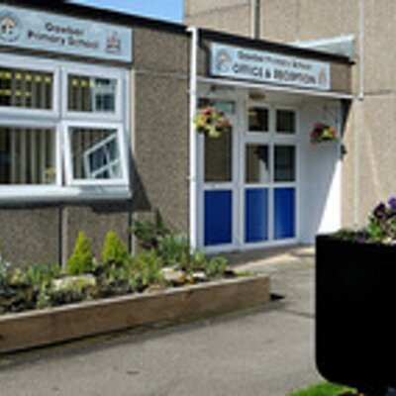
The School Building
This is the main entrance to the School. Here you will find the main reception, Hall and the Head teacher’s office. When the school gates are closed (during the day) please enter through this door. However, when dropping off and collecting we have a separate entrance off the playground.

Slide 4
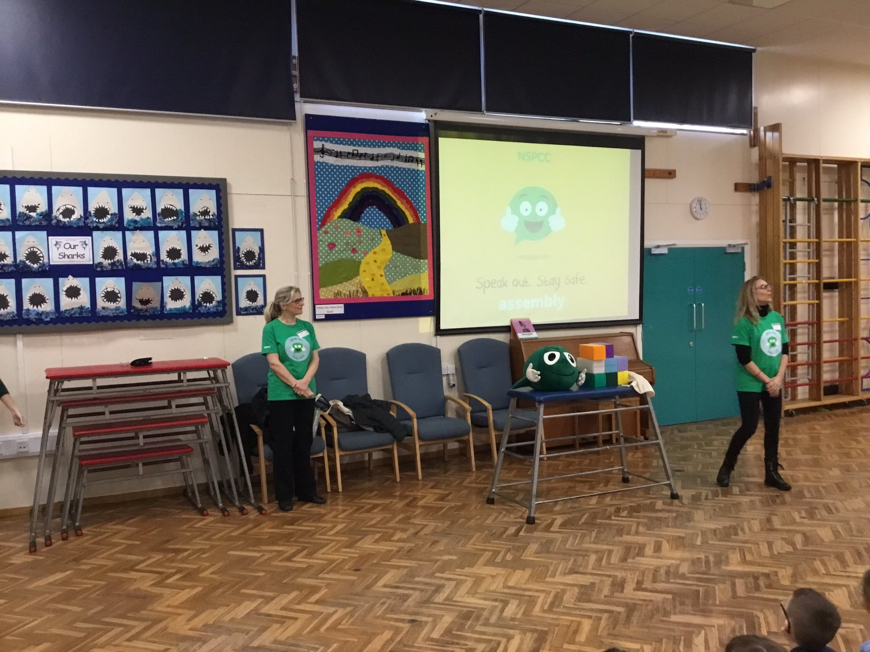
The Main Hall
This is where we will have our lunch, go to assembly and have PE lessons.

Slide 5
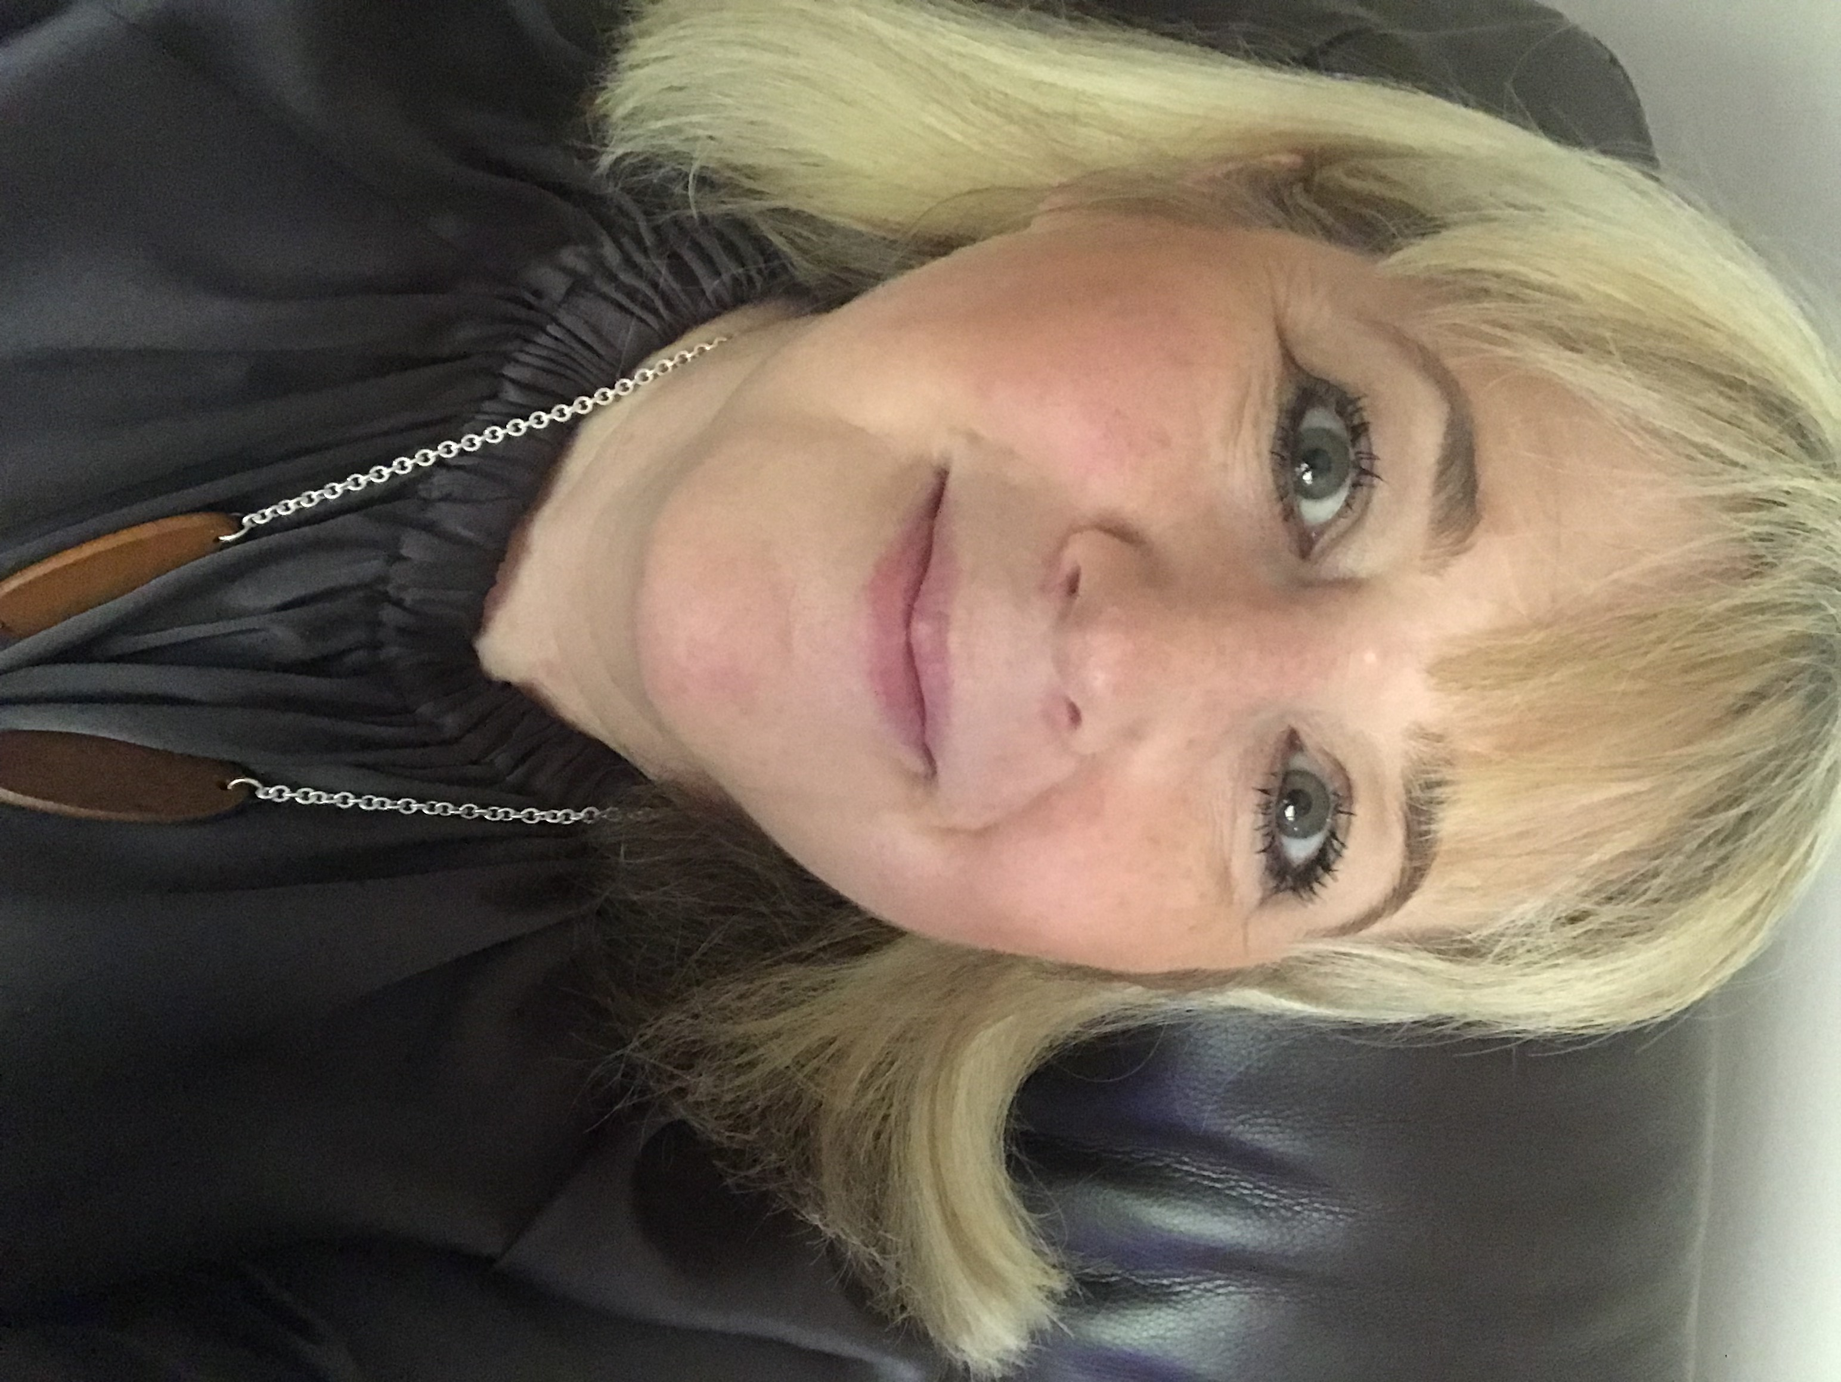
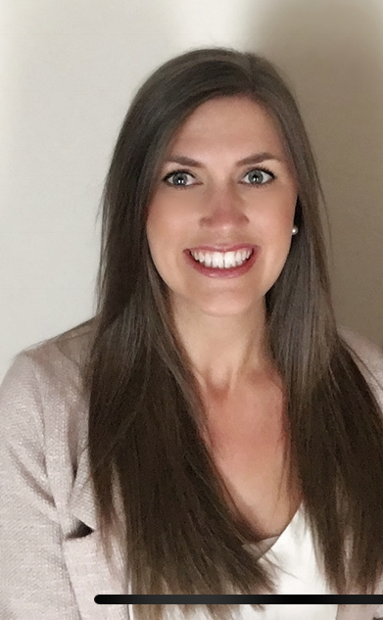
Meet the staff
Head teacher - Mrs D Bradshaw
Deputy Head – Miss R Knox

Slide 6
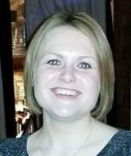
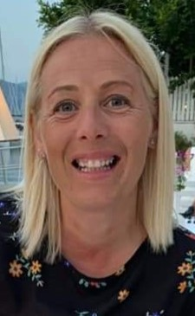
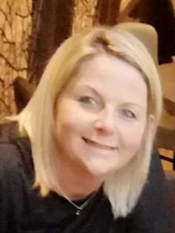
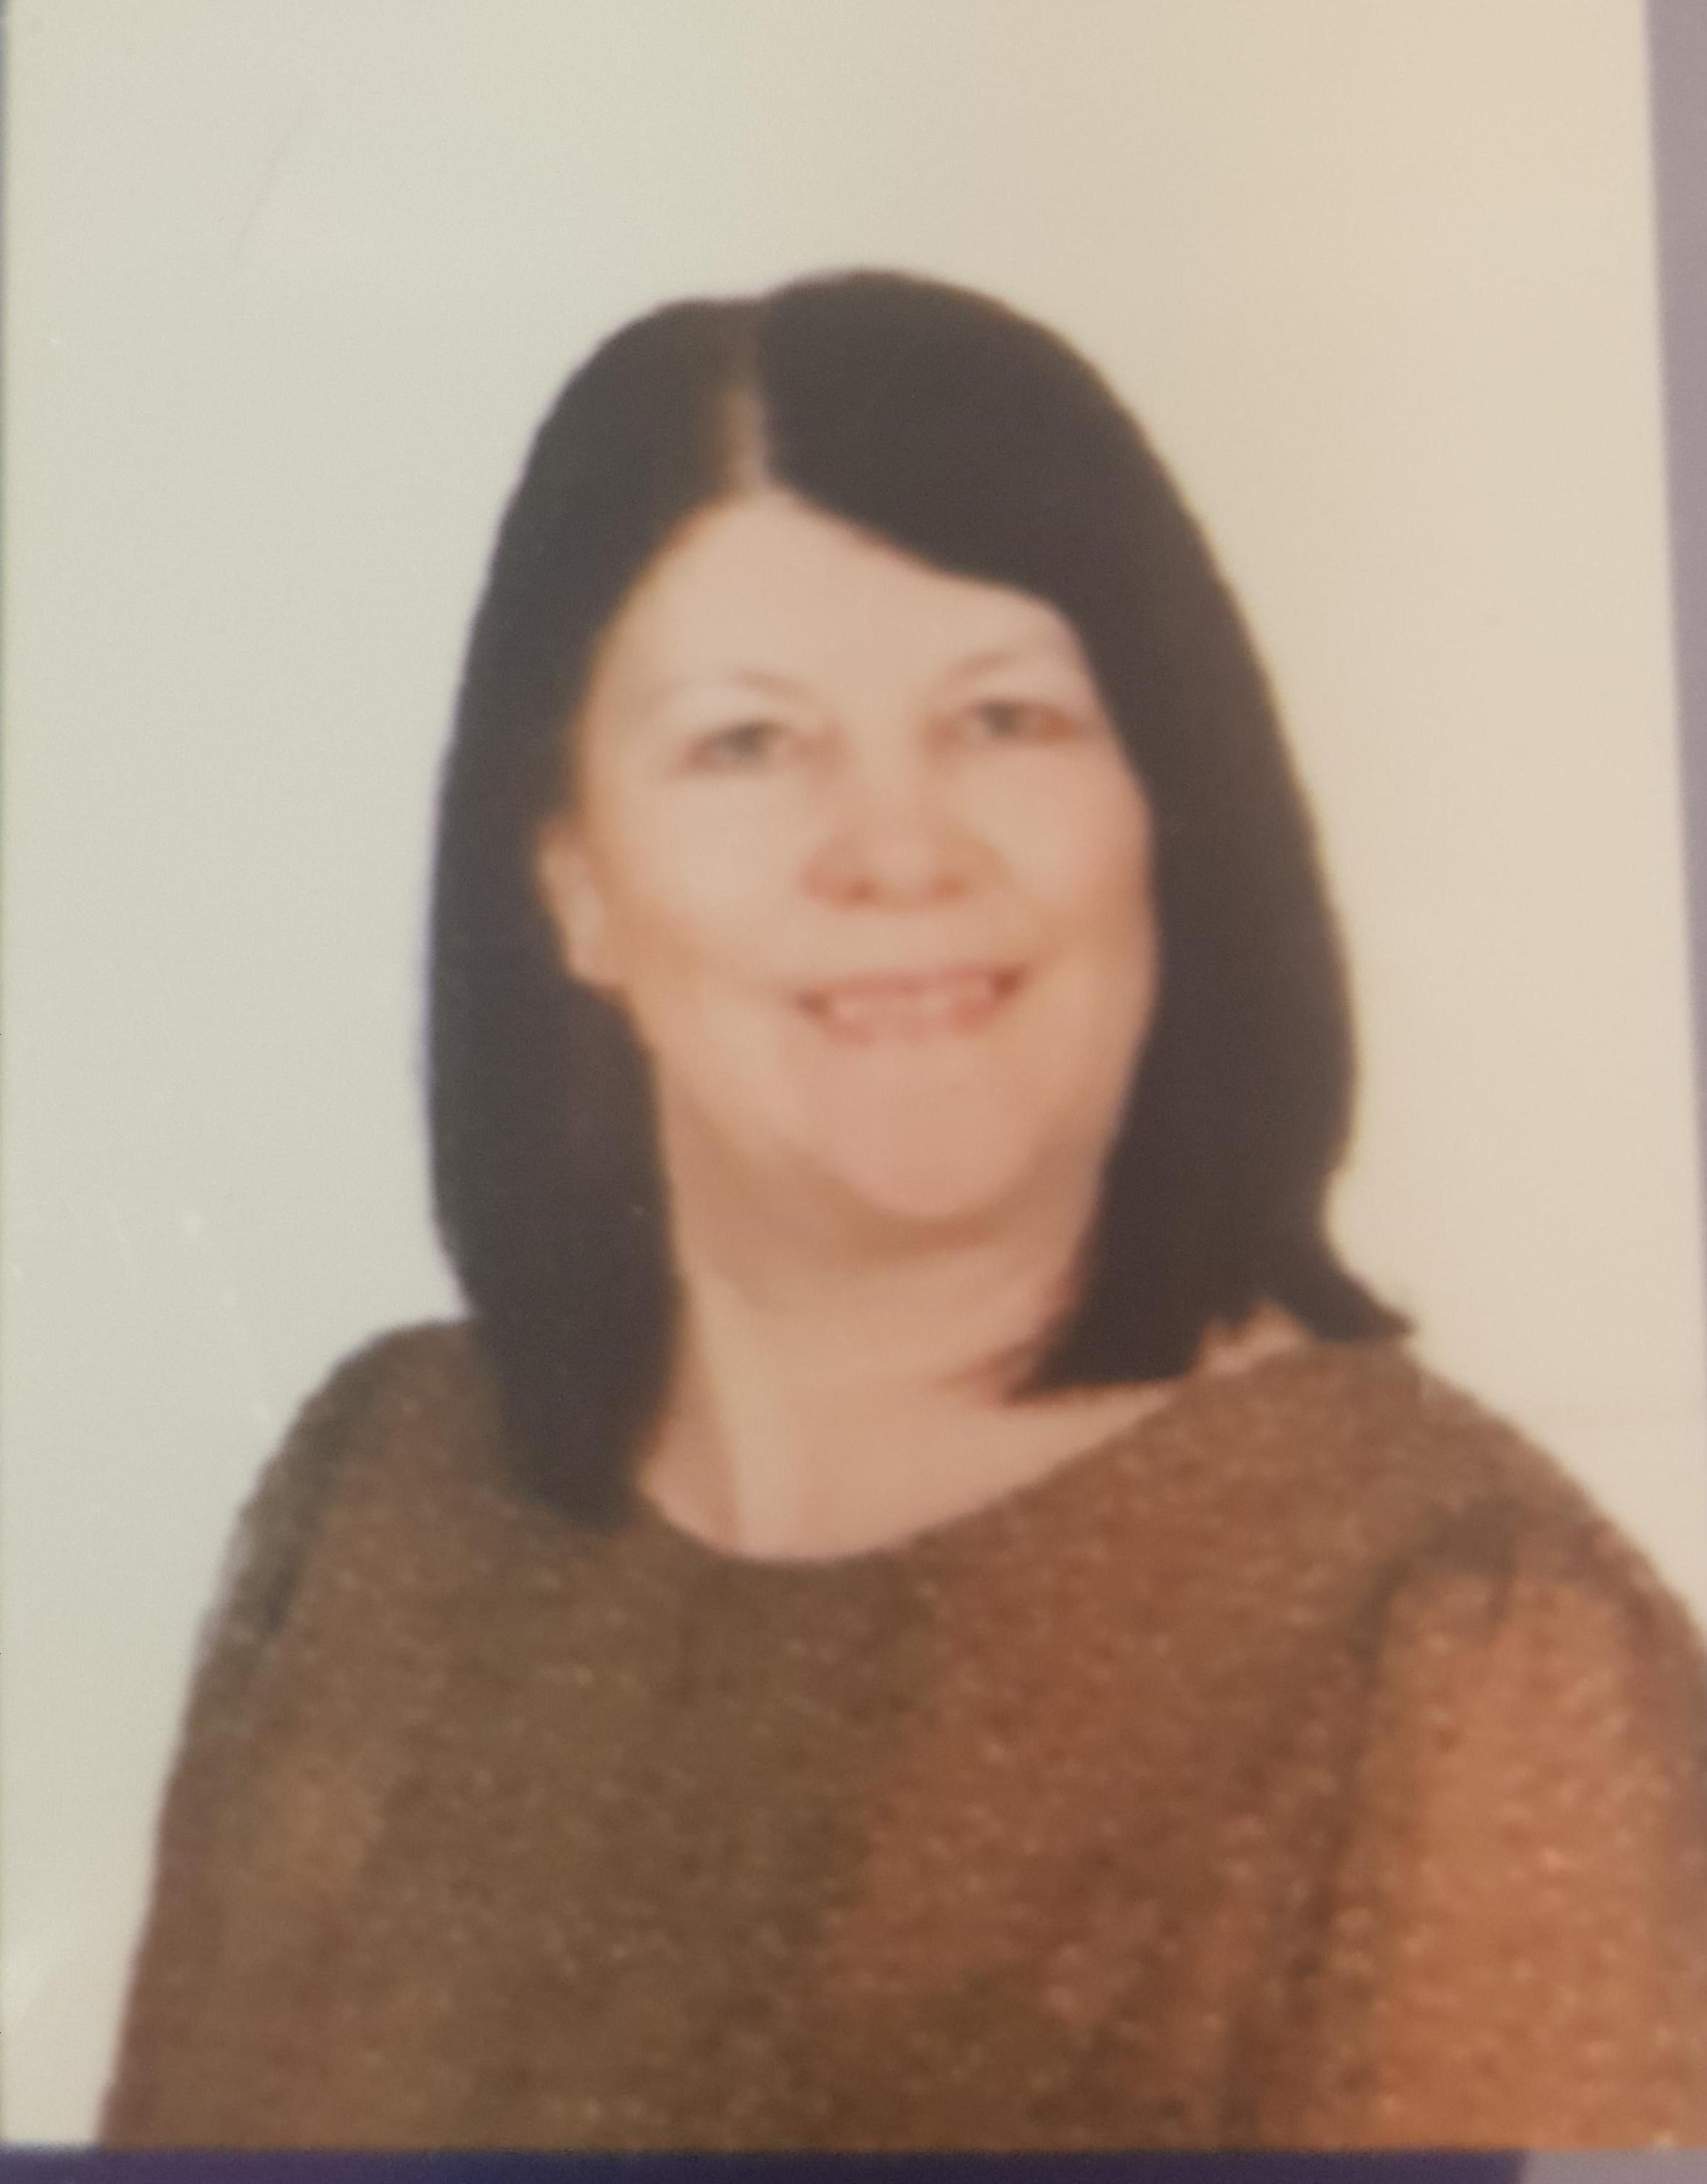
FS2 Team
My name is
Miss Kiernan and I will be your Teacher on Wednesday afternoon, Thursday and Friday.
My name is
Mrs Crossley and I will be your Teacher on Monday, Tuesday and Wednesday morning.
My name is
Mrs Dexter and I will be your TA everyday.
My name is
Miss Jones and I will be your TA every morning.

Slide 7

Class 0
When you start School you will be in Class 0 (FS2)
we are known as ‘The Clever Cats’.

Slide 8
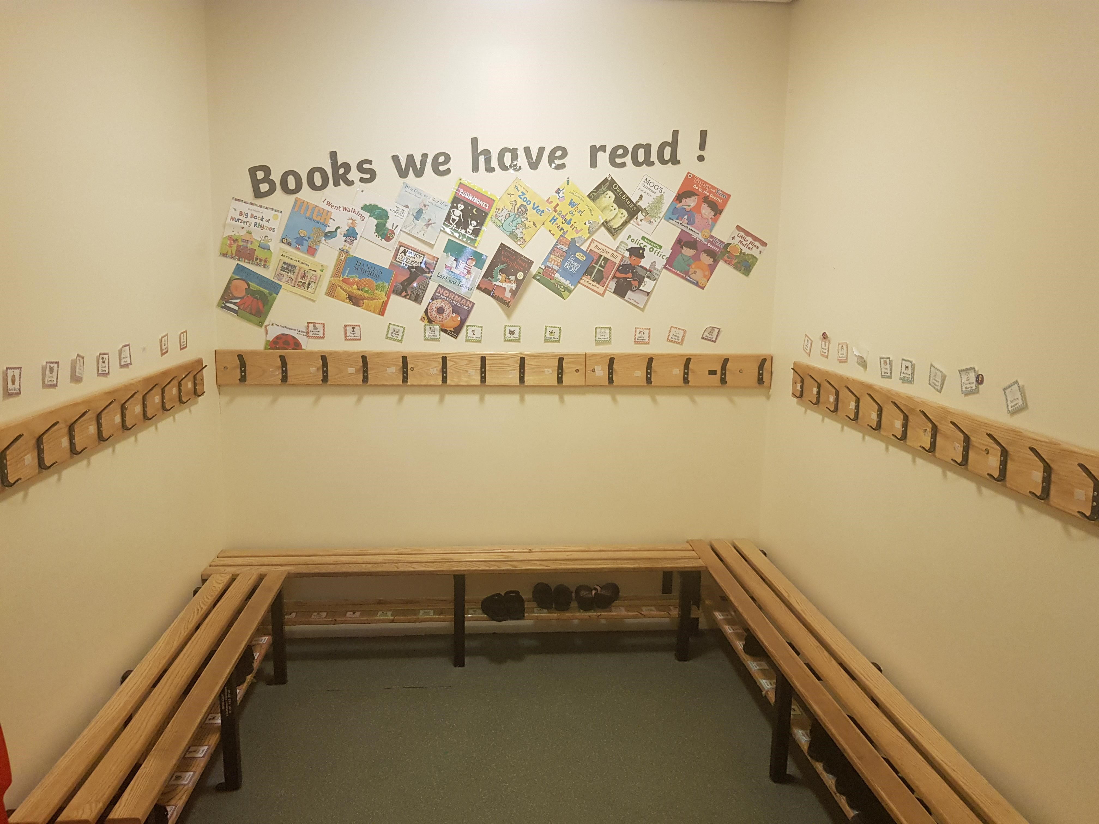
FS2 Classroom
As you enter the classroom you will walk into our cloakroom. Everyone will have a named peg where you can keep your bag and coats tidy.
Our toilets are located just off the cloakroom.

Slide 9
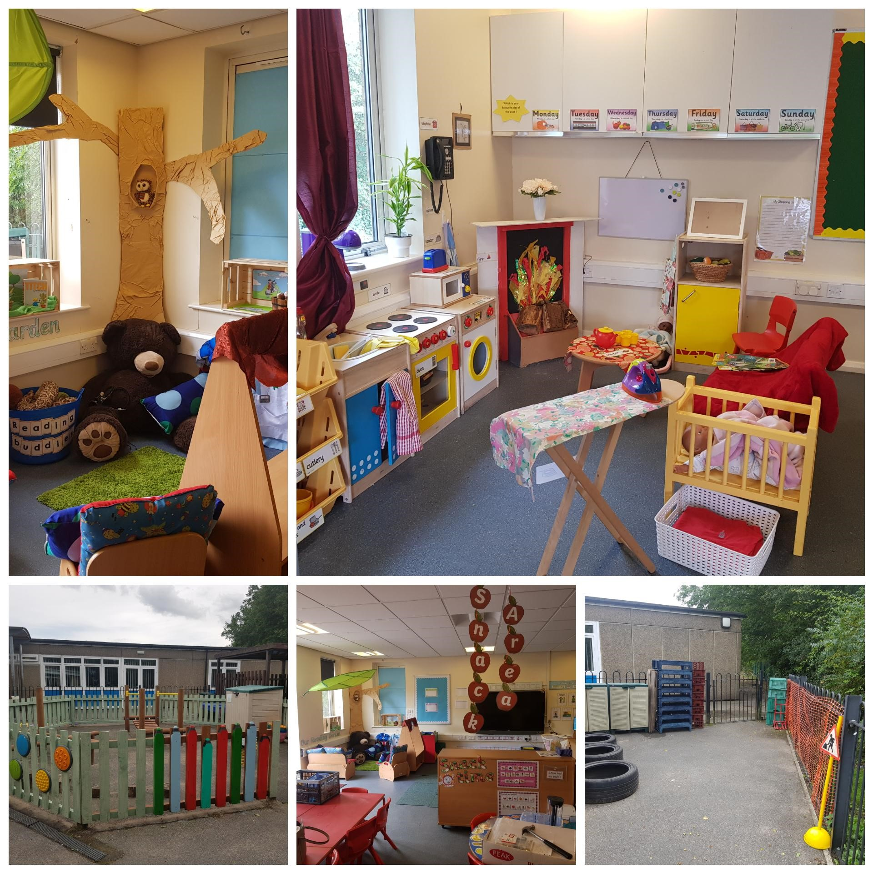
FS2 Classroom
Our Classroom has many different areas that you can choose to play and learn in throughout the day.
We have a reading den, construction area, maths area, creative area, dough area, funky fingers area, role play area and snack area.
Some of these areas will change throughout the year to link with our topics.

Slide 10
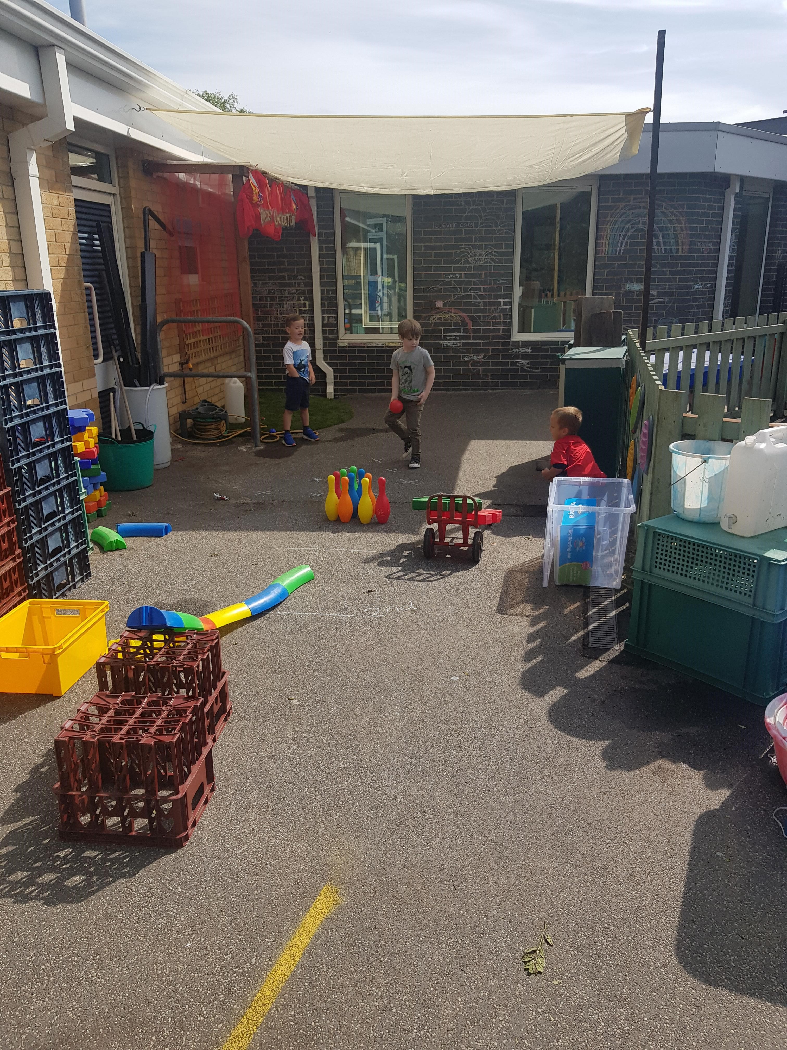
FS2 Playground
Our playground can be accessed straight from the classroom.
Throughout the day you will be able to go outside and explore the available learning activities.
Activities will change weekly linked to the weeks learning.

Slide 11
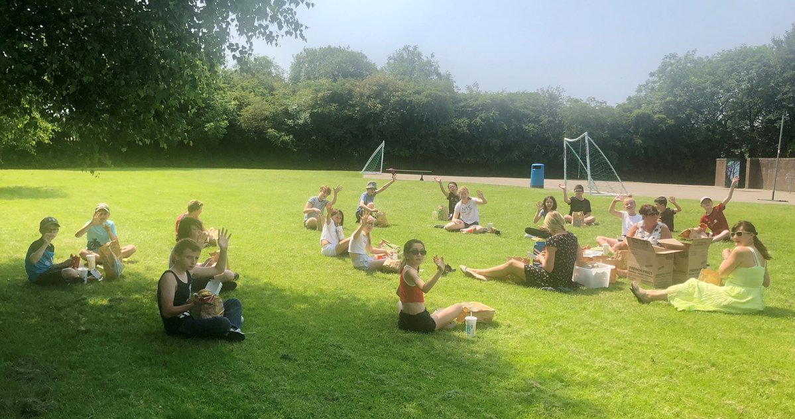
School Playground
We have a lovely playground at Gawber. It has a stage area, trim trail, reading area, seating areas and lots of lovely space. At lunchtime we will go into this area to play with the older children in school.

Slide 12

FS2 Curriculum
In FS2 we follow the EFYS Profile as set out by the government. https://www.gov.uk/government/publications/eyfs-profile-exemplication-materials each term we will study different topics and every week we base our learning around the book we are reading in literacy.
In the Early Years Foundation Stage (EYFS) we focus on learning through play. Our timetable is a balance of Adult Led and Child Initiated activities, covering all 7 areas of development -Personal Social and Emotional Development (PSED), Communication and Language (CL) Physical Development (PD), Literacy (L), Mathematics (M), Understanding of the World (UW), Expressive Arts and Design (EAD)
Lots of our learning is hands on and we spend a lot of time playing and engaging inside and out.

Slide 13

‘We are a reading school’
We love reading and listening to different stories at Gawber. Each week we base our learning on the book we are reading in Literacy. We end each day with story time.
We follow the Read Write Inc programme for our phonics teaching. We also use the reading books that match our current phonics learning. We will read at least 3 times a week to an adult in school as well as bringing our book home to practise.
Every week, each class visits the school library. FS2 go in small groups to pick a book of their choice, they are able to take this book home to enjoy with you and return the following week.

Slide 14
What a typical day looks like..
8.45 – Doors open, Registers & Welcome
9.00 – 9.30 – Phonics
9.30 – 10.00 – Carpet time - Wake and shake/Literacy
10.00 – 12.00 - Continuous Provision-inside and out/small group work
12.00 – 1.00 - Lunch & Outdoor play
1.00 – 1.20 – Carpet time – Maths/Dough Disco
1.20 – 2.45 – Continuous Provision- inside and out/small group work
2.45 – 3.00 – Story time/Singing
3.00 - Home time

Slide 15


As well as the lovely work your children will produce throughout the year, we also use an online learning journal which records photograph and observations that we write to assess your child’s progress. More details will follow in September of how you can assess this at home.
This year we have used Class Dojo as another communication tool between parents and school . We have found it very successful this year, so we will set up a new site ready for September.

Slide 16
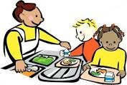
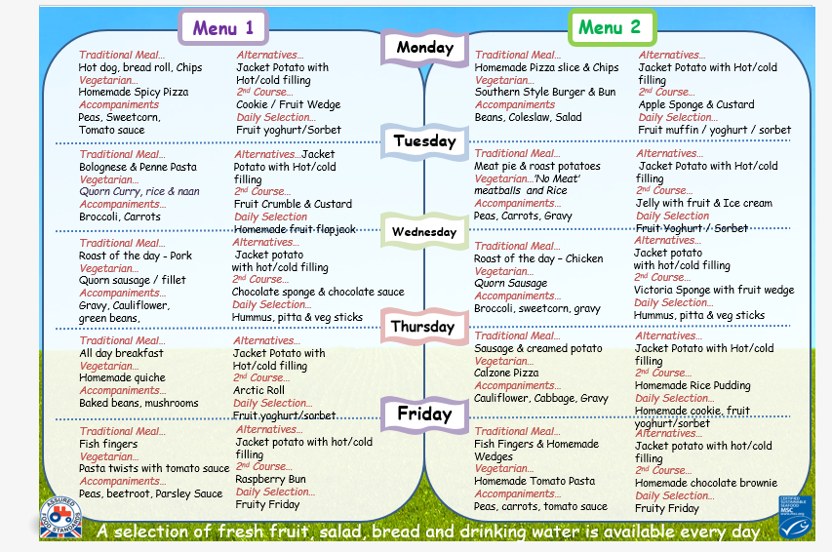
School Dinners
We have delicious School dinners at Gawber school, prepared daily by our own school cook.
School Dinners are free to all children in FS2 and we actively encourage children to try them. The weekly menu will be available in the classroom.
Each day you may choose from a traditional (Hot dinner) or a Jacket Potato with a choice of fillings.
This is a sample menu of our school dinners,.

